Slide 1
India Fellowship Seminar June 2016
Transition to a low interest rate environment
Impact on long term liabilities management
Guide
Richard W Holloway
Presenters
Prerna Nagpal
Himanshu Garg
9th June 2016
Mumbai, India
Indian Actuarial Profession
Serving the Cause of Public Interest

Slide 2
Contents
Impact of low interest environment on Insurers
Indian Market
Regulations and Practice Standards
Conclusion
Insurance Industry Response & Solutions
Multiple Choice Questions

Slide 3
Impact of Low Interest environment on Insurers
Are Low (or negative) Interest Rates even possible ?
Cause of Low Interest Rates
Impact of low Interest Rates on Income and Valuation
Assessment of Impact at Product level

Slide 4
Are Low (Negative) Interest Rates possible?
Official Policy Rates in Major Economies

Slide 5
Causes of Low Interest Rates
Drivers for decline in long term risk free real interest rates over past two decades
Demographic pressure associated with increased longevity
Gradual integration of China into global financial markets with pattern of capital flowing ‘uphill’ from emerging to advanced economies.
Decline in propensity to invest played a role in explaining developments since 2008.
Shifts in the supply of, and demand for, safe assets, particularly since the financial crisis. This is consistent with the rise in equity risk premium in recent years.

Slide 6
Impact of Low Interest Rate on Income and Valuation
1 | Impact is mainly in two ways: Income Channel (Impact on profitability) – Lower Reinvestment income as fixed income securities are re-invested at lower rates. Balance Sheet Channel (Impact on Solvency) – decrease in interest rates increases values of both assets and liabilities. In Solvency II there is higher increase in value of liabilities because duration of liabilities is much longer than assets (average duration of government bonds in EIOPA stress test was 8.6 years!). Further, magnitude of assets invested in fixed income securities is lower than total liabilities.
2 | Profitability impact takes time whereas Solvency impact is immediate.

Slide 7
Product wise Impact
PRODUCT | IMPACT
NON PARTICIPATING | ALM Mismatch leading to Reinvestment Risk Guaranteed Maturity Benefits > Asset Shares Guaranteed Surrender Benefits > Asset Shares Significant balance sheet strain High hedging costs Lapsation may increase Options built in policy may be exercised by policyholders
ANNUITIES AND TERM | Lack of long duration assets to match hence high Asset Liability Mismatch leading to Reinvestment Risk High Hedging costs Insurer may be unable to meet liabilities Reinsurance for Term policy may reduce the impact

Slide 8
Product wise Impact cont..
PRODUCT | IMPACT
PARTICIPATING | Bonus rates may not be PRE Reinvestment Risk May increase lapsation Value of In built guarantees < Asset Shares
UNIT LINKED | Not much impacted unless minimum/Guaranteed Sum Insured are high Lower investment returns may reduce marketability

Slide 9
Product wise Impact cont..
PRODUCT | IMPACT
HEALTH | 1 year policy may not be impacted but premium may increase leading to low marketability Long Term Care products may be impacted
NON LIFE | 1 year policy may not be impacted but premium may increase leading to low marketability Long Term Home Policies may be impacted

Slide 10
Market Response and Solutions
Insurance Industry Response: Japan
A case study of Sub Prime Crisis
Assessment of various solutions available
a. EIOPA Stress Tests
b. Interest Rate Modelling approach
C. Product Innovation

Slide 11
A case study on Japan
The Japanese life insurance industry offers a real-world example of what can happen when interest rates suddenly decrease and stay low for an extended period of time
8 life insurers were liquidated or taken over between 1997 and 2003.
Rapid decline in the interest rate in 1980s induced insurers to invest in stock markets which subsequently also faced downturn when the stock market bubble burst in 1989.
Significant losses to insurers in foreign currency holdings in the mid-1980s following a large appreciation of Yen.
Insurers continued to offer guarantees in order of 5.5% until mid-1990s amid fierce competition from Government sponsored financial institutions.
Loss of policyholder confidence and surge in surrenders

Slide 12
Japan – Solutions Implemented
Deregulation of product and price; dramatic shift in sales mix
Improved financial planning reporting; solvency requirements
Gradual implementation of risk management process
Rationalisation of sales; reduction in sales force size
Dramatic growth of well managed new entrants
Staff reductions; hiring freezes; compensation reductions
Growth of new distribution channels
Insolvency and restructuring of weaker players
Gradual reduction in balance sheet risk

Slide 13
A Recent Example: Subprime Crisis
Fiscal
Expansionary fiscal policy- tax cuts for every income bracket in US
Increased spending on war in Iraq and Afghanistan
Monetary
Loose monetary policy in the aftermath of the collapse of dot-com bubble
Regulatory + Supervisory
Lax financial supervision
Regulatory and legislative changes made it easier for firms and households to take on increased debt loads and encouraged more subprime lending.
US Government’s Debt/GDP ratio reduced from less than 58% in 2001, to 65% in 2005, to nearly 70% in 2009.
By the end of 2001, Fed rates lowered by 2%

Slide 14
Impact of first QE announced in 2008 in US
Impact of QE on US Banks
Margin Pressure – funding cost decline was more than offset by fall in securities yields. Banks NIMs were pressured and profitability impacted.
Lower Volatility – By reducing volatility, QE impacted investment banks’ securities trading operations
QE related Deposits – Institutional investors placed some of the excess liquidity as deposits. Deposit volumes grew and bank liquidity positions improved.
Book value accretion – ALM portfolios showed an uplift, owing to unrealized gains

Slide 15
Some Solutions
Solution | Considerations
Interest Rate Derivatives/Swaps | Availability, Regulatory constraints
Product Diversification | Costs, ALM strategy
Geographical (outside India) Diversification | Regulatory constraints
Lower Guarantees in New Products | Market sentiments
Higher premium for New Policies/Products | Popularity, competition
Lowering of Bonus rates | Comparable products, anti selection
Increasing charges on policies | Popularity, competition
Asset Liability Matching | Cost, availability of assets
Creation of Industry funded policyholder protection fund | Willingness of other players ?
Investment in alternate assets | Availability, cost constraints
Use of Internal Models | Regulatory approval
Reinsurance | Availability, complexity of contracts

Slide 16
EIOPA Stress Test 2014
The low yield module, as developed for the 2014 EIOPA stress test exercise, is a bottom-up stress test exercise implying calculations performed by insurance undertakings aiming at capturing the impact of several low interest rate scenarios.
A ‘Japanese-like scenario’ embodying a persistent low interest rate environment
An ‘Inverse scenario’ with an atypical change in the shape of the yield curve
Impact on Balance Sheet
Impact on Interest Rate Exposure
Impact on Profitability
SCR, Own funds
Asset & Liability Values
Durations
Cash flow Matching
Internal Rates of return

Slide 17
Modeling Interest Rates
In the contemporary stochastic modeling approach, there is no possibility of modeling negative interest rates.
The dominant core principles of interest rate modeling of the past decades have been that
interest rates don’t go negative
there must be consistency with current bond prices
there must be parametric consistency with historical data.
There is no history to guide an appropriate contemporary model approach
Alternatives Available
Discard the log normal modeling approach
Model using a normal distribution “random walk”

Slide 18
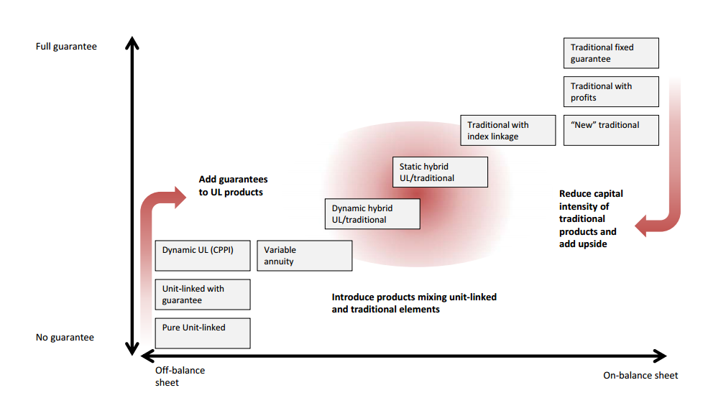
Product Innovation

Slide 19
Indian Market
Interest Rate Environment in the Indian Economy
Risks and Issues

Slide 20
10 Year GoI Yield Movement
Interest rates have fallen in India for a long period
Current | Highest | Lowest | Dates | Unit
7.46 | 14.76 | 4.96 | 1994-2016 | percent

Slide 21
Risks and Issues of a low Interest Rate regime
1 | Increasing Non-Participating business of Life Insurers Post Regulatory reforms, sale of endowment/term/products will in-built guarantees is increasing as compared to Linked Insurance. Hence, low interest regime will increase hedging costs, reduce marketability of the products and may make valuation of guarantees higher than the asset share.
2 | Bonus on Participating business may become unattractive Decreasing interest rates may further lower bonus on participating business which may become unattractive to policyholders / new customers (actual bonus rates may not meet PRE)
3 | Increasing ALM Risk Decreasing interest rates combined with absence of long dated fixed income securities, Indian Insurers have high re-investment risks which in case of low interest environment may make Asset Liability Management more challenging.

Slide 22
Risks and Issues of a low Interest Rate regime cont..
4 | Annuities will become further less unmarketable Annuities are still not very popular in Indian market though picking up. Lower interest rates will reduce their marketability and will make asset liability mismatch for Insurers cost prohibitive.
5 | Increased Lapsation / Persistency may deteriorate Low interest environment will increase premiums and reduce attractiveness of benefits such as Bonus thus will increase lapsation.
6 | Non Life underwriting losses Currently Non Life Insurers are subsidizing underwriting losses from investment surplus, which may not be possible in low interest regime.

Slide 23
Some more Risks and Issues…
7 | Regulatory Risk – Change of existing solvency regime to Risk based solvency Actuaries need to evaluate the implication of interest rates particularly on non participating portfolio and guarantees given under the scenario of solvency regime change to risk based solvency.
8 | Stress Tests – are current guidelines and practices robust and relevant? Industry can consider merit in evaluating whether current stress tests guidelines are adequate, robust and relevant with changing interest rate environment.

Slide 24
Regulations and Practice Standards

Slide 25
Key Guidance Notes and Practice Standards
Relevant Guidance Notes and APS
Key Learnings
GN 22 Reserving for Guarantees in Life Assurance Business
GN 6: Management of Participating life assurance business with reference to distribution of surplus
GN 29 Valuation of Interest Rate Guarantees on Exempt Provident Funds
APS 1: Appointed Actuary and Life Insurance Business
APS 2: Additional Guidance for Appointed Actuaries and Other Actuaries involved in Life Insurance
APS 3: Financial Condition Report
APS 5: Appointed Actuary and Principles of Life Insurance Policy Illustrations
APS 7: Appointed Actuary and Principles for determining Margins for Adverse Deviation (MAD) in Life Insurance Liabilities
APS 10: Determination of embedded value of Life insurance companies incorporated in India
In respect of non participating business the risk of a decline in the interest rate should be duly recognized and a suitable adjustment made.
Actuary needs to consider all future interest rate scenarios that can be reasonably be foreseen.
Actuary must identify and consider the extent, to which falling or rising interest rates may threaten the ability of the office to secure policyholder interests and where such risks cannot be substantially matched or mitigated
Adequate provisions to be kept for guarantees and embedded options
Various approaches including stochastic modelling to be used. Margin for adverse deviation to be assessed.
Documentation of approach, rationale and conclusions used by Actuary

Slide 26
IRDA Regulations
Relevant IRDA Regulations | Key Considerations
IRDA (Assets, Liabilities and Solvency Margin of Insurers) Regulations | Do solvency margins increase for a low interest rate environment?
Guidelines on Interest Rate Derivatives | Availability of derivatives, flexibility of regulations?
IRDA Protection of Policyholder’s Interest Regulation | Do they cover changes to policyholder’s behaviour?
IRDA (Actuarial Report and Abstract) Regulations | Adequacy and Appropriateness of Interest Rate Risk Management practices?
IRDA (Investment Regulations) | Are they stringent/practical for current market scenario?
Asset Liability Management and Stress Testing Circular | How strict are the stress test standards?
Guidelines on Corporate Governance for Insurers in India | Do they evolve with changing market scenario?

Slide 27
Conclusion

Slide 28
Some Thoughts……
Possibility of prolonged low interest rate environment possible in India
Need for a risk based solvency framework/product Innovation
Interest Rate Risk specific guidance notes
Importance of regular Stress testing and ALM
Assessment of Interest rate risk in actuarial reports

