Slide 1
Indian Fellowship Seminar – June 2015
Sustained low interest rate environment
Impact on Guarantees and PRE
Guide Name: Souvik Jash
Presenters Names:
Ankur Saraf
Arpita Jetha
Bharat Khurana
Date & Place
19th June 2015, Mumbai
Indian Actuarial Profession
Serving the Cause of Public Interest

Slide 2
Agenda
What is sustained low interest rate environment?
Indian economic environment
- possibility of prolonged low interest rates
Key impacts on insurers
Impact on guarantees and PRE on various product categories
Possible actions and its challenges
Regulations and Practice standards
Further thoughts

Slide 3
What is a sustained low interest rate environment ?

Slide 4
Sustained low interest rate environment
Interest rates remain at low level, say for 5-6 years or more
Low interest rates are combination of low demand and high -- supply of funds
- Low demand created by low growth or recession
Unemployment
Low inflation
Increase in taxes
Increase in savings
Drivers of low growth

Slide 5
Situation of Indian economic environment
Still not a persistent low interest rate environment
RBI base rate hovering between 6% to 8% over last nine years
Slow pace of economic recovery – low growth projections

Slide 6
Situation of Indian economic environment
RBI has been under-pressure from the government and businesses
RBI cautious but inflation outlook is positive
Frequent cuts in interest rates to stimulate economic growth
3 cuts of 25 bps each in last 6 months
Outlook is positive as per analysts
Implementing reforms causing momentum
Favorable economic policy and business environment
Growth forecast of 6.2% in current fiscal year as per analysts

Slide 7
Plausible sustained interest rate environment in India ?

Slide 8
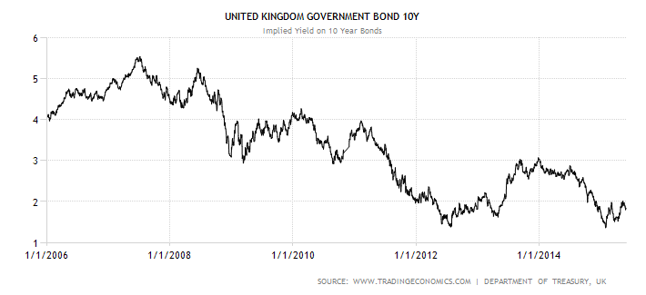
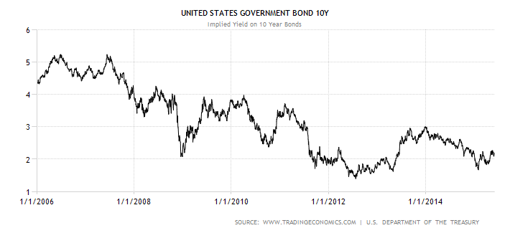
Data - Interest rates in world economies

Slide 9
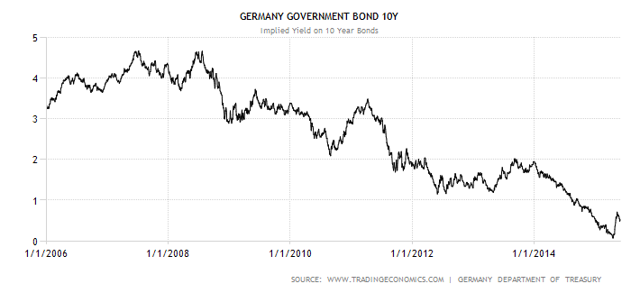
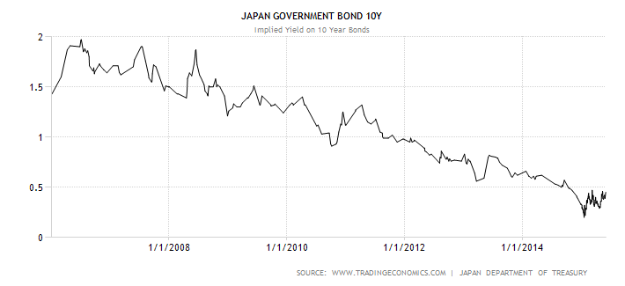
Data - Interest rates in world economies

Slide 10
Sustained low interest rate
environment
presents
significant financial pressure for the
entire life insurance industry

Slide 11
Key impact on insurers
Leads to management actions
Reducing the bonus rates
Keeping in view the PRE
Management actions should be taken within the PRE and TCF benchmarks
Increased cost of guarantee
Inherent ALM mismatch
Unavailability of assets
Dynamic policyholder behaviour
Deliberate investment strategy
Low Interest rate environment leads to high reinvestment risk
Hence Increase in cost of meeting the guarantees
Increasing the charges to policyholder
Changed investment strategy
Changed valuation assumptions
Change in pricing of new products
Different sources of PRE and TCF
Keeping view of the regulations and the available practice standards and professional guidance
Impact on guarantees is the key and this varies by products and companies
Absence of other profits could lead to negative financial results

Slide 12
Impact on guarantees of various products categories

Slide 13
Non-participating products
Guaranteed surrender value
Surrender values higher than asset share
Might lead to selective withdrawals
Significant losses for the company
Non Par saving products
Guaranteed maturity benefit
Non Par saving products
ALM mismatch leading to reinvestment risk
Guaranteed benefits higher than asset share
Leading to significant strain s for the insurer
Guaranteed money backs and monthly income
Money back endowments and monthly income plan
ALM mismatch for long duration cash-flows
Leads to reinvestment risk
Earned rate lesser than guaranteed rate
Considerations
Review premium or charges?
How to allow for Policyholder dynamic behaviour ?
Why ALM mismatch?
Hedging using interest rate derivatives?

Slide 14
Unit Linked and Variable insurance products
All ULIP products
Charges not sufficient to meet the expenses
Could be loss making
Guaranteed charges
Investment return guarantee
ULIP products with return guarantee funds
Earned rates not sufficient to meet the guarantee
Guarantee charges not sufficient to meet the cost
Hence funding through shareholder surplus
Lower AUM leads to lower charges
Minimum crediting rate
Variable insurance products
Earned rates not sufficient to meet the minimum crediting rate
Leading to losses to the company
Considerations
Increasing the charge for guarantees
Provide guarantees only to maturing policies
Why offer Investment guarantee?
Use investment strategies like CPPI

Slide 15
Annuity and term products
Guarantee rate of annuity
Single premium annuity products
Annuity payments go beyond 35-40 years
Unavailability of long duration assets leading to ALM mismatch
Hence lower than anticipated interest rates would lead to strain
Term insurance
Interest rates fall below the pricing levels
Earned rates not sufficient to meet the benefit outgoes
Product conversion or increase the term
In the money guarantees
Policyholder prefers to exercise options
Insufficient guarantee charge
Re-investment risk
Hence leading to losses
Impact not as severe as the interest rate guarantee products
Considerations
Offer low guarantees
Write annuity business on par platform
Falling interest rates along with increased longevity
Globally companies have seen huge losses

Slide 16
Participating products
Guaranteed maturity/ surrender benefits
Guaranteed benefits
+ Accrued bonuses
ALM mismatch leading to reinvestment risk
Expected future bonuses
Not guaranteed
But policyholder expects future bonuses
Consistency with the PRE
Management actions possible but limited by PRE
Split between RB and TB
Other considerations
Split between RB and TB – impact on guarantee
Management actions in form of bonus cuts
Cost of smoothing
Reasons for the ALM mismatch
Health of the PAR estate and burn through cost
Market value reductions?

Slide 17
Participating products – PRE
Policy documents and benefits illustrations
What do they say?
Past practices
Company’s action in past in similar situation
What are the low and high interest rates shown in Illustrations?
Smoothing rules?
TB:RB split
Past declared RB rates
Market practices
Bonus cuts?
Competitors actions
Treating customers fairly
Consistent with past practices
Fair with all generations of policyholders
Any inappropriate steps or investment strategy?
Pay-outs in the target ranges

Slide 18
Possible actions and its challenges
Action | Positives | Challenges | Initiated
Offering lower guaranteed rates on new business | Reduces the average guaranteed rate over time | Makes saving products less attractive – lesser sales | Japan
Diversifying into health/protection | Lessens dependency on investment income - reduced exposure to low interest rate risk | Increased mortality/longevity risk – difficult to estimate | Japan, UK
Diversifying into unit-linked asset management business | Lessens dependency on investment income and increases fee-based profits – reduced exposure to interest rate risk | Unable to meet insurance needs of policyholder, moving towards asset management, lower margins | Japan
Higher premium on new business | Higher margins on interest rate guarantees | Unattractive products, competitors practices | All
Changing asset allocation | Could increase investment returns | Increased illiquidity risk and counter-party risk | All

Slide 19
Possible actions and its challenges
Action | Positives | Challenges | Initiated
Implementing hedging strategies | Shortens the duration gap and hence minimizes interest rate risk | Lower margins, increases counter-party, liquidity and re-investment risk, strict regulatory requirements | Germany, UK
Lowering credited rates on in-force policies | Offsets the risk of the insurers’ profitability of declining investment returns | Less attractive for policyholder (higher lapses and lower new business) | Japan
Bonus cuts, change RB:TB distribution split under with-profits business | Lower guarantees, lessens the strain on PAR estate | PRE and TCF | UK
Match asset-liability duration | Lower impact on liabilities on interest rate movements, improved quality of profits | Unavailability of assets in the market, lower profits | UK
Review charges and premium for existing portfolio | Sharing of losses with policyholders | Regulatory restrictions, PRE, TCF, competitors actions | All

Slide 20
Regulations and Practice standards

Slide 21
Regulations
Regulations | Brief details | Thoughts?
Guidelines on Interest Rate Derivatives 2014 | Type, use and limit of derivatives | Does it give enough flexibility?
IRDAI Investment Regulations | Admissible assets, norms and exposure of assets | Are they too stringent?
Asset Liability Management and Stress Testing circular 2012 | Asset liability duration, scenario and sensitivity testing | Does it change from year to year?
IRDAI ALSM Regulation, 2000, | Valuation of Assets and Liabilities. Rules for solvency margin calculations | Move to Market consistent valuation? Are SM requirements too stringent? Move to EC?
IRDAI Protection of Policyholders’ Interest Regulation, 2002 | Minimum disclosure requirements | Does it cover the dynamic policyholder behaviour?

Slide 22
Guidance Notes and APS
Regulations | Brief details | Thoughts?
GN22 Reserving for Guarantee in life Assurance Business | Reserves should allow for guaranteed benefits and embedded derivatives | Are companies using the stochastic approach for more appropriate valuation?
APS 1 AA and Life Insurance Business | Due regards to guarantees and options methods. Use of derivatives | Market consistent approach?
APS 2 Additional guidance for AA and other Actuaries involved in life Insurance | Provisions to be made for investment guarantees and options | Use of prudent or market consistent assumptions?
APS 3 Financial Condition Report | Projected solvency of the company in adverse economic scenarios | Helps the companies in terms of readiness for facing the adverse scenarios
APS 5 AA and Principles of Life Insurance Policy Illustrations | Minimum information -illustration, options and benefits, guarantees | Very useful for prospective policyholders

Slide 23
Further thoughts
Will interest rates reach sustained low level?
Are insurers ready for this situations?
Will use of market consistent valuation help in the stressed situation ?
Will periodic revisions of guarantees assist?
Use of interest fluctuation reserve out of unrealized capital gain on equity investments?
Unit linked shift the interest rate risk, but not the solution of interest rate problem?
To what extent insurer use derivatives to hedge the guarantees in their traditional policies?

Slide 24
QUESTIONS?

