Slide 1
23rd India Fellowship Seminar
Opportunities and Challenges in offering whole life fixed rate annuities
Guide: Hemanshu Jain
Presenters:
Chinnaraja C
Mahidhara Davangere V
18th June 2015, Mumbai
Indian Actuarial Profession
Serving the Cause of Public Interest

Slide 2
Agenda
Annuities
Types of Annuities
Methodology
Opportunities
Challenges
Conclusion

Slide 3
Annuities
Series of future payments to a buyer (annuitant) in exchange for the immediate payment of a lump sum or a series of regular payments prior to the onset of the annuity
Unknown duration based principally upon the date of death of the annuitant
Longevity risk transferred to provider of annuity

Slide 4
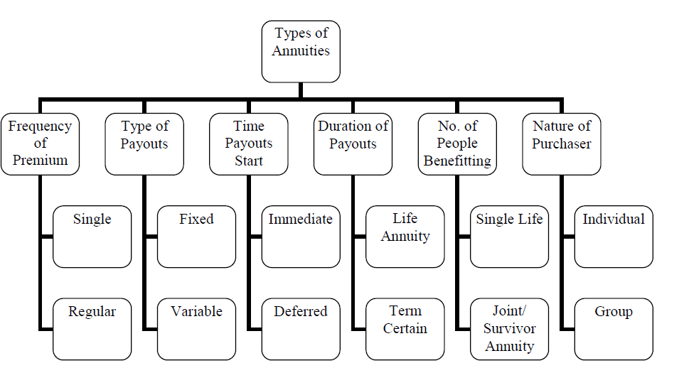
Types of Annuities

Slide 5
Methodology
Opportunities and Challenges analyzed under the following context:
India growing steadily towards more developed nation
India to experience same kind of demographic pattern as being experienced by more developed nation
Projection of demographic numbers are sourced from United Nation
External and environmental factors considered to access the demand for annuities

Slide 6
Opportunities
Opportunities
Demographic Transition
Youngest Population
Fertility Rate
Life Expectancy
Dependency
Percapita Health Expense
Pension Scheme
Regulation
Others

Slide 7
Demographic Transition (I)
Full mid-section with predominance of young and middle age and significant volume at the older age
Structure is in rather rapid transition to a more aged population with more than 30 per cent of older persons by 2050
India ranks 105 with 8.2% of world population aged 60+ in 2013 with 104m which is going to increase to 297m in 2050
India
More Developed

Slide 8
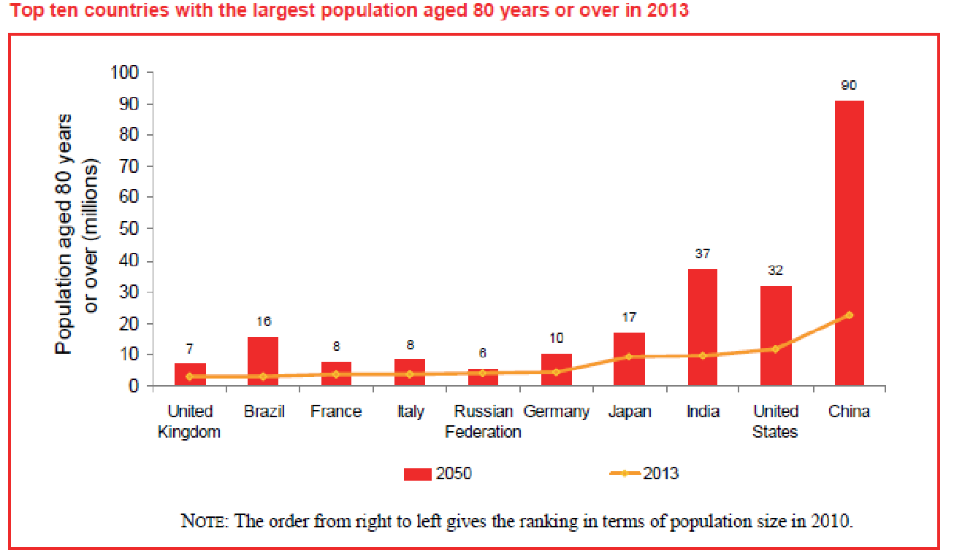
Demographic Transition(II)
India has 10 million population aged 80+ in 2013 which is going to increase to 37 million in 2050 becoming the second largest population in this category
The number of centenarians in the world is projected to increase rapidly from approximately 441,000 in 2013 to 3.4 million in 2050 and 20.1 million in 2100

Slide 9
Youngest population
India has the world’s highest number of 10 to 24-year-olds, with 356 million—despite having a smaller population than China, which has 269 million young people
India has nearly 4 times lower index level compared to developed nation
Rapid expected increase in wealth and potential for huge market for pension solutions with both an accumulation phase and eventual income phase

Slide 10
Fertility rate
Fertility rate of India to decrease further from current level of 3 as experienced by developed nation
This further going add to the increased financial security required for old age

Slide 11
Life expectancy
India
Current level of life expectancy of India is low
India to reach a level as observed in 1980-85 of more developed nation in 2045-50
Developed nation to have higher life expectancy hence more scope in India for improvement
Age | 1980-1985 | 2010-2015 | 2030-2035 | 2045-2050
0 | 56.30 | 66.30 | 70.40 | 72.90
60 | 14.90 | 17.00 | 17.90 | 18.90
65 | 12.10 | 13.70 | 14.50 | 15.30
80 | 6.20 | 6.90 | 7.20 | 7.50
More Developed
Age | 1980-1985 | 2010-2015 | 2030-2035 | 2045-2050
0 | 72.80 | 77.70 | 80.80 | 82.80
60 | 19.20 | 22.60 | 24.60 | 25.80
65 | 15.60 | 18.80 | 20.50 | 21.70
80 | 7.10 | 8.90 | 10.10 | 10.90

Slide 12
Dependency
India
Dependency ratio to increase as the country develops
Leading to more nuclear family structure indicating requirement for support at older age
Old age dependency ratio of India to reach a level of developed nation observed after 2050
Dependency Ratio | 1980 | 2013 | 2030 | 2050
Child | 68.80 | 44.30 | 35.00 | 28.80
Old-age | 6.40 | 8.00 | 12.00 | 18.70
Total | 75.20 | 52.40 | 46.90 | 47.60
More Developed
Dependency Ratio | 1980 | 2013 | 2030 | 2050
Child | 34.20 | 24.60 | 26.30 | 27.70
Old-age | 17.80 | 25.30 | 36.60 | 44.40
Total | 52.00 | 49.90 | 62.80 | 72.10
Region | Female | Male
India | 15.8 | 17.3
More Developed | 73.4 | 75.1
2013,Proportion living independently, age 60+ (%)

Slide 13
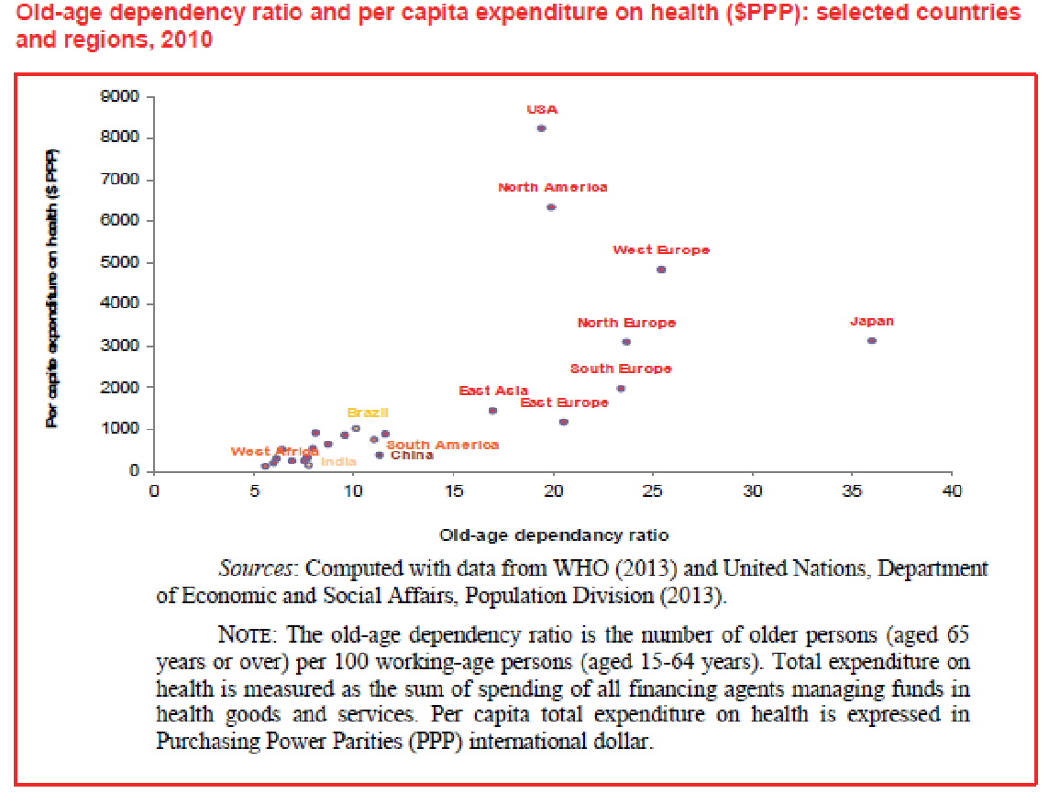
Percapita health expense
Per capita health expenditure tends to increase with population ageing and with old-age dependency ratio
Currently India spends around $100 per capita on health compared to $3120 by Japan and $4833 by Western European countries
Expected expense going to increase as India emerge as a developed nation
Thus there is clear indication of increased in demand for financial certainty in older

Slide 14
Pension scheme
National Pension Scheme (NPS)
NPS introduced for Central Government employee in 2004
From 1st May, 2009 NPs available for all citizen on voluntary basis
NPS accretes contribution of subscribers (18-60) years while working and uses the accumulation at retirement to procure a pension
Atal Pension Yojna
Focuses on unorganised sector, who do not have any formal pension provision
APY is a Government scheme administered by PFRDA through NPS architecture launched in 2015
Subscriber joining at 18 years of age have to contribute Rs. 42 and Rs. 210 on monthly basis to get a fixed monthly pension of Rs 1000 and Rs 5000 respectively.
Government co-contribution is 50% of the total contribution amount or Rs. 1000 per annum, whichever is lower, for a period of 5 years. Government co-contribution is available for those who are not covered by any Statutory Social Security Schemes and are not income tax payers.
Guaranteed minimum monthly pension between Rs. 1000 and Rs. 5000 to the subscriber and spouse with return of corpus to the nominees after 60 years of age

Slide 15
Regulation
Annuity purchase mandate post accumulation phase
Under NPS
before age of 60 subscriber need to invest 80% of the pension wealth to purchase life annuity from ASP and remaining 20% may be withdrawn as lump sum
On attaining age of 60 need to invest 60% in life annuity
ASP are annuity service provider empanelled with PFRDA
FDI
Increase the cap on foreign direct investment (FDI) in the insurance sector from 26 to 49 per cent
Experience of developed nation insurer can be shared with local for development of annuity market
Increased investment paving ways for new annuity products
Local regulation aligning with the global solvency standards

Slide 16
Other Factors
Diversification
Allows life insurer to diversify the business risk
Longevity risk act as a natural hedge against mortality risk
Sales Channel
NPS scheme using India Post to reach rural network
Social media
Telcassurance

Slide 17
Challenges
Challenges
Risks
ALM
Alternative Investment
Regulation
Other Factors

Slide 18
Risks
Longevity risk
Medical advance had resulted in increase in life expectancy
Difficult to predict life expectancy based on past experience
Information asymmetry with individual in good health taking the policy
Market risk
Annuity rate depends on the market condition at the time of buying resulting in lower amount of benefit during bearish phase
Inflation may erode the real benefit of regular income from annuity

Slide 19
Risks
Liquidity
Most of the investment in pension scheme is not accessible until retirement
Even on retirement only part of the accumulated amount can be opted as cash lump sum
Alternative investment has more control and flexibility
Operational risk
Model and parameter risk in predicting the long term interest rate, life expectancy and expenses related to the scheme
Higher chance of mismanagement of fund over the longer period of the policy
Reputational risk if the obligation are not fulfilled or under paid affecting the social welfare of the country

Slide 20
ALM
Longest tenor of government bonds available is 30 years
Inflation index bonds with maximum tenor of 10 years
Resulting in high rollover risk
Longevity swap market not mature
Longevity index used may not be exact replica of underlying population resulting in basis risk

Slide 21
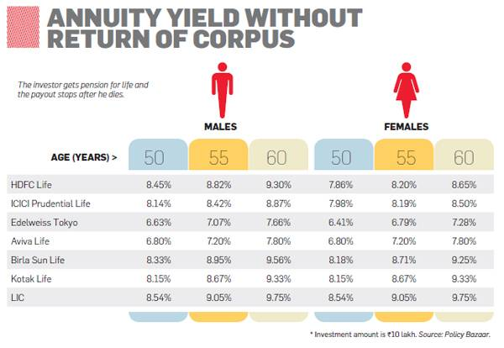
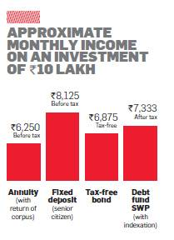
Alternative investment
Increased individual access to financial market due to internet and mobile banking
Improving understanding of investment market
Lower yield in Annuity products
Individual making own provision by investing in bonds, equity and properties
Equity release scheme where in no lump sum need to be made and individual can enter after retirement , but scheme provider may hedge their risk by buying annuity
Self Managed Trust

Slide 22
Regulation
Life insurer authorized to provide annuities, restricting the number of players
Indian Assured Lives Mortality (2006-08) table used from April, 2013 to compute annuity which may not be appropriate for the target population
Longevity and mortality risk are not allowed to offset for capital computation in current stator regime
Insurers in India allowed to hedge interest rate risk with the benefit limited to 12 months under the rule of forecasted transactions
Contribution towards pension scheme covered under 80C which also includes investment in ELSS, life insurance premium, home loan principal repayment, ULIPS, fixed deposits
Income from annuity treated as income and fully taxable
Service tax applicable on the initial annuity investment, currently 3.5%
Discount and loading should not exceed 30% of the approved premiums
Approval required to change the annuity rate by more than 10% increasing the Asset liability mismatch during large change in interest rate

Slide 23
Other Factors
Traditional investment of relying on property as a financial security in old age
Aligning the interest of insurance company and policy holders as unlike the life insurance policy both would not like the event of being paid which is not the case in annuity
Agents preferred sales channel currently
Present incentive structure for agents is often skewed in favour of non-annuity insurance products
Commission in annuity up to 7.5% against 25% in life product in first year

Slide 24
Conclusion
Huge opportunity and need in India for Whole Life Fixed Rate Annuities
Tax Authorities, Regulators and the Insurance Industry need to come together to develop conducive environment
Tax incentives for pension to drive the savings behaviour
Regulatory changes to allow insurance companies hedge the financial guarantees
Rapid population aging and rising life expectancies will lead to potentially huge demand for conventional annuity and annuity-like products
NPS Scheme is expelled to increase demand for annuities

Slide 25
Q& A are welcomed
Thank You

