Slide 1
23rd Indian Fellowship Seminar
Natural disasters: Importance of household insurance and issues involved in pricing household insurance products in India
Guide - Kirti Kothari
Presenters:
Varun Agarwal
P S Karthikeyan
Sana Konnur (‘nee:Santosh R Charan)
19th June 2015, Mumbai
Indian Actuarial Profession
Serving the Cause of Public Interest

Slide 2
Agenda
Natural Disasters
Some facts
Some figures
Household Insurance
Pricing Issues

Slide 3
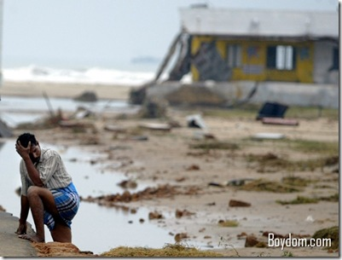
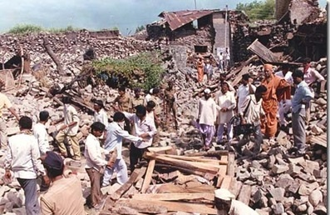
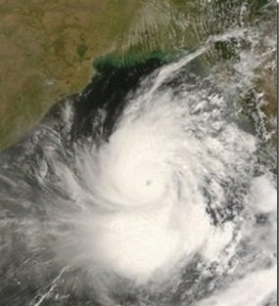
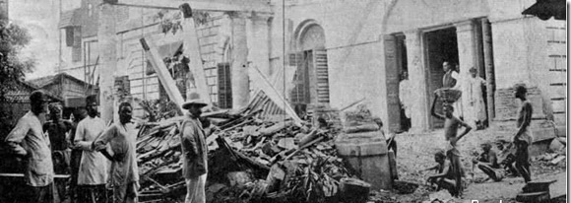
Natural disasters in the past
Notes:
2001 Gujarat Earthquake, 2004 Indian Ocean Tsunami, 1993 Latur Earthquake, 1839 Coringa cyclone, 1737CalcuttaCyclone

Slide 4
Economic losses – some figures
The recent Jammu and Kashmir floods and cyclone Hudhud are likely to cost general insurers around 40 billion Indian rupees ($651.6 million),

Slide 5
India – A Disaster prone country
30% of landmass prone to severe earthquakes
Another 27% prone to moderate earthquakes.
Nearly 12% prone to floods
76% of coastline prone to cyclones and tsunamis.
> 1 million houses damaged annually
Millions rendered homeless due to floods.
Penetration - Less than 1% of those who can afford
Notes:
Coverage A – Dwelling Covers the value of the dwelling itself (not including the land). Typically, a coinsurance clause states that as long as the dwelling is insured to 80% of actual value, losses will be adjusted at replacement cost, up to the policy limits. This is in place to give a buffer against inflation. HO-4 (renter's insurance) typically has no Coverage A, although it has additional coverages for improvements. Coverage B – Other Structures Covers other structures around the property that are not used for business, except as a private garage. Typically limited at 10% to 20% of the Coverage A, with additional amounts available by endorsement. Coverage C – Personal Property Covers personal property, with limits for the theft and loss of particular classes of items (e.g., $200 for money, banknotes, bullion, coins, medals, etc.). Typically 50- 70% of Coverage A is required for contents, which means that consumers may pay for much more insurance than necessary. This has led to some calls for more choice.[15]There are two types of policies for personal property: cash value policy and replacement cost policy. Cash value policy will pay the cost to replace belongings, minus deprecation. Replacement cost policy will reimburse the assured for the full, current cost of replacing belongings. [16] Coverage D – Loss of Use/Additional Living Expenses Covers expenses associated with additional living expenses (i.e. rental expenses) and fair rental value, if part of the residence was rented, however only the rental income for the actual rent of the space not services provided such as utilities. Additional Coverages Covers a variety of expenses such as debris removal, reasonable repairs, damage to trees and shrubs for certain named perils (excluding the most common causes of damage, wind and ice), fire department charges, removal of property, credit card / identity theft charges, loss assessment, collapse, landlord's furnishing, and some building additions. These vary depending upon the form. Exclusions In an open perils policy, specific exclusions will be stated in this section. These generally include earth movement, water damage, power failure, neglect, war, nuclear hazard, septic tank back-up expenses, intentional loss, and concurrent causation (for HO3).[17] The concurrent causation exclusion excludes losses where both a covered and an excluded loss occur. In addition, the exclusion for building ordinance can mean that increased expenses due to local ordinances may not be covered.[18] A 2013 survey of Americans found that 41% believed mold was covered, although it is typically not covered if the water damage occurs over a period of time, such as through a leaky pipe.[19] Floods Flood damage is typically excluded under standard homeowners' and renters' insurance policies. Flood coverage, however, is available in the form of a separate policy both from the National Flood Insurance Program (NFIP) and from a few private insurers. [20] Section II — Liability Coverages Coverage E – Personal Liability Covers damages which the insured is legally liable for and provides a legal defense at the insurer's own expense. About a third of the losses for this coverage are from dog bites.[21]
Causes of loss[edit]
According to the 2008 Insurance Information Institute factbook, for every $100 of premium, in 2005 on average $16 went to fire and lightning, $30 to wind and hail, $11 to water damage and freezing, $4 for other causes, and $2 for theft. An additional $3 went to liability and medical payments and $9 for claims settlement expenses, and the remaining $25 was allocated to insurer expenses.[22] One study of fires found that most were caused by heating incidents, although smoking was a risk factor for fatal fires.[23]

Slide 6
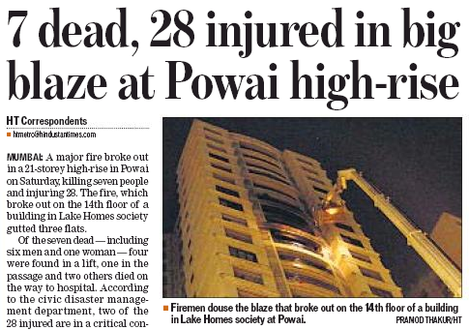
Other Perils
Fire, Lightning, Explosion
Riot Strike, Terrorist damage
Bursting and overflowing of water tanks, apparatus, pipes
Impact damage by rail/road vehicle and animal
Leakage from automatic sprinklers installations
Theft
Notes:
Coverage A – Dwelling Covers the value of the dwelling itself (not including the land). Typically, a coinsurance clause states that as long as the dwelling is insured to 80% of actual value, losses will be adjusted at replacement cost, up to the policy limits. This is in place to give a buffer against inflation. HO-4 (renter's insurance) typically has no Coverage A, although it has additional coverages for improvements. Coverage B – Other Structures Covers other structures around the property that are not used for business, except as a private garage. Typically limited at 10% to 20% of the Coverage A, with additional amounts available by endorsement. Coverage C – Personal Property Covers personal property, with limits for the theft and loss of particular classes of items (e.g., $200 for money, banknotes, bullion, coins, medals, etc.). Typically 50- 70% of Coverage A is required for contents, which means that consumers may pay for much more insurance than necessary. This has led to some calls for more choice.[15]There are two types of policies for personal property: cash value policy and replacement cost policy. Cash value policy will pay the cost to replace belongings, minus deprecation. Replacement cost policy will reimburse the assured for the full, current cost of replacing belongings. [16] Coverage D – Loss of Use/Additional Living Expenses Covers expenses associated with additional living expenses (i.e. rental expenses) and fair rental value, if part of the residence was rented, however only the rental income for the actual rent of the space not services provided such as utilities. Additional Coverages Covers a variety of expenses such as debris removal, reasonable repairs, damage to trees and shrubs for certain named perils (excluding the most common causes of damage, wind and ice), fire department charges, removal of property, credit card / identity theft charges, loss assessment, collapse, landlord's furnishing, and some building additions. These vary depending upon the form. Exclusions In an open perils policy, specific exclusions will be stated in this section. These generally include earth movement, water damage, power failure, neglect, war, nuclear hazard, septic tank back-up expenses, intentional loss, and concurrent causation (for HO3).[17] The concurrent causation exclusion excludes losses where both a covered and an excluded loss occur. In addition, the exclusion for building ordinance can mean that increased expenses due to local ordinances may not be covered.[18] A 2013 survey of Americans found that 41% believed mold was covered, although it is typically not covered if the water damage occurs over a period of time, such as through a leaky pipe.[19] Floods Flood damage is typically excluded under standard homeowners' and renters' insurance policies. Flood coverage, however, is available in the form of a separate policy both from the National Flood Insurance Program (NFIP) and from a few private insurers. [20] Section II — Liability Coverages Coverage E – Personal Liability Covers damages which the insured is legally liable for and provides a legal defense at the insurer's own expense. About a third of the losses for this coverage are from dog bites.[21]
Causes of loss[edit]
According to the 2008 Insurance Information Institute factbook, for every $100 of premium, in 2005 on average $16 went to fire and lightning, $30 to wind and hail, $11 to water damage and freezing, $4 for other causes, and $2 for theft. An additional $3 went to liability and medical payments and $9 for claims settlement expenses, and the remaining $25 was allocated to insurer expenses.[22] One study of fires found that most were caused by heating incidents, although smoking was a risk factor for fatal fires.[23]

Slide 7
Household Insurance
What gets covered – cover is customisable….
Buildings &/ or Contents are covered against:
Fire, theft, accidental damage,
‘Acts of God’ – may have opt out option or deductible
As with any insurance – ‘exclusions more important than inclusions’
Add-ons like liability cover, belongings while away from home bicycles etc.
Typical premiums – Let’s talk about the money…..
Do not forget that purchasing a home is a significant investment!
Notes:
What gets covered - While all home insurance policies offer cover against earthquakes, some insurers have a compulsory 5% deductible in case of damage due to an "act of God".
How much does it cost? Pittance - A 1,500 sq ft house can be covered for Rs 50 lakh against fire and other perils for less than Rs 1,700 a year. If contents worth Rs 10 lakh are included, the cost will go up by Rs 400. You don't need to take a cover for the market value of the property but only for reconstructing it. Construction costs vary from Rs 1,000 per sq ft for a no-frills structure to almost Rs 3,000 per sq ft for premium.
Multi year policies available…. Option to allow for escalation available to allow for reconstruction costs rising……

Slide 8
Factors influencing premium (not exhaustive)
Location
Replacement cost (property type & size; value of contents)
Proximity to water
Personal claims history
Age of roof
Other uses
Other factors
Notes:
Replacement cost. The size, composition and contents of your property affect the cost of your insurance the most. The larger your home and the more contents you have, the more they cost to replace. In addition to the square footage, insurers consider the quality of construction used to build your property, which can vary greatly.
Where you live. Insurers track the number, type and cost of claims by neighbourhood. By referencing past experiences, they understand your neighbourhood’s unique circumstances and how likely it is that you may make a claim.
Proximity to water. Insurers look at how far your home is from a fire hydrant or fire station. If you live in an urban area, this is generally not a concern. If your country property is far from water, it will influence the cost of your home insurance. The sooner a fire can be put out, the lower the cost of restoring your home.
Your personal claims history may have an impact on your premium. Past claims are often an insurers’ best predictor of future claims activity.
Electricity. Insurers consider a number of factors such as type of wiring and the way electricity comes into your house. They are on the lookout for:
a.Knob-and-tube or aluminum wiring (especially if it has deteriorated or become damaged) that can increase the chance of fire. Insurers may:
Ask for a guarantee that a home does not have this kind of wiring
Give you time to remove it
Inspect the condition of the wiring to ensure it’s safe
b.Breakers that pose less risk than fuses
c.A minimum of 100-amp service. A lower amp can lead to overloading and fire.
Pipes. Galvanized or lead piping usually means your plumbing is older, which makes it more likely to crack or leak. Insurers generally prefer homes with upgraded copper or plastic plumbing.
Wood stoves. These are a common source of house fires and carbon monoxide poisoning if they are not properly installed and maintained. Insurers may want to inspect them. Before buying or renting a home with a wood-burning stove, or installing one, consult your insurer.
Age of roof. Insurers generally prefer your roof to be updated within the last 20 years. Some policies will pay only depreciated values, for example 25% of the replacement cost, for damaged roofs that are near the end of their designated service life.
Other uses. Advise your insurer if you’ve built or plan to build a rental apartment, start operating a business or make any other significant alterations to the structure or the way you use your house.
Other factors. Insurers want to know if you have security and/or fire alarms, and if they are monitored by an outside service. Advise your insurer if you have a swimming pool or other structures such as pool houses.

Slide 9
Pricing Issues
Loss History – Not a good guide
Market pressure – Competition
Lack of diversification
Lack of clarity on type & level of Coverage
Data
Others

Slide 10
Is Loss History a good guide ?
Value Concentration
Climate Change
Unplanned Development
Insurance Penetration
Increasing Vulnerability
Natural Catastrophe – A rare event

Slide 11
Value Concentration
Mumbai 1900s* Mumbai 2000s*
Flora Fountain, Mumbai (1900s)* Flora Fountain, Mumbai (2000s)*
*Source/Photo Credit: Himansu Kamdar and Discover India Team<http://discoverindiabyroad.blogspot.ch/p/lost-mumbai.html>

Slide 12
Is Loss History a good guide ?
Value Concentration
Climate Change
Unplanned Development
Insurance Penetration
Increasing Vulnerability
Natural Catastrophe – A rare event

Slide 13
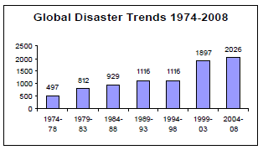
Climate Change
Source: Centre for Research on the Epidemiology of Disasters (CERD)

Slide 14
Is Loss History a good guide ?
Value Concentration
Climate Change
Unplanned Development
Insurance Penetration
Increasing Vulnerability
Natural Catastrophe – A rare event

Slide 15
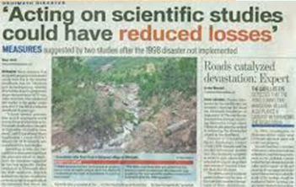
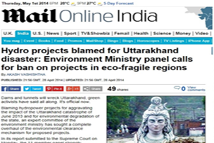
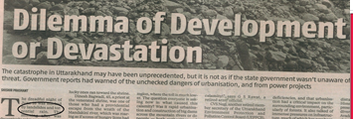
Unplanned Development

Slide 16
Is Loss History a good guide ?
Value Concentration
Climate Change
Unplanned Development
Insurance Penetration
Increasing Vulnerability
Natural Catastrophe – A rare event

Slide 17
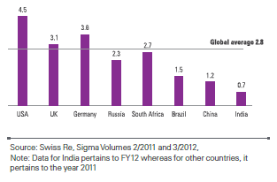
High expected Insurance Penetration
General insurance penetration in percentage (ratio of premium to GDP)

Slide 18
Is Loss History a good guide ?
Value Concentration
Climate Change
Unplanned Development
Insurance Penetration
Increasing Vulnerability
Natural Catastrophe – A rare event

Slide 19
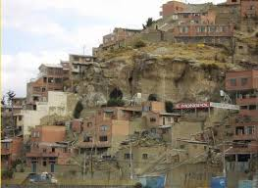
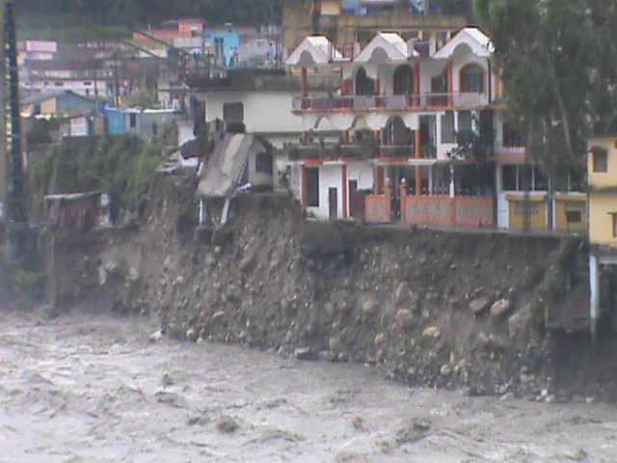
Increasing Vulnerability

Slide 20
Is Loss History a good guide ?
Value Concentration
Climate Change
Unplanned Development
Insurance Penetration
Increasing Vulnerability
Natural Catastrophe – A rare event

Slide 21
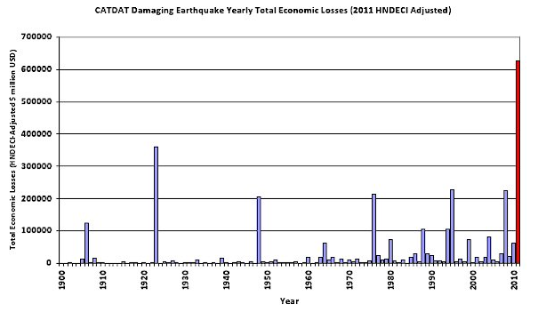
Earthquakes Economic Loss in Past 100 years
Source: CATDAT yearly review in 2011

Slide 22
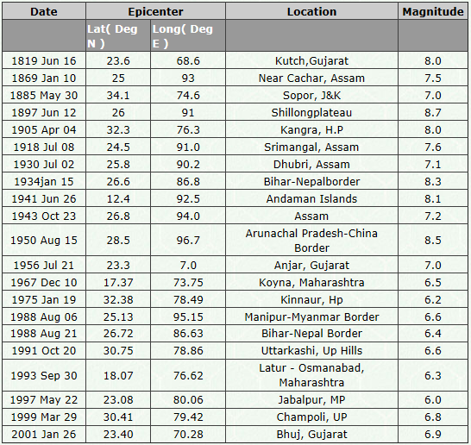
Significant Earthquakes in India

Slide 23
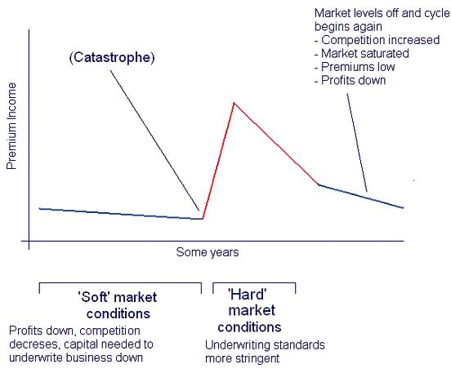
Nat Cat – Other Pricing Issues
Market Pressure – Competition
Notes:
Discount Wars

Slide 24
Cont..
Lack of Diversification
Not a compulsory cover
Low premiums – Lack of incentive to sell
A diversified portfolio requires less capital and hence less capital costs
Independence of different natural hazards like earthquakes, storms, floods
Natural hazards are usually geographically independent
Notes:
Soln for point 2: Bundling with other products, Offering cover for longer durations

Slide 25
Cont..
Lack of clarity on type & level of Coverage
Is the client aware of the coverage type?
Indemnity based ( or) ‘New for Old’ based Cover
Is the Sum Assured set at right level?
Underestimating true value of the Contents
Notes:
Under content insurance there are broadly two types of covers viz. new for old and indemnity cover while the payout in the former will be enough to buy the equivalent cover the latter will reimburse the current depreciated market value of the item. Example of new for old could be new LED TV getting stolen or repaired, the insurance cover will be sufficient to purchase the new LED TV. However, in the case of indemnity cover, the depreciated market (after allowing for the age of the item) of the TV will become payable.
New for Old cover is not available for all contents (e.g. clothes). If available, it is be little more costlier than the indemnity cover.
It is observed that in UK one in every 4 houses is underinsured.

Slide 26
Cont..
Data
Not enough data available
Vulnerability assessment
Extent of damage given the event intensity
Vulnerability
Intensity

Slide 27
Cont..
Other Issues
Lack of expertise
Fraudulent claims
Notes:
Pricing NatCat cover involves stochastic modelling etc and it requires technical expertise to model the same. Many a times, reinsurers’ inputs are used as base rates to price the cover.
As the premium levels and the resultant commission are very less, there is less incentive to sell the product. Hence in order to ensure better reach and diversification, it is better to bundle the cover with other products.

Slide 28
Questions

