Slide 1
Impact of Ind AS 104 in Life Insurance Reporting
25th India Fellowship Seminar
Presented by:
Jinal Sheth
Ankur Goel
Tribhuvanaram Sundaramurti
Guide: Kshitij Sharma
9 June 2016, Mumbai
Indian Actuarial Profession
Serving the Cause of Public Interest

Slide 2
Agenda
Objective and Scope of Ind AS 104
Contract Classification & Unbundling
Embedded Derivatives
Recognition & Measurement
Liability Adequacy Testing (LAT)
Disclosures
General Impact on Life Insurers
Impact on Reporting for Life Insurers
Financial Statements
Disclosures
Timelines
Key Issues that Need Clarification

Slide 3
Objective and Scope of Ind AS 104
Objective
To specify the financial reporting for insurance contracts by any entity that issues contracts.
Scope
An entity shall apply this Indian Accounting Standard to:-
Insurance contracts (including reinsurance contracts) that it issues and reinsurance contracts that it holds.
Financial instruments that it issues with a discretionary participation feature.

Slide 4
Insurance Contract - Definition
Ind AS 104 requires the contracts to be classified as Insurance or Investment contract.
The risk transferred in the contract must be insurance risk (risk except for financial risk).
Notes:
Uncertain future event
Uncertainty (or risk) is the essence of an insurance contract. Accordingly, at least one of the following is uncertain at the inception of an insurance contract:
whether an insured event will occur;
when it will occur; or
how much the insurer will need to pay if it occurs.

Slide 5
Unbundling of Contracts
Some insurance contracts contain both insurance and deposit components. Unbundling is required if both the following conditions are met:
Insurer can measure the deposit component separately
Insurer’s accounting policies do not otherwise require it to recognise all obligations and rights arising from the deposit component.
If unbundled,
Apply this Standard to the insurance component.
Apply Ind AS 39 to the deposit component.

Slide 6
Embedded Derivatives
Ind AS 39 requires an entity to separate embedded derivatives from the host instrument that contains them, measure them at fair value and recognise changes in their fair value in profit or loss.
However, an insurer need not separate an embedded derivative that itself meets the definition of an insurance contract.
Type of Embedded Derivative | Treatment if embedded in a host insurance contract | Treatment if embedded in a host investment contract
Death benefit linked to equity prices or equity index, payable only on death or annuitisation | Fair value measurement is not required | Not applicable
Death benefit that is the greater of: unit value of an investment fund and guaranteed minimum | Fair value measurement is not required | Not applicable

Slide 7
Discretionary Participation Features
In Insurance Contracts
In Financial Instruments
= Guaranteed Element
+ Discretionary Participation Feature
Liability: Need not to recognise it separately. It can be classified as Total Liability
(However it can be classified as guaranteed element and equity component)
Premium: Recognise all premiums as Revenue without separating any portion that relates to equity component
Liability: If entire discretionary participation feature classified as liability – Apply Liability Adequacy Test
If part/all of feature classified as separate equity component – Apply Ind As 39. ( Include Intrinsic Value of Option)
Premium: Recognise all premiums as revenue and recognise as an expense the resulting increase in carrying amount of liability

Slide 8
Recognition & Measurement
Existing Contracts
Provisions only for existing contracts
Liability Adequacy Test
To determine adequacy of insurance provisions
Reinsurance Asset
Impairment testing of reinsurance asset
No Offsetting
Liabilities are shown directly, and not offset against reinsurance asset

Slide 9
Liability Adequacy Testing
When To Assess
At the end of each Reporting period
What to Assess
Whether recognised insurance liabilities are adequate
How to Assess
Using current estimates of all contractual cash-flows & related cash-flows ( claims handling costs, embedded options & guarantees
If the test shows that the liability is inadequate, the entire deficiency must be recognised in profit or loss
The liability measurement principles are pretty stringent in India as negative reserves are not considered and flooring of reserves to the surrender value in the valuation of policy liabilities

Slide 10
Impact on Life Insurers
Key implications of segregation of insurance and investment contracts (considered in the next section)
Changes in Financial Statements
Significant Effort on Disclosures
Most material impact of Ind AS 104 is on disclosures which will require heavy investment of resources in the initial years of implementation

Slide 11
Key Implications of Un-bundling
Changes in IT systems to capture the deposit component and recognise front end fees as revenue
Erosion of top-line – with deposit component accounted as deposit liability
Implications on 17D of Insurance Rules/ Expenses of Management
Changes to Product designing Process

Slide 12
Impact on Reporting for Life Insurers
Impact on Financial Statements
Impact on Disclosures
P&L Account & Balance Sheet
Re-insurance Asset shown separately
Information to understand amounts in Financial Statements
Information to understand risks in Insurance Contracts

Slide 13
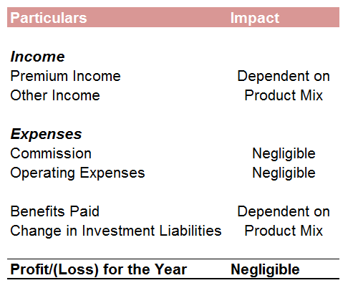
Financial Statements: P&L Account
Premium Income, Commission, Investment Income & Claims on Investment contracts removed from P&L
Impact of investment contracts adjusted in change in Investment Liabilities
DAC amortised – reducing volatility on bottom line by equalising the acquisition costs over the contract period

Slide 14
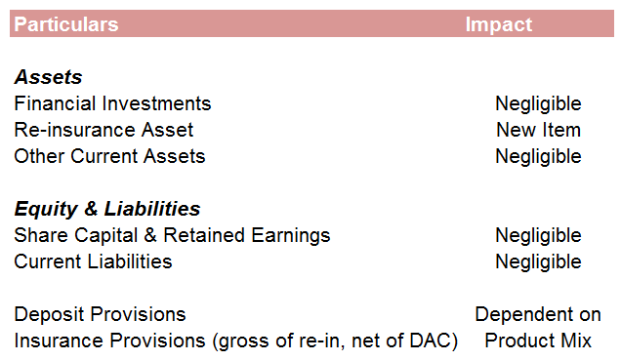
Financial Statements: Balance Sheet
Reinsurance Asset shown separately
Valuation of Investments as per other Accounting Standards
Deposits for investment contracts shown separately
Adjustment for DAC in calculation of Insurance Liabilities

Slide 15
Disclosures Under IND AS 104
Accounting Policies
Premiums,
Assets, Liabilities, Income & Expenses
Charges & Expenses,
Claim benefits,
Embedded options & guarantees,
Reinsurance
Disclosure on insurance contracts specifically
Significant Assumptions and Sources of Uncertainty
Gains or losses on buying reinsurance
Process of determining assumptions most significantly affecting assets, liabilities, income and expenses,
Where possible, quantified disclosure of assumptions
Changes in Assumptions
Effect of change
Consistent with Ind AS 8 -> disclosure of nature and extent of change in accounting estimate (current period or in future)

Slide 16
Additional Disclosures:
Disclose information that enables users of its financial statements to evaluate the nature and extent of risks arising from insurance contracts
Objectives, policies, processes and methods used for managing risks arising from insurance contracts
Information about insurance risk (before and after risk mitigation actions)
Information about financial risks - credit risk, liquidity risk and market risk

Slide 17
Additional Disclosures: Risk Summary
Nature and Extent of Risks Arising from Insurance Contracts
Balance between quantitative and qualitative disclosures
To be consistent with how management perceives its activities and risks
To generate information that has more predictive value
To be more effective in adapting to the continuing change
Aggregate information to display the overall picture without combining information that has materially different characteristics

Slide 18
Additional Disclosures: Risk Management
Risk Management Objectives and Policies for Mitigating Risks
Structure and organisation of the insurer’s risk management function(s), including a discussion of independence and accountability
Scope and nature of the insurer’s risk measurement and reporting systems
To generate information that has more predictive value
Insurer’s processes for accepting, measuring, monitoring and managing risks
Asset-liability Management (ALM)
Enterprise-wise risk management approach

Slide 19
Additional Disclosures: Insurance Risk
Insurance Risks
Quantitative information - Methods used, assumptions, strengths and limitations of the method & assumptions
Risk exposures,
- Nature of risks, split by class
- Gross and net of risk mitigating elements (eg reinsurance)
- Nature of participation features
- Management/Mitigation Actions
Quantitative disclosures of effects on summary indicators E.g.- P&L, Equity, Embedded Value
- Concentrations of Insurance risk
- Development of prior-year insurance liabilities
Sensitivity to Insurance Risk
Qualitative disclosures on sensitivity that a material effect on the amount, timing and uncertainty of future cash-flows

Slide 20
Additional Disclosures: Financial Risks
Disclosure of Financial Risks covered in Ind AS 107. Additional requirements from Ind AS 104 regarding insurance contracts given below :
Credit Risks
Financial loss due to reinsurer default
Liquidity Risk
Impairment of reinsurance assets
Loss on balances due from agents or brokers
Maturity analysis of remaining contracts vs disclosures of amounts recognised in B/s by timing
Market Risk
Sensitivity (of EV or other indicators including insurance contracts) to market variables
Exposures to market risk under embedded derivatives

Slide 21
Reporting Timelines
Required to prepare Ind-AS based standalone and consolidated financial statements for FY2018-19 with comparatives of
FY2017-18
Only to be applied from above time, and not permitted to adopt earlier
Required to submit ‘pro forma Ind-AS financial statements’ to IRDA from quarter ending 31 December 2016 onwards until implementation

Slide 22
Key Issues That Need to be Addressed
Amendments
Financial Statements Vs Regulatory Reporting
Required to Insurance Act/ Regulations
Both basis to continue?
Uncertainties surrounding solvency calculations

Slide 23
Questions?

