Slide 1

The Post Covid Emerging Disease Trends
Institute of Actuaries India
Mumbai
13 October 2022
Dr Shayhana Ganesh ( MD, MBA, PhD)
Head : Health Risk Management
Aditya Birla Health Insurance
Mumbai, India
12 October 2022

Slide 2


The aftermath of the Corona Virus pandemic
Once in a few centuries there is a watershed event on planet earth that changes the course of human history.
The proper perspective, the total number of worldwide deaths due to the COVID-19 virus [113 million] exceeded by 43 million the total number of deaths in both world wars [70 million] (Diffen, 2021).
Though there are no worldwide statistics on the economic losses due to the COVID-19 virus, it is safe to assume that the number of jobs lost worldwide, is more than 100 million.
The top five occupations that have suffered the biggest job losses due to COVID-19 virus, were: (1) Leisure and Hospitality jobs – 1.3 million employees, resulting in 16.7 % unemployment; (2) Support jobs for Mining, Oil and Gas Extraction – 58,000 employees, resulting in 8.4 % unemployment; (3) Construction jobs – 441,000 employees, resulting in 9.6 % unemployment and (4) Motion Picture and (5)Music industry jobs – 110,000 employees, resulting in 6.4 % unemployment (AARP, 2021).
So, what are the consequences on health..
Published online 2021 Mar 2. doi: 10.1016/j.ijhm.2021.102909
The aftermath of the corona virus pandemic
Abraham Pizam

Slide 3

Discussion Focus
The South African Covid Context
The Claims Impact of Covid
The Mental Health Experience
The Oncology Experience
The Non-communicable diseases Experience
Other Disease trends Experience
The Long Covid Experience

Slide 4
“When a system at equilibrium is disturbed by the application of a stress, the system will adjust so as to minimise the stress and regain equilibrium.”
Le’Chatelier’s principle

Slide 5


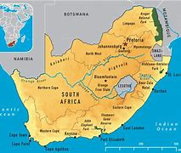
Setting the context
The South African Experience

Slide 6
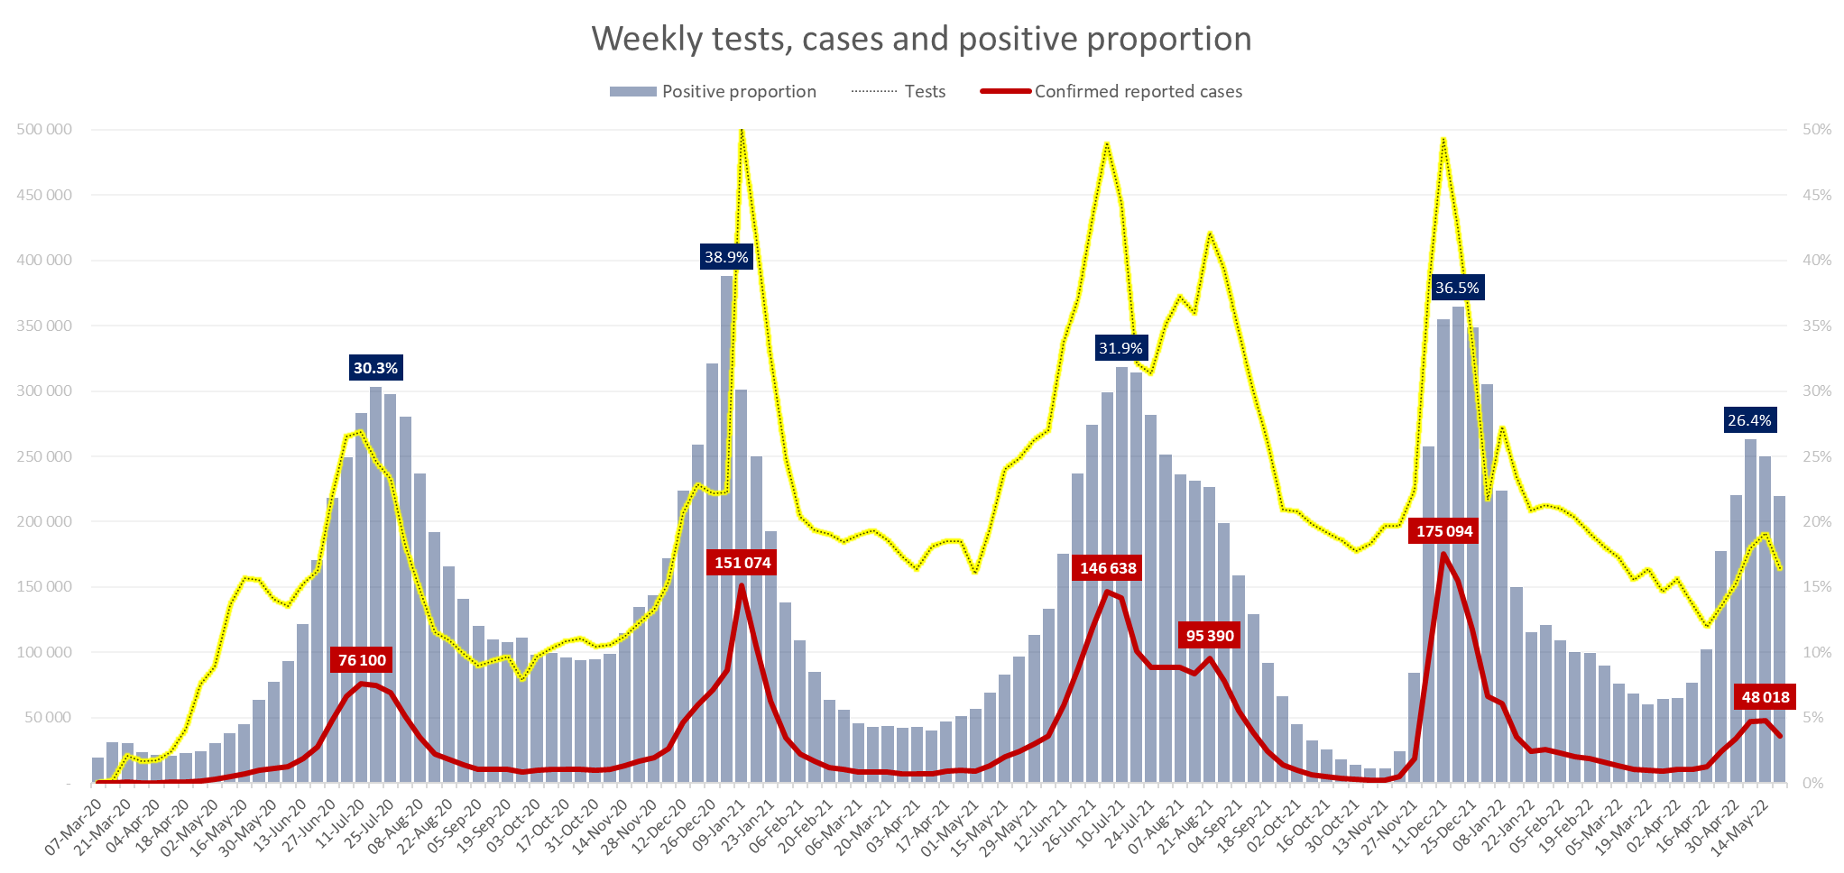
The evolution of the Covid-19 pandemic
https://www.nicd.ac.za/wp-content/uploads/2022/05/COVID-19-Testing-Summary_Week-20-2022.pdf
Notes:
Testing rates are reducing.

Slide 7
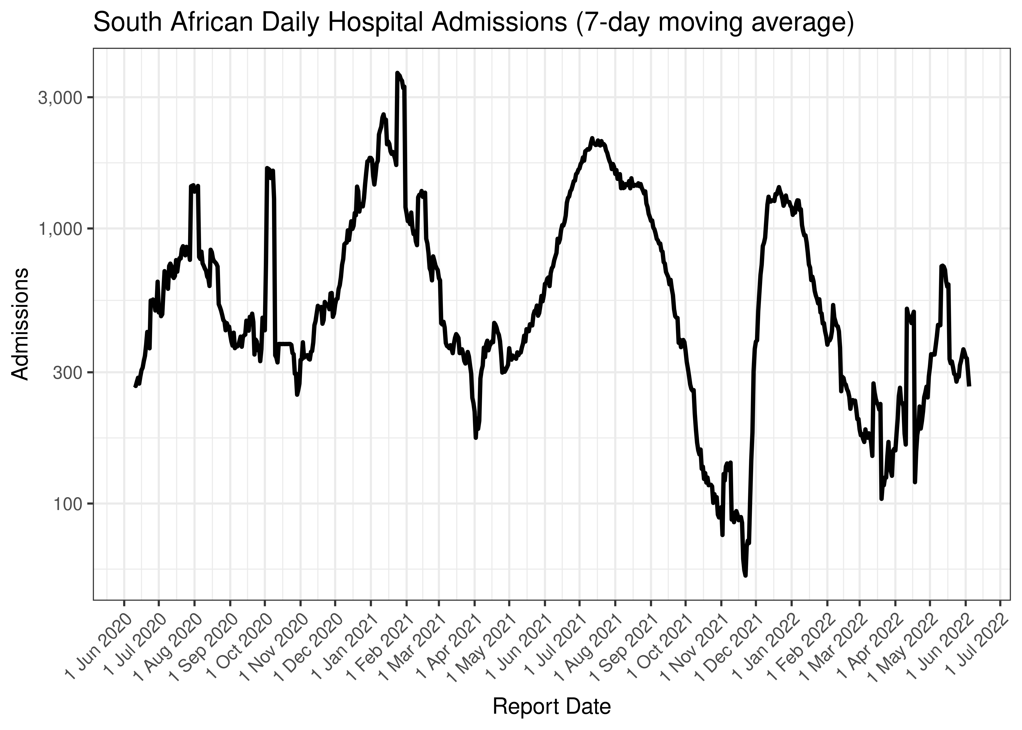
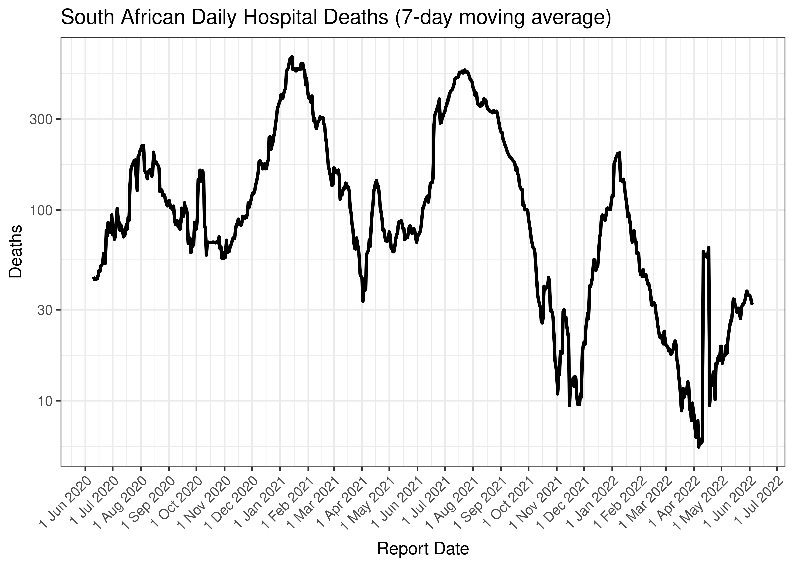
The evolution of the Covid-19 pandemic
South African Hospital Admissions and Deaths
https://unsupervised.online/static/covid-19/estimating_r_za.html#51_National
Notes:
(Note log scales – jumps from lower base look bigger, but also take into account that spread is related to base)
Hospital admission increased over past month or so
Hospital deaths increased over past two weeks or so

Slide 8
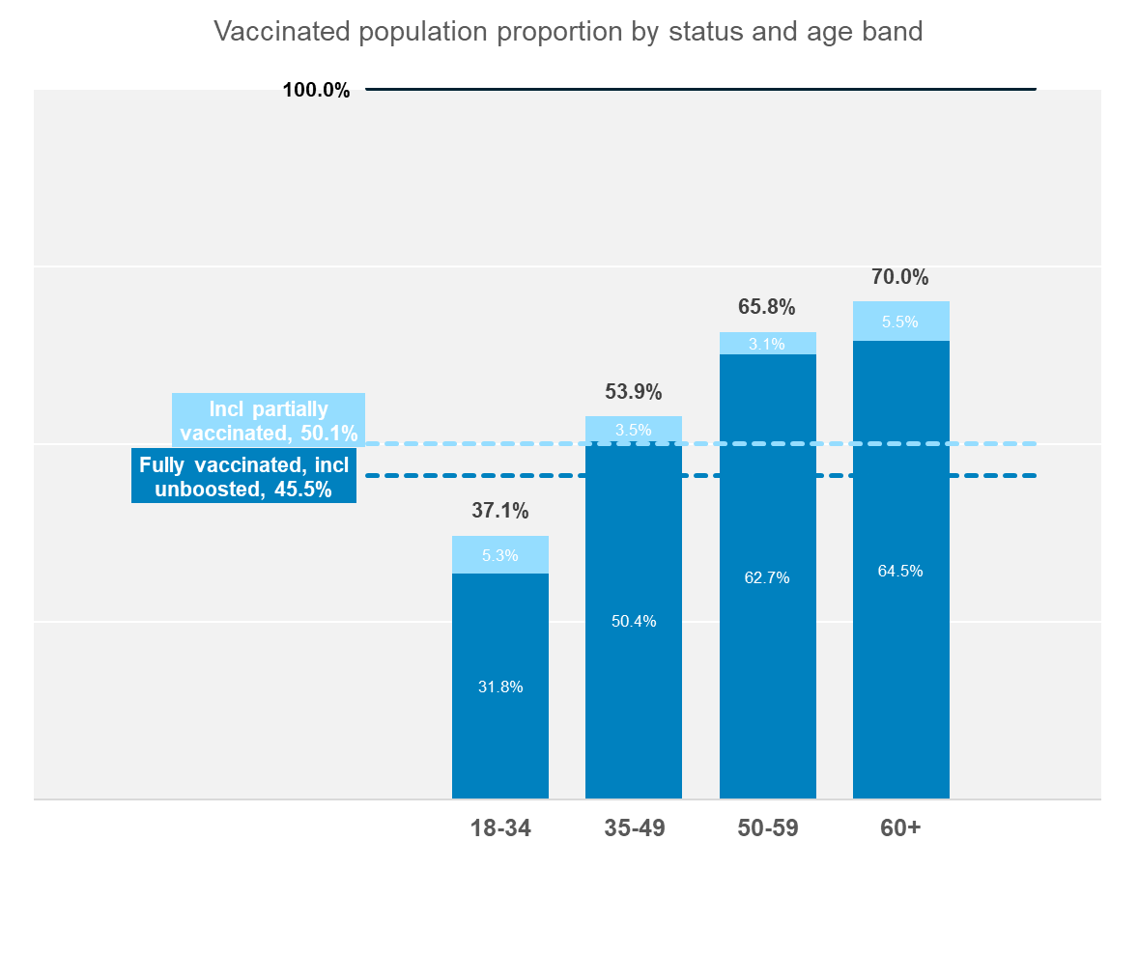
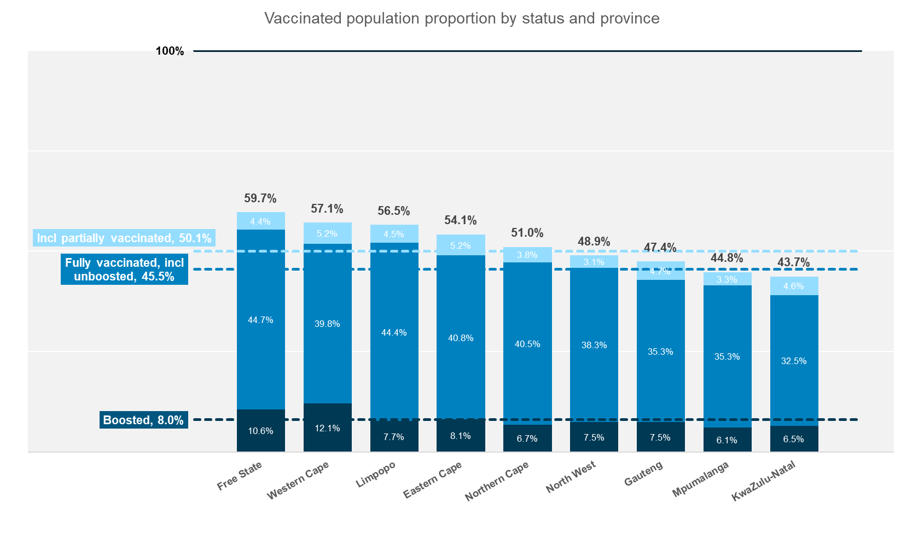
South Africa Vaccination Rollout
https://sacoronavirus.co.za/latest-vaccine-statistics/
Prev mth Incr Prev incr
50.1% of SA adults are vaccinated (partially or fully) 49.2% +0.9% +1.3%
45.5% of SA adults are vaccinated fully 44.6% +1.0% +1.8%
8.0% of SA adults have had booster vaccinations 6.5% +1.5% +3.6%
Second extension of Pfizer shelf life (12m)
10.3m unused vaccines (mid-May)
SA using <900k per month (peak: >1m pw)
5.4m vaccines expire end Sep 2022
4.8m vaccines expire end Oct 2022
Booster numbers by age bands are not available
Notes:
There has been a slight increase in basic vaccine coverage over the past few months.
The Boosted percentage has more than doubled, but is still on a low base with between 6 and 12% of the population having received a booster dose.

Slide 9
South African Vaccination and Hospitalisations
https://sacoronavirus.co.za/latest-vaccine-statistics/
The proportion unvaccinated hospital covid patients, is higher than the proportion unvaccinated people in the population.
This is the case for:
all levels of care
all age bands
Notes:
Larger proportions of unvaccinated people in hospital than in general population
But correlation not necessarily causation (Could vaccinated people just be protecting themselves better in general? Probably both.)

Slide 10



The CLAIMS Impact of COVID

Slide 11
Hospital Admission Experience 2020
Notes:
Show 2019 dotted line first
Orange
Grey
Actual admission rate index

Slide 12
Claims experience – Out of hospital visit rate 2020

Slide 13
Claims experience - Out of hospital visit rate 2021

Slide 14
Claims experience – Out of hospital visit rate comparison

Slide 15
Not only hospitalizations were impacted

Slide 16


THE Mental health experience

Slide 17
Mental health experience

Slide 18
Behavior Changes Leading to Long-term Health Problems
Behaviors that may be used as coping mechanisms during times of increased stress (e.g., increased use of alcohol and medications and food intake, lack of physical activity) may also have long-term impacts on health.
Providers should ensure they ask patients about these behaviors and provide patient education about safe coping mechanisms.

Slide 19
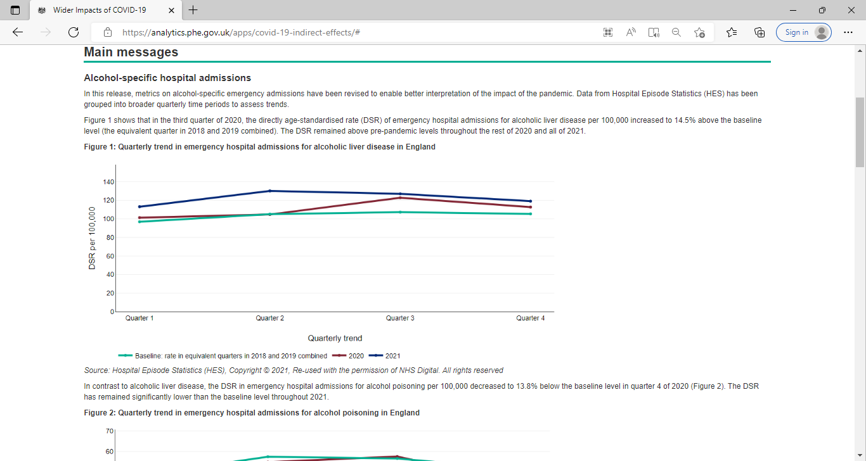

Slide 20
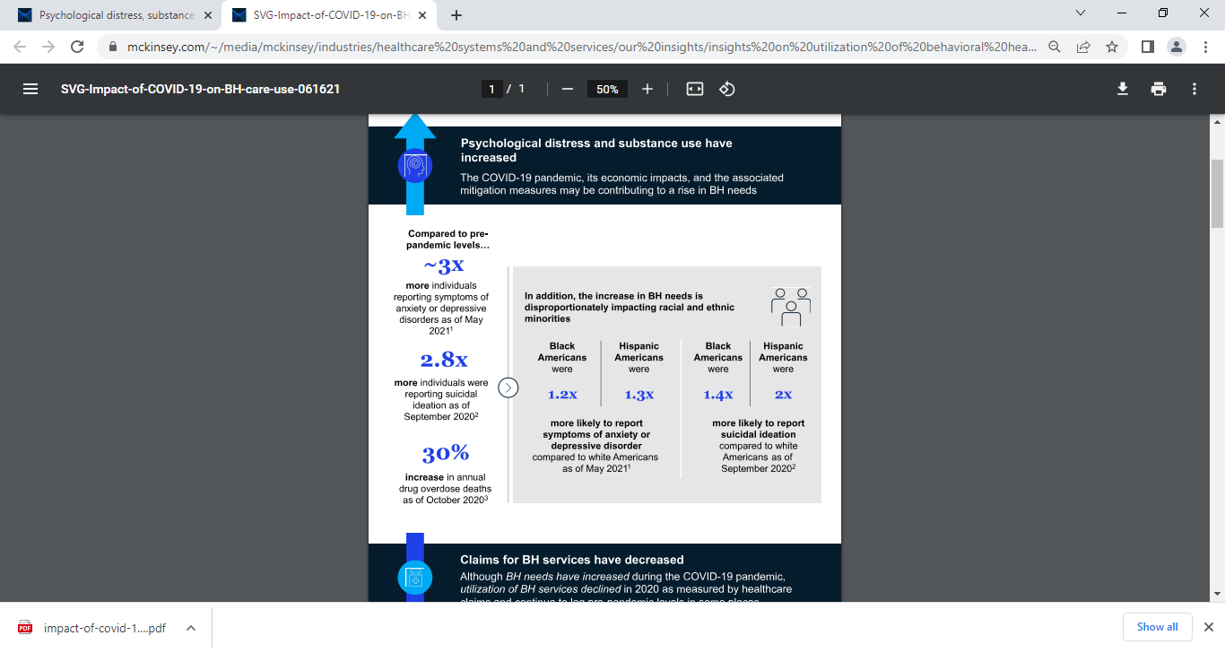
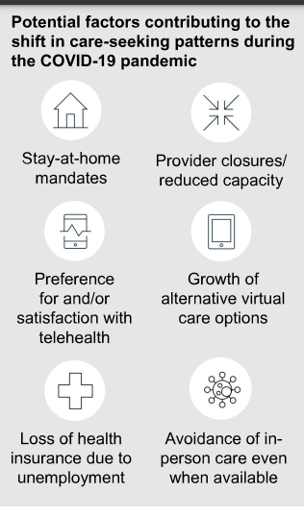
Increased utilization of out-patient behavioral health services

Slide 21
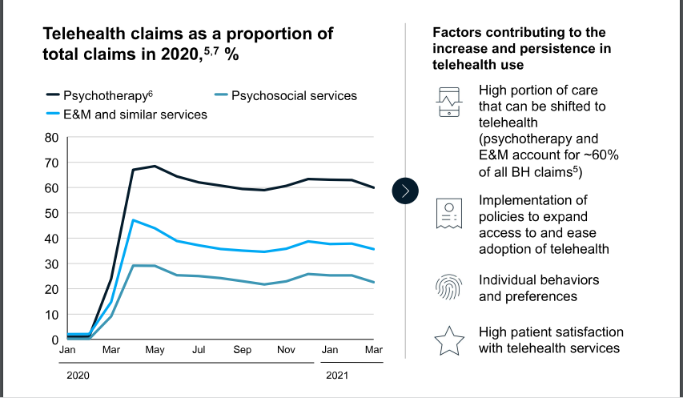
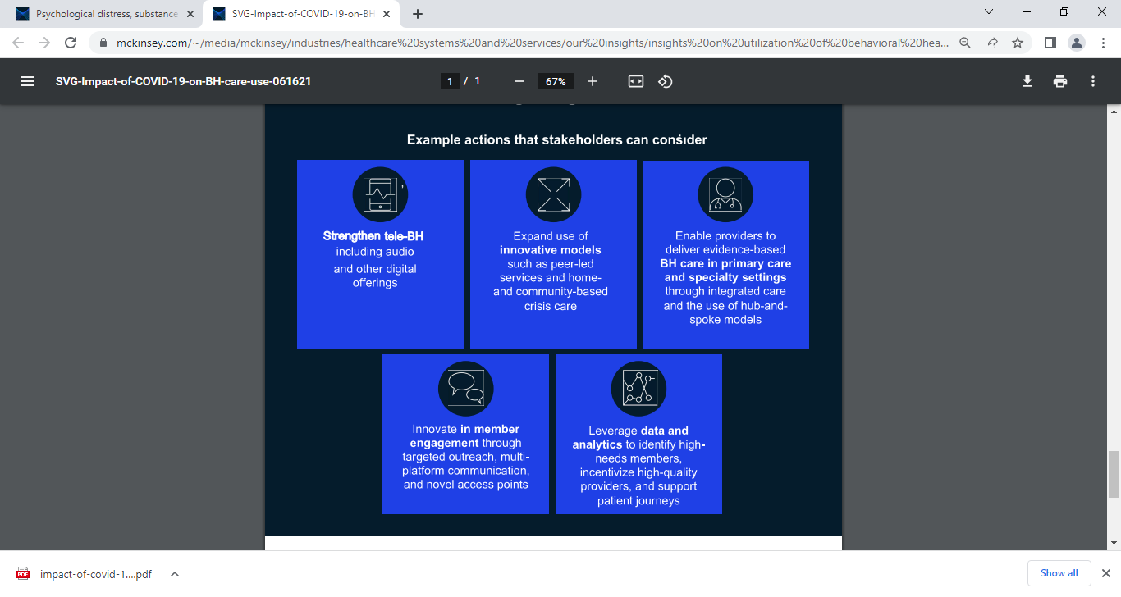
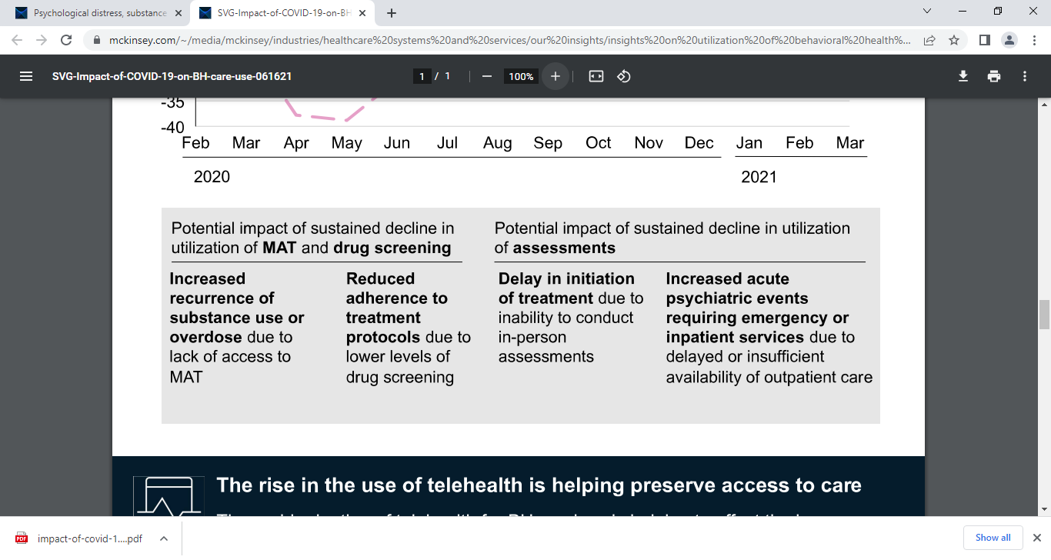

Slide 22


THE ONCOLOGY experience

Slide 23
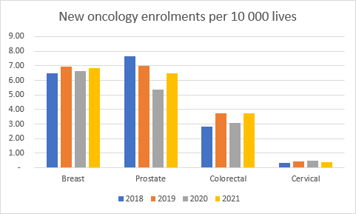
Oncology experience
Notes:
The top 10 drugs driving the increase in oncology medicine from 2017 – 2021 represents 27.5% of total oncology medicine claims in 2021, while it only represented 1.3% of the oncology medicine claims in 2017
The top 10 drugs driving the increase in oncology medicine from 2017 – 2022 represents 29.4% of total oncology medicine claims in 2022 YTD, while it only represented 3.2% of the oncology medicine claims in 2017

Slide 24
Increased severity of patients enrolling on oncology management programme
(as a result of delayed health seeking behavior)
The COVID-19 pandemic has disrupted the spectrum of cancer care, including delaying diagnoses and treatment and halting clinical trials patients with cancer appear to be more vulnerable to worse outcomes from the infection, including greater need for ventilator support and elevated mortality rates.
Diagnosis may be delayed as screening programs and diagnostic services have been decreased or suspended in many countries, and patients, wary of exposing themselves to the risk of infection, have been more reluctant to present to healthcare services treatment pathways have been altered to minimize potential exposure of patients with cancer to SARS-CoV-2 and to reduce the risk during surgery or radiation therapy
Certain aspects of ongoing care have been deprioritized to enable health systems to respond to the COVID-19 pandemic, which has resulted in patients’ receiving suboptimal or delayed care many clinical trials have been suspended, which has reduced current therapy options for patients who might have participated and has jeopardized longer-term therapy development

Slide 25
Later-stage Cancer Diagnosis
Since COVID-19 started, one study found a 76% decrease in urgent referrals from general practitioners to major cancer centers for suspected cancer.
For future pandemic waves, healthcare facilities should identify infection control practices to put in place to allow continued delivery of cancer related therapies.
Interrupted Clinical Research and Clinical Trials
Many clinical trials have been postponed or are experiencing some form of disruption and funding for future non-COVID-19 related medical research may be redirected or reduced.
Consider ways to adjust protocols to minimize the amount of in-person

Slide 26
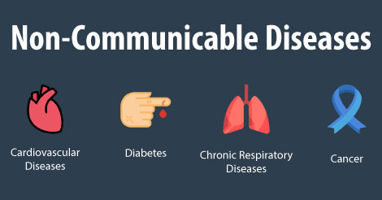
The noncommunicable diseases experience

Slide 27
Impact on health services for noncommunicable diseases
“The results of this survey confirm what we have been hearing from countries for a number of weeks now,” said Dr Tedros Adhanom Ghebreyesus, Director-General of the World Health Organization. “Many people who need treatment for diseases like cancer, cardiovascular disease and diabetes have not been receiving the health services and medicines they need since the COVID-19 pandemic began. It’s vital that countries find innovative ways to ensure that essential services for NCDs continue, even as they fight COVID-19.”
Service disruptions were widespread
The main finding is that health services have been partially or completely disrupted in many countries. More than half (53%) of the countries surveyed have partially or completely disrupted services for hypertension treatment; 49% for treatment for diabetes and diabetes-related complications; 42% for cancer treatment, and 31% for cardiovascular emergencies.
Rehabilitation services have been disrupted in almost two-thirds (63%) of countries, even though rehabilitation is key to a healthy recovery following severe illness from COVID-19.
Reassignment of staff and postponing of screening
In the majority (94%) of countries responding, ministry of health staff working in the area of NCDs were partially or fully reassigned to support COVID-19.
The postponement of public screening programmes (for example for breast and cervical cancer) was also widespread, reported by more than 50% of countries. This was consistent with initial WHO recommendations to minimize non-urgent facility-based care whilst tackling the pandemic.
But the most common reasons for discontinuing or reducing services were cancellations of planned treatments, a decrease in public transport available and a lack of staff because health workers had been reassigned to support COVID19 services. In one in five countries (20%) reporting disruptions, one of the main reasons for discontinuing services was a shortage of medicines, diagnostics and other technologies

Slide 28

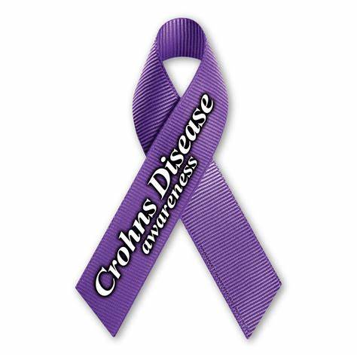

Other disease trend impacts

Slide 29
Other disease trend impacts
Decreased Immunization Rates
Orders for childhood vaccinations from the Centers from Disease Control and Prevention have dropped by about 11 million doses in 2020 from previous yearly averages.
Consider offering drive-through vaccination clinics or sending mobile vaccination units into communities. Providers should reach out to all patients with scheduled vaccination appointments to explain safety procedures and encourage them to keep appointments.
Delayed Elective Procedures
Decreased ED Visits/Patients Delaying Emergency Care
Visits to the ED were down by nearly 40% in some areas; acute care outpatient visits have also decreased.
Medical practices, health systems, and health insurers can reach out directly to patients with chronic medical conditions or use education campaigns to encourage community members to seek care for emergent conditions and to keep up with their preventive or routine care.
HIV/TB-Delayed 90-90-90 goals

Slide 30
Delayed Organ Transplants
The number of organ procurements and transplants decreased by about half, nationwide, in April 2020, but rebounded and overall increased over 2019 numbers.
Review lessons learned to determine if any changes in protocol or process are possible for subsequent waves, while closely monitoring all organ transplant patients, via telehealth and home health services.
Possible Decrease in Seasonal Communicable Disease
Transmission decrease
There is a potential for a decrease in the spread of all communicable diseases, such as influenza and other commonly occurring diseases, if community mitigation measures change to continue into the fall.
Continue to encourage social and physical distancing practices and support and encourage a robust seasonal flu vaccination program

Slide 31
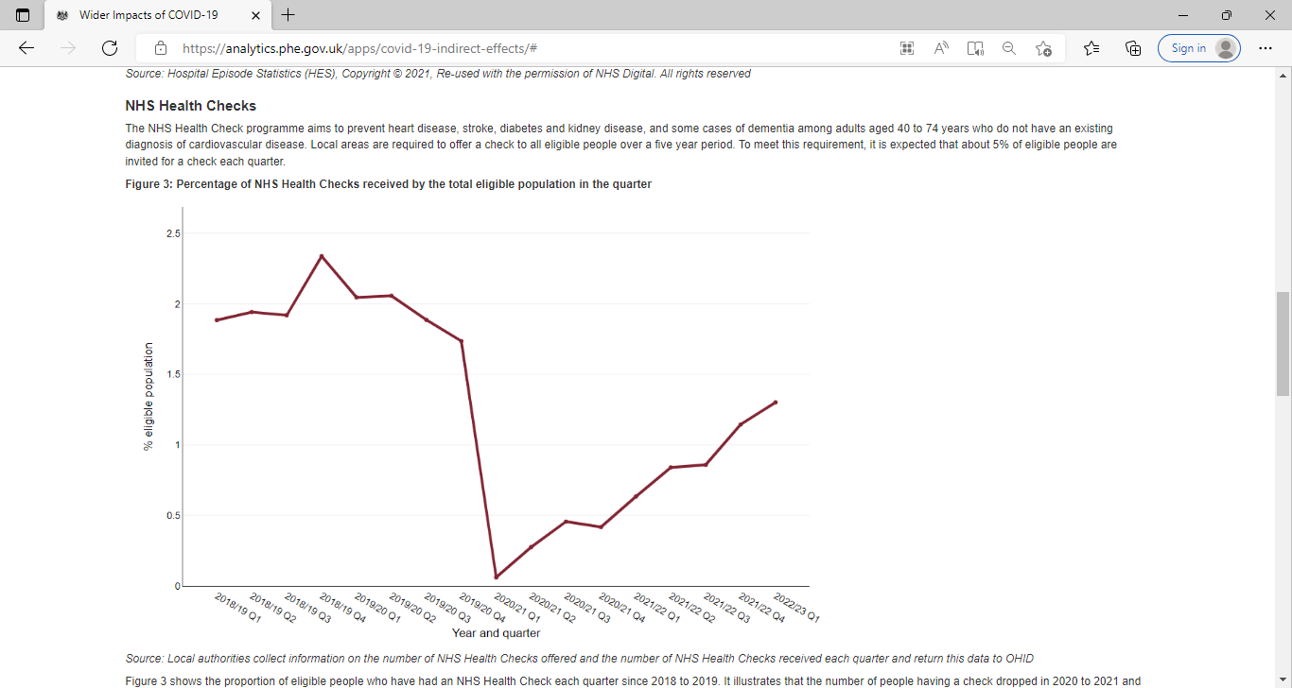
NHS checks

Slide 32
LONG COVID
Who is at the risk of long COVID?
The UK based Long COVID guideline states that the long-term consequences are noted in those who suffered from severe symptoms, with admissions into high care and ICU facilities2. In the guideline, two definitions of post-acute COVID-19 are given: (1) ongoing symptomatic COVID-19 for people who still have symptoms between 4 and 12 weeks after the start of acute symptoms; and (2) post-COVID-19 syndrome for people who still have symptoms for more than 12 weeks after the start of acute symptoms.
What are some symptoms of long covid?
Lingering breathlessness
Ongoing tiredness
General Malaise and fatigue
Persistent cough
Severe headaches,
Chronic pain and aches
Gastrointestinal issues- Diarrhoea, nausea, vomiting
Skin rash
Change in blood pressure, glucose readings
Anxiety, palpitations, sleeping problems and mood swings

Slide 33
What we know so far?
Given that this is an emerging area of the pandemic:
Current data shows that most patients are able to spontaneously recover with holistic support, rest, symptomatic treatment, and gradual increase in activity
Specific symptoms or worsening of symptoms will need to be monitored and will need to be assessed by a medical doctor if there is no resolution.
Worsening of symptoms in the areas of cardiac, respiratory or neurology may require a specialist consultation for further evaluation.
Data shows that the elderly patients tend to have more severe symptoms and will require further support and care on their road to recovery.
Metabolic derangement –NCDS?
Hospitalizations with Increased Claims ( CVS/respiratory)

Slide 34
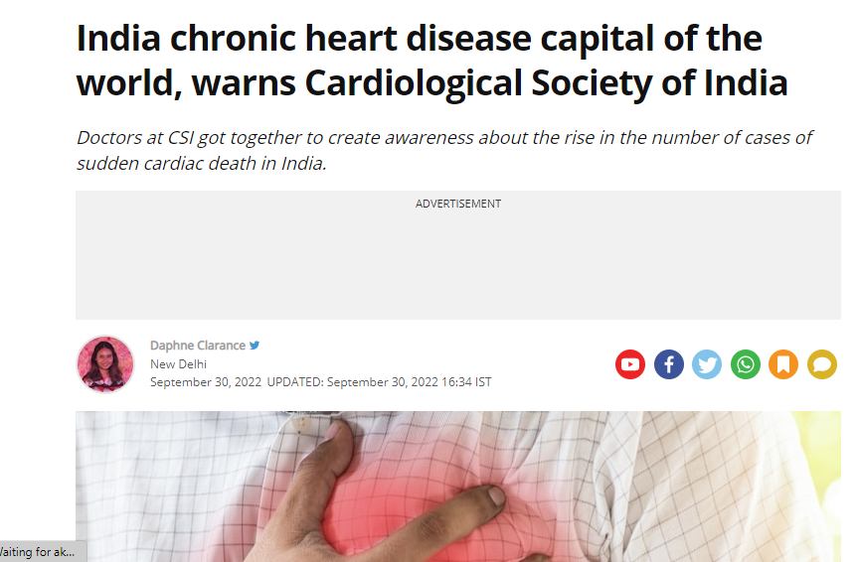
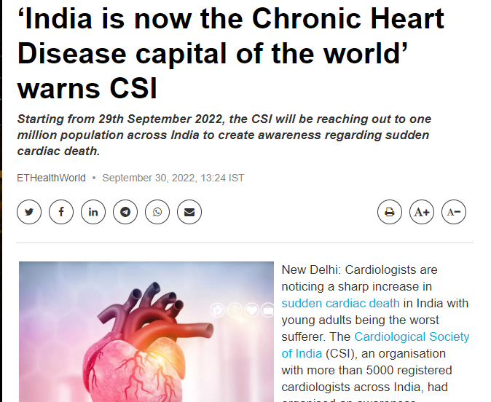
Over 5,000 doctors observed a sharp rise in the number of cases of sudden cardiac death in the country.
Lifestyle changes like increased screen time, high sugar intake, lack of exercise lead to heart diseases.
Depression due to poverty and unemployment has increased chances of chronic heart disease among poor people.
**Post Covid etiology remains unknown

Slide 35


IMPACT
ON
PREVENTION

Slide 36
Preventative screening experience
Colonoscopies
Pap Smears
Mammograms
PSA Tests

Slide 37
In summary
The Covid-19 pandemic fundamentally changed how healthcare was experienced
The novel virus had a devasting impact for some families
The virus placed extraordinary demands on the healthcare delivery system
As citizens and healthcare workers continue to deal with its effects on their personal and professional lives, everyone is adjusting to a new equilibrium
For Health insurance and their members this means adjusting rates and reserves to account for increasing claims and continuous horizon scanning and monitoring.

Slide 38
Key Take-aways
COVID-19 has shown that many of the tools required for fighting a pandemic are
Disease surveillance, a strong civil society, robust public health, clear communication, and equitable access to resilient universal health-care systems.
COVID-19 could provide new insights into interactions between the immune system and NCDs, and potentially change the way we understand and treat these diseases.
It might also generate new long-term disabilities that will add to the Chronic disease/HIV/TB/CVS/Mental Health burden.
2020 has shown the crucial relation between communicable diseases and NCDs.
Both inflict an unacceptable toll on human life.

Slide 39
Recommendations
Active health surveillance-Collecting remote monitoring data e.g., continuous glucose monitoring
Augmented risk profiling and predictive analytics methodology
Digital preventative screening capability
Active health assessment and screening( digital/Physical)
Routine health check ups
High index of clinical discretion
Strong promotive and preventive focus
Active disease management
Early detection and treatment
Lifestyles focus ( diet/exercise/mindfulness)

Slide 40

In conclusion :“When a system at equilibrium is disturbed by the application of a stress, the system will adjust so as to minimise the stress and regain equilibrium- two years later to what is now the new normal”
Le’Chatelier’s principle

Slide 41
References
AARP . 2021. Eight Occupations Hit Hardest by the Pandemic in 2020.https://www.aarp.com February 26. [Google Scholar]
BBC . 2021. COVID Map: Coronavirus Cases, Deaths, Vaccinations by Countries.https://BBC.com-world-51235105 February 26. [Google Scholar]
CIDRAP . 2021. US Job Losses Due to COVID-19 Highest Since Great Depression.https://www.cidrap.umn.edu February 26. [Google Scholar]
DIFFEN . 2021. World War I vs. World War II - Difference and Comparison.https://www.diffen.com February 26. [Google Scholar]ABC
COVID-19 Healthcare Delivery Impacts
https://files.asprtracie.hhs.gov/documents/covid-19-healthcare-delivery-impacts.pdf
https://www.mckinsey.com/~/media/mckinsey/industries/healthcare%20systems%20and%20services/our%20insights/insights%20on%20utilization%20of%20behavioral%20healt
Liang, W. et al. Lancet Oncol. 21, 335–337 (2020).
Wu, Z. & McGoogan, J. M. JAMA 323, 1239–1242 (2020).
.Onder, G., Rezza, G. & Brusaferro, S. JAMA 323, 1775–1776 (2020).
Centers for Medicare & Medicaid Services.
www.actuariesindia.org

