Slide 1
25th India Fellowship Seminar
Cyber risk and Terrorism risk - Challenges in pricing
Supervisor:
P.A. Balasubramanian, FIAI
Shivendra Tripathi
Samarth Vikram Singh
Indian Actuarial Profession
Serving the Cause of Public Interest

Slide 2
Agenda
Cyber Risk
Cyber Insurance
Pricing challenges in Cyber Insurance
Indian Perspective
Way Forward
Terrorism Risk
Terrorism Insurance
Pricing challenges
Indian Perspective - GIC Pool for India
Alternatives

Slide 3
Cyber Risk
'Cyber risk' means any risk of financial loss, disruption or damage to the reputation of an organization from some sort of failure of its information technology systems
Cyber risks are a business issue with technical aspects. Cyber risk impacts and is impacted by all areas of the organization
All types and sizes of organizations are at risk, not only the financial services firms, defense organizations and high profile names which make the headlines

Slide 4
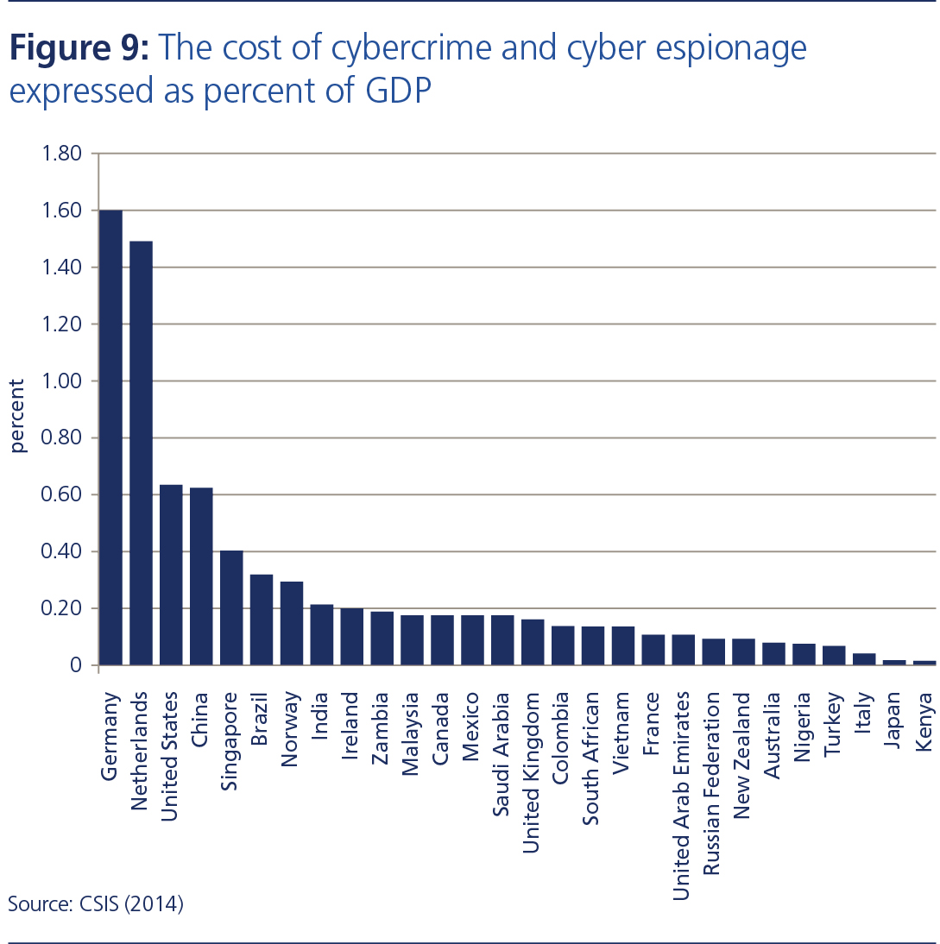
Major Events
Major global attacks recently on LinkedIn, Myspace, facebook…
Primera blue Cross insurance, JP Morgan Chase….
Cost of Cybercrime as a % of GDP
Notes:
Importance of Cyber Insurance – as risk is a decent prop of GDP

Slide 5
Cyber Insurance Coverage
Insurance product used to protect businesses and individual users from Internet-based risks, and more generally from risks relating to information technology infrastructure and activities
Generally cyber risks fall into first party and third party risks. Insurance products exist to cover either or both of these types of risk.
First-party insurance covers your business’s own assets and Third-party insurance covers the assets of others, typically your customers.
First Party
Third party
Loss or damage to digital assets
Business interruption from network downtime
Cyber exhortation
Customer notification expenses
Reputational damage
Theft of money or digital assets
Security and privacy breaches,
Investigation, defence costs
civil damages associated
Damages arising from defamation, breach of privacy or negligence
Loss of third party data, including payment of compensation to customers for denial of access, and failure of software or systems
Notes:
First-party insurance covers your business’s own assets. This may include:
Loss or damage to digital assets such as data or software programmes
Business interruption from network downtime
Cyber exhortation where third parties threaten to damage or release data if money is not paid to them
Customer notification expenses when there is a legal or regulatory requirement to notify them of a security or privacy breach
Reputational damage arising from a breach of data that results in loss of intellectual property or customers
Theft of money or digital assets through theft of equipment or electronic theft
Third-party insurance covers the assets of others, typically your customers. This may include:
Security and privacy breaches, and the investigation, defence costs and civil damages associated with them
Multi-media liability, to cover investigation, defence costs and civil damages arising from defamation, breach of privacy or negligence in publication in electronic or print media
Loss of third party data, including payment of compensation to customers for denial of access, and failure of software or systems

Slide 6
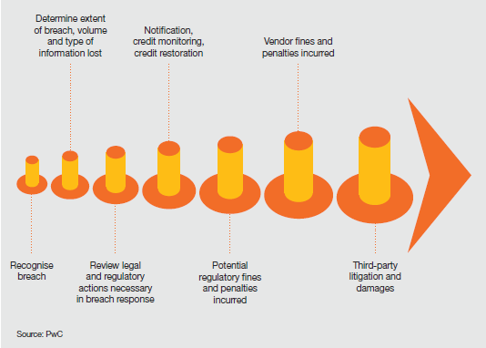
Pricing Challenges
Limited availability of data
Not a one size fit all policy – every policy is different
Exponential evolution in the nature of the risk
Breach may remain undetected for long periods
Notes:
Talk about 1st and 3rd party for better understanding

Slide 7
Pricing Challenges
Premium = (Freq * Sev) + Commission + Expenses + Profit Margin
Rating factor selection?
Governing laws specific to countries
Cost continues to increase as more business functions move online & more connect to internet
Loss from theft of IPR will increase as ability to make use of it to manufacturing improves
Difficulties of calculating a dollar value on the impact of cyber crime-approach the issues from both direct & indirect costs assessment
Need more actuarial data
Adverse selection and moral hazard
Issue of incomplete data-more variations as cyber crimes are unreported
Uncertainty needs to be built into the models
Pricing actuaries should consider the professional conduct standards (PCS) while pricing for such a product.
Notes:
Talk about 1st and 3rd party for better understanding

Slide 8
Indian Perspective
In 2010-11 India was the 10th most heavily cyber-attacked country; today it is second only to United States.
Currently the maximum cyber-insurance cover provided is for Rs 300 crore
Expensive and unaffordable to small companies
Mostly IT companies and BPO handling 3rd party data
Premium amount depends on data being in India or outside
Not a solution to the security threats or vulnerabilities
Huge digital and e-commerce growth in India makes it vulnerable to cyber attacks and makes cyber insurance crucial
Notes:
For instance, a company seeking insurance has to shell out anywhere between Rs 12 lakh to Rs 18 lakh as a yearly premium amount to avail a cyber-insurance coverage of Rs 10 crore and between Rs 2.4 crore to Rs 3 crore as a yearly premium amount to avail a cyber-insurance coverage of Rs 300 crore
it’s surprising to note that in the United States, a majority of the insurance premium amount of cyber-insurance companies come from the small and mid-size companies.

Slide 9
Looking Forward
Clarify risk appetite
Gain broader perspective
Create tailored, risk specific conditions
Share data more effectively
Develop real time policy updates
Consider hybrid risk transfer
Improve risk facilitation
Enhance credibility

Slide 10
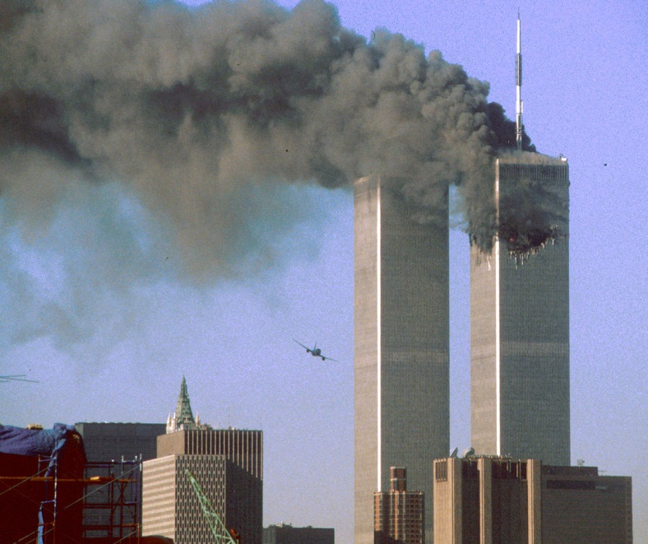
Terrorism Risk
Terrorism – unofficial or unauthorized use of violence and intimidation in pursuit of political, religious or ideological aims
Major Global Events
9/11 attack on WTC
London Tube Bombings in 2006
Major Indian Events
26/11 attack in Mumbai
Recent terrorist attack on Pathankot Air Force Station
Notes:
Brief Introduction on Terrorism
Message on modes of terror and that terror is a global threat and quite unpredicatable

Slide 11
Terrorism Insurance
Mainly property damage comes under the purview of terrorism insurance
Damage due to bombings, shooting, fire etc.
Prior to 9/11 standard commercial insurance policies covered terrorism but now offered separately
Also covers business interruption and workers compensation
Current clients are public and private sector companies along with many Indian temples and landmark buildings
However, government buildings have no cover along with small and medium enterprises

Slide 12
Pricing - Challenges
Frequency and severity of loss highly unpredictable
Not enough data – difficult for risk quantification
High levels of loss potential
Risk may be highly concentrated
Risk is not truly random – diversification of risk hampered
Difficult for one insurer to provide adequate cover at a reasonable price
Major global events forced the industry to look for an acceptable solution – Terrorism Insurance Pool

Slide 13
Pricing - Challenges
Impossible to model the probable no. of events(frequency) likely to result in claims
What is the worst case scenario?
Increasing frequency of these attacks makes matters worse
Should this be a mandatory cover – regulator to decide
Designing of apt coverages, building sufficient capacities and prudent pricing are challenges at present
Pricing actuaries should consider the professional conduct standards (PCS) while pricing for such a product.

Slide 14
Indian Perspective – GIC Pool
Terrorism cover is an optional add-on cover provided under Property Insurance Policies by endorsement
All insurers charge the same rates
Varies from 0.08 to 0.23 per mille of total sum insured
Rates vary by residential, non-industrial and industrial
0.5% deductible on sum insured subject to min and max limit
Cap on limit provided per location (currently at INR 1500 Cr)
Capacity provided by Indian Market Terrorism Risk Insurance Pool (IMTRIP)
For cover limit beyond Pool capacity, insurers seek facultative reinsurance support from international market (Source: GIC Re)
Notes:
Initiative by Indian non-life insurers in 2002
Response to hardening of international market for terrorism cover post 9/11
Entire terrorism risk on Property Insurance policies written by all Companies is reinsured by all Pool members
All non-life insurance companies operating in India are members of the Pool. Present strength is 21.
GIC Re is the Manager of Pool
Terms of cover, premium rates, deductibles are determined by Pool Underwriting Committee

Slide 15
IMTRIP – Historical Changes
Source: GIC Re
Notes:
Member count Increased from 11 in 2002 to 21 currently
All members provide capacity to the Pool in specified shares
❑ Pool takes reinsurance protection on excess of loss basis
❑ Pool results are shared among Pool members in same proportion as the capacity provided
❑ Capacity offered by Pool is presently INR 10,000 million [about USD 185 million] per location (maximum limit of indemnity)

Slide 16
Pool performance/Other Alternatives
Successfully operated for last 13 years
Limits may be revised to INR 1800 Cr in view of current terror threats
IRDA plans to reduce rates to encourage more domestic companies to take cover
Treating terror risk as CAT and modelling terror risks possible in future
May still be difficult to cover big risks on individual basis – pool may remain the most practical solution
Govt. support as provided in other western countries
Notes:
In India Insurance companies provide Terrorism coverage only upto Rs.750 crores at any one location from the Market Terrorism Pool as per Terrorism Pool rules and terms. If a client wants coverage for terrorism risks above Rs.750 crores insurance companies can arrange the same and issue a Stand Alone Terrorism Coverage policy.
With many public and private sector companies and landmark buildings and temples queing up to buy the cover, the Indian terrorism pool has now swelled to Rs 4,600 crore.
Commission on premium upto 5%.
An individual member's retention of a ceded risk and that member's share of all other risks written to the pool are pre-determined for a particular year, which runs from April 1 to March 31 and is reviewed annually.
The pool receives 90% of the original premium on a ceded risk. An individual member must submit quarterly accounts of relevant business written and pay within 90 days thereafter. Interest is levied on outstanding payments.
GIC Re is also responsible for reinsuring the pool at members' cost.
http://www.internationallawoffice.com/Newsletters/Insurance/India/Tuli-Co/Insurance-of-Terrorism-Risks-in-the-Indian-Market

Slide 17
Questions?

