Slide 1
Organizer
19th Global
Conference of Actuaries
30th – 31st January, 2018 | Mumbai, India
Dr Gaurav Khemka
Senior Lecturer in Actuarial Studies

Slide 2
19th Global
Conference of Actuaries
30th – 31st January, 2018 | Mumbai, India
A method of estimating a three-state no-recovery transition matrix using readily available population data
31 January 2018 14:50 hrs
In order to ascertain the value (and price) of various social and insurance contracts, the minimum data requirements are a no-recovery three state (healthy, ill, dead) transition matrix. Estimating a transition matrix requires the availability of longitudinal data. However, in many countries, the only credible statistical information available is the age-specific population mortality and disability prevalence rates.
In this study, first, we propose a simple method of estimating the ranges that the transition probabilities can take (‘feasible set’). Second, we provide two methods of estimating a unique solution, using the extra-mortality concept proposed by Rickayzen and Walsh (2002) and an optimization procedure. Finally, we provide a practical example of using such a transition matrix to price a long-term care insurance. Another application of the feasible set can be by insurers to set solvency capital for such products.

Slide 3
Motivation
19th Global
Conference of Actuaries
30th – 31st January, 2018 | Mumbai, India
Pricing and valuation of LTC contracts and aged care needs
Longitudinal data
No recovery assumption

Slide 4
Assumptions
19th Global
Conference of Actuaries
30th – 31st January, 2018 | Mumbai, India
Three state model
active (or healthy) (a)
invalid (or disable) (i)
Dead (d)
Discrete time Markov chain
Time-homogeneous, and age-specific transition probabilities

Slide 5
Aim
19th Global
Conference of Actuaries
30th – 31st January, 2018 | Mumbai, India
Develop a method of generating the transition matrix using population level age- and gender-specific:
mortality ($q_{x}$), and
disability prevalence rates ($π_{x}$)

Slide 6
Some notations and conditions
19th Global
Conference of Actuaries
30th – 31st January, 2018 | Mumbai, India
Transition matrix conditions
Types
$$\begin{matrix}p_{x}^{aa}+p_{x}^{ai}+p_{x}^{ad} & =1 \\ p_{x}^{ii}+p_{x}^{id} & =1 \\ p_{x}^{dd} & =1\end{matrix}$$ | (1)
Mortality and prevalence conditions
$q_{x}=\frac{d_{x}}{l_{x}}=\frac{l_{x}−l_{x+1}}{l_{x}}$ | (2)
$l_{x}=l_{x}^{a}+l_{x}^{i}$ | (3)
$$π_{x}=\frac{l_{x}^{i}}{l_{x}}=1−\frac{l_{x}^{a}}{l_{x}}$$ | (4)

Slide 7
Solving for$p_{x}^{aa}$
19th Global
Conference of Actuaries
30th – 31st January, 2018 | Mumbai, India
the number of individuals in state $a$ at age $x+1$, given $l_{x}^{a}$ individuals in state $a$ at age $x$is
$$l_{x+1}^{a}=l_{x}^{a}p_{x}^{aa}$$
$$⇒\frac{l_{x+1}^{a}}{l_{x+1}}.\frac{l_{x+1}}{l_{x}}=\frac{l_{x}^{a}}{l_{x}}p_{x}^{aa}$$
$⇒\left(1−π_{x+1}\right)\left(1−q_{x}\right)=(1−π_{x})p_{x}^{aa}$
$$⇒p_{x}^{aa}=\frac{\left(1−π_{x+1}\right)\left(1−q_{x}\right)}{1−π_{x}}$$ | (5)

Slide 8
Remaining transition probabilities
19th Global
Conference of Actuaries
30th – 31st January, 2018 | Mumbai, India
The number of individuals in state 𝑖 at age 𝑥+1 can be calculated as:
The number of individuals in state 𝑑 at age 𝑥+1 is:
$$π_{x+1}\left(1−q_{x}\right)=\left(1−π_{x}\right)p_{x}^{ai}+π_{x}p_{x}^{ii}$$ | (6)
$$q_{x}=\left(1−π_{x}\right)p_{x}^{ad}+π_{x}p_{x}^{id}$$ | (7)

Slide 9
Rearranging last two equations
19th Global
Conference of Actuaries
30th – 31st January, 2018 | Mumbai, India
$$p_{x}^{ii}=\frac{π_{x+1}(1−q_{x})}{π_{x}}−\left(\frac{1−π_{x}}{π_{x}}\right)p_{x}^{ai}$$ | (6a)
$$p_{x}^{id}=\frac{q_{x}}{π_{x}}−\left(\frac{1−π_{x}}{π_{x}}\right)p_{x}^{ad}$$ | (7a)

Slide 10
Conditions to reduce ‘feasible set’
19th Global
Conference of Actuaries
30th – 31st January, 2018 | Mumbai, India
Each of the four values has to satisfy the condition: $0≤p≤1$.
The probabilities have to satisfy the conditions provided by equation (1).
As we are usually concerned with the elderly (ages 60 and above), $p_{x}^{id}>p_{x}^{ad}$
“Stickiness”: $p^{ii}>p^{id}$, $p^{aa}>p^{ai},p^{ad}$

Slide 11

Generating point estimate
19th Global
Conference of Actuaries
30th – 31st January, 2018 | Mumbai, India
Two approaches:
‘Extra Mortality’ (Rickayzen and Walsh, 2002):
$$ExtraMort_{x}=\frac{M}{1+{1.1}^{50−x}} \left(=p_{x}^{id}−p_{x}^{ad}\right)$$
Least Squares procedure: Minimize the total squared distance from the mid-point of the range for all the transition probabilities, simultaneously

Slide 12
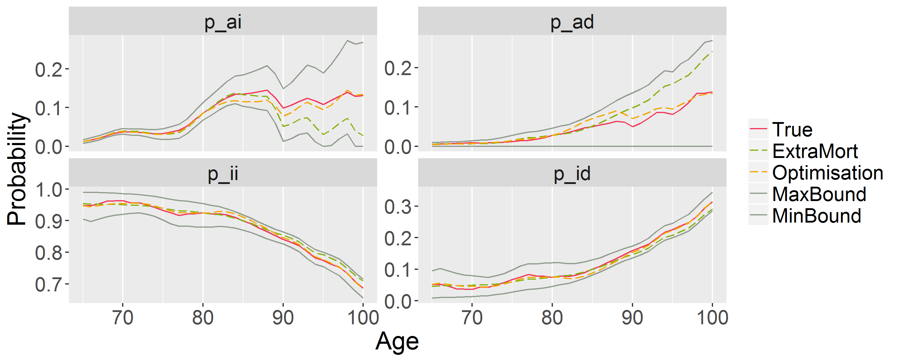
Australian Data
19th Global
Conference of Actuaries
30th – 31st January, 2018 | Mumbai, India

Slide 13
Root mean square error of the two methods
19th Global
Conference of Actuaries
30th – 31st January, 2018 | Mumbai, India
Estimation method | Australian Females | Australian Males
Extra mortality | 0.600 | 0.632
Optimisation procedure | 0.215 | 0.408

Slide 14
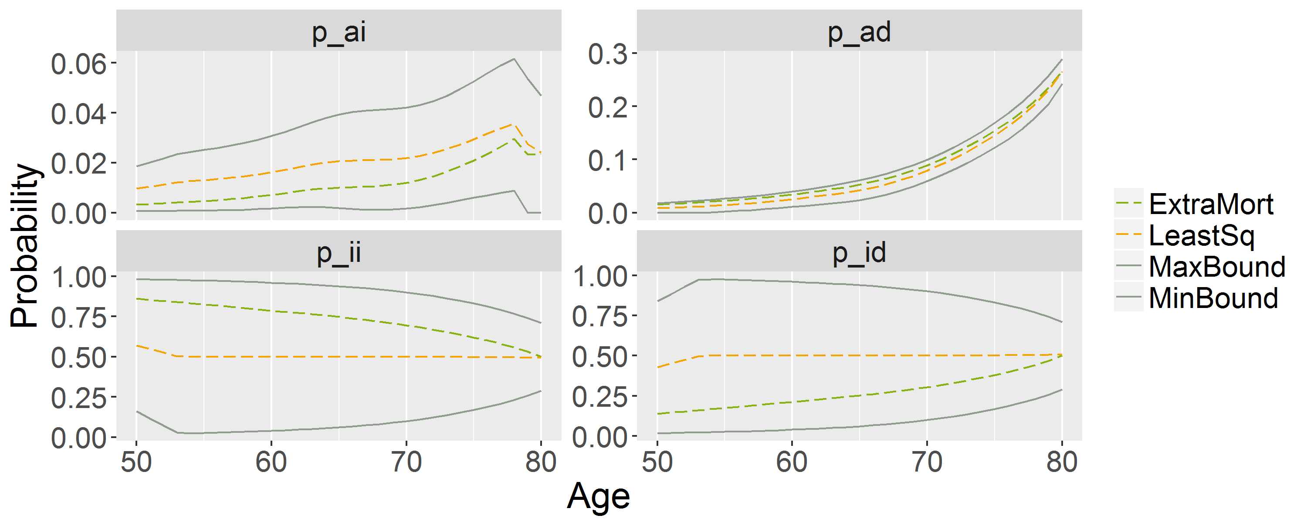
Application to Indian Data
19th Global
Conference of Actuaries
30th – 31st January, 2018 | Mumbai, India

Slide 15
Application results for Life Care Annuity (AU)
19th Global
Conference of Actuaries
30th – 31st January, 2018 | Mumbai, India
Transition probabilities | Age 65 |  | Age 75 |  | Age 85
 | Price ($) | Difference | Price ($) | Difference | Price ($) | Difference
True NR | 551,235 |  | 417,886 |  | 270,586
True WR | 538,955 | - 2.2% | 407,233 | - 2.5% | 262,455 | - 3.0%
ExtraMort | 551,741 | + 0.1% | 409,961 | - 1.9% | 252,901 | - 6.5%
LeastSq | 552,233 | + 0.2% | 411,841 | - 1.4% | 256,785 | - 5.1%

Slide 16
Application results for Disability Annuity (AU)
19th Global
Conference of Actuaries
30th – 31st January, 2018 | Mumbai, India
Transition probabilities | Age 65 |  | Age 75 |  | Age 85
 | Price ($) | Difference | Price ($) | Difference | Price ($) | Difference
True NR | 231,597 |  | 218,415 |  | 162,745
True WR | 202,522 | - 12.6% | 199,663 | - 8.6% | 151,170 | - 7.1%
ExtraMort | 232,103 | + 0.2% | 210,490 | - 3.6% | 145,060 | - 10.9%
LeastSq | 232,595 | + 0.4% | 212,369 | - 2.8% | 148,944 | - 8.5%

Slide 17
Organizer
19th Global
Conference of Actuaries
30th – 31st January, 2018 | Mumbai, India
Thank You
Gaurav.Khemka@anu.edu.au

