Slide 1
Burning Cost

Slide 2
Agenda
Detariff Cycle & its evolution
Market overview
Need for burning cost & its introduction
Challenges & next step
GHI burning cost
Way forward
Notes:
2

Slide 3
De tariff cycle - learning from other markets
Phase I
Phase II
Phase III
Price War
Pressure on cost
Adequacy of Sum Insured
Coverage enhancement
Market Forces
Collaborations
Triggers M&As
Capacity difficult to come by
Rational Behavior
Return of growth
Induced Behavior
Return of growth
Regulatory
Intervention
Re tariff
Capital infusion
Restriction on entry of new players
Value destruction
Companies go down under
Notes:
Re-Tariff- In China, Motor
Collaboration & M&A – Japan
Capital Infusion- Insolvency- Korea
3

Slide 4
China – Evolution of Distribution, Regulation & Pricing
6 Years
To 2002
2003 – 2006 1H
2006 2H - 2008
2009-2011
2012+
Distribution
Sales Staff
Sales Staff, Agency
Sales Staff, Agency
Sales Staff, Agency, Call Center, Cross Sell
Sales Staff, Agency, Call Center, Cross Sell
Rate Regulation
Tariff
File and use
Tariff
Tariff, Strengthened Market Practice Guideline
Tariff Reform
Pricing Technology
Basic Risk Segmentation
Some Insurers successfully adopted GLM
GLM and more advanced risk classification gain momentum
Deep Discount from previous tariff price offered by many insurers.
Regulators concerned by increased solvency risk
Stiff Tariff-market but it is moving towards detariffication again

Slide 5
Historical underwriting results of Chinese local market
Millions RMB
Data Resource: CIRC, China Insurance YearBook, Annual Statements for P&C insurers, Towers Watson
Data are for all domestic P&C insurers combines.

Slide 6
Japan
Combined Ratio
Mergers and Acquisitions
Market agreement between market players to control price
Detarrification in 1998
Massive erosion in premium
Triggers consolidation
Large agents close down
Gives rise to increase in solicitors
Notes:
From 20 Insurance companies (in 1998) initially , are merged to 10 companies (by 2009) with further consolidation in progress
6

Slide 7
Agenda
Detariff Cycle & its evolution
Importance of reserves
Need for burning cost & its introduction
Challenges & next step
GHI burning cost
Way forward
Notes:
7

Slide 8
Global Property Market Scenario: Pricing and Market Capacities
Gross Premium and Capacity in INR Mn
Gross Property Premium , Capacity in the domestic market and Average rates are being compared for Indian Market Context with Southeast Asian Market , African Market and Middle east market
Capacity of Indian market is higher than the Southeast Asian, African and Middle East counterparts
Higher domestic capacity in the market lead to high competition thereby having an adverse impact on the Pricing
Source: www. axco.co.uk – Country specific Insurance market research papers
Period: 2010-11 to 2012-13

Slide 9
Loss Ratio : Industry trend
Loss ratio’s across products are consistently on an higher side for major products in General Insurance Industry
No benchmark data available for pricing the risk
Source: IRDA published Numbers
Period: 2007-08 to 2013-14

Slide 10
Regulator Intervention on Price
Burning Cost to be the starting point of Pricing
IIB has published the FLEXA burning cost of 89 Occupancy
Insurer can calculate their own burning cost from their past acceptance
Insurer can use lower of the two for FLEXA rating
Burning rate has to loaded for acquisition, management cost and CAT cost
Risk accepted at the rate lower than the two needs to be report to the Board of the company .

Slide 11
IIB Approach to Burning rates
All premium and claims data for FY 12, FY 13 and FY 14 considered.
out of 255 occupancies IIB has provided data for 89 of them
In claim data, only Non AOG losses considered for calculation.
All losses which are upto 5 Cr (100% of the loss) are being considered as frequency losses
losses above 5 Cr ( 100% of the loss) are being termed as large loss
The large loss loading % need to be applied on frequency burning rates
The overall burning rate = frequency loss burning rate + large loss loading on this rate.

Slide 12
Agenda
Detariff Cycle & its evolution
Need for burning cost & its introduction
Challenges & next step
Indian industry and reserving evolution
GHI burning cost
Way forward
Notes:
12

Slide 13
Challenge with current Burn cost approach
Burn rate is currently for 89 occupancies . 40% market is still unaddressed
Inadequacy of claims data with some of the insurance companies
Guidance on AOG pricing to be developed
No uniform methodology for calculation of burning rates among companies

Slide 14
Exposure based pricing
There is a need to pass on the cost of large loss objectively to the customer
The prescribed approach is subjective
The load for large losses will depend on:
The distribution of large loss for the risk group
The risk tolerance of the company
RoE

Slide 15
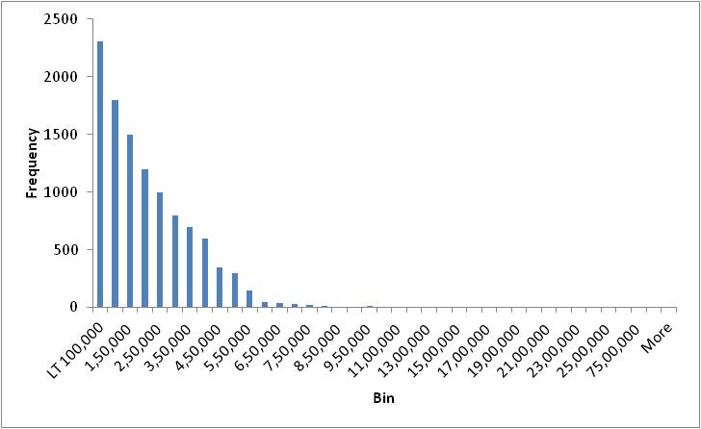
Threshold for large loss
Separate losses into attritional and large
Threshold is estimated separately for each risk band
Probability of claims greater than threshold is low
Large losses are low frequency-high severity
Attritional
Large Loss

Slide 16
Estimating large loss load
Statistical distribution fitted on large claim experience
Loss cost is typically simulated as a product of frequency and severity of large loss
Load over and above average is defined as a cost of raising capital
Extreme loss defined as per risk tolerance of company (say 1 in 20 years (95%VaR))
Cost of raising capital is assumed (say 20%)
Large loss load is allocated in risk categories

Slide 17
Agenda
Detariff Cycle & its evolution
Need for burning cost & its introduction
Challenges & next step
Challenges
GHI burning cost
Way forward
Notes:
17

Slide 18
Burning cost for GHI
Can industry wide loss cost per life per SI be collated?
Demography (Age, Gender)
Coverages (say maternity, PED etc)
Copay, deductibles and sublimits customized for each risk
Location (Tier I, Tier II; spread of lives in Tier I and Tier II)
Complex equation; numerous permutation and combination;
Per life risk rate not possible

Slide 19
Possible approach
Segment wise approach
One approach will not suit all types of policies
Burning cost methodology v/s standard risk rate
Rather than quantifying the burning cost, the approach to be adopted need to be agreed upon
Policies with GWP >25 Lacs
Standard methodology of burning cost to be agreed
Factors to be considered to be standardized (IBNR, O/S claims, medical inflation)
Policy level LR not to exceed threshold LR (recommended at 90%) incl IBNR
Reporting to board for deviation cases
Policies with GWP <25 Lacs
Portfolio level monitoring

Slide 20
Agenda
Detariff Cycle & its evolution
Need for burning cost & its introduction
Challenges & next step
GHI burning cost
Way forward
Way forward
Notes:
20

Slide 21
Way Forward
Pricing Mechanism for industry
Moving towards exposure based pricing from current burning cost approaches
Research papers on pricing
New dimension to price instead of base as tariff
Industry exposure curves

Slide 22
Thank You

