Slide 1
25th Indian Fellowship Seminar
CLIMATE CHANGE-
IMPACT ON AGRICULTURAL INSURANCE
Mentor - Saket Singhal
presented by
Amit Kumar Gupta
Sonam Bhatia
Balakrishnan S Iyer
Date: 9-10th June 2016, Mumbai
Indian Actuarial Profession
Serving the Cause of Public Interest

Slide 2
OUTLINE
Evidence of Climate change
Increase in Natural Disasters.
Changes in Precipitation.
Drought.
Impact of Climate Change on Developing Countries
Agricultural Production – Current and Forecast
Agricultural Insurance – Current insurance schemes
Pradhan Mantri Fasal Bima Yojana (PMFBY)
Pricing – Data sources and challenges
Reserve valuation and challenges
Pricing Considerations
Agricultural Insurance – Future Crops and Products
Conclusion
Appendix

Slide 3
IMPACT OF CLIMATE CHANGE
The Intergovernmental Panel on Climate Change (IPCC) is the leading international body for the assessment of climate change. It was established by the United Nations Environmental Programme and the World Metrological Organization in 1988. Currently 195 countries are Members of the IPCC.
IPCC committee have concluded in their recent study:
A “very high confidence” that anthropogenic activities such as fossil fuels burning and deforestation have affected the climate change.
Global average temperatures are expected to increase by another 1.1° to 5.4° by 2100.
Impact of this change:
Increase in sea level and total global precipitation over land.
Considerable warming of certain region.
Substantial changes in temporal and spatial distribution of precipitation.

Slide 4
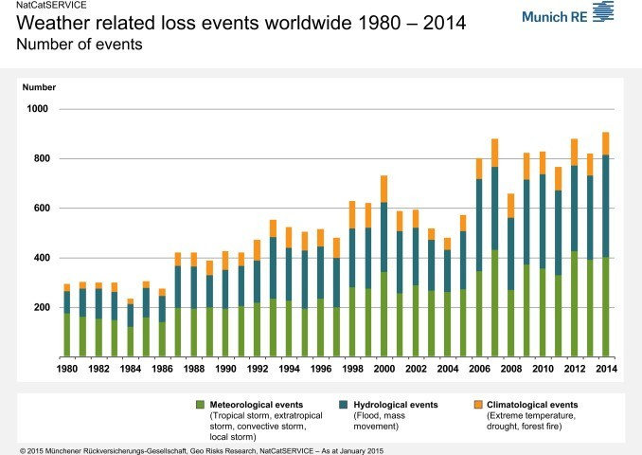
IMPACT OF CLIMATE CHANGE – Natural Disasters
The Munich Re NatCatSERVICE data on loss relevant natural disasters already show a strong upward trend in the last 30 years.

Slide 5
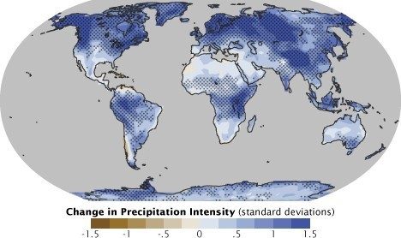
IMPACT OF CLIMATE CHANGE – Precipitation
Global climate change will affect the water cycle, likely creating perennial droughts in some areas and frequent floods in others.
One expected effect of climate change will be an increase in precipitation intensity: a larger proportion of rain will fall in a shorter amount of time than it has historically. Blue represents areas where climate models predict an increase in intensity by the end of the 21st century, brown represents a predicted decrease (Map adapted from the IPCC Fourth Assessment Report.).

Slide 6
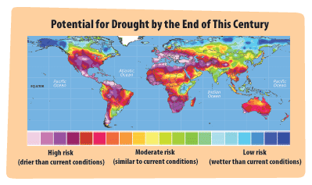
IMPACT OF CLIMATE CHANGE – Drought
Global climate change affects a variety of factors associated with drought. There is high confidence that increased temperatures will lead to more precipitation falling as rain rather than snow, earlier snow melt, and increased evaporation and transpiration. Thus the risk of hydrological and agricultural drought increases as temperatures rise.

Slide 7
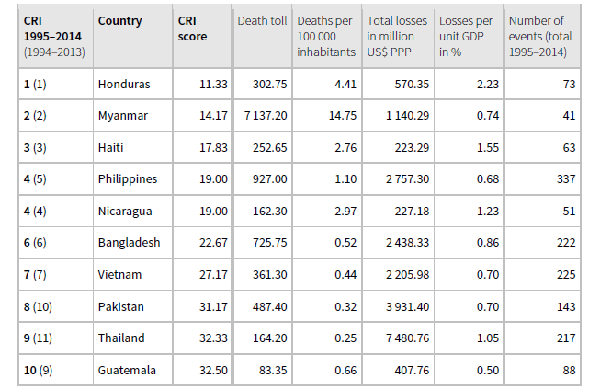
IMPACT OF CLIMATE CHANGE ON DEVELOPING COUNTRIES
The German Watch Climate Risk Index, which ranks the countries according to their extreme weather risks, shows that all countries in the top ten of this index are developing countries, led by Myanmar, Honduras and Haiti.
Long Term Climate Risk Index (CRI)

Slide 8
CLIMATE IMPACT ON AGRICULTURE
Climate Change will continue to have significant impact on agriculture, water resources, land resources and biodiversity in the 21st century as temperature extremes begin exceeding thresholds that harm crop growth more frequently and precipitation and runoff patterns continue to change.
Agricultural producers have always faced numerous production and price risks, but forecasts of more rapid changes in climatic conditions in the future have raised concerns that these risks will increase in the future relative to historical conditions. Some of the impact are:
More heat waves which will impact livestock, damage crops, and lead to an increase in bushfires.
Warmer conditions which will increase the likelihood of pests and diseases from tropical and sub-tropical region.
More intense and sporadic rainfall (including from tropical cyclones) which would increase flooding and associated loss of life, property and productivity. It would also affect soil erosion and pollution of rivers and oceans.

Slide 9
Agricultural Production – Current and Forecast
Agriculture Statistics | Current (15-16) | 5 year Plan ( Assumptions)
Total No Of Farmers | 263 million | 288 million*
Food Production | 257.04 million tons | 283 million tons*
Land Under Cultivation | 195.26 mil hectares | 195.26 mil hectares*
Contribution to GDP | US $259.5 Billion | US $450 Billion
The total no of farmers as total population ( 1.2 Billion) is 22%. Assuming the same share, the total farmers would be 288 million.
India has total gross cropped area of 195.26 million hectares in the country.
Food grain production is estimated at 257.04 million tones (MT) for 2015-16. Assuming the growth of 2% (assumed in 12th Five year Plan) total production reaches to 282 million tons.
The Indian economy is expected to reach at 3 Trillion Dollors in 2020. Assuming the current agriculture percentage contribution ( 15%) to GDP is same, the expected contribution should be $450 Billion.

Slide 10
Need for Crop Insurance in India
Agriculture plays a significant role in Indian economy as more than 50% of population is involved in or related to agricultural activities.
Indian agriculture is heavily dependent on rainfall as two thirds of the cultivated area has no irrigation. The abnormal behavior of monsoon may cause natural disasters such as scarcity conditions or drought, floods, etc.
On an average 12 million hectares of crop area is affected annually by these calamities severely impacting the yields and total agricultural production.
Crop insurance act as a means of protecting farmers against the variations in yield resulting from uncertainty of practically all natural factors beyond their control such as rainfall (drought or excess rainfall), flood, hails, other weather variables (temperature, sunlight, wind), pest infestation, etc.

Slide 11
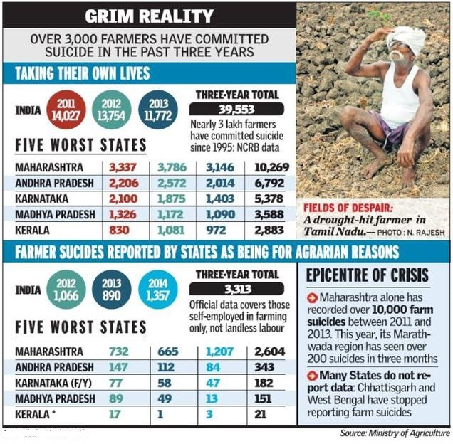
Farmers Condition in India

Slide 12
AGRICULTURAL INSURANCE – Insurance schemes
In existence since the past three decades
Each successive scheme tried to improve on the previous schemes’ shortcomings
Major schemes introduced by the Government of India
CCIS (Comprehensive Crop Insurance Scheme) - 1985
NAIS (National Agricultural Insurance Scheme) - 1999
WBCIS (Weather Based Crop Insurance Scheme) - 2007
MNAIS (Modified NAIS) - 2010
NCIP (National Crop Insurance Programme) - 2013

Slide 13
AGRICULTURAL INSURANCE – Current insurance schemes
Types of Crop Insurance available in India
Modified national agricultural scheme : MNAIS
Weather based crop insurance scheme : WBCIS
S.No | National Agricultural Insurance Schèmes (NAIS) | Weather Based Crop Insurance Scheme (WBCIS)
1 | Practically all risks covered (drought, excess rainfall, flood, hail, pest infestation, etc.) | Parametric weather related risks like rainfall, frost, heat (temperature),humidity etc.) are covered. However, these parametric weather parameters appear to account for majority of crop losses
2 | Easy-to-design if historical yield data up to 10 years’ is available | Technical challenges in designing weather indices and also correlating weather indices with yield losses. Needs upto 25 years’ historical weather data
3 | High basis risk [difference between the yield of the Area (Block / Tehsil) and the individual farmers] | Basis risk with regard to weather could be high for rainfall and moderate for others like frost, heat, humidity etc.
4 | Objectivity and transparency is relatively less | Objectivity and transparency is relatively high
5 | Quality losses are beyond consideration | Quality losses to some extent gets reflected through weather index
6 | High loss assessment costs (crop cutting experiments) | No loss assessment costs
7 | Delays in claims settlement | Faster claims settlement
8 | Government’s financial liabilities are open ended, as it supports the claims subsidy | Government’s financial liabilities could be budgeted up-front and close ended, as it supports the premium subsidy.

Slide 14
AGRICULTURAL INSURANCE – Pradhan Mantri Fasal Bima Yojana (PMFBY)
Objectives of PMFBY
To provide insurance coverage and financial support to the farmers in the event of failure of any of the notified crop as a result of natural calamities, pests & diseases.
To stabilise the income of farmers to ensure their continuance in farming.
To encourage farmers to adopt innovative and modern agricultural practices.
To ensure flow of credit to the agriculture sector.

Slide 15
AGRICULTURAL INSURANCE – Pradhan Mantri Fasal Bima Yojana (PMFBY)
Key features of PMFBY:
The government has launched new crop insurance scheme - Pradhan Mantri Fasal Bima Yojana which will replace the existing crop insurance schemes both MNAIS and NAIS.
PMFBY will increase the insurance coverage to 50 per cent of the total crop area of 194.40 million hectare from the existing level of about 25—27 per cent crop area.
Actuarial premium based scheme with provision for upfront premium subsidy to be released to insurance companies
The farmer share of premium- One Season One Rate
Kharif 2%
Rabi 1.5%
ACH 5%
The gap between the actuarial premiums and the rates payable by farmers would be fully met by the government. There is no upward limit on government subsidy.

Slide 16
AGRICULTURAL INSURANCE – Pradhan Mantri Fasal Bima Yojana (PMFBY)
Sum insured same for both loanee and non-loanee farmers and equal to Scale of Finance fixed by DLTC and no other mechanism to be accepted.
The SI will be calculated by multiplying the MSP of a crop with the average seven-year ‘threshold’ yield (excluding calamity years) for the particular village panchayat area where it is grown.
No provision on capping of premium rates and reduction in sum insured - farmer to get full claim amount upto S.I.
Implemented through Insurance Agents (Companies)
Allocation of districts on cluster basis to IA through transparent bidding process where the clusters are based on variable risk profile of states.
IA’s to be assigned for 3 years.
Coverage period to be the same for loanee and non-loanee farmers.

Slide 17
AGRICULTURAL INSURANCE – Risks Covered
YIELD LOSSES (standing crops, on notified area basis): Comprehensive risk insurance is provided to cover yield losses due to non-preventable risks, such as
(i) Natural Fire and Lightning
(ii) Storm, Hailstorm, Cyclone, Typhoon, Tempest, Hurricane, Tornado etc.
(iii) Flood, Inundation and Landslide
(iv) Drought, Dry spells
(v) Pests/ Diseases etc.
PREVENTED SOWING (on notified area basis): In cases where majority of the insured farmers of a notified area, having intent to sow/plant and incurred expenditure for the purpose, are prevented from sowing/planting the insured crop due to adverse weather conditions, shall be eligible for indemnity claims up to a maximum of 25% of the sum-insured.
POST-HARVEST LOSSES (individual farm basis) Coverage is available up to a maximum period of 14 days from harvesting for those crops which are kept in “cut & spread” condition to dry in the field after harvesting, against specific perils of cyclone / cyclonic rains, unseasonal rains throughout the country.
LOCALISED CALAMITIES (individual farm basis):Loss / damage resulting from occurrence of identified localized risks i.e. hailstorm, landslide, and Inundation affecting isolated farms in the notified area.

Slide 18
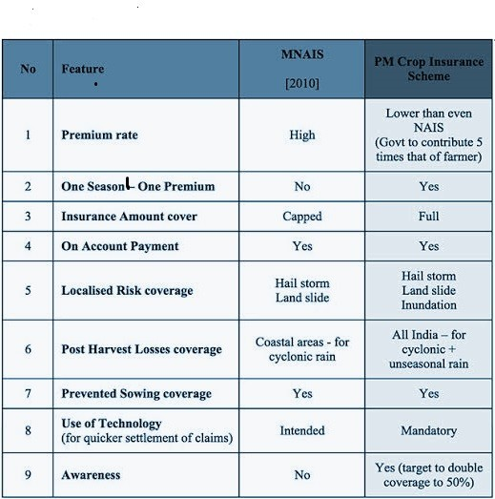
Pradhan Mantri Fasal Bima Yojana (PMFBY) and current ongoing crop insurance schemes

Slide 19
Crop Insurance – Pricing
For selecting the actuarial premium rates, volatility of the actual yield is assessed based on yields observed in the past for different crops and season and data provided by the State Government.
The premium is arrived at on the basis of Loss Cost (LC) i.e. Claims as % of Sum Insured (SI) observed in case of the notified crop(s) in notified unit area of insurance during the preceding 10 similar crop seasons (Kharif / Rabi)
Regression techniques to regress the yield against many factors including weather based parameters
Weather based insurance – dependency between weather parameters and yields – multivariate distributions, flexible time series model, copulas and regression modelling
Allocation of districts on cluster basis to IAs through transparent bidding
Cluster to be formed –based on variable risk profile of states
Expenses towards management including capital cost and insurer’s margin.

Slide 20
Crop Insurance – Data sources
Scale of Finance determined by District Level technical Committee for determining sum insured
Yield data by the State Government for crops and areas notified is provided to the Insurance companies.
The yield is calculated based on CCEs conducted. This forms basis of pricing for the insurance companies and companies are provided complete access to CCEs for determining actuarial rates
CCEs conducted for per area per crop and provides yield information
Where CCEs are not conducted, other alternatives can be used
Yield estimates also provided at IU level by State Government
Normalized Difference Vegetation Index and satellite imagery products can be used to estimate the yields
RST and Drone for rationalization of CCEs
Mobile phones and other technology for CCEs
Data from weather stations, ARG and CCEs

Slide 21
Crop Insurance – Issues and challenges
Climate is changing continuously and is unpredictable
No sophisticated statistical models or tools to calculate yields from the various climatic changes and resultant parameters
Less innovation in product features for changing climate as compared to improvements in other countries
CCEs do not capture systemic risks
Accurate trending of historical yields
Reliability of the yields as yields are prone to manipulation risks: Farmers tend to report lower yields in low yield scenarios
Financial illiteracy among the farmers about product design
Enough training to conduct CCEs
Complex product design
Actuarial rates in absence of less or accurate data
Reliability and validation of yields from CCE and Weather stations
Basis Risk for weather based insurance
Spatial correlation modelling
Moral hazard and adverse selection

Slide 22
Crop Insurance – Reserve valuations and challenges
Short tailed classes
Claims paid and settled quickly – within 45 days for weather based insurance
One year delay for crop insurance due to CCEs.
Loss ratios for estimation of reserves determined by the pricing team
Case by case analysis or grouping of risks by crop and season
Use of forecasted yield to calculate the expected indemnity and loss distribution
Standard development methods for grouped risks. Analysis by month or quarters as the losses are short tailed
Not enough data for all the crops for reliable analysis
Adequate trending for forecasting claim payments. The loss experience is very volatile:
Changes in the agricultural production over the last few years due to climatic changes
Increased awareness among the farmers

Slide 23
Product design & Pricing considerations…
State wise calendar- staggered launches
Bidding process and changes in the process
Scheme details: PMFBY,WBCIS, MNAIS)
By crops (kharif, rabi , horticultural)
By clusters of districts within states
Crop under consideration
Perils to be covered
Prior experience
Data- procurement of weather data, (relevance, adjustments etc)
Pay out calculation on the basis of historical data , index designed and trigger setting
Mapping of key areas in district for installation of AWS
Detailed study of crop and crop cycle on the basis of primary and secondary data

Slide 24
Product design & Pricing considerations…
Implementing agency (IA)- responsibilities
Advertising/marketing
Education programmes to increase customer engagement
Verification of data and costs
Cost of capturing the data and integration with systems
Transmitting data to the crop insurance portal; associated costs.
Co-ordination with the government agencies
Administrative costs
Manpower costs
Claims management and associated costs
Reinsurance
Retention limits
Mandatory reinsurance
Commissions, data sharing and costs
Extensions in cover
Type of treaty required in the context of risk profile.
Receipt of the premium subsidy
Impact on solvency

Slide 25
Product design & Pricing considerations…
Claims
Likelihood of frauds and fraud management
Other factors
Prior experience in administration of the scheme
Ability to execute in more than one states, associated infrastructure
Advances in technology (Drones, GPS, RST)
Advancements in fertiliser treatments, seed & crop enhancements
Crop Policy administration by the state and centre
Initiatives for the farmers
Competition
Changes in the irrigation system
Receipt of the premium subsidy
Impact on solvency
Profit margin
On the risk attitude of the company and competitive pressures

Slide 26
Agricultural Insurance…Future Crops & product Development
Future Crops
Provide crops that are more resilient to climate shocks and can yield on soils that are marginal for major commodity crops.
Diversification also provides opportunities to use non-food crops that grow in marginal environments as sources for animal feeds and biomaterials.
Genetically modified crops
Change in cultivation and harvesting methods.
Toxic Crops - undergoing mutations as adaption to climate change
May increase the scope of the coverage or the product.
(Extreme climate increasing level of toxins in crops: Study Nairobi: REUTERS)
Under normal conditions, plants convert nitrates they absorb into nutritious amino acids and proteins. But prolonged drought slows or prevents this conversion, leading to more potentially problematic nitrate accumulating in the plant, the report said. If people eat too much nitrate, it can interfere with the ability of red blood cells to transport oxygen in the body .
Some drought-stressed crops like cassava, flax, maize and sorghum plants, when then exposed to sudden large amounts of rain that lead to rapid growth, in turn accumulate hydrogen cyanide, more commonly known as prussic acid.

Slide 27
Agricultural Insurance…Changes in the future operating environment
Initiative by the Government
Steps have been taken to improve soil fertility on a sustainable basis through the soil health card scheme.
Support the organic farming scheme ‘Paramparagat Krishi Vikas Yojana’
Improved access to irrigation through ‘Pradhanmantri Gram Sinchai Yojana’.
Enhanced water efficiency through `Per Drop More Crop.
Rs 5300/- cr allocated towards micro irrigation, watershed development and ‘Pradhan Mantri Krishi Sinchai Yojana’;
The state governments are compelled to allocate adequate funds to develop the agriculture sector, take measures to achieve the targeted agricultural growth rate and address the problems of farmers.
Agreements with 63 countries would provide better agricultural facilities in areas such as research and development, capacity building, germ-plasm exchange, post-harvest management, value addition/food processing, plant protection, animal husbandry, dairy and fisheries.
Govt has allocated Rs 25,000 crore (US$ 3.9 billion) for the Rural Infrastructure Development Fund (RIFD), Rs 1,500 crore (US$ 231 million) for the long-term rural credit fund, Rs 45,000 crore (US$ 6.93 billion) for the short-term cooperative rural credit finance fund and Rs 25,000 crore (US$ 3.85 billion) for the short-term Regional rural bank (RRB) refinance fund.

Slide 28
Agricultural Insurance…Conclusion
Steps taken by the govt to increase penetration
Integration of the data between stakeholders
Dissemination of information to the farmers in a transparent manner
Use of latest technology both in claim assessment as well as information to the farmers
Claim payments in time directly to the beneficiary
Subsidy disbursal time improved
Better statistics available.
Improved rural infrastructure
Improved irrigation systems.
Improved agricultural techniques as well as genetically modified seeds
Better resources available and hence actuaries better informed to do pricing and reserving for agricultural insurance.

Slide 30
APPENDIX

Slide 31
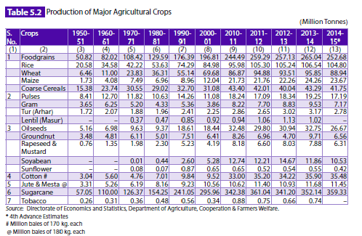
Agricultural Insurance… Major agricultural crops

Slide 32
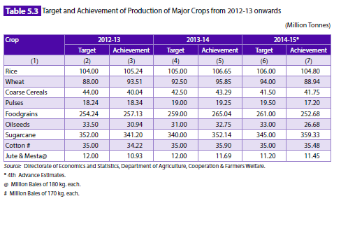
Agricultural Insurance… Major agricultural crops

Slide 33
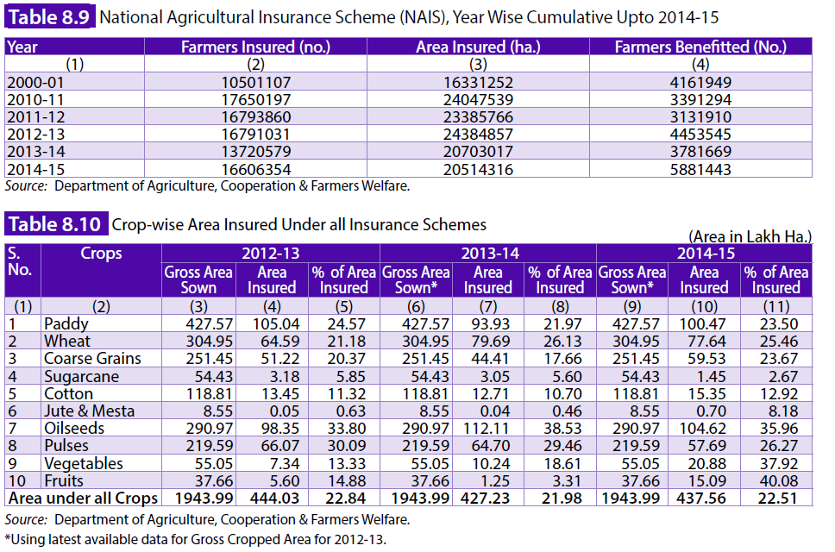
Agricultural Insurance… Major agricultural crops

