Slide 1
24th India Fellowship Seminar
Treatment of Lapse Profits sitting in the Asset Share / FFA of with-profit policies
By - Abhishek Patodia, Anupam Biswas, Hemant Kumar (Group 4)
Guide : Ajay Kumar Chaturvedi
10th December 2015
Mumbai
Indian Actuarial Profession
Serving the Cause of Public Interest

Slide 2
Agenda
Introduction
Treatment of Lapse profit
Professional & Regulatory Framework
Market Practice
Summary & Conclusion

Slide 3
Introduction – Important definitions
What is With-Profit (Par) contract:
Contracts which participates in the surplus (profits) during the term of the policy.
IRDAI (Actuarial Report and Abstract) Regulations, 2000 defines par policies as “policies with participation in profits” means policies which are not non-par policies” as defined under the relevant clause of the regulation.
Defining Asset Share:
Accumulation of:
Premium plus Investment Income
Benefit Outgo plus Commission plus Expense plus Tax plus SH Transfer plus COC & COG plus Misc
GN6 definition: “An asset share for a policy grouping at a given point in time is the accumulation of the premiums received plus investment income earned from the inception of the policies, less deductions due to benefit payments, commission, expenses, tax, a reasonable cost of capital and of guarantees, contribution from miscellaneous surplus (if considered appropriate) and transfers to shareholders”.
The above definition doesn’t explicitly capture surrender profit, hence it may be deemed that its treatment is open for interpretation.

Slide 4
Introduction – Important definitions
Defining FFA:
For with-profit contracts FFA is also commonly known as Estate
IRDAI (Preparation of Financial Statements and Auditor’s Report of Insurance Companies) Regulations, 2002 defines FFA as “The FFA shall represent all funds, the allocation of which, either to the policyholders or to the shareholders, has not been determined by the end of the financial year”.
Estate in a par fund represents the undistributed surplus in with-profit fund.
Regulatory Consideration in Distribution of Surplus (Profit):
Distribution of surplus for life insurance companies in India is governed by IRDAI (Distribution of Surplus) Regulations, 2002.
Section 4(b) of the Regulation prescribes the maximum allocation to shareholders to the extent of “one-ninth of the surplus allocated to policyholders in case of a life fund maintained for participating policyholders”

Slide 5
Introduction - Lapse as a source of Surplus (Profit)
Typical Sources of surplus (profit):
Bonus loading
Investment return
Expenses
Mortality
Lapse (termination)
Surplus from other contracts (if any)
One-off or miscellaneous
What is Lapse Profit?
Lapse profit can be defined as Asset Share of a policy less the benefit paid to policyholder upon termination by lapse or surrender.
How Lapse Profit arises?
Companies generally pay lesser than the earned asset share of the policy, because:
Asset Share calculation is a recent phenomena
Intentional – to protect the insurer against adverse market movement
Lapse profit primarily arises due to
poor customer retention
practical challenges of having to calculate the asset share frequently at a policy level,

Slide 6
Possible Approaches of Lapse Profit Allocation
Possible Approaches
Credited to Asset share
Credited to FFA/Estate
Cash flow addition to Asset Share
Addition via investment return
Approaches:
Credited to Asset Share
- Cash flow method
- via Investment Return
Credited to Estate / FFA

Slide 7
Considerations - Credit to Asset Share
Which policyholders? Same cohort or all remaining policyholders?
Regard to Policyholders’ Reasonable Expectation (PRE) and past practices
Bonus Philosophy of the company – Form and Method of distribution of surplus
Communication to Policyholders in the form of Benefit Illustration and/or Customer friendly PPFM
Uncertain nature of Lapse Profit
Competitive consideration
Administrative and system readiness

Slide 8
Considerations - Credited to FFA / Estate
Reasons for crediting to FFA
1. Regulatory Capital Support
2. Provides investment freedom
3. Absorbing expense overrun of the par fund to the extent not charged to Asset Share
Consideration
1. Past practice and PRE
2. Solvency Ratio
3. Reattribution of estate
Eventually all/part of lapse profit will flow to asset share….

Slide 9
Professional Consideration - APS 1
Appointed Actuary must ensure the following:
business in conducted on sound financial lines
ratio of ASM to RSM is reasonable
On PRE
On Surplus
advise the company on surplus distribution
he/she has regards to PRE
appropriate and equitable treatment of the policyholders
company appreciates the implication of any big change on PRE
new policyholders are not mislead with respect to their expectation
ensure compliance with Section 49 of the Act
advise the company whether PRE is met or not and the distribution is sustainable or not

Slide 10
Professional Consideration – GN6
Appointed Actuary must consider the following:
grouping of policies for determination of asset share and bonus
such grouping should not materially advantage one group of policyholders at expense of another
Treatment of surrender surplus
Addition to Asset Share
Where the asset share is to include the impact of surrender profits, the Appointed Actuary should consider whether to explicitly or implicitly (for example by artificially adjusting the investment return) allow for the surrender profits when carrying out the calculations.
Whether and to what extent surrender surpluses are being used to support the payouts to policyholders who hold their policies for longer.
Appointed Actuary should consider if the method of surplus distribution, either reversionary or terminal bonus, is well-matched to the source of surplus.
Approach adopted is fair and appropriate and that a consistent method is adopted from year to year.
Appointed Actuary should document the company’s approach to and treatment of each of the items of surplus or deficit

Slide 11
Regulatory consideration - Insurance Regulatory and Development Authority (Non-Linked Insurance Products) Regulations, 2013
Relevant Sections
35 (i) The special surrender value shall represent the asset share in case of the par policies, where the asset share shall be determined in accordance with the guidance or practice standards issued by the Institute of Actuaries of India.
45 (c) The detailed working of the asset share, the expensed allowed for, the investment income earned on the fund etc which are represented in the asset share shall be approved by a with profits committee.
Increasing governance framework around par business – may reduce the surrender surplus in future – increasing persistency is the key

Slide 12
Suitable Approach?
Is one approach more suitable than another?
Even if lapse profit is transferred to estate it may benefit policyholder in the form of higher investment return through greater investment flexibility, enhanced protection in terms of higher solvency margin etc.
Estate may ultimately get transferred to the policyholders in form of bonuses (one off or regular) than supported by Asset Shares
It may also depend on how increased per policy expenses are recouped? – Reference to GN6 and APS5
Charging to asset share
via estate
by shareholders
Benefit Illustration does not communicate asset share directly but implicitly yes through bonus rates.
There is no stopping from payment of say TB through transfer from estate.
Mixed practices observed in India

Slide 13
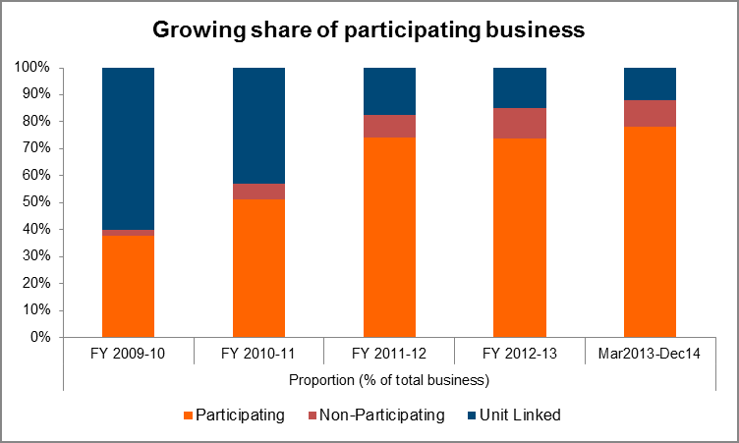
What’s the practice in Indian market?
Indian Par Business – Share
$
Share of par business grew from ~40% in 2010 to ~80% in 2014
Spurt in Par Business – a Recent phenomena
Why this pattern is emerging?
Calculation of Asset Shares – a recent phenomena. So challenges in allocation of profits and expenses
Evolving market - Building up of the Estate
New Companies-Expense overruns
Similar trend in allocation of other miscellaneous profits
$ Participating Business: Towards better governance and transparency by Milliman – 28 November 2014
# India Asset Share Survey by Milliman – 04 February 2014

Slide 14
What’s the practice in Indian market?
Indian Market
Industry in Nascent Stage - Industry opened up only 15 years back. Industry started focusing on with profits business only in last 5 years
Emergence of lapse profit is highly uncertain. Distributing it through regular bonuses may lead to unwarranted PRE.
A large proportion of insurers do not set the maximum deviation amount of maturity or surrender payments from Asset Share
Overall Trend – Asset share is not the sole criteria to set bonus and surrender values. Lapse Profits are held back to build up estate.

Slide 15
What’s the practice in UK market?
PPFM – A mandatory document for With Profits Business
Covers Treatment of Surrender Profits and other miscellaneous profits
Decision on the advice of With Profits Actuary and With Profit Committee
Investment Freedom
Smoothing Flexibility
Trend - Declining share of with profits business
~40% of new business in mid 80s to less than 10% in this decade
Most of the UK insurance companies have a contracting fund size
Hence treatment of estate and lapse profit sitting in it is an important issue

Slide 16
What’s the practice in UK market?
UK Market
If the Company has a Stable
With Profit Business
Profits from Surrenders are credited to the estate until credited back to the Asset Share but maintaining a sound Estate
Asset Share in excess of the sum assured and annual bonuses paid is distributed through final bonus – Subject to:
Smoothing and
Financial condition of the fund
If the Company has a Shrinking Fund
Declining with profits business
Estate size is greater than is required for shrinking size of the funds
Reattribution of the estate
Policyholders are offered cash bonuses in return for giving up their right to future distributions from the relevant estate

Slide 17
Summary & conclusion
We have detailed regulations on Par business, Calculation of Asset Share and distribution of profits between policyholders and shareholders
Indian Par Business – On a growth trajectory in recent past
Majority of the companies have started calculating Asset share only recently
Imbibe learnings from UK market. Cautious approach is required for treatment of Lapse Profits sitting in the estate. A prudent approach is required to distribute these profits in order to avoid building up of PRE.
Emergence of Lapse Profits are highly uncertain. Distribution of Lapse Profits through regular bonuses may lead to unwarranted PRE.
Eventually all lapse profits, presently being credited majorly to the Estate should flow back to the policyholder through attribution to Asset Share.
To enable the above
Strengthen governance – similar to PPFM
Periodic review of scope and functioning of With Profits Committee

Slide 18
Time for discussion

