Slide 1
39th India Fellowship Seminar
Date: 23rd-24th June 2023
Group 6: Health Insurance Product
Growth & Viability
Guide : Twinkle Agarwal
Presented By :
1. Priya Agarwal
2. Prachi Chemburkar
3. Sakshi Rawat
4. Charvi Ahuja

Slide 2
About our guide: Twinkle Agarwal
Twinkle is Consulting Actuary at Milliman India. She is a fellow from Institute of Actuaries of India (IAI) and Institute of Faculty of Actuaries (IFoA). She has over 6 years of experience across General, Life and Health insurance. Prior to this role she was Senior Actuary at Central Bank of UAE (CBUAE), Dubai where she has worked on various strategic projects.
www.actuariesindia.org

Slide 3
Agenda
Introduction
Case Study Overview
Financial Viability of Product
Risk Factors associated with Product
Questions?
Market Benchmarking and Competition Impact
Feasibility of Company’s Growth
www.actuariesindia.org

Slide 4
Agenda
Introduction
Case Study Overview
Financial Viability of Product
Risk Factors associated with Product
Questions?
Market Benchmarking and Competition Impact
Feasibility of Company’s Growth
www.actuariesindia.org

Slide 5
Case Study Overview
Company:
Wants to increase footprint in health insurance market
Currently has minor share
CDO has roped in one Web Aggregator.
Experience with the web aggregator has not been great for motor in the past.
Strategy to gain market share: Launch a very high sum insured health indemnity product at a very low price point with this Web Aggregator
Actuary (Self):
Recently joined as Appointed Actuary in medium size GI company
Previous experience as Pricing Actuary with leading GI company
worked on similar product in previous company with same web aggregator.
CEO has asked to analyse the proposal and recommend:
Feasibility of growth in health insurance segment if such product is created
Financial viability of such a product
Various risk factors associated with the product.
Market benchmarking and competition impact
www.actuariesindia.org

Slide 6
Agenda
Introduction
Case Study Overview
Financial Viability of Product
Risk Factors associated with Product
Questions?
Market Benchmarking and Competition Impact
Feasibility of Company’s Growth
www.actuariesindia.org

Slide 7
Feasibility of Company’s Growth
Will Proposition help achieve Target Growth & Market Share?
Health Insurance Market: Current
Health Insurance Market: Future
Preliminary Analysis
Challenges & Benefits
www.actuariesindia.org
Notes:
Medical Inflation: https://www.news18.com/business/how-medical-inflation-affects-your-health-insurance-premium-7354519.html
India’s current medical inflation rate is 14% – the highest amongst Asian countries in 2021. In 2023, a further 10% rise is foreseen
………………. increase in demand for healthcare services can be noted post COVID-19. These are further fueled by factors such as lifestyle changes, long-term diseases, the emergence of new ailments, and a higher rate of sudden sickness

Slide 8
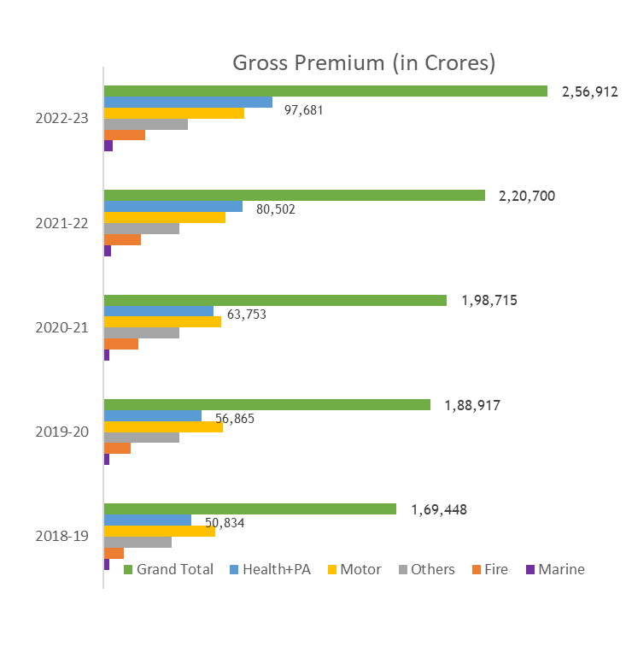
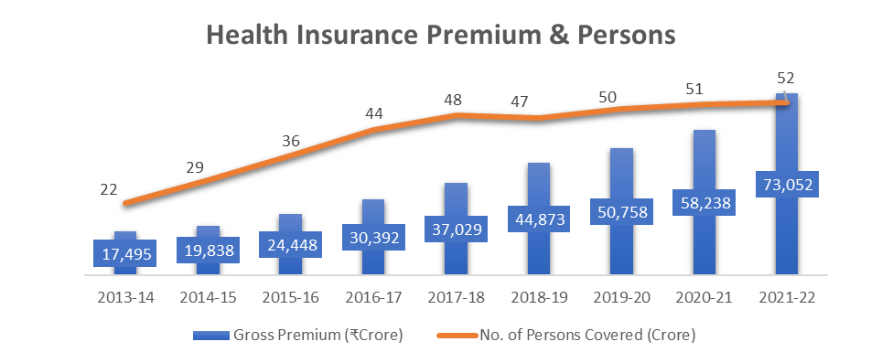
Feasibility of Company’s Growth
Health Insurance Market: Current
Contribution to Overall GI Premium
Increased from 30% in 2018-19 to 38% in 2022-23
Growth Rate
CAGR of last 5 years is 14.5%.
YoY growth of 2021-22 is 25%.
Persons covered has increased marginally by 1% in 2021-22.
Insurance Penetration is standing at 0.34% for General - health insurance and is quite low
Data Source: IRDAI Handbook Mar 22 and GI Council Segment Report Mar 23
www.actuariesindia.org

Slide 9
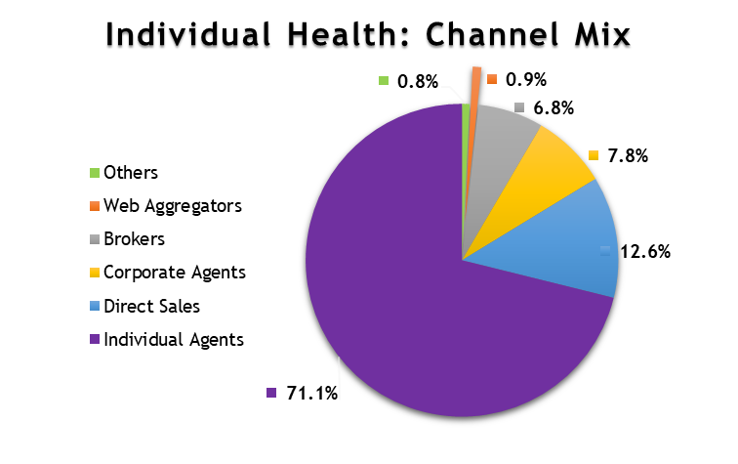
Feasibility of Company’s Growth
Health Insurance Market: Current
Only 0.9% of total individual health insurance premium comes from web aggregators.
High SI products are offered by competitors in market through Web Aggregators
such as above 50 lakhs
What is very high sum insured needs to be determined
How can web aggregator help us?
Display of Product Comparison
Transmission of Leads to us
Sale of Insurance Online
Sale of Insurance through Tele marketing and other distance methods
Source: IRDAI Annual Report Mar 22 and Web Aggregator Regulations, 2017
What does Insurance Web Aggregators Regulations say?
Website for potential customers to compare insurance products and premium of different insurers
No limit on the number of insurers.
Not allowed to display ratings, rankings, endorsements or best-sellers of insurance products
May be allowed to share leads to maximum 3 insurers
No fees for sharing leads but are entitled to remuneration when leads are converted into sale.
www.actuariesindia.org

Slide 10
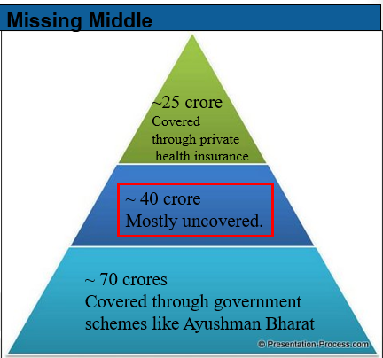
Feasibility of Company’s Growth
Health Insurance Market: Other Factors
Missing Middle
The ‘missing middle’ is a broad category which is positioned between the deprived poorer sections, and the relatively well-off organized sector.
The deprived and poor sections receive Government subsidized health insurance.
Relatively well-off in the organized sector of the economy are covered under social health insurance, or private voluntary insurance.
Missing middle compromises of 40 crore individuals that are devoid of any health protection.
Missing Middle
19%
30%
51%
Data Source: Niti Aayog Missing Middle Report
www.actuariesindia.org

Slide 11
Feasibility of Company’s Growth
Health Insurance Market: Future
Increasing realization of the need
In the wake of the pandemic, there has been greater concern and awareness about health, and enquiries about health insurance policies have increased by 30–40%
Increasing digitization
Increasing adoption of technology to advertise, sell, renew and claim insurance.
Uncertain Medical Inflation
Technological advancements, high demand, Covid and service costs are few factors that are leading to increasing inflation.
New Regulations
“Insurance for all by 2047” leading to newer regulations which are easing the way businesses are conducted.
Future
Trends
Increasing Realization
Increasing Digitization
New Regulations
Uncertain Medical Inflation
www.actuariesindia.org

Slide 12
Preliminary Analysis
APS 34
Questions?
Objective of the Company
Target Customers
Risk Appetite
Market Size, Demand and Competitor Study
Other strategies to achieve the target
Performance of Web Aggregator
Knowledge of Regulations
www.actuariesindia.org
www.actuariesindia.org

Slide 13
Challenges in Implementing the Proposal
Lack of Expertise/resources to enter new segment
Capital issues and high initial expenses.
Underwriting challenges when sold through web aggregator
Low price point may be attractive but not sustainable.
Expenses might exceed the limit specified in regulation.
Preference to buyers for high SI product.
Lower than expected conversion of leads.
www.actuariesindia.org

Slide 14
Benefits from Implementing the Proposal
Diversification
Reaching mass in significantly lower distribution expenses.
Affordability is a key barrier to health insurance. Hence, higher take up of the policy.
Competitive advantage.
Aggregator has wider knowledge base about the demand.
Appointed Actuary’s knowledge from previous experience.
www.actuariesindia.org

Slide 15
Agenda
Introduction
Case Study Overview
Financial Viability of Product
Risk Factors associated with Product
Questions?
Market Benchmarking and Competition Impact
Feasibility of Company’s Growth
www.actuariesindia.org

Slide 16
Financial Viability of Product
“Very high sum insured health indemnity product with very low price points”
Will Product be viable?
Regulations, Guidelines and APS
Initial Considerations
Pricing Considerations
Solvency Considerations
www.actuariesindia.org
Notes:
Medical Inflation: https://www.news18.com/business/how-medical-inflation-affects-your-health-insurance-premium-7354519.html
India’s current medical inflation rate is 14% – the highest amongst Asian countries in 2021. In 2023, a further 10% rise is foreseen
………………. increase in demand for healthcare services can be noted post COVID-19. These are further fueled by factors such as lifestyle changes, long-term diseases, the emergence of new ailments, and a higher rate of sudden sickness

Slide 17
Financial Viability of Product
Initial Considerations: Lower Risk => Low premium
Product Design
Underwriting Control
Claims Management
Sum Insured , Covers, Co-pay or deductible, exclusions, waiting periods, Wellness
Medical / Financial/ Lifestyle / Rating factors
Hospitals Tie-ups and Packages, Fraud control
Commissions & Expenses
Reinsurance Support & Cost
% or Premium or Fixed Amount per policy
Claim process and claim handling expenses
Stakeholders
Potential Customers
Insurer’s Philosophy
Underwriters
Claims Team
Operations & IT
Finance
Reinsurer
Regulator
Professional Body
Shareholders
General Economic and Commercial Environment
www.actuariesindia.org
Notes:
Medical Inflation: https://www.news18.com/business/how-medical-inflation-affects-your-health-insurance-premium-7354519.html
India’s current medical inflation rate is 14% – the highest amongst Asian countries in 2021. In 2023, a further 10% rise is foreseen
………………. increase in demand for healthcare services can be noted post COVID-19. These are further fueled by factors such as lifestyle changes, long-term diseases, the emergence of new ailments, and a higher rate of sudden sickness

Slide 18
Financial Viability of Product
Pricing Consideration:
Data
Own Data/ Alternate Data
Data credibility, reliability and relevance
Burn Cost
Frequency, Severity and Burn Cost (GLM)
Commissions, expenses, Profit margin
Curve Fit
Office Premium
Data adjustments
IBNR, future medical inflation and trends
Long Covid effects / cover changes
extrapolate Burn Cost of higher Sum Insureds
Reinsurance cost and Margin for Adverse Deviation
Premium once filed and launched cannot be changed frequently. Hence product must be viable over long term.
Premium once filed and launched cannot be changed frequently. Hence product must be viable over long term.
www.actuariesindia.org
Notes:
Medical Inflation: https://www.news18.com/business/how-medical-inflation-affects-your-health-insurance-premium-7354519.html
India’s current medical inflation rate is 14% – the highest amongst Asian countries in 2021. In 2023, a further 10% rise is foreseen
………………. increase in demand for healthcare services can be noted post COVID-19. These are further fueled by factors such as lifestyle changes, long-term diseases, the emergence of new ailments, and a higher rate of sudden sickness

Slide 19
Financial Viability of Product
Capital & Solvency Consideration:
Solvency
Required
Projected solvency must be more than 150% as prescribed by ALSM Regulation,2016 or company’s internal target at all times
Current Status
Current level of capital and solvency ratio
Future Solvency
Business projections for next three years
Sensitivity &
Stress Test
Sensitivity test key assumptions like inflation, frequency, severity, target loss ratio, expense load
Impact on future RSM and solvency ratio
Stress test adverse or extreme scenarios
Additional Capital requirement
Higher Risk => Higher Return
Return on Equity
Additional Capital Required
Availability of Capital
www.actuariesindia.org
Notes:
Medical Inflation: https://www.news18.com/business/how-medical-inflation-affects-your-health-insurance-premium-7354519.html
India’s current medical inflation rate is 14% – the highest amongst Asian countries in 2021. In 2023, a further 10% rise is foreseen
………………. increase in demand for healthcare services can be noted post COVID-19. These are further fueled by factors such as lifestyle changes, long-term diseases, the emergence of new ailments, and a higher rate of sudden sickness

Slide 20
Financial Viability of Product
Regulations, Guidelines & APS
IRDAI (Appointed Actuary) Regulations
APS 21: Appointed Actuary and General Insurance Business
IRDAI (Health Insurance) Regulations
Consolidated Guidelines on Product filing in Health Insurance Business
www.actuariesindia.org
Notes:
Medical Inflation: https://www.news18.com/business/how-medical-inflation-affects-your-health-insurance-premium-7354519.html
India’s current medical inflation rate is 14% – the highest amongst Asian countries in 2021. In 2023, a further 10% rise is foreseen
………………. increase in demand for healthcare services can be noted post COVID-19. These are further fueled by factors such as lifestyle changes, long-term diseases, the emergence of new ailments, and a higher rate of sudden sickness

Slide 21
Financial Viability of Product
Appointed Actuary Regulations,2022: (Duties and Obligations)
…Advice in the areas of product design and pricing, insurance contract wording, …….
….Reporting to Board material concerns which may adversely affect the solvency …..
Ensuring overall pricing policy is in line with the overall underwriting and claims management policy
Ensuring that the premium rates are fair
Health Insurance Regulations, 2016
Premium based on, Age and Other relevant risk factors…..
The premiums filed shall ordinarily be not changed for a period of three years after a product has been cleared in accordance to the product filing guidelines specified by the Authority. ………..
IRDAI Health Insurance Guidelines
Pricing is fair to the customers and the product is viable and self-sustainable for the Insurer
Pricing shall be based on appropriate and reliable data.
APS 21: Appointed Actuary and General Insurance Business
premium rates are fair, i.e., neither excessive nor inadequate.
Judgment based on use of sound techniques and consider product mix, claim costs, LAE…..
analyse insurer’s own claims experience and, where possible, compare it with the industry experience
be satisfied …………….the company will be able to meet the necessary reserves and solvency margin requirements from capital within the shareholders funds.
www.actuariesindia.org
Notes:
Medical Inflation: https://www.news18.com/business/how-medical-inflation-affects-your-health-insurance-premium-7354519.html
India’s current medical inflation rate is 14% – the highest amongst Asian countries in 2021. In 2023, a further 10% rise is foreseen
………………. increase in demand for healthcare services can be noted post COVID-19. These are further fueled by factors such as lifestyle changes, long-term diseases, the emergence of new ailments, and a higher rate of sudden sickness

Slide 22
Agenda
Introduction
Case Study Overview
Financial Viability of Product
Risk Factors associated with Product
Questions?
Market Benchmarking and Competition Impact
Feasibility of Company’s Growth
www.actuariesindia.org

Slide 23
Risk Factors Associated with Product
“Very high sum insured health indemnity product with very low price points”
What Risks do we face?
Product Proposition Risks
Web Aggregator Risks
www.actuariesindia.org
Notes:
Medical Inflation: https://www.news18.com/business/how-medical-inflation-affects-your-health-insurance-premium-7354519.html
India’s current medical inflation rate is 14% – the highest amongst Asian countries in 2021. In 2023, a further 10% rise is foreseen
………………. increase in demand for healthcare services can be noted post COVID-19. These are further fueled by factors such as lifestyle changes, long-term diseases, the emergence of new ailments, and a higher rate of sudden sickness

Slide 24
Risk Factors associated with Product
Pricing Risk
Other Underwriting Risk
Policy design & wordings, are we targeting the “Missing middle”?
Alternative data not a good representative of risk
Health insurance regulation, 2016 states that filled rates may not change for the period of 3 years
Underwriting guidelines may not allow the company to sell such high sum insured product without a significant level of scrutiny
Low price point may be attractive but not sustainable
Lower conversion rates
Risk of accumulation
lack of personal touch, web aggregator not a first choice of customers
Inadequate prices - inappropriate model design, assumptions & Parameters
Product Proposition Risks (1/3)
Business Risk
Underwriting Risk
Insurance & Exposure Risk
Unfavourable claims experience, Lower profitability
Proposed health product’s alignment to the company’s long term and short term strategies
increase in capital requirements
Expense of management might exceed the limit of 30%
High sum insured (>=10lakh) not within the risk appetite of shareholders
www.actuariesindia.org

Slide 25
Risk Factors associated with Product
Product Proposition Risks (2/3)
Other Risk
Operational Risk
Lack of adequate support available to appointed actuary within the organization
Technological Risk
Increase digitization, bringing new challenges
Cyber Risk
Errors in company’s own data or alternative data
Prone to Anti selection & Fraud risk
Insufficient tie ups with good hospitals
Hospitals providing lower package discounts due to minor market share
Capturing of good quality data
Reliance on various devices. E.g. - Wearables
www.actuariesindia.org

Slide 26
Risk Factors associated with Product
Product Proposition Risks (3/3)
Other Risk
Reinsurance Risk
Revision of Reinsurance strategies
External Risk
Competition already selling policies with high sum insured such as above 50 lakhs
Rise in medical inflation due to technological advancements
New reinsurance cover Requirements
Insurance disruptors e.g. new age insurance players, AI, machine learning etc
After effects of Covid-19 still unpredictable
Reputation & Brand image
Climate change
www.actuariesindia.org

Slide 27
Risk Factors associated with Product
Web Aggregator Risks (1/2)
In FY 2022, web aggregator has only contributed to approximately 0.9% of the entire health insurance business in terms of GWP. While 98.3% of the business still comes through Individual & Corporate agents, Direct sales (Excluding online) & Brokers.
Individual agents alone contributes to 71.1% of the business, this indicates that people still prefers buying health policy with human touch.
An emerging trend has been observed amongst youngsters (40% of India population) in purchasing health insurance through online platform. Young population may not require such high level of sum insured.
Prior to proceeding with the partnership with web aggregator, risk & return analysis would be recommended.
www.actuariesindia.org

Slide 28
Risk Factors associated with Product
Web Aggregator Risks: Bima Sugam impact (2/2)
Additional use like providing data to insurance company and helps in claims servicing
Favourable fee structure, as it is backed by IRDAI
Attract better volume of business
What is Bima Sugam?
Benefits of using Bima Sugam as compared to traditional web aggregators
It’s an online platform introduced by IRDAI, “One stop shop” for all insurance needs
Insurance companies can use platform as data bank and it will promote transparency & accountability amongst the insurance industry
facilitate servicing of claims for insurance policy
Proposed fee structure: Fee would be charged on every transaction (Sale, renewal, claims and enquiries)
www.actuariesindia.org

Slide 29
Agenda
Introduction
Case Study Overview
Financial Viability of Product
Risk Factors associated with Product
Questions?
Market Benchmarking and Competition Impact
Feasibility of Company’s Growth
www.actuariesindia.org

Slide 30
Market Benchmarking & Competition Impact
“Very high sum insured health indemnity product with very low price points”
Who is doing what and what can we do?
Market Benchmarking
Competition Impact
Final Recommendation
www.actuariesindia.org

Slide 31
Market Benchmarking
Components considered for Benchmarking
Market Share of insurance companies underwriting health insurance
Distribution Channel Analysis of Standalone health insurers
Key Parameters of leading insurance companies underwriting health insurance
Comparison of similar products offered by other insurers
www.actuariesindia.org
Notes:
Medical Inflation: https://www.news18.com/business/how-medical-inflation-affects-your-health-insurance-premium-7354519.html
India’s current medical inflation rate is 14% – the highest amongst Asian countries in 2021. In 2023, a further 10% rise is foreseen
………………. increase in demand for healthcare services can be noted post COVID-19. These are further fueled by factors such as lifestyle changes, long-term diseases, the emergence of new ailments, and a higher rate of sudden sickness

Slide 32
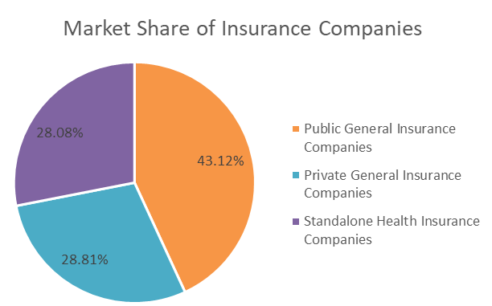
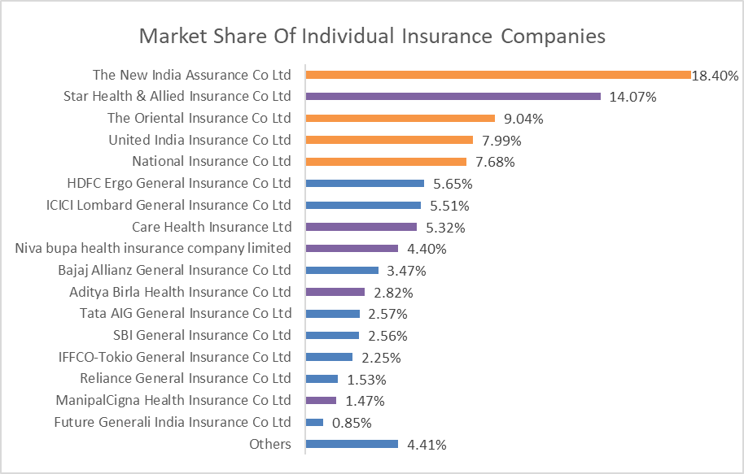
Market Benchmarking
Market Share of Insurance Companies underwriting health insurance
For the FY 2022-23 , Public General insurance companies contribute the maximum i.e. 43% of the total Gross Direct Premium underwritten for health portfolio in India.
Lead Players are as below with market share:
PSU: New India: 18%.
SAHI: Star Health: 14%.
GI: HDFC Ergo and ICICI Lombard: 5%
Source: Segment-wise report up to Mar23 published by General Insurance Council

Slide 33
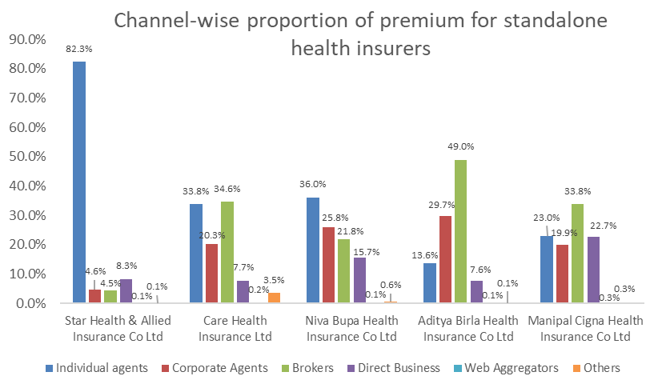
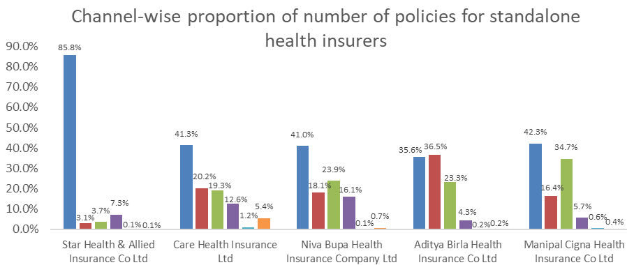
Market Benchmarking
Channel-wise Mix of Standalone health insurers
Individual agents, brokers and corporate agents contribute to the maximum business
Star which has almost 14% market share gets around 0.1% of its premium from web aggregators.
Web aggregator contributes less than 0.5% in term of premium as well as policies across SAHI companies.
Need to consider if Web-aggregator is right channel for growth.
Also, some sort of web aggregator benchmarking must be done in terms of number of visitors, quotes, leads, conversion, target segment etc.

Slide 34
Market Benchmarking
Key parameters of leading health insurers
Leading Insurance Companies in health insurance | Net retention ratio | Net commission ratio | EoM /NWP | Net Loss Ratio | COR
The New India Assurance Co Ltd | 89% | 5% | 19% | 103% | 122%
Star Health & Allied Insurance Co Ltd | 95% | 14% | 30% | 65% | 95%
United India Insurance Co Ltd | 94% | 3% | 41% | 90% | 131%
ICICI Lombard General Insurance Co Ltd | 84% | 1% | 34% | 74% | 108%
The Oriental Insurance Co Ltd | 96% | 4% | 43% | 123% | 166%
Care Health Insurance Co Ltd | 88% | 10% | 38% | 54% | 92%
HDFC Ergo General Insurance Co Ltd | 67% | 0.6% | 21% | 79% | 100%
National Insurance Co Ltd | 83% | 2% | 41% | 102% | 144%
Niva Bupa Health Insurance Co Ltd | 78% | 6% | 43% | 54% | 97%
Bajaj Allianz General insurance Co Ltd | 76% | 1.5% | 27% | 75% | 103%
For the FY 2022-23, the net retention ratio for the insurers varies depending upon the Reinsurance strategies and business mix.
The net commission ratio is a result of gross commissions and reinsurance strategy.
The Expense of management to Net Written Premium is in the range of approximately 20% to 40%.
The net loss ratio for health insurance business is very high, i.e. more than 90%.
Consequently, the combined ratio is also very high for health insurance business.
www.actuariesindia.org
www.actuariesindia.org

Slide 35
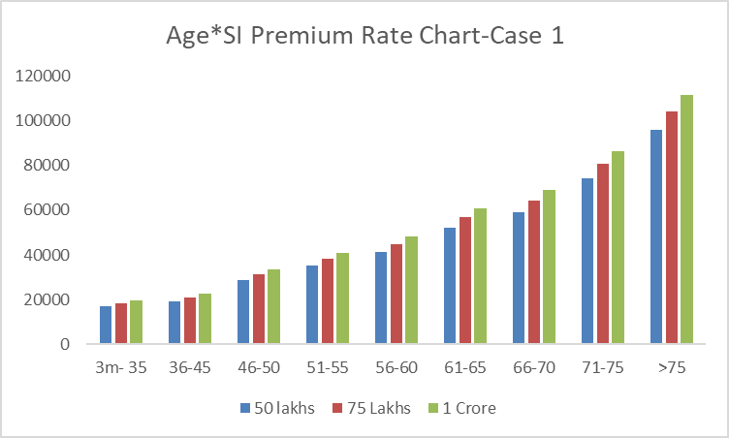
Market Benchmarking
Similar Product-Case Study 1:
Basic Coverage
Additional Coverage
USP
Hospitalization cover
Ambulance expenses
Pre and post hospitalization
OPD
Domiciliary hospitalization
Delivery and New Born
Out patient dental
Organ donor
Hospital cash
Health check up
Bariatric Surgery
AYUSH
Accidental death and permanent total disablement
Wellness Program
Buy back pre existing disease
Premium Rate Chart for 1A (Zone A)
Age Band / SI insured | 50 lakhs | 75 Lakhs | 1 Crore
3m- 35 | 16795 | 18225 | 19505
36-45 | 19380 | 21030 | 22505
46-50 | 28840 | 31295 | 33490
51-55 | 35355 | 38365 | 41055
56-60 | 41435 | 44960 | 48110
61-65 | 52315 | 56765 | 60740
66-70 | 59275 | 64315 | 68820
71-75 | 74425 | 80755 | 86410
>75 | 95900 | 104055 | 111340
Co-Pay: 10%
www.actuariesindia.org

Slide 36
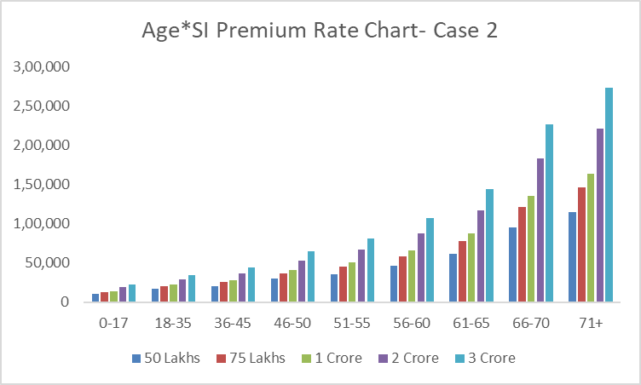
Market Benchmarking
Similar Product-Case Study 2:
Basic Coverage
Additional Coverage
Hospitalization cover
OPD Dental
Accidental Death
Maternity Cover
Pre and post hospitalization
First year vaccinations
Organ donor
OPD
Domiciliary hospitalization
Ambulance Cover
Hospital cash
Health check up
Bariatric Surgery
AYUSH
Reinstatement
Recharge
Premium Rate Chart for 1A (Zone A):
Age (in years) / SI | 50 Lakhs | 75 Lakhs | 1 Crore | 2 Crore | 3 Crore
0-17 | 10,467 | 12,688 | 14,198 | 18,791 | 22,984
18-35 | 17,218 | 20,685 | 22,681 | 29,136 | 34,942
36-45 | 20,056 | 25,377 | 28,119 | 36,413 | 43,727
46-50 | 29,804 | 36,379 | 40,510 | 53,217 | 64,529
51-55 | 35,964 | 45,015 | 50,323 | 66,685 | 81,314
56-60 | 46,801 | 58,532 | 65,454 | 87,139 | 1,06,626
61-65 | 61,092 | 77,767 | 87,135 | 1,17,174 | 1,44,354
66-70 | 94,680 | 1,20,700 | 1,35,113 | 1,82,519 | 2,25,984
71+ | 1,15,106 | 1,46,261 | 1,63,305 | 2,20,515 | 2,73,069
Co-Pay: Nil
www.actuariesindia.org
www.actuariesindia.org

Slide 37
Possible Impact due to Competition
Difficulty in Gaining market share
Loss ratio
Trade-off between profitability and market share
Underwriting, pricing and claims methodology
Expenses and Commissions
Hospital network
Reinsurance
www.actuariesindia.org
www.actuariesindia.org

Slide 38
Final Recommendation
Coverage benefits
Distribution Channel and Network
Target Market
Very High Sum Insured
Extensive Coverage
Additional features having low severity to attract customers
Web Aggregator
Number of Leads
Conversion Ratio
Hospital tie-ups and package rate
Missing Middle
Income Level
Occupation
Minimize Adverse selection
Reinsurance
Underwriting and Pricing
Ease of Claim Settlement
Quota Share + XOL
Technical Assistance in terms of underwriting, pricing, claims management.
Trade-off between profitability and market share
Low price point
Expenses & Commissions
AI enabled processing
Whatsapp intimation
Digital documentation
App based Claim intimation and tracking
We can also hire an external entity to do market benchmarking and web aggregator benchmarking
www.actuariesindia.org
www.actuariesindia.org

Slide 39
Agenda
Introduction
Case Study Overview
Financial Viability of Product
Risk Factors associated with Product
Questions?
Market Benchmarking and Competition Impact
Feasibility of Company’s Growth
www.actuariesindia.org

Slide 40
Thank You!
www.actuariesindia.org
www.actuariesindia.org

