Slide 1
39th India Fellowship Seminar
Date: 24th June 2023
General Insurance Professional
Guide: Ashok Kumar Lahoty
Presented By:
1. Christopher Clement
2. Lakshay Mody
3. Prathamesh Ghanekar
4. Rajesh Kumar

Slide 2
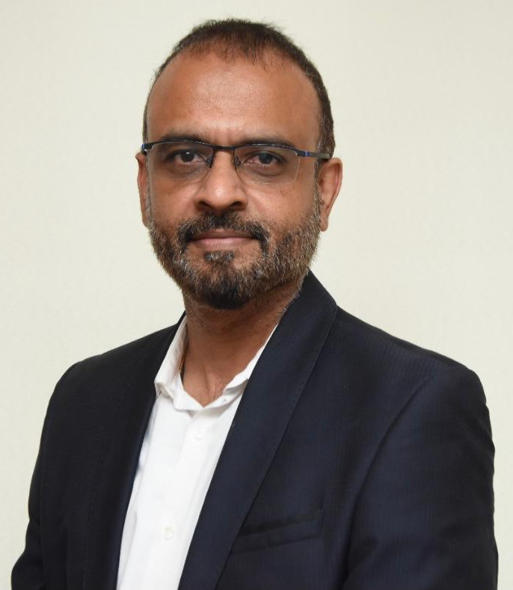
About the Guide
Mr. Ashok Kumar Lahoty is the Appointed Actuary at National Insurance Co Ltd
With more than 16 Years of experience in General Insurance, he brings diverse experience across multiple markets.
He has worked with several leading Insurers in India (IFFCO Tokio, Universal Sompo, Royal Sundaram, National Insurance) and renowned MNCs (WNS, JLT).
www.actuariesindia.org

Slide 3
Case Study (expansion)
General Insurance (GI) Actuary providing independent consulting services to the clients & holds Certificate of Practice (CoP) from Institute of Actuaries of India (IAI)
A Chartered Accountant (CA) who audits a large number of GI companies in Asia and Africa comes up with a proposal
The CA has built good relationship with the key management personnel in these companies
He would be able to influence the decision making given his relationship
He has proposed to help the Actuary to become consulting appointed/chief actuary in these companies for a fee of 10% which he needs for his efforts
Business would expand significantly if the Actuary accepts the proposal
What should the Actuary do?
www.actuariesindia.org

Slide 4
Agenda
Compliance
Competence and Care
Conflict of Interest
Integrity and Ethical Practice
Ways to expand business
Next Steps
www.actuariesindia.org

Slide 5
Compliance
www.actuariesindia.org

Slide 6
Compliance
What does various Acts, guidelines, professional conduct standards say about such situations?
Can fees be paid to non-members or non-partners for procuring business?
What is the right way to gain publicity for your work and expand your business?
Is Indian CoP valid in other countries?
www.actuariesindia.org
Notes:
As per this rule, the Actuary cannot pay any remuneration to the CA in question for the business brought in

Slide 7
Compliance
Actuaries Act, 2006 (Section 31, part 1)
Guilty of professional misconduct
by paying fees/commission to any person other than a member of the Institute or a partner
secures any professional business either through the services of a person who is not an employee of such Actuary or who is not qualified to be his partner
accepts an assignment as Actuary previously held by another Actuary without first communicating with him/her in writing
www.actuariesindia.org
Notes:
As per this rule, the Actuary cannot pay any remuneration to the CA in question for the business brought in

Slide 8
Compliance
Professional Code of Conduct
Work Outside India
Members working outside India are strongly encouraged to join the local actuarial body (PCS 1.5.1)
Is Indian CoP valid in the concerned country?
Confidentiality
Information acquired by Actuary in the course of professional work is frequently confidential to the client (PCS 3.1)
Any information governed by confidentiality should not normally be disclosed unless consent has been obtained from the client (PCS 3.1)
However, obliged to disclose confidential information, either by virtue of statutory or judicial authority or by virtue of other guidance by which the client is bound (PCS 3.2.1)
www.actuariesindia.org
Notes:
As per this rule, the Actuary cannot pay any remuneration to the CA in question for the business brought in

Slide 9
Compliance
Professional Code of Conduct
Professional standards
Clients are entitled to have absolute confidence in the skill, objectivity and integrity of the Actuary (PCS 2.3)
Publicity
Publicity leading to unjustified or unfair professional advantage (PCS 8.1)
An actuary must be able to substantiate in an objective manner the content of any publicity (PCS 8.2)
Above requirement applies particularly where the publicity could be taken as suggesting that for some reason it is preferable to obtain advice from the actuary, rather than from another actuary (PCS 8.2)
www.actuariesindia.org
Notes:
Actuaries act states conditions which can deem the actuary guilty of misconduct. As per this rule, the Actuary cannot pay any remuneration to the CA in question for the business brought in

Slide 10
Competence and Care
www.actuariesindia.org

Slide 11
Competence and Care
Competency
Appropriate level of knowledge
Skills to perform
Experience in the required domain of work
Engage in Continual Professional Development
www.actuariesindia.org

Slide 12
Competence and Care
Nature and scope of work
Role of the principal
Any limitations or constraints on the actuary
Any requirements that the actuary is required to satisfy
Expected cost
Communication
www.actuariesindia.org

Slide 13
Competence and Care
Resource Planning
Able to allocate sufficient time
Staffing
Access to client personnel
Access to information
Ability to communicate
www.actuariesindia.org

Slide 14
Competence and Care
Market and Industry knowledge
Nature of the business
Local laws and regulations
History of client
Processes of various department
www.actuariesindia.org

Slide 15
Competence and Care
Technical Considerations
Availability of sufficient and reliable data
Ability to validate data
Identify deficiencies in data
Choice of Assumptions and Methodology
Modelling approach
www.actuariesindia.org

Slide 16
Competence and Care
Communication
Form and Content
Clarity
Communicate within reasonable time period
Identify the issuing actuary
Disclosures
www.actuariesindia.org

Slide 17
Conflict of Interest
www.actuariesindia.org

Slide 18
Conflict of Interest
Non-Compromise on judgement and decisions:
PCS 6.1 - Actuaries must ensure that their professional judgement is not compromised, and is not seen to be compromised, by any bias, conflict of interest or the undue influence of others.
This could arise given the influence of the CA on the Company in question
www.actuariesindia.org

Slide 19
Conflict of Interest
PCS 6.2 - If there is or might appear to be a conflict of interest between two or more clients of an actuary or of the actuary's firm, or a conflict between a client and the actuary or the actuary's firm, the actuary must consider the nature and extent of the conflict and whether it is such as to make it improper for the actuary to provide actuarial services to one or more of the clients involved in the conflict.
PCS 6.3 - In the event of any such conflict or apparent conflict of interest, the client or clients involved must be notified at the earliest opportunity and if any actuarial services provided to a client is, or will be, influenced by interests other than those of that client or by any constraint other than that imposed by professional guidance or other guidance, this must be disclosed in the output of the actuarial services.
www.actuariesindia.org

Slide 20
Conflict of Interest
PCS 6.7 –Financial rewards which are large in relation to the professional time spent, including success related or contingency fees, can threaten objectivity and thus contravene the general requirements of the Professional Conduct Standards. Accordingly, actuaries are advised to exercise extreme care in determining whether to accept such rewards or fees and must ensure that they are appropriate in the circumstances of the advice given and that there is no conflict with the requirements for professional objectivity.
www.actuariesindia.org

Slide 21
Integrity & Ethical Practice
www.actuariesindia.org

Slide 22
Integrity & Ethical Practice
Integrity - Real integrity is doing the right thing, knowing that nobody's going to know whether you did it or not.
Ethics - Ethics is knowing the difference between what you have a right to do and what is right to do.
www.actuariesindia.org

Slide 23
Integrity & Ethical Practice
PCS 2.1 –The actuarial profession has an obligation to serve the public interest within the context of building and promoting confidence in the work of actuaries and in the actuarial profession. Collectively it seeks to do so by informed contribution to debate on matters of public interest and by influencing those with power to protect and enhance the public interest. Individually members must maintain the highest standards of conduct. The standing of the actuarial profession depends on the judgment of individual members.
PCS 2.2 - Members have a duty to the actuarial profession and clients and must always act honestly and with integrity.
PCS 2.3 – Clients are entitled to have absolute confidence in the skills, objectivity and integrity of the member.
www.actuariesindia.org

Slide 24
Integrity & Ethical Practice
PCS 2.4 – Healthy debates and expressing different opinions on matter of professional interest are good for the betterment of the actuarial profession. However, such debates and opinions must demonstrate due respect and must not bring disrepute to the actuarial profession or other members or the professional body. Members must be aware of any requirement of confidentiality and must respect the same.
PCS 3.1 – As a matter of law, information acquired by an actuary in the course of professional work is frequently confidential to the actuary’s client. As such, any information that is governed by confidentiality between the actuary and the actuary’s client should not normally be disclosed unless consent has been obtained from the actuary’s client.
www.actuariesindia.org

Slide 25
Ways to expand business
www.actuariesindia.org

Slide 26
Ways to expand business:
Cultivate your influence
Serve the untapped markets
Get involved in the community
Host Webinars
Existing Clientele:
More assignments from existing clients
Referrals from existing clients
Offering bundled services at attractive rates
www.actuariesindia.org

Slide 27
Ways to expand business:
Networking
Advertising and Marketing
Carve out a Niche
Build customer relationships
Becoming an expert in a niche market
Build up a website showcasing his/her services and testimonials from existing clients.
www.actuariesindia.org

Slide 28
Ways to expand business:
Grow the Firm’s Branding
Branches of foreign companies in India
www.actuariesindia.org

Slide 29
Next Steps
www.actuariesindia.org

Slide 30
Next Steps
Consulting with a senior actuary regarding the proposal,
Reaching out to IAI/Local Actuarial vody,
Partner with/Hire an actuary in Africa/Asia for the proposal,
Negotiate on the proposal,
Whistle Blowing,
www.actuariesindia.org

Slide 31
Thank You
www.actuariesindia.org

