Slide 1
38th India Fellowship Webinar
Date: 12th January, 2023
Health Insurance
Guide : Mr. Vishwanath Mahendra
Presented By :
1. Vishal Jain
2. Sujeet Shetty
3. Anjani Choudhary
4. Ranjan Pant

Slide 2
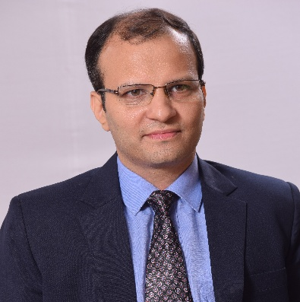
About our guide
Vishwanath Mahendra, Appointed Actuary, Niva Bupa
He has more than 25 years of rich experience in analytics, actuarial and finance in some of the reputed organisations in India.
He is currently working with Niva Bupa Health Insurance Company Limited as Director and Chief Actuary and is a key member of the Executive Leadership team. In his previous stint he has worked with Apollo Munich Health Insurance Company Limited for almost 12 years and was holding position of Chief Actuary and Chief Risk Officer at the time of exit as part of the key leadership team.
He is a Fellow Member of The Institute of Cost Accountants of India (erstwhile ICWAI), Fellow Member of Institute and Faculty of Actuaries (IFoA), UK and Institute of Actuaries of India (IAI) with specialisation in Health and Care Insurance. He is Chairman of Advisory Group on Health Care Insurance of IAI.
www.actuariesindia.org

Slide 3
Background
A general insurance company in India started operations 4 years back with a focus on Motor insurance. With the recent surge seen in Health insurance during Covid, the management has decided to increase focus on the Health insurance business and double the contribution of the same in their books in the next 3 years.
www.actuariesindia.org

Slide 4
Topics Covered
The recent regulations and the key risks before expanding into health insurance
Impact and implication of standard products introduced by the regulator
Pricing considerations for products given the lack of any data.
Impact on liquidity and solvency of the insurance company with the increasing proportion of Health business.
www.actuariesindia.org

Slide 5
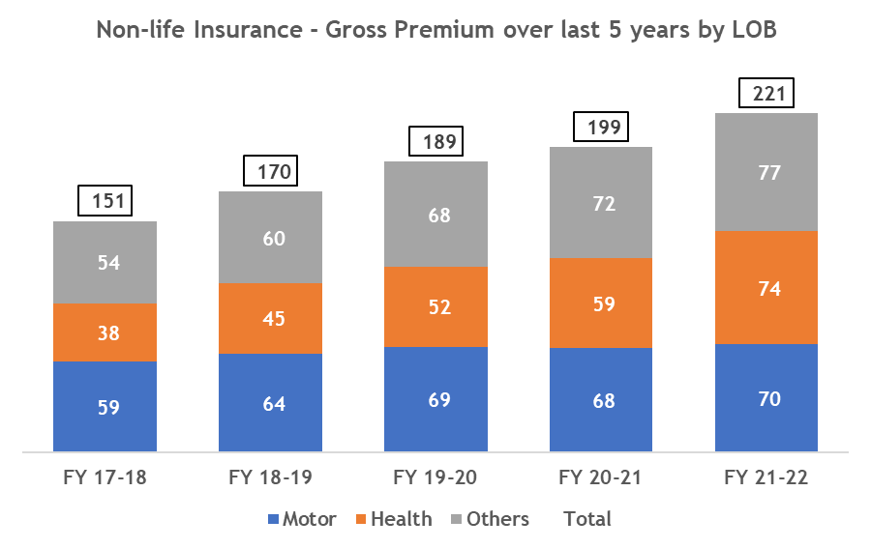
Changing Market dynamics
Inorganic growth in Health insurance over last few years vs other LOB
Health insurance LOB in Private GI grew by 26% p.a. in last 5 years while Motor insurance grew by 11% p.a
clearly indicating increased focus by Pvt GI
Opening up of economy post COVID saw better growth in Motor insurance @ 17% (YTD Nov’22 over YTD Nov’21), but still lower than Health @ 23%
In Health, both Retail and Group (other than Govt) segment are primary contributor
10%
9%
18%
4%
CAGR
Amount in INR ‘000 Crores
Source : IRDAI Segment-wise Premium Figures
www.actuariesindia.org
Notes:
YTD Nov’22 growth – M 17% H 23% Other 10% Overall 16%

Slide 6
Evolving Regulatory framework
Increasing Insurance Penetration
IRDAI planned out many programs with main objective of “Insurance for all by 2047”
Given least penetration, Health Insurance has biggest scope – Motor had seen upscale with change in Traffic regulations
Bima Sugam – one stop shop, an electronic Insurance program
Every insurer will take part and contribute to cost
Low acquisition cost model if able to get volume
Key drivers - Correct pricing & quality service
Bima Vahaak, Bima Vistaar etc
Transition
Increasing Consumer Protection
More conducive environment for Insurers
Reducing reporting requirement
Phase
Alignment with International Markets
www.actuariesindia.org

Slide 7
Evolving Regulatory framework
Increasing Insurance Penetration
Use and File for Individual products:
No waiting for approval helps quick launch
Re-pricing still conditional and hence correct pricing is must
Opening up of Corporate agency and IMF:
Increasing number of relations to 9+9+9 instead of 3+3+3 increases opportunity
Transition
Increasing Consumer Protection
More conducive environment for Insurers
Reducing reporting requirement
Phase
Alignment with International Markets
www.actuariesindia.org

Slide 8
Evolving Regulatory framework
Expense of Management and Commission payment
Allowed EOM = 30%+ for GI
3 years extension for existing players
HI is high acquisition business
3 year business growth should met EOM target
Flexibility to decide commission rate would support desired growth (but overall EOM should be met)
Other form of capital
No Prior approval + enhanced limits
Can be used as alternative to support growth
Increasing Insurance Penetration
Transition
Increasing Consumer Protection
More conducive environment for Insurers
Reducing reporting requirement
Phase
Alignment with International Markets
www.actuariesindia.org

Slide 9
Evolving Regulatory framework
Implementation of IFRS 17
Yet to be notified in India
Still not clear if Health insurance products would qualify for PAA
Business plan to include time & effort of BBA method
Risk Based Capital framework:
Currently Motor and Health LOB have similar solvency
New framework might have differentiated solvency
Current Economic capital framework requires lower solvency for Health vs Motor
Diversification can provide solvency benefit
Increasing Insurance Penetration
Transition
Increasing Consumer Protection
More conducive environment for Insurers
Reducing reporting requirement
Phase
Alignment with International Markets
www.actuariesindia.org

Slide 10
Evolving Regulatory framework
Increasing Insurance Penetration
While Bima Sugam would create more awareness and help end consumer, IRDAI focused to increase Consumer protection and build required trust in the industry
Mandating insurers to pay all genuine COVID claim irrespective of T&C and pricing
Standardization of product exclusions, cover mental illness diseases
Pricing should consider updated Regulations & Circulars while benchmarking with Competition
Transition
Increasing Consumer Protection
More conducive environment for Insurers
Reducing reporting requirement
Phase
Alignment with International Markets
www.actuariesindia.org

Slide 11
Evolving Regulatory framework
Increasing Insurance Penetration
Ensuring Regulatory architecture is aligned with Market dynamic
Revisiting all Regulations and Circulars with objective to scrap non-warranted reporting requirement and increase efficiencies
Eg: HIR returns, Reinsurance regulations, repealing of Old circulars etc.
Transition
Increasing Consumer Protection
More conducive environment for Insurers
Reducing reporting requirement
Phase
Alignment with International Markets
www.actuariesindia.org

Slide 12
Other considerations on expansion
Risk
Opportunity
Given high growth potential, competitions from existing and new entrants
Health Insurance is a sensitive subject involving emotions – sale and servicing expertise are different than Motor Insurance
Uncertainties of COVID and similar pandemic
Unprecedented medical trend post pandemic
Increased awareness of Health insurance post COVID
Higher growth prospects given low penetration
Regulator pushing for increased penetrations
Opening up of Corporate agency
www.actuariesindia.org
Notes:
YTD Nov’22 growth – M 17% H 23% Other 10% Overall 16%

Slide 13
Objectives of standard product
Standard product as per extant guidelines*- Arogya Sanjeevani
The primary objective in bringing in a standard individual health product are:
to take care of basic health needs of insuring public
to have a standard product with common policy wordings across the industry
to facilitate seamless portability among insurers
*IRDAI/HLT/REG/CIR/001/01/2020 dated. 1st January, 2020
www.actuariesindia.org

Slide 14
Product features- brief
Feature | Arogya Sanjeevani
Min/Max Sum Insured | INR 50,000 / 10,00,000
Policy term | 1 year
Cap on Room rent | 2% of SI subject to max of INR 5,000 per day
ICU/ICCU charges | 5% of SI subject to max of INR 10,000 per day
Ayush treatment | Covered without any sub-limits
Day care treatments | All day care treatments are covered
Waiting period | 4 years
Cumulative bonus | Increase in SI by 5% for each claim free year; maximum of 50% of SI
Pre/Post hospitalisation period | 30/ 60 days
Co-pay | 5% co pay on all claims
Add-ons or Optional covers | Not allowed
www.actuariesindia.org

Slide 15
Implications of standard product
(+) Easier for customers to compare the product features as well as premium rates
(-) much higher SI amounts are being offered
(-) products with no cap or much relaxed room rent/ICU charges
(-) Waiting period can be lower
(-) Maternity benefits, Health Check-up benefits, Organ Donor expenses
(+) End goal of the Regulator of Health Insurance Coverage for all is being fulfilled
www.actuariesindia.org

Slide 16
Other standard products
Corona Kavach
Individual/Floater basis
Indemnity based cover
SI: INR 50,000 to 5,00,000
Policy period: 3.5, 6.5 and 9.5 months
Coverage: Hospitalization expenses incurred for the treatment of Covid on Positive diagnosis of Covid
Premium under this product shall be Pan India basis; no geographic location based pricing is allowed
Corona Rakshak
Individual basis
Fixed benefit cover
SI: INR 50,000 to 2,50,000
Policy period: 3.5, 6.5 and 9.5 months
Coverage: 100% of the SI shall be payable on positive diagnosis of Covid, requiring hospitalization for a minimum continuous period of 72 hours
www.actuariesindia.org

Slide 17
Differential product features
Coverage for longer term (say 2- 3 years)
Top-up covers, possibly for smaller amounts
Abroad/international cover
Combi products: Health plus Life Product (Pure protection or savings products)
Add-on covers for cancer care, possibly with sub-limits
-Intent of the Regulator is good, but some flexibility could allow insurers to add more value and make it an even better offering for the customer
www.actuariesindia.org

Slide 18
Health Insurance Design
Health Insurance Contribution
The gross direct premiums income from the health insurance constitutes sizeable proportion of the total non-life insurance gross premiums.
Types of health insurance products sold by general insurance companies
Indemnity and fixed cover products
Hospitalization Cover
OPD cover
Surgical Cash cover
Individual / Family floater cover
www.actuariesindia.org

Slide 19
Pricing Considerations
Data Considerations
Data availability?
Design Considerations
Technical aspects of pricing and product design
Risk Considerations
Alternate sources of data for calculating the incidence and severity
Risk management inbuilt into pricing and design
www.actuariesindia.org

Slide 20
Pricing Considerations
Data Considerations
Data Sources like IIB data global data, reinsurer’s data, public disclosure information of health insurers.
Nature of data is the key when choosing the data source in terms of reliability, relevance, credibility, usability to link to pricing and product design.
Benchmarking the cost estimates with the industry.
www.actuariesindia.org

Slide 21
Pricing Considerations
Pricing and Design Considerations
Calculation of burning cost includes
Claims frequency
Claims severity
Pricing to allow for medical inflation
Assumptions for Waiting period, cost sharing arrangements.
Premiums to be loaded for management expense and margins and unknown unknowns due to lack of data.
Benchmarking the rates with the industry
www.actuariesindia.org

Slide 22
Pricing Considerations
Risk Considerations
Product features like waiting period, exclusions, underwriting, co-pay, deductibles, pre-existing disease.
Premium reviewability
Reinsurance arrangements – Quota share
Distribution channel – target market - Anti-selection
Modelling risk – lack of existing model, outsourcing
Risk of cross-subsidies
Policy wordings - terms and conditions
www.actuariesindia.org

Slide 23
Impact on Solvency and Liquidity
Solvency
As per IRDAI ALSM (GI) Regulations 2016, Solvency Ratio of the company would be estimated as
Available Solvency Margin (ASM) / Required Solvency Margin (RSM)
ASM-Excess of value of Assets over value of liabilities
RSM-Calculated using factor-based formula on net premium and net incurred claims
As per IRDAI’s guidelines, insurers are required to maintain a solvency ratio of 150% to minimize bankruptcy risk.
Increase in the health business volume is likely to increase the NB strain
Increase in Mathematical Reserves and initial acquisition expenses
This would result in a reduction in the Available Solvency Margin (ASM) since premium inflows would be received over the term of the policy
There would be an increase in the Required Solvency Margin (RSM) due to increase in net premium and incurred claims
In summary there would be capital requirement to be met by the company as a result of aggressive business growth
www.actuariesindia.org

Slide 24
Impact on Solvency and Liquidity
Liquidity
Insurer will need to ensure that it has sufficient liquidity to meet the expenses and outgoes related to business.
Asset-Liability matching by duration can help maintain required liquidity
Insurer need to ensure that assets backing the liabilities are sufficiently liquid, i.e. can be converted into cash without a material impact on price
Adherence to IRDAI (Investments) regulations 2016 would be useful in maintaining required liquidity
Insurer can also develop and monitor a liquidity indicator such as
Liquidity Ratio = (Expected Income and Receipts in next 12 months + Liquid assets) / (Projected Expenses & Outgoes in next 12 months)
This ratio can be estimated under base and stress scenarios
Stress scenarios can be around new business volumes, claims outgo, investment income, expenses, etc.
Incorporating NB expansion in this ratio would help the insurer identify the future investments
www.actuariesindia.org

Slide 25
Solvency Projections: Illustrative Example
Category | Year 0 | Year 1 | Year 2 | Year 3
ASM | 7,000 | 6,300 | 5,670 | 5,103
RSM | 2,500 | 3,125 | 3,906 | 5,000
Surplus (ASM-RSM) | 4,500 | 3,175 | 1,764 | 103
Solvency Ratio | 280% | 202% | 145% | 102%
Above illustration outlines the need for additional capital to support insurer’s expansion plan
www.actuariesindia.org

Slide 26
Capital Management
Sources of Capital
Internally by way of portfolio optimization, expense management, claims management etc.
Capital infusion by the Shareholders
Risk transfer by way of reinsurance could generate capital relief
As per IRDAI (Other Forms of Capital) Regulations, 2022 insurer could raise capital through
Preference Share Capital
Subordinated Debt
subject to limits and conditions laid out in the regulations
www.actuariesindia.org

Slide 27
Questions?
www.actuariesindia.org

Slide 28
Thank you!
www.actuariesindia.org

