Slide 1
38th India Fellowship Webinar
Date: 12th January 2023
Climate Risks
Guide : Neha Taneja
Presented By :
1. Sivapriya Kuppusubramaniam
2. Parin Kalra
3. Swati Khanna
4. Piyush Jain

Slide 2
Agenda
Introduction
Overview of Climate Risk
Climate Risk - India
Interaction of Climate Risk and Other Related risks
Climate Change - Risk Management
Questions?
Way Forward
www.actuariesindia.org

Slide 3
Overview

Slide 4
Climate risk
A result of changes in climate that result in adverse consequences impacting lives, livelihood, health, economy etc. These are broadly categorized as
Risks
Physical Risk
Transition
Risks related to transitioning to a lower carbon economy
Liability
Risks from third parties seeking compensation from the effects of climate change
Arises from weather-related events like floods, storms, etc.
economic ramifications of damage to infrastructure, supply chain and the built environment that could result in insurance claims
potential re-pricing of carbon intensive assets & reduction in premium from carbon intensive sectors
Companies being sued because of the impact of their greenhouse gas emissions
www.actuariesindia.org

Slide 5
Physical Risk Profile
As India is more vulnerable to its diversified climate zones, ecosystem, topography, the risk is expected to be higher in India. Some climate change and its related risks are
Heat Waves
Increase in Frequency and Severity
Damage to Infrastructure and associated business interruption
Extreme Rainfall
Frequency of extreme precipitation events
Damage to property and crops
Tropical Events
Increase in diseases/ impact on Human Health
changing patterns of atmospheric circulation, Polar icecap melts
Droughts and Wildfires
Increase in duration and intensity
Crop Damage, Water Scarcity
* The above listed risks are not exhaustive.
www.actuariesindia.org

Slide 6
Transition Risk Profile
Insurers both side of balance sheet will be impacted
Climate Related Risk
Impact on Asset
Impact on Liability
Unpredictable Risk
Loss of market value
Increase in liability value
www.actuariesindia.org

Slide 7
Transition Risk Profile
Examples that might impact on general insurers
Asset
investments in the renewable energy sector
withdraw insurance support from projects and companies in the coal sector
Liability
Move from fossil fuels
New/change in manufacturing processes
technological changes - transition to lower-carbon economy
Change in policies and promoting more sustainable land-use practices
Potential latent claims
Disruptive changes across economic sectors and industries in the near term (political risks)
New emerging risks and increasing uncertainty as countries switch to alternatives such as wind, solar, hydro, geothermal, nuclear, biofuels, etc.
www.actuariesindia.org

Slide 8
Liability Risk Profile
Insurance companies exposed both through the insurance contracts they write, and through the liability risks to their investments.
Increase in climate related litigation claims due to following reasons*
Increase in Litigation claims
Failure to mitigate
Failure to disclose or comply
Failure to adapt
Physical Impact such as through emissions of greenhouse gases
not sufficiently accounted for climate change risk factors in their acts, omissions or decision-making.
Misleading as not sufficiently disclosing information or not complying with climate change-related legislation or regulation
*As stated by PRA
www.actuariesindia.org
Notes:
Failure to mitigate: If insured parties are being held responsible for the physical impacts of climate change, such as through emissions of greenhouse gases.
ii. Failure to adapt: If insured parties have not sufficiently accounted for climate change risk factors in their acts, omissions or decision-making.
iii. Failure to disclose or comply: If insured parties (or insurers themselves) have not sufficiently disclosed information relevant to climate change, have done so in a manner that is misleading, or have otherwise not complied with climate change-related legislation or regulation

Slide 9
Risk/Opportunity for General Insurers
Climate change imposes various risk levels and opportunities on the sector from various levels
Higher Losses
Natural catastrophes claims
Indirect impact like disruption of supply chain
Increase Frequency and Severity
Increased weather specific events – heatwaves, floods, wildfires
Broader shift in climate – sea level change, rising average temperature, extreme weather impacting agriculture (e.g. Bumper crops and crop failure)
Threat to assets
Fall in infrastructure and real estate due to rising sea level or extreme weather
Falling value of share or debt securities of carbon incentive companies
Regulatory constraints
Green investment strategies leading to lower investments in carbon incentive industries
Regulatory restriction of limits of investment in carbon incentive industries
Opportunities
Investment in green energy - High set–up cost for migrating to renewable energy infrastructure
New infrastructure or electric vehicles
Insurance Gap/Less Affordable
flood prone areas/areas with high climate related events leading to
Reduced insurance penetration
Widen protection gap
Greater accumulations of risk/Increased correlation of events
Causing civil unrest and inflation
Affecting underwriting results
leading to more than 100% combined ratio
www.actuariesindia.org

Slide 10
Climate Risk and India

Slide 11
Indian Climate risk – High-Level Statistics
Extreme CAT events
Frequency increased by 24% post-2005 compared to 2005 and prior
Cyclone
Exposing 42.50 million people (Cyclone only)
In the last decade alone, cyclones hit 258 districts
Flood
In two years, 2018 and 19 - Major floods and landslides killed over 700 people and caused USD 11 billion worth of damage
20 times more for flood associated events between 1970 and 2019
Drought
79 districts recorded extreme drought events year-on-year, exposing 140.06 million people annually
At least 55 or more districts witnessed extreme flood events year-on-year, exposing 97.51 million people annually
www.actuariesindia.org

Slide 12
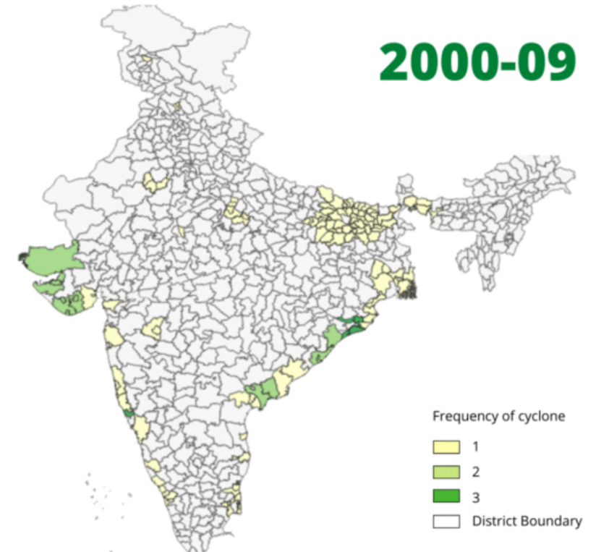
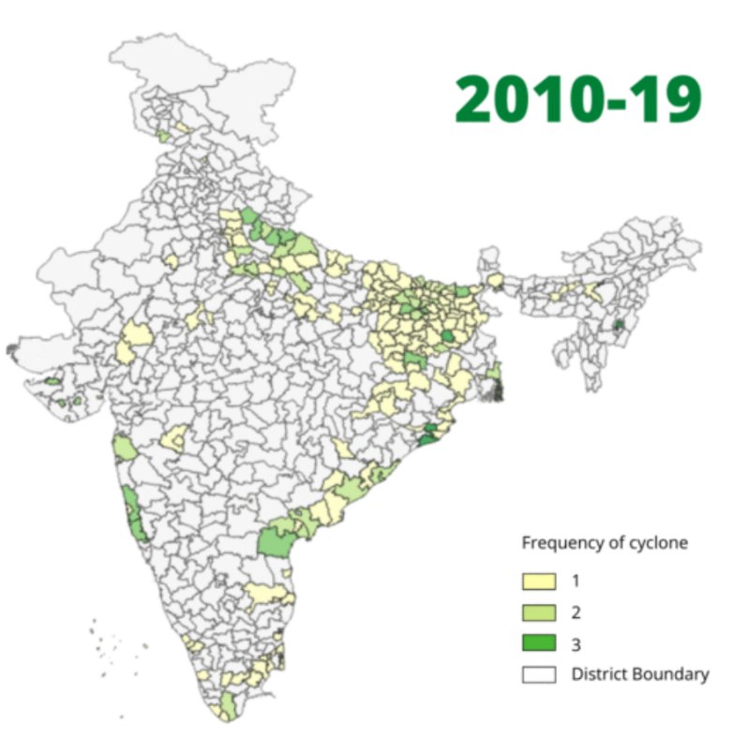
Change in Cyclone frequency in India
These unpredictable and extreme weather events result in greater volatility in company losses, leading to structuring insurance solutions more challenging.
Change in Impact in 10 year period
Change in Impact in a year period between 2019-20 and 2020-21 is 69% (number of claims reported)
www.actuariesindia.org

Slide 13
Climate Risk - India
“India is one of the most vulnerable countries globally in terms of population that will be affected by sea level rise. By the middle of the century, around 35 million people in India could face annual coastal flooding, with 45-50 million at risk by the end of the century”
IPCC Working Group
www.actuariesindia.org

Slide 14
India’s Climate Risk Profile
Diverse climate zones
Diverse topography
Diverse ecosystems
Unevenly distributed climate Risk
Alter the distribution and quality of India’s natural resources
Adversely affect the livelihood of people
www.actuariesindia.org

Slide 15
High Confidence Impacts
Rise in Sea Levels & Extreme Rainfall
Vector and water borne diseases (like Malaria, Dengue)
Damage to property and crops
Decline in fisheries
Examples -Mumbai, Ganga & Brahmaputra basins prone to rise in sea levels and flooding
Heat Waves, Draughts & Wildfires
Heat related diseases (like heat cramps, heat exhaustion, heat syncope, and heat stroke)
Damage to Infrastructure and associated business interruption
Examples – Ahmedabad extremely vulnerable to heat waves, Chennai, Bhubaneswar, Patna & Lucknow at dangerous levels of heat and humidity
Water Scarcity, Crop damage
Changes to Earth's eco-systems
Malnourishment
Urbanisation
Dietary Shifts
Epidemic
Circulatory, respiratory diseases
Mental Health Issues
Air pollution events
*Above list is non-exhaustive
www.actuariesindia.org
Notes:
Extreme Rainfall - Frequency of extreme precipitation events
Heat Waves - Increase in Frequency and Severity
Draughts and wildfires – Increase in duration and intensify droughts
Worst affected group - Economically and socially marginalized residents, Urban India with projected population of 877 million by 2050

Slide 16
Macro Level Potential Impact
More than 75 per cent of Indian districts, which are home to over 638 million people, are extreme climate event hotspots
Carbon Emission
Price spikes, threatening food affordability, food security
Increase in country-level cost#
Impact on organization’s credit profiles/ share prices
Fall in production of cereals and pulses@
Fall in Country’s GDP*
9%
3%
Flood-prone areas becoming drought-prone and vice-versa has changed in over 40 per cent of Indian districts
$86
@ As per IPCC report in 2050 and 17% for Maze
* As IPCC report for low-income countries (assuming India falls under low-income country) by 2050; Damage to Mumbai could be up to $162 billion a year by 2050
# As per IPCC report - per tonne of CO2 emission;
www.actuariesindia.org

Slide 17
Interaction between climate risks and other risk categories

Slide 18
Multi-dimensional Climate Risk!!
‘The insurance industry is exposed to climate-related liabilities on two fronts: In both its investments, and on the liability side through property and casualty underwriting.’ – S&P Global
 | Physical Risk | Transition Risk | Liability Risk
Insurance Risk | High | Medium | Low
Market Risk | Medium | High | High
Credit Risk | Medium | High | Medium
Liquidity Risk | High- Medium | Low - Medium | Low
Operational Risk | Low | Medium | Low
www.actuariesindia.org
Notes:
With increasing climate risks, as pronounced emphatically in the recently released IPCC WGII report, India stands to be impacted across sectors. If the last couple of years are any indication, India’s insurance sector has had to bear the cost of increasing number of claims for climate related disasters like cyclone and floods.

Slide 19
Climate Risk and Insurance Risk…
Insurance Risk
Underwriting Risk
Catastrophe Risk
Reserve Risk
Past is not a good guide of future!!
www.actuariesindia.org
Notes:
Move to non-traditional reserving methods – exposure based methods/statistical methods? Reduced reliance on past data, additional prudence in numbers – which enhances UW risk, LATENT CLAIMS
Higher prices due to prudence or not accurate reserving – loss of top line, Adverse selection against insurers who haven’t allowed for climate change adequately
CAT Risk –
mean return periods changing, inaccurate RI placement or worse RI not within limits (Greater accumulations risk)
expensive insurance, reducing affordability, reduced insurance penetration – impacts developing economies like India more than the developed economies
Increased correlation of events – RI Default
Increased capital requirement – increased tail risk – extreme events are more frequent and more severe

Slide 20
Climate Risk & Market Risk….
Regulatory Interference
Climate Risk
Stranded Assets
Market Risk
Market Volatility
Increased emphasis on investment return
www.actuariesindia.org
Notes:
Impacting the asset side –
Certain investments loose value/are downgraded/are now loss making
Guidance from regulator to invest in some specific categories of assets while avoiding some completely
Preferred assets may not provide good return
With increased risk and uncertainty on liability side, asset side would be expected to perform better and provide high returns to cover up for UW loss (or low profit)
If insurer has substantial exposure for the ones that need avoiding, this would impact the assets poorly

Slide 21
Climate Risk and Other Risk Types…
Credit Risk
Reinsurance Default
Default on Investments
Liquidity Risk
Non-green investments
Unpredictable claims
Increased frequency and severity of catastrophe events
Operational Risk
Strategic decisions
Reputation and Brand
Regulatory and Compliance
www.actuariesindia.org
Notes:
All the three risks below are affected by all 3 sub risk types of Climate Risk (Physical, Transition and Liability Risk)
Credit Risk – increased risk of RI default (correlation of risk events), default on investments - For example, if rising sea levels force a manufacturer to abandon one of its major factories, the loss of that investment could leave the company unable to repay its corporate bonds or bank loans.
Liquidity Risk – increased CAT events and high uncertainty on liability side pose liquidity risk
Operational risk - is the risk of loss resulting from failed processes, systems, or practices. Climate change has had a clear impact on operational risk, as extreme weather may force office closures or damage crucial resources such as data centers.

Slide 22
Risk Management Framework

Slide 23
Climate Risk framework for Business Decision
Need for Framework
No widely accepted process for assessing financial impacts from climate change risk
No single climate change scenario can assess the impact effectively across all firms and across all business decisions
Provide insight to functions such as risk management, underwriting, risk transfer, exposure management, and capital modelling
www.actuariesindia.org

Slide 24
Climate Risk framework for Business Decision
Implementation of framework - Key considerations
Who might have responsibility for the framework?
an ability to embed the outputs of the framework in the overall firm operations
sufficient authority to ensure that the outputs inform decisions
What is the relationship between framework stages?
comprised of six stages, there may be iterations between stages
Does the framework apply to firms of all sizes?
stages are generic to make it applicable to most firm types
the firm size will inform the emphasis to be given to each of the different stages
each stage of activity informs the next stage
www.actuariesindia.org

Slide 25
Climate Risk Management Framework
Stage 1: Identify the business decision(s) – inform a business decision or activity, decide the time horizon and metrics
Stage 2: Define Materiality – focus on business area with material impact of climate change risk
Stage 6: Reporting & action – communicate outcome to decision makers highlighting the limitations and uncertainty related to the analysis
Stage 4: Assess available tools – select appropriate tool to assess the impact of climate change
Stage 5: Calculate impact - using the tools selected to assess the financial impact from the projected changes to the perils.
Stage 3: Background research - review existing scientific publications to understand the influence on relevant areas identified
Outline of a sample climate change risk management framework for business decisions
www.actuariesindia.org

Slide 26
Risk management responses
Update the risk management policy of the company to include procedures for identification, measurement, monitoring, managing and reporting exposures to climate related risks
Consider capacity building within business. Example - training, guidance, case studies and supporting research with the aim of building carbon literacy
Assessing the potential climate change impact for short-, medium- and long-term time horizon, impact on financial viability, future strategy and capital requirement
Incorporating climate risk within the risk register including its classification, quantification, potential mitigants and recommended actions
Getting out forward looking stress and scenario test to check insurance resilience to physical, transition and liability risk
Appropriate disclosures of current and future risk
Defining and assessing KPIs to monitor exposure and emerging factors
www.actuariesindia.org

Slide 27
ERM key features with potential climate-related risk considerations
Governance and ERM Framework
Those responsible for governance should ensure that climate related risks are properly considered and assessed in its ERM framework
Risk Management Policy
Should be flexible to incorporate climate-related risks now and in future
Risk Tolerance Statement
Explicitly consider climate related risks with regards to investment strategy, or tolerance to demography or other insurance exposure
Risk responsiveness and feedback loop
Analyse previous experience as well as forward looking emerging risk assessment
Scenario Analysis
Forward looking view of companies’ risk exposures and its impact on future business strategy
www.actuariesindia.org

Slide 28
Use of Stress/Scenario Analysis
To assess Financial viability

Slide 29
Stress/Scenario Analysis
Objectives
Assess exposure to a combination of complex climate changes
Understand the impacts on an enterprise and its supply chain, business model or program
Identify risks and opportunities associated with the future ecosystem
Test the resilience to more extreme scenarios
www.actuariesindia.org

Slide 30
Stress/Scenario Analysis
Desirable characteristics
Plausible
The events described in the scenario should be possible and credible
Distinctive
Each scenario should be based on a distinct and clearly differentiated set of determinants
Consistent
Interaction between the qualitative and quantitative elements described in the scenario should obey strong logic
Relevant
The specific issues at stake should be key to the scenario
Challenging
The scenarios should challenge the prevailing visions of the future
Transparent
The scenarios should be transparent as to the methods applied, the assumptions made, the reasons behind their choice, the results and the conclusions
www.actuariesindia.org

Slide 31
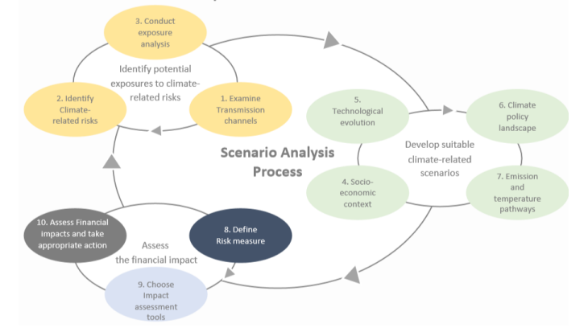
Stress/Scenario analysis
Process
www.actuariesindia.org

Slide 32
Climate change Scenarios - Examples
Temperature rises by 2℃
Average sea-level rises by 50 cm
Annual maximum daily temperature is 2.6℃ higher
Temperature rises by 4℃
Sea level rise of approximately 70 cm on average
50% less water availability
Number of hot days increase by 25%
Frequency of extreme rainfall increases by 36%
Average drought length increase by 4 months
Average crop yield for wheat and maize decease by 4% and 9% respectively
Very high Heatwave and forest fire risk
Risk to marine fisheries and ecosystem plus negative impact on agriculture and food production
Increased chances of famine and reduction in food supplies and employment
www.actuariesindia.org

Slide 33
Way Forward

Slide 34
Some Government Initiatives
A report by Climate Transparency said India's actions set under the 2015 Paris climate accord make it compatible to achieve carbon emissions curbs by 2 degrees Celsius.
The policies and programs implemented by the government show that environmental protection is one of the central pillars of India’s governance framework.
Government has planned to move from relief to a prevention, mitigation and preparedness approach
As a process, the government has actionable such as enhancing research on climate modelling in India
Promoting data access
Regulations for local issuance of green bonds
www.actuariesindia.org

Slide 35
Next Steps – for Actuarial Associations and Individual Actuaries
For Actuarial Associations
Research and development efforts
Training and continuing professional development
Regulatory environment
For Individual Actuaries
Be informed
Learn about climate-related risks & value of adaptation
Build deeper expertise
Collect and share data and techniques
Start a dialogue
Validate the sources of information used
Develop a plan to make this an integrated part of day-to-day work
Continuously learn
www.actuariesindia.org
Notes:
In

Slide 36
References

Slide 37
References
A New Framework for Assessing Climate Change Risk in Financial Markets - Federal Reserve Bank of Chicago (chicagofed.org)
Climate-change-report-29072020.pdf (actuaries.org.uk)
Practical Guide to Climate Change for GI Practitioners_1.pdf (actuaries.org.uk)
A framework for assessing financial impacts of physical climate change - a practitioner's aide for the general insurance sector (bankofengland.co.uk)
Introduction to Climate-Related Scenarios (actuaries.org)
Importance of Climate-Related Risks for Actuaries
Five climate change issues for operational risk scenario analysis - RiskLogix (risklogix-solutions.com)
India only country among G20 nations to meet climate change mitigation commitments | India News (timesnownews.com)
NAPCC – MoEF&CC (cckpindia.nic.in)
https://indianpsu.com/physical-climate-risks-for-indias-insurance-sector/
https://reliefweb.int/report/india/climate-risk-country-profile-india
Inner 01-54-C 7.6.08 (cckpindia.nic.in)
Climate Risk Profile: India | Global Climate Change (climatelinks.org)
https://www.irdai.gov.in/admincms/cms/uploadedfiles/annual%20reports/IRDAI%20Annual%20Report%202019-20_English.pdf
Template (climatelinks.org)
India - G20 Climate Risk Atlas (g20climaterisks.org)
India.pdf (cmcc.it)
https://www.ipcc.ch/report/ar6/wg2/
https://www.ipcc.ch/report/ar6/wg3/
www.actuariesindia.org

