Slide 1


6th Techtalk on Employee Benefits
Webinar
Date: 15-12-2022
Warranty Valuation
By: Suruchi Bhargava
(FIA,FIAI,FIII)
Lead Non-life insurance, K.A.Pandit

Slide 2


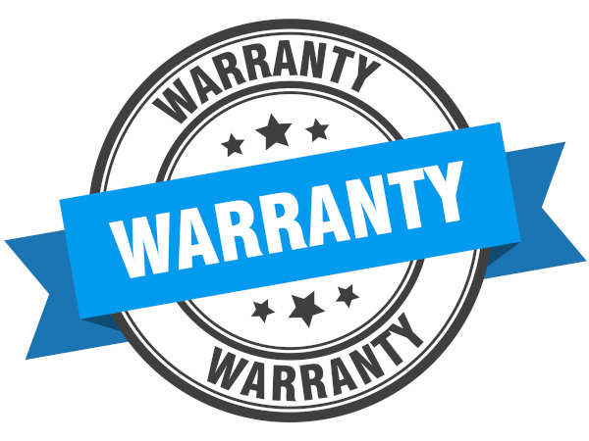

Agenda
Introduction to Warranty Valuation
Factors to Consider for Valuation
Areas of Application
Different Approaches
Operational Considerations
www.actuariesindia.org

Slide 3
1. Introduction to Warranty Valuation

Slide 4
What is a Warranty?
A warranty is a contractual obligation incurred by a manufacturer (vendor or seller) in connection with the sale of a product
To cover the event of a premature failure of the underlying item
To cover the event when the underlying item is unable to function as originally described or intended
www.actuariesindia.org

Slide 5
Types of Warranty
Types of Warranties
Express Warranty
Implied Warranty
Express Oral Warranty
Express Written Warranty
Warranty of Merchantability
Warranty of Fitness
Warranty of Title
Warranty Of Habitability
www.actuariesindia.org

Slide 6








Express Warranty
Guarantee by the seller or manufacturer to repair or replace a product or its component in case of a defect
Written or Verbal
Seller
Buyer
White Goods Store
www.actuariesindia.org

Slide 7
Implied Warranty
A legal term for the assurance by the seller that the product is fit for the purpose that it is intended and that it is merchantable, i.e., conforms to an ordinary buyer’s expectations.
  Presumed guarantee in product sales.
IMPLIED WARRANTY
www.actuariesindia.org

Slide 8
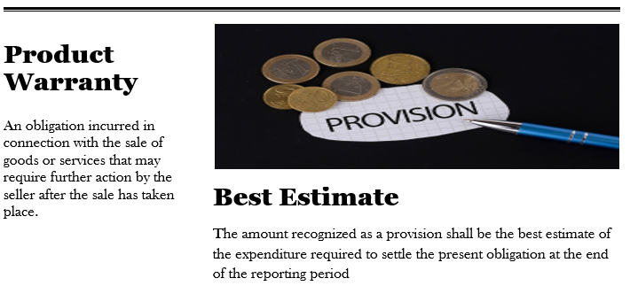
Warranty Valuation
www.actuariesindia.org

Slide 9
Warranty Valuation
Indian Accounting Standard (Ind AS) 37 “Provisions, Contingent Liabilities
and Contingent Assets”
The Standard defines a provision as a liability of uncertain timing and amount and a provision shall be recognized when:
  an entity has a present obligation (legal or constructive) that is a result of a past event
  It is probable that an outflow of resources embodying economic benefits will be required to settle the obligation and
  A reliable estimate can be made of the amount of the obligation
www.actuariesindia.org

Slide 10
Warranty Claims Provision
Provisions & Contingencies
Recognition
Provision
Contingency
Measurement
Disclosure
Provision
Contingency
Best Estimate
Risks/Uncertainties
Present Value
Expected Asset Disposals
Future Events
Contingent Asset
Contingent Liability
www.actuariesindia.org

Slide 11
2. Factors to Consider for Valuation

Slide 12
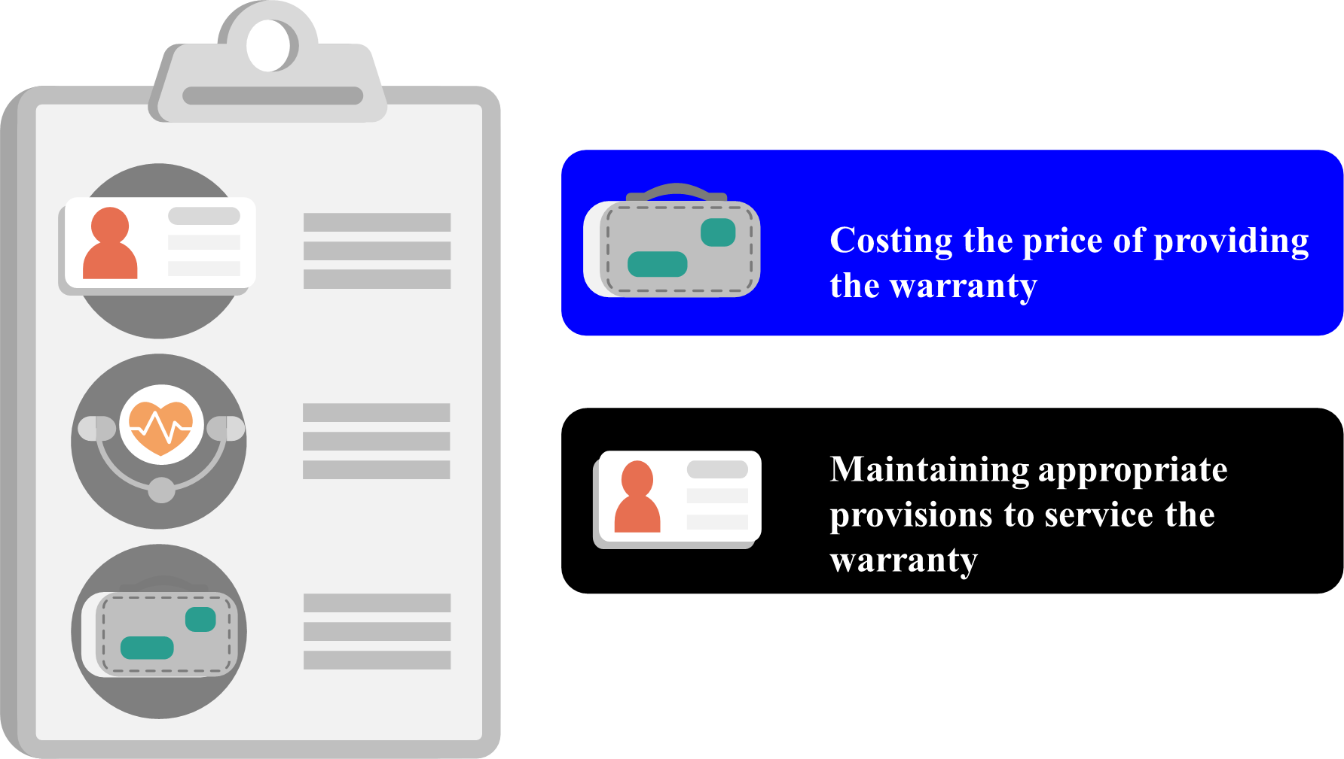
Purpose of Valuation
www.actuariesindia.org

Slide 13
Availability of Data
Type of product
Historical experience
08
01
Make & Model
Type of Defect: Repair or Replacement of Product
07
02
Manufacturing Date,
Sales Date,
Date of Warranty Claim
06
03
Point of Sale
05
04
Cost of Product
Cost of Repair or Replacement
Term of Warranty
www.actuariesindia.org

Slide 14




Credibility of Data
Defective
Part
Replacement
Part
WTY Claim
Customer claim data
(e.g. via Excel file)
www.actuariesindia.org

Slide 15
Sample Data Requirements
www.actuariesindia.org

Slide 16
Sample Data Requirements
www.actuariesindia.org

Slide 17
Other Factors
Manufacturing Quality
Changes in Warranty Period
Product Mix
www.actuariesindia.org

Slide 18
3. Areas of Application

Slide 19








Different Products
Marine Products
Appliances
08
01
Jewelry & watches
07
02
Electronics
Products
Sporting Goods
06
03
Automobile Products
Exercise Equipment
05
04
Smart & Connected Devices
www.actuariesindia.org

Slide 20
4. Different Approaches

Slide 21
Frequency-Severity
Default Rate
Expected Units to be repaired
Expected Warranty calls
Number of units sold
Default rate
Warranty Servicing Cost
Expected Repair cost per unit
Expected Replacement cost per unit
Expected Units to be replaced
www.actuariesindia.org

Slide 22
Other Methods
Development Techniques
Total amount of warranty claims projected using past data
Burning Cost
Aggregate warranty claims cost over the past years per claim
Total Basis
Number/Amount
www.actuariesindia.org

Slide 23


Monte Carlo Simulation
Product’s Reliability Rate/Failure Rate
Assume the product reliability is characterized by a Weibull distribution whose failure rate is constant
Weibull distribution boils down to an Exponential distribution with a single parameter: the MTTF (Mean Time To Failure)
www.actuariesindia.org

Slide 24
5. Operational Factors

Slide 25





Warranty Value Chain
Customer Claim
Management
Cost Recovery Process
Point of Sale
Company
Service Centre
Supplier
Customer
www.actuariesindia.org

Slide 26




Claims Processing System
The entire business process and workflow management are driven by the Internet and e-commerce enabled system application that generally consists of the following modules:
Service Warranty Database and Tracker (Database information uploaded from Sales Module)
Service Request Registration, authorization, service job ticket issue, job ticket closure & Report functions.
Parts procurement request, parts issue authorization
Parts Inventory Management, Purchase Order Management, Repair Management, Vendor Management etc.
www.actuariesindia.org

Slide 27
Warranty Management is Cross Functional
CRM
SMEs
Logistics
Services & Parts Management
Inventory Management, Distribution
Management
Product Life Cycle Management
www.actuariesindia.org

Slide 28
Thank you!

