Slide 1


Surety 101: U.S. Perspective
7th Webinar on General Insurance
October 7, 2022

Slide 2
Disclaimer
Please note: The views expressed in these materials are those of the authors and do not necessarily reflect the views of The Travelers Companies, Inc. or any of its subsidiary insurance companies (“Travelers”). This material is for general informational purposes only and is not legal advice. It is not designed to be comprehensive, and it may not apply to your particular facts and circumstances. Consult as needed with your own attorney or other professional adviser. Any examples or discussions of coverages are about coverages generally available in the marketplace and are not based specifically on the policies or products of Travelers. Any examples or discussions of claim handling or processes are for illustrative purposes only. Every claim is unique and must be evaluated on its own merits. Coverage depends on the facts and circumstances involved in the claim or loss, all applicable policy or bond provisions, and any applicable law.

Slide 3

Poll Question 1
What is your current role at your company?
Actuarial Pricing
Actuarial Reserving
Actuary not involved in Pricing or Reserving (e.g., Enterprise Risk Management, R&D, etc.)
Non-Actuary (e.g., Underwriting, Claim, etc.)
www.actuariesindia.org

Slide 4
CAS Presentation to Institute of Actuaries in India
Surety 101
Agenda
Travelers Companies Background
Surety 101
Surety Claim Examples
Frequency, Severity, Reserving
Surety Ratemaking / Pricing
Reinsurance / Co-Surety
Portfolio Management
Q & A

Slide 5




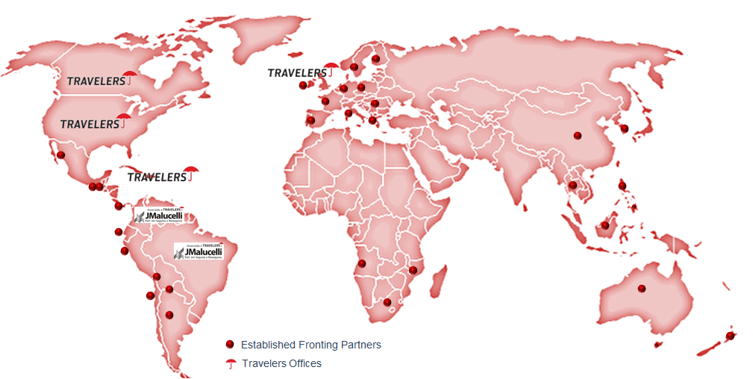

Travelers At a Glance
Largest writer of surety bonds in the U.S. with 13% market share
$7.2 billion surety market in U.S.
Stable experienced leadership: long-term approach to business and relationships
  $117B assets and $22.9B shareholders equity
  $5.5B assets and $2.1B shareholders equity in Canada
  Component - Dow Jones IA (NYSE: TRV)
Financial Strength Ratings
Global Capabilities
 | A.M. Best | Fitch | Moody's | Standard & Poor's
Travelers Pool ¹ | A++ | AA | Aa2 | AA
Travelers Casualty and Surety Co. of America | A++ | AA | Aa2 | AA
Travelers Insurance Co. of Canada | A++ | NA | NA | AA-
5
© Travelers Companies, Inc. / Travelers Insurance Company of Canada

Slide 6
Surety 101

Slide 7
Surety 101: What is a surety bond?
An agreement among three parties, in which the Surety guarantees a promise made by the Principal to an Obligee.
City, State, Federal Government, Entity
Requires bonds
Requests bonds
Obligee
(Creditor)
Principal
(Debtor)
Business, Individual (Insured)
Surety
Travelers
(Insurer)
Provides bonds

Slide 8
Contract surety bond example
The Obligee (e.g., Department of Transportation (DOT)) wishes to resurface a highway between two cities.
The Principal (e.g., ABC Asphalt Contractor) bids on the project and wins the resurfacing contract.
The Surety (e.g., Travelers) guarantees that the contract will be fulfilled.
DOT
Requires bonds
Requests bonds
Obligee
(Creditor)
Principal
(Debtor)
ABC Asphalt
Surety
Travelers
(Insurer)
Provides bonds

Slide 9
Surety 101
Insurance vs Surety Bonds
 | Insurance | Surety
Protection for | Insured against losses | Obligee (beneficiary) from principal’s (buyer) failure to perform
Limit | Policy limits | Bond penal sum limit
Forms | Typically, standard policy terms | Bond form terms vary
Duration | Usually term (duration) specific | Project specific coverage
Indemnity Agreement | Not applicable | Gives the surety the right to contract balances and the right to recover from the principal
Surety is not insurance!
Rather, it is a guarantee of performance with credit as the foundation of underwriting.

Slide 10
Surety 101
Two Major Surety Bond Categories
Contract Surety
Commercial Surety
(aka Non-Contract, Miscellaneous Surety)
Secures performance of obligations under a written contract
Construction of a building
Delivery of products
Guarantee performance of services (e.g., janitorial, trash, busing, computer installation)
Supply of products
Typically required by statute or ordinance
License & Permit Bonds
Court and Fiduciary Bonds
Official Bonds
Miscellaneous Bonds

Slide 11
Surety 101
Construction Projects Requiring Bonds
Miller Act – During the Depression of the 1930s, the U.S. Congress passed the Miller Act statute requiring guarantees for all construction work funded by the Federal Government in order to protect taxpayer funds being used to build public works projects (e.g., Army Corps Of Engineers, Department of Defense, United States Postal Service, etc.)
Little Miller Acts – Over time, states, counties and municipalities adopted similar bonding legislation for state/local funded public works construction (e.g., Connecticut Department of Transportation, Connecticut Department of Public Works, City of Hartford, etc.)
Private Enterprise – Private developers increasingly require contractors to provide bonds, as well as project lenders as a condition to the financing
Bond Forms – The type of bond form required is generally mandated by the project owner, either by statute or as set forth in the contract bid documents and are non-cancellable

Slide 12
Surety 101
Parties to the Construction Process
Owner
Performance Bond
Bid Bond
Advance Payment Bond
Maintenance Bond
Warranty Bond
Lender
Contract
General
Contractor
Payment Bond
Wage & Benefits Bond
Supplier Bond
Subcontract
Subcontractor
Sub-subcontract
2nd Tier Sub or Supplier
Notes:
12

Slide 13
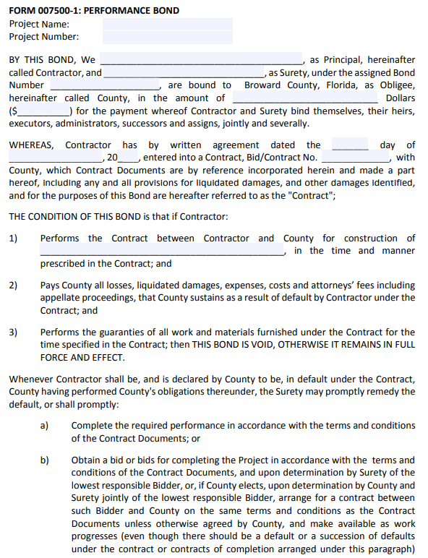
Sample Performance Bond
Bond form is a relatively simple document
Underlying obligation being secured, the construction contract, usually is incorporated by reference into the bond
Contractor (Principal) and surety are jointly and severally bound to the owner via the bond form
In order to determine exposure under performance bond, surety must review the construction contract
Source: page 1 of 2 from https://www.broward.org/purchasing/documents/FORM%20007500-1%20Performance%20Bond.pdf

Slide 14
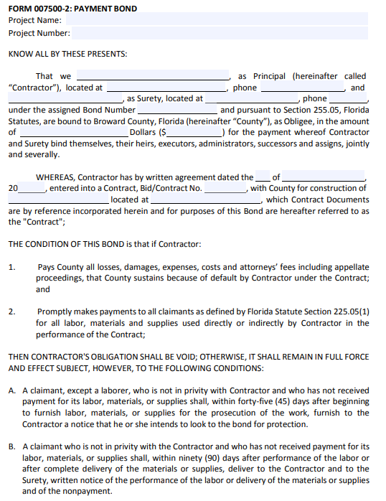
Sample Payment Bond
Payment bond is similar with conditions that focus on
  Paying for all labor, materials and supplies used directly or indirectly by the Contractor in performance of the contract
Note most performance and payments bonds are each for 100% of the contract price for the project
Source: page 1 of 2 from https://www.broward.org/Purchasing/Documents/paybond.pdf

Slide 15
Surety 101
U.S. Surety vs New Surety in India
 | U.S. Surety | New Surety in India*
Types of Surety Bonds | Contract and Various Miscellaneous | Contract and 1 type of Miscellaneous (Customs or Tax Bonds and Court Bonds)
Contract Surety Bonds | Typically, 100% bonds | 30% bonds
Underwriting Data | Surety underwriters evaluate and monitor projects and do not rely on banks and other financial institutions for their analysis | Insurers can work with banks and other financial institutions to share risk information, technical expertise to monitor projects, cash flow amongst other aspects.
Multiple Projects | Surety bonding of multiple projects, one after the other, beyond a contractor’s normal aggregate work program parameters is discouraged | Surety bonds shall be issued only to specific projects and not clubbed for multiple projects
Product Filing | Various regulations including prior approval, file & use, use & file, and no file which vary by state | File & Use
Reinsurance | Determined by insurer | Determined by insurer
Per IRDAI (Surety Insurance Contracts) Guidelines, 2022

Slide 16
Surety 101
Role of Underwriting
Prequalify Contractors
3 C’s: Character, Capacity, Capital
Approve bonds
Obtain corporate and personal indemnity
Develop underwriting policies, procedures, and strategies
Manage risk in the portfolio

Slide 17
Surety 101
Surety Underwriting
Character Capacity Capital
Reputation With | Ability to Perform | Financial Strength
Project Owners Subcontractors Suppliers Lenders | Prior experience on similar projects, type and work location Equipment Personnel Past, current, and future workload (bonded & non-bonded) Estimate/bid practices Continuity plan Organization Management/business plan | Annual & interim financial statements Investment strategies Cost control mechanisms Work in progress Bid results Cash flow Net worth Working capital Bank & other credit relationships
Account vs transactional underwriting

Slide 18
Surety 101
Role of Claim
Provide feedback on indemnity agreements and other legal documents
Provide feedback to contractors on language in construction contracts
Conduct books & records assessments
Help mitigate claim exposure
Set claim and expense reserves
Coordinate/hire outside counsel and project managers in claim situations
Salvage/Subrogation Recoveries

Slide 19
Direct Calendar Year Loss Ratios by Product
Surety Industry
Shaded areas denote recessionary periods
Source: Surety and Fidelity Association of America (SFAA) 12-Year Experience Summaries
Recessionary periods indicated in shaded areas from National Bureau of Economic Research (NBER)

Slide 20
Surety Claim Examples

Slide 21
Contract Surety
Most-Often Cited Causes of Contractor Failure
Strategic:
Unrealistic growth/Over expansion
Change in Size of Projects
Unfamiliar new markets
Entry into new types of construction
Volume obsession
Unrealistic promises/Bad Contracts/Poor project selection
Organizational:
Insufficient capital/profits
Lack of business knowledge/Poor financial management/Poor sales skills/Inadequate marketing
Poor leadership/Poor leadership transfer
Project Losses/Poor field performance
Owner court battles/Owner bankruptcy
Uncontrollable:
Industry/Economic weakness
Banking and Surety changes

Slide 22
Contract surety
The Surety’s Claim Investigation
Surety’s Goal for Investigation
Goal of surety is to gather sufficient facts to assess potential exposure, and liability, and explore best way to satisfy its obligation (if any) while mitigating damages.
All bid, performance and payment bond claims are different; accordingly, the surety must undertake an investigation to determine if the claim is covered.
Surety will attempt to develop a claim investigation and resolution strategy appropriate for each claim.
Resolve claims in a prompt, fair and professional manner in accordance with the applicable bond coverage, information obtained, and applicable law.

Slide 23
Contract surety
Types of Claims – Performance Bond
Demand presented by the Obligee against the surety to undertake completion of a project or to correct defective work performed by or at the direction of the defaulted principal. Obligations and rights of the surety are contained within the "four corners" of the bond.
Single Project Default - Claim by Obligee that contractor is in default of its contract for failure to meet project schedule, deficient or defective work, scope of work dispute, etc.
Multi-Project Default - Contractor encounters financial difficulties and either requests financing from surety or abandons all uncompleted bonded projects.

Slide 24
Contract surety
Types of Claims – Payment Bond
Claims by subcontractors and suppliers seeking payment for materials and services furnished in connection with the construction of the project.
  Examples: labor, materials, union contributions, rental charges for equipment used on the project.
  Defenses
      Principal’s defenses: Material or services were deficient or defective, sub has already been paid, pay-when-paid, breach of contract, contractual offset.
      Surety’s defenses: Failure to provide notice required by bond, labor and materials not provided for specific project covered by bond, statute of limitations to commence action against the bond, improper tier.

Slide 25
Contract surety
Matrix of Possible Surety Claims in the Construction Context
Owner
Surety
Payment and Performance Bonds
Contract
Surety
Release of Lien Bond
General
Contractor
Surety
Payment and Performance Bonds
Subcontract
Subcontractor
Sub-subcontract
2nd Tier Sub or Supplier
Performance Bond Claim
Payment Bond Claim
Release of Lien Bond Claim
Notes:
25

Slide 26
Contract surety
Loss Exposure
Loss =
    Cost-to-Complete project
+ Liquidated Damages/Actual Damages
+ Unfunded Accounts Payable
+ Expenses
– Unbilled Contract Balances
– Salvage
Loss “occurs” when contractor unable to perform or pay subcontractors/suppliers

Slide 27
Contract surety
Loss Mitigation
Surety Claim Remedies/Options
  Finance Contractor
  “Take over”: Step in shoes of principal
  “Tender option” or “re-let”: Bring in a completion contractor
  Deny Claim
  Bond buy back: Pay the penal sum of the bond
Indemnity
  Corporate
  Affiliates
  Personal & Trusts
  Secured (Letter of Credit (LOC)/Indemnity Deed of Trust)

Slide 28
Contract surety
Claim Example
Background
  Principal was a General Contractor working on several projects with a $6 million aggregate work program
  Surety issued 3 contract bonds with an aggregate penal sum of $8.6 million (M)

Slide 29
Contract surety
Claim Example Continued
Surety received notice of default from the Obligee on one project that their Principal (contractor) was significantly delayed in their progress on the project.
In addition to the performance issue, payment bond claims were also received from subcontractors and suppliers on all three bonded projects.

Slide 30
Contract surety
Claim Example Continued
On one project the contractor completed it; however, due to delays it didn’t receive substantial completion until well after the completion date and the owner provided an extensive punch list from the architect. This was a $6.1 million project with under $400k remaining in contract balances ($100k earmarked for the punch list items).
  The Surety investigation revealed the estimated cost to complete the renovation work was only $150k to $200k. The Surety ultimately took position that they were not obligated to actually complete the work pursuant to the bond language.
  Owner (Obligee) hired a completion contractor and completed the work for $350k
  Owner demanded $150k from Surety and the Surety was able to negotiate a $100k payment (with full release of the performance bond)
  There were also numerous payment bond claims totaling over $1.1 million

Slide 31
Contract surety
Claim Example Continued
On two other projects the work had been completed but both projects were delayed and there was minor punch list work remaining
  Remaining contract balances $170k (ultimately released to the Surety)
  Surety estimated the cost of work remaining to be completed was less than remaining contract balance (so, no performance reserve needed)
  However, due to delays contractor had to pay over $470k in liquidated damages
  Contractor received about $200k in contract funds which it didn’t pass on to its subcontractors and suppliers
  Surety ended up receiving about $250k in payment bond claims

Slide 32
Contract surety
Claim Example Continued
Ultimate Paid (before salvage) = $1.85 million ($1.75 million loss plus $100k expense)
Salvage via indemnity of Principal: Surety obtained consent judgments totaling $1.8 million against their indemnitors
  Due to limited assets, Surety reached a settlement of $500k against the indemnitors whereby they are making monthly payments to pay the Surety back (collected $117k so far)

Slide 33
Frequency, Severity, Reserving

Slide 34
Direct Calendar Year Loss Ratios by Product
Contract Surety Industry
Shaded areas denote recessionary periods
Source: Surety and Fidelity Association of America (SFAA) 12-Year Experience Summaries
Recessionary periods indicated in shaded areas from National Bureau of Economic Research (NBER)

Slide 35
Loss Frequency
Surety account underwriting focuses primarily on credit and reducing default risk (i.e., loss frequency)
Loss triggers for surety are stricter than those assumed in definition of default for a pure financial instrument (e.g., public debt defaults) so an adjustment is needed to develop the probability of a surety loss
Larger sureties have their own proprietary credit models that evaluate financials for companies which allow them to develop proprietary probabilities of default by account based on surety claim data

Slide 36
Loss Severity
Claim example for Construction Account
  General Building Contractor with $6 million aggregate work program working in Southeast part of U.S.
  Total Open Limits* at time of claim were $8.6 million on 3 projects with the largest being an $6.1 million job
*Open Limits defined as in-force plus limits expired in prior 12 months

Slide 37
Surety
SFAA Construction Loss Severity Study
Industry Study with over 3,000 contractor losses from SFAA members
Key Drivers of Loss Severity
  Size of Contractor (Total Open Limits*)
  Type of Contractor
  Concentration of limits in one project
    Region of Operation
Loss Severity statistics
  “PEL” = Probable Expected Loss = Average
  “PML” = Probable Maximum Loss = 90th percentile
*Open Limits defined as in-force plus limits expired in prior 12 months
Source: Surety & Fidelity Association of America (SFAA)

Slide 38
Uses for SFAA Severity Study and Loss Frequency
Capital Modeling
Loss Simulation
Portfolio Risk Management
Pricing Metrics
Reinsurance Pricing

Slide 39
Uses for SFAA Study - Loss Simulation Example
Need surety data at individual contractor level
Frequency
(Default Rates)
Contractor
Data
Correlation
Monte Carlo Simulation
Loss Distribution
Loss Severity Distribution
Loss Severity Considerations
Exposure
Contractor Type
Largest Project
Region
Collateral
Co-Surety
Etc.

Slide 40
Reserving
Selection of reserving methods will vary with
  Size of company
  Available data
  Nature of surety business
Considerations influencing selection of method
  Analysis of controls and reporting
  Handling of contract balances
  Peculiar Large Claims
  Recoveries (i.e., Salvage / Subrogation)
  External Influences
Loss Experience vs exposure-based methodologies

Slide 41
Surety Ratemaking / Pricing

Slide 42


Overview
Surety rates are regulated by each U.S. state
Each state has unique filing regulations and in many cases we must formally file our surety rates in each state and territory
Rate filings require actuarial support to justify any changes in rates
…Rates shall not be excessive, inadequate, or unfairly discriminatory

Slide 43
Types of Surety Bonds
Contract
Bid Bonds
Performance Bonds
Payment Bonds (or Labor & Material Bonds)
Miscellaneous Contract (e.g., Maintenance, Supply, Subdivision)
Commercial (Miscellaneous, Non-Contract)
Court and Fiduciary Bonds
Official Bonds
License and Permit Bonds
Other Miscellaneous Bonds

Slide 44
Exposure Base
Construction Projects = Contract Price vs Bond Limit
  In U.S., most bonds are 100% bonds (i.e., where bond limit = contract price value) vs the 30% bonds being implemented in India
  Pricing is based on per 1,000 of Contract Price; however, note that for most projects there is a 100% performance bond and 100% payment bond written
  Industry practice is to price off the larger of the Contract Price or Bond Limit
  Maximum premium rule applies for low percentage bonds (i.e., where bond limit is low % of contract price, e.g., 10%)
Commercial Surety bonds (e.g., Court Bonds) = Bond Limit (some exceptions)

Slide 45
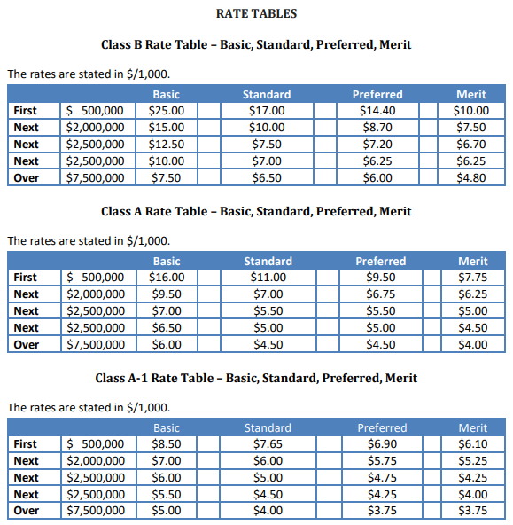
How Bonds are Rated – Obligation Based Example
Premium = ( Base Rate * Risk Modifiers ) * (Exposure/1000)
Some surety companies follow an obligation-based rating approach which is similar to how surety end rates historically were promulgated by the Surety & Fidelity Association of America
  Obligations are mapped to classification codes that are then mapped to class groups (e.g., Class B, A, A-1, etc.)
  Tiered rating approaches with credit-based criteria may also be incorporate into the rating (e.g., Basic, Standard, Preferred, Merit)
An example of a common Risk Modifier in the industry would be a time surcharge for each month exceeding 24 months (e.g., 1% per month)

Slide 46
How Bonds are Rated – Account Based Example
Premium = ( Base Rate * Risk Modifiers ) * Exposure
 | Surety Rating Plan
Base Rate: Rate per Exposure | Gross or Net, Rate per Thousand of Exposure
Risk Modifiers: Factors that depend on the value of various characteristics, also known as Risk Mods, Rating Variables, Rate Plan Elements, Rating Factors, etc. | Depends on rating plan For Contractors, factors may include Type of Work, Net Worth, Work Program/Net Worth, Credit Score, Large Program, Expense, IRPM, Time Surcharge
Exposure: Quantity of exposure base | Commercial Surety Bonds: Generally, per $000’s of Bond Limit (some exceptions) Contract Bonds: Generally, per $000’s of Contract Price or Bond Penalty (some exceptions)
Note: IRPM = Individual Risk Premium Modification Plan

Slide 47
Pricing Considerations
Exposures are inflation sensitive or immune
Premium earning pattern
Most contract bonds use “contract price” as the basis of rating. As inflation raises contract prices, exposures keep pace.
Many non-contract or commercial bonds have defined “penalty” amounts that are used for pricing. These penalties do not change as a function of the Consumer Price Index (CPI) but are typically mandated by statute or regulation.
Many P&C information systems require earnings pro-rate between coverage effective and expiration dates
Earn premium over period estimated at bond issuance, but, may require adjustment if bond duration is extended
Take down any unearned premium reserve remaining when bond obligation is met
Earned but unbilled premium (EBUB)

Slide 48
Pricing Considerations
Assignment of “accident” date
Loss payment patterns are long-tailed and often go “negative”
When does a contractor fail to perform or meet an obligation?
Information systems often constrain accident dates to be within coverage effective dates. Therefore, there may be a “massing” of losses assigned to the last day of coverage.
Losses on multiple contracts for a single principal should carry the same accident date.
In contract cases, at times it is in the best interest of all parties for the surety to provide assistance to the principal. The surety may provide financing, for example.
Assuming the contractor gets back “on its feet”, indemnity agreements can come into play and the surety collects over a number of months or years until it becomes whole.
Litigation to recover funds from third parties (including job owners) also leads to money coming in to offset payments made earlier.

Slide 49
Pricing Considerations
Booking of “contract balances”
Macroeconomic issues
In contract, not all funds are dispersed from the job owners to the principals at the inception of the work. Often contracts call for several payments coincident with certain contract milestones.
These funds are generally available to the surety once the job has become a claim situation.
The general economic cycle, through its impact on the business cycle, affects the frequency of contract surety claim situations.
Great recession starting in 2007 resulted in decreased construction volume.
Marginally operating firms may fail to meet obligations.
Subsequent poor results trigger industry losses and/or consolidation.

Slide 50


Surety Actuarial Pricing
Rate and Profitability Monitoring
Rate Filings
Pricing Tool Development and Enhancement
Underwriting Tools
Deep Dive Analyses
Strategic Growth Initiatives
New Product Development
Planning/Portfolio Review
Risk Management/
Reinsurance

Slide 51
Reinsurance / Co-Surety

Slide 52
Types of Reinsurance Agreements
reinsurance
Treaty
    Pro-Rata
    Quota Share
    Surplus Share
  Excess of Loss (XOL)
Facultative
Fronting
Non-Reinsurance risk sharing: Co-Surety

Slide 53
Types of Reinsurance Agreements
reinsurance
Treaty
  Pro-Rata
    Quota Share
    Surplus Share
  Excess of Loss (XOL)
Facultative
Fronting
Non-Reinsurance risk sharing: Co-Surety

Slide 54
Types of Reinsurance Agreements
reinsurance
Treaty
  Pro-Rata
    Quota Share
    Surplus Share
  Excess of Loss (XOL)
Facultative
Fronting
Non-Reinsurance risk sharing: Co-Surety
XOL
Max Treaty Limit
10%
co-par
Layer 2
Layer 1
$x million
Retention Level
Insurer
Reinsurer

Slide 55
Why insurers buy reinsurance?
reinsurance
Earnings Stability
  Stabilizing insurance company earnings for “extreme events” ⇨ risk transfer
Capacity
  Reducing insurance company exposure allowing for top line growth
Knowledge
  Shared industry knowledge of new product lines

Slide 56
Co-Surety
Non-reinsurance risk sharing
A Co-Surety Surety Bond is a general term used to describe a surety bond that is guaranteed by two or more surety companies. All co-sureties are bound to the Obligee jointly and severally but often the bond states the limit of liability for each surety in dollar amounts on the bond.
Co-Sureties are typically used for large construction accounts to spread risk of a contractors overall aggregate backlog or for specific large projects where the bond amount exceeds a surety’s permissible limit within that jurisdiction and therefore two or more sureties are needed to cover the obligation.

Slide 57
Portfolio Management

Slide 58
Key Considerations
Diversification by size, type of contractor, geography
Tracking surety exposure and loss severity by account for surety and aggregations across insurance company (non-surety lines, investments, bank letter of credit, etc.)
Tracking contract rates and credit quality by bond year, duration, size
Internal and External Capital Management
SFAA Loss experience vs economic cycles and impact on results

Slide 59
Summary
Need to account for differences between U.S. and India surety markets
Underwriting, Claim, Portfolio Management, and Reinsurance are critical to success
Significant learning curve

Slide 60

Questions

Slide 61
Appendix

Slide 62


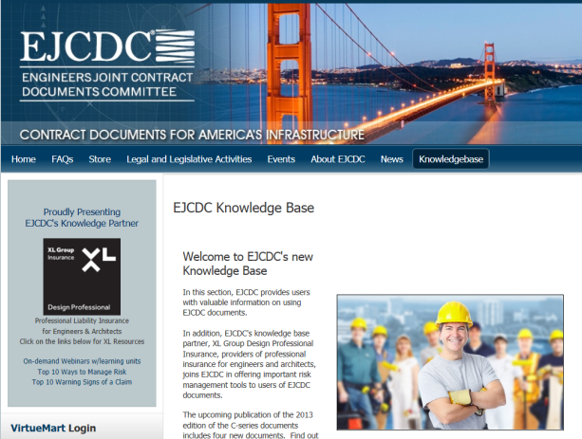
Standard U.S. Industry Form Contracts and Bond Forms
https://www.consensusdocs.org/
http://www.aia.org/contractdocs/
http://www.ejcdc.org/

