Slide 1
17th Current Issues in Life Assurance:
03 December 2021
13:30 to 16:30 IST
Setting the Context
1

Slide 2
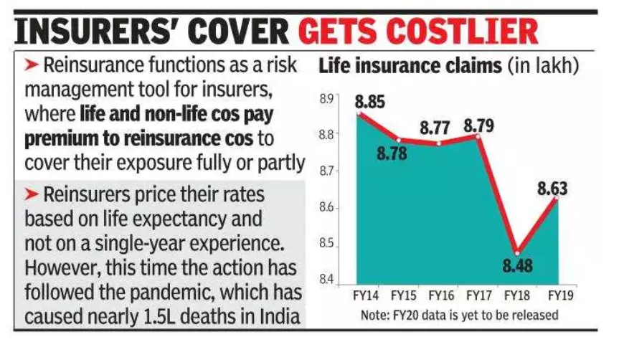
Background
Source: Internet
www.actuariesindia.org

Slide 3
Challenges: 2019-2021
Insurers:
Reinsurance treaty repricing and associated regulatory challenges
Lower volumes owing to higher prices and COVID
Higher retentions>impact on NB strain, capital management
Margin management challenges
Unsettling phase: explaining the changes to shareholders, managing competitive dynamics
Reinsurers:
Huge losses continuing long into the future
Double whammy – COVID impact and mortality losses, no offsetting business
Treaty termination and re-pricing challenges
Challenges on data discipline and minimum operational standards
Attracting scrutiny locally and globally
A lesson learned the hard way!
www.actuariesindia.org

Slide 4
What has been done so far?
RAG
Re-pricing in line with experience
Tightening of underwriting norms
Diligence in claims assessments
Implementation of risk models
Alignment between insurer and reinsurer
www.actuariesindia.org

Slide 5
Impact of COVID
- Challenges with emergence of inherent mortality experience
- Trends in anti-selection / non-disclosures during COVID waves
- Challenges in Claims management of COVID cases
- Challenges with estimation of COVID provisions, under-reporting issues
www.actuariesindia.org

Slide 6
Way forward?
How can experience monitoring be improved? Data discipline?
How can entry stage underwriting strike the optimal balance between risk management and onboarding?
How can we surmount Section 45 challenges, non-disclosures and anti-selection in claims management?
www.actuariesindia.org
Notes:
covid impact

Slide 7
Way forward?
What are the implications for protection business margin management going forward?
Is our investment in risk mitigation technologies sufficient? How can we better leverage data for monitoring and risk mitigation?
Source: Internet
Can we and should we segment protection products by target segments? Which aspects should be considered?
www.actuariesindia.org

Slide 8
Panel discussion
Moderators: Vivek Jalan & Sunayana Mahansaria
Panelists:
Avdhesh Gupta – AA, Bajaj Allianz Life
Jose John - AA, Max Life
Samrat Das – COO, PNB MetLife
Sanjeeb Kumar – CEO, Gen Re India Branch
www.actuariesindia.org

