Slide 1
34th India Fellowship Webinar
Date: 29th January, 2021
Case Study 5 Life Technical (Group 4)
Product design & pricing for small & new company in low interest rate scenario
Guide : Vandana Baluni 5
Presenters :
1. Ms. Surekha Dinkar Tambe
2. Ms. Abhilasha Goyal
3. Mr. Neerav Sagar Bhomaj
4. Ms. Spurthi Reddy Rapol

Slide 2
Case Study - Overview
Recently joined as AA of a small and new life insurance company
Strategy review in the company – to expand aggressively & tap into larger share in the market
Current market research identified three most popular products
Decided to price
Non Linked Non-Participating Saving Product
Non Linked Non-Participating Term Product
Non Linked Participating Product
Product design factors with differentiating aspect between participating Vs non-participating
Challenges in pricing such products in the current low interest rate scenario in the covid-19 hit economy.
“Aggressive” and “Competitive” pricing in current economic scenario, for a small and new life insurance company
Managing Interest Rate Guarantee & Communicating professionally with CIO & CFO in regards to differing view on the same.
www.actuariesindia.org

Slide 3
Agenda
Research
Product design factors
Challenges for pricing in current low interest rate scenario
“Aggressive” & “Competitive” pricing
Professionalism & Communication to Senior Management
Conclusion
www.actuariesindia.org

Slide 4
Agenda
Research
Product design factors
Challenges for pricing in current low interest rate scenario
“Aggressive” & “Competitive” pricing
Professionalism & Communication to Senior Management
Conclusion
www.actuariesindia.org

Slide 5
Research
Insurance Penetration
3.70 % in FY 2018-19 vs Global Average of 6% Young Nation : 17.7 % of the total world population reside in India with median age as 28.4 years. Demand for protection: Awareness of the need to have term insurance
Why not ULIP ??
Cap on charges/RIY Uncertain economic environment More administration
Products
Non Linked Non-Participating Saving Product Non Linked Non-Participating Term Product Non Linked Participating Product
www.actuariesindia.org

Slide 6
Agenda
Research
Product design factors
Challenges for pricing in current low interest rate scenario
“Aggressive” & “Competitive” pricing
Professionalism & Communication to Senior Management
Conclusion
www.actuariesindia.org

Slide 7
Product Design – Regulation, APS & GN
Regulation
IRDAI (Non-Linked Insurance Products) Regulation 2019 IRDA ALSM Regulation 2016
APS
Appointed Actuary And Life Insurance Business – APS 1 Additional Guidance for Appointed Actuaries and other Actuaries involved in Life insurance business – APS 2 Appointed Actuary and Principles of Life Insurance Policy Illustrations – APS 5 Appointed Actuary (AA) and Principles for determining Margins for Adverse Deviation (MAD) in Life Insurance liabilities – APS 7
GN
GN 6 - Management of participating life insurance business with reference to distribution of surplus GN 22 - Reserving for Guarantees in Life Assurance Business
www.actuariesindia.org

Slide 8
Product Design Factors
Regulator
Profitability
Marketability
Distribution Methods
Competitive
Administration
Risk
Taxation
Customer Needs -Target Market
Reinsurance
TCF & PRE
Capital
www.actuariesindia.org

Slide 9
Participating vs Non-Participating Products
Definition :
A participating policy, as the name suggests, allows its policyholders to share the profits that the company earns. These are shared as bonuses or dividends which makes this a policy with profits. A non-participating policy does not share any profits in the form of dividends and hence is a without profit policy
Products :
Participating : PH able to see and get the dividends/returns from policy while still alive 1) Endowment 2) Whole Life Non-Participating: Benefits received by nominee of the PH in protection product 1) Term 2) Endowment
www.actuariesindia.org

Slide 10
Participating vs Non-Participating Products
Differentiating Factors | Participating | Non-Participating
Governance | PRE – Bonus Policy , Sales Literature, BI, Common market practice, past documents issued, life insurers current practice GN – 6 WPC Committee - Independent Director, CEO, AA, Independent Actuary With Profit Fund Management – Expenses Allocation, Assets Share, Disclosure in Annual Report | Relatively less governance GN-22 BI, Sales literature
Surrender Value | In smooth progression of Assets Share GN - 6 = AS/ SV within certain specified range | Smooth progression towards maturity value
Benefits | Guaranteed (SA) + Non-guaranteed(Bonus) | Guaranteed
Target Audience | Risk Taker(Relatively), wealth creation | Risk Averse, life & financial protection
Profit Distribution | Distribution of surplus in 90:10 ratio (IRDA distribution of surplus regulation 2002) | 100% profit belong to SH
Marketability | Lower saleability due to discretion in bonus rates, less transparency | With interest rate guarantee saleability can be increased, More transparency
www.actuariesindia.org

Slide 11
Participating vs Non-Participating Products
Differentiating Factors | Participating | Non-Participating
Estate | Undistributed Surplus Use in Solvency Capital(ASM) Sufficient Estate, then self sustainable | Relatively capital intensive product
Risk | Relatively low risk - Sharing of the risks with PH | High investment risk for Saving. Extensive ALM required (IRDAI ALSM regulation-2016)
Forms of Returns | Revisionary Bonus Terminal Bonus | Term : No return Saving : Either interest rate guarantee/Increased maturity amount
Bonus | Bonus rate function of Investment performance, Expense Management, Smoothening Philosophy discretions of the insurer(Keeping PRE) | Saving : Guaranteed returns Non Saving : No bonus
Premium | Higher premium due to saving nature of the product | Lower premium for Term Insurance policies(Protection)
www.actuariesindia.org

Slide 12
Agenda
Research
Product design factors
Challenges for pricing in current low interest rate scenario
“Aggressive” & “Competitive” pricing
Professionalism & Communication to Senior Management
Conclusion
www.actuariesindia.org

Slide 13
Pricing considerations
External environment
Compliance with regulations, APS and GN
Economic environment (currently low yield COVID hit economy)
Shareholder expectation
Generating higher value for shareholders (profit margin)
Manage risks
Policyholder expectation
Meeting needs
Higher guaranteed return
Competitive premiums
With professionalism
www.actuariesindia.org

Slide 14
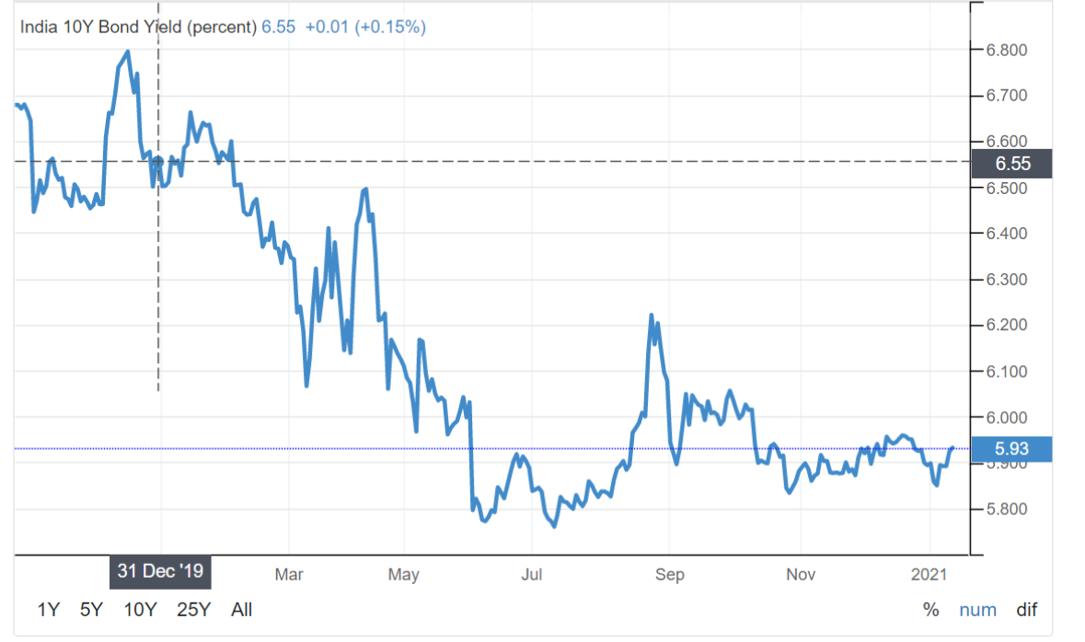
Economic scenario
Low Interest rate – COVID hit economy
In the weak economy, actions taken by RBI of cutting repo rate and reducing cash reserve ratio have resulted in yields falling
10Y G-sec has fallen by ~60bps over the year and ~200bps since June 2018.
While the curve has started to recover, and there is a forecast suggests there will be recovery in yields by 2021, however, there is a lot of uncertainty for future and curve can swing in either direction or remain flat
Yields Down
Profit Margin
Expenses
PH IRR
Investment return
Source: TradingEconomics
www.actuariesindia.org

Slide 15
Challenges in pricing
Low interest rate – COVID hit economy
Investment Return
Challenge is to find appropriate short-term and long-term asset mix to match the liability (inclusive of guarantees) appropriately: Reinvestment risk of future net cashflows at unknown (lower yields) Credit risk – higher chance of credit default, recent default of IL&FS highlights this concern further. Regulatory restriction – As per the Investment Regulation of 2016, there are restrictions on admissible assets as well as limits to exposure to asset classes.
Protection | Savings | Participating
www.actuariesindia.org

Slide 16
Challenges in pricing
Low interest rate – COVID hit economy
Policyholder behaviour
Its challenging to predict policyholder behavior in such economic environment, there might be higher than usually expected lapses: there are job losses and pay cuts have led to liquidity crunch distribution challenge - agents unable to service client /difficulty in premium collection Increase in revival period as per (Non-Linked Insurance Products Regulations, 2019) – in setting lapse assumption (net of revivals) Increased awareness of need for protection – sales might increase
Protection | Savings | Participating
www.actuariesindia.org

Slide 17
Challenges in pricing
Low interest rate – COVID hit economy
Expenses
If persistency continues to fall it shall lead to increase in per policy cost Fall in NB vol and change in mix – shall defer the point of overrun elimination Increase in development cost due to need of digitalization
Protection | Savings | Participating
Mortality
Increased mortality rate in short term Unknown long-term trend yet to develop Reduced underwriting leading to fraud Reinsurance rates have been volatile
Protection | Savings | Participating
www.actuariesindia.org

Slide 18
Challenges in pricing
Low interest rate – COVID hit economy
Others
Higher uncertainty may lead to higher reserves – resulting in higher new business strain Lack of credible data – due to new company and furthermore economic uncertainty Innovative differentiators to remain competitive – rider for COVID, cover for job loss in pandemic
Protection | Savings | Participating
www.actuariesindia.org

Slide 19
Agenda
Research
Product design factors
Challenges for pricing in current low interest rate scenario
“Aggressive” & “Competitive” pricing
Professionalism & Communication to Senior Management
Conclusion
www.actuariesindia.org

Slide 20
Aggressive & Competitive Pricing
What does it mean?
Lower premium, higher benefits
Lower profit margin
Higher policyholder IRR
High surrender values
Higher level of bonuses
Implications
Increased market share
Impact on expenses
New business strain
Implications on bonus structure
www.actuariesindia.org

Slide 21
Evaluation by performing analysis
Sensitivity analysis and scenario testing
Check if lapses on old products have increased since competitor launching high guarantee products
Investment instruments
Availability and duration of hedging instruments, partly paid-up bonds, zero coupon bonds
ALM
ESG and cost of guarantees
Use ALM to find out most appropriate investment strategy
Allow various economic scenarios especially where interest rates fall and lapses reduce
Check whether high levels of bonuses are sustainable
Project investment returns
Use of stochastic models to project return on assets
Solvency forecast
Check when solvency will fall below minimum internal threshold.
www.actuariesindia.org

Slide 22
Risk Management
Minimise risk
Underwriting
Trigger points for repricing or restructuring
Change in interest rates
Prepare for unforeseen circumstances
Need for capital, issues regarding equity capital
Reinsurance
Change in availability of hedging instruments
Competitor repricing
Achieving certain business volume
At certain level of free capital
Subordinated debt
Financial reinsurance
Credit default swaps
Interest rate derivatives
www.actuariesindia.org

Slide 23
Agenda
Research
Product design factors
Challenges for pricing in current low interest rate scenario
“Aggressive” & “Competitive” pricing
Professionalism & Communication to Senior Management
Conclusion
www.actuariesindia.org

Slide 24
Differing views
Views on | Senior Management (CIO and CFO) | Appointed Actuary
Interest rate guarantee | Economic scenario will normalise within a year Life Insurance is long term hence nothing to worry | Uncertain when it would normalise Assets locked for low investment return when held to maturity. Reinvestment risk - Assets shorter term than liabilities Derivatives can be used to hedge interest rate risk. Secondary risks from derivatives Eg. Counterparty risk, roll forward risk, removes upside risk, risk of rebalancing
Investment Strategy | Existing Investment strategy can be continued | Existing Investment Strategy unsuitable - new objectives and characteristic of liabilities Small changes in interest rate will impact liabilities more than assets Asset Liability Modelling (duration matching) can be used to develop an appropriate Investment strategy
www.actuariesindia.org

Slide 25
Professional issues and Communication
Interest rate guarantee – Hedge using Derivatives
Professional Considerations
Communication with Senior management
Assets
Liabilities
Interest rate derivatives – Prescribed Guidelines on Interest Rate Derivatives
Valuation Interest Rates needs to comply with APS1 and APS2
Sufficient margins for adverse deviations (MAD) as per APS7
Interest Rate guarantee reserve can be quantified using Stochastic or Deterministic Models as per GN22
Information presented - simple to understand.
Range of economic scenarios and their implications E.g. Provide a range of interest rate scenarios and their influence on the profitability.
Cost vs Benefit of the strategies must be conveyed
www.actuariesindia.org

Slide 26
Professional issues and Communication
Investment Strategy– Asset Liability Modelling
Professional Considerations
Communication with Senior management
Assets
Liabilities
Setting Investment Policy - IRDAI Investment Regulations, 2016
Consistency in valuation of assets and liabilities
Asset Liability Matching by duration
Guidelines as per IRDAI Circular on ALM and Stress Testing, 2012
Quantifiable objectives and respective investment strategies can be compared and presented to the CIO and CFO
E.g. Expected solvency level for each investment strategy can be compared
www.actuariesindia.org

Slide 27
Agenda
Research
Product design factors
Challenges for pricing in current low interest rate scenario
“Aggressive” & “Competitive” pricing
Professionalism & Communication to Senior Management
Conclusion
www.actuariesindia.org

Slide 28
Conclusion
Aggressive and Competitive Pricing for market penetration can be met
Appropriate Risk Management Process
Suitable Investment Strategy
Focus on protection products
Continuous monitoring – withdraw, re-price, re-design, change sales strategy
Achieve Synergies to lower expenses
Digitalisation
www.actuariesindia.org

Slide 29
www.actuariesindia.org

Slide 30
Thank You
www.actuariesindia.org

