Slide 1
35th India Fellowship Webinar
Date: 16 July 2021
Cyber Insurance
Presented By : Group 8
1. Mahipal Choudhary
2. Ananthanarayanan C
3. Ashish Kr Sarangi
4. Rochak Garg
Guide : Khushwant Pahwa

Slide 2
Introduction of Guide
Khushwant Pahwa
Khushwant is a Qualified Actuary. He is into consulting and practices in the areas of employee benefits as well as insurance.
He has been, in the past, a member of various Advisory Groups of the Institute of Actuaries of India, including pensions and employee benefits as well as life insurance.
www.actuariesindia.org

Slide 3
Cyber Insurance
Scope of presentation:
In the post COVID-19 cyber security landscape, discuss emerging cyber risks and threats for large corporations, small / medium enterprises and individuals
Examine cyber risk coverages available in the Indian market, emerging new coverages in Global markets and gaps in coverages currently available
Discuss pricing of cyber risk - challenges and solutions.
www.actuariesindia.org

Slide 4
Part I: Emerging Risks and Threats
FACT:- Share prices fall 7.27% on average after a breach
www.actuariesindia.org

Slide 5
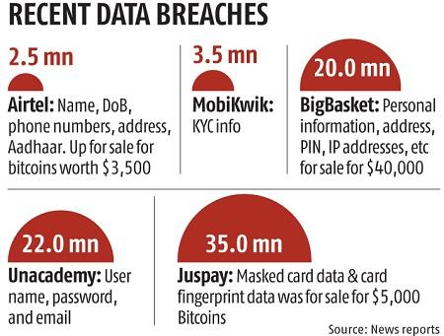
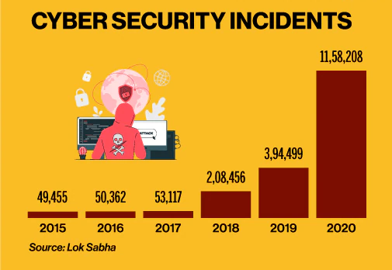
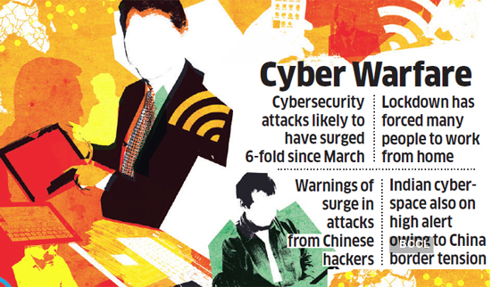
www.actuariesindia.org

Slide 6
Recent major Cyber attacks
Russian hacker group 'Nobelium' targeted email accounts of government agencies, as part of intelligence gathering, impacted 24 countries. SolarWinds, a major US IT firm, was subject, that spread to its clients and went undetected for months.
Ransomware attack on Colonial Pipeline, USA: largest fuel pipeline and important part of NCIF, took system down for a week, disrupted gas supplies, causing chaos and panic, paid ~$5mn in bitcoin to Russian hackers.
Recent Data breaches:
Air India booking system, details of 45 lakh passengers leaked
Dominos, details of 18 Crore orders, including Credit card details, phone numbers, address of customers.
all Upstox customer details
Chinese hacker group ‘RedEcho’ attacked 10 Indian power sector assets, may lead to Grid failure/ major power outage.
www.actuariesindia.org

Slide 7
Cyber Insurance: Introduction
Cyber Insurance is designed to guard businesses from potential effects of cyberattacks.
Helps an Organisation / Individual mitigate risk exposure by offsetting costs, after a cyber-attack / data breach / covered loss
Covers Liability and Intellectual Property losses for sensitive customer data held by businesses.
Extremely fast evolving risk landscape, increased digitisation of transactions and internet usage in wake of COVID-19 outbreak.
Emerging trend: Incident duration and business interruption is lengthening (avg. 23 days), loss higher than extortion demand
www.actuariesindia.org

Slide 8
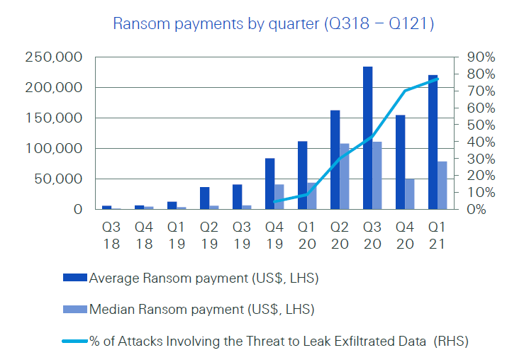
Threats for Large Corporations
Sophisticated Phishing: use of Machine learning to craft convincing fake messages, emails sent to employees.
Ransomware: hijack database; cost billions of dollars each year; Bitcoins help anonymous payments, US Insurance giant CNA paid $40mil (Mar 2021)
Cyber-physical attacks: Targeting Computerized critical infrastructure like electrical grids, transportation systems, hospitals, etc.
Business interruption: data deleted, DDoS attack, hacker recent focus on Linux, loss of sales, reputational risk.
Regulatory fines and Penalties
www.actuariesindia.org

Slide 9
Threats for small / medium enterprises
Malware attacks: lack of costly physical endpoint devices to prevent attacks
Data leak: release of sensitive information of clients, credit card, bank accounts, etc.
Weak password management: lack of awareness in employees and audits
Insider threats: greed, malice, ignorance, carelessness
Work from home pushed increase in leakage points
Lack of strong security management to force app-updates, installation of genuine software
Significant cost: Forensic service to locate and analyse vulnerability, notification cost to customers, public relations cost to minimize reputational impact
www.actuariesindia.org

Slide 10
Threats for Individuals
Factors particular to individuals: inadequate knowledge, low awareness, individually insignificant losses
Threats: illicit access to sensitive financial information, especially for HNI
Identity theft: Steal identity to purchase online, fake Social media profiles
Fake mobile apps, SIM swap, bricking of smartphones, encrypting personal data, phishing website and email,
Use of COVID-19 environment, fake vaccine booking apps and portals to capture personal details.
Smart-home attack / IoT: controlling smart devices, security devices, home appliances, CCTV/ VC devices, threat to privacy
Did you update your smartphone OS or installed apps recently???
www.actuariesindia.org

Slide 11
Part II: Global Market
FACT:- 91% of cyber attacks in 2017 started with a phishing email
www.actuariesindia.org

Slide 12
Cyber Insurance across Globe
Cyber Insurance Coverages across the Globe are influenced by three factors:
1) Industry in which the organization is operating. As a broad level, we would expect the following
BFSI > Aggregators > Utilities > Manufacturing
2) Penetration of IT in business Usage
Here we mean not just using a laptop/desktop with office work enabling software
It also means reliance on data servers, system driven decision making, process automation etc.
3) Index of litigation and the level of regulations in the region
The more litigious the society, the higher would be the monetary impact, the more would be the need for cover to protect against adverse events.
Reasonable to say that US markets would have more reasons to get cyber insurance than say Maldives
www.actuariesindia.org

Slide 13
Cyber Insurance coverages across Globe
The coverages can be split into first party and third party
First Party here refers to the buyer of the insurance policy
Third Party here refers to an external entity who has been affected by the cyber event
We will consider two cyber insurance policies from two different countries and see their coverages
From the US and UK: (Looking at the First Party)
Loss or Damage to Electronic Data – Client information
Loss of Income or Extra Expenses – Due to stoppage / restoration
Cyber Extortion Losses - Ransomware
Notification Costs – This can be quite high
Reputation Damage (Also known as Crisis Management Cover)
www.actuariesindia.org

Slide 14
Cyber Insurance coverages across Globe
Let us take a real case and see how this insurance coverage works
An e-commerce platform, SellYouLater, contracted with a third party service (TPS) provider. A burglar stole two laptops from the service provider containing the data of over 800,000 clients of the SellYouLater.
First question is who is liable ?
SellYouLater or TPS
Second question, suggest possible heads of claims
Notification cost
Crisis management
The claim amount ?
$5,000,000. Five million dollars !!!!
www.actuariesindia.org

Slide 15
Cyber Insurance coverages across Globe
A UK Government survey estimated that in 2018
61% of large corporations and
31% of small businesses suffered a cyber breach.
Looking at the Third-Party Liability coverages in US and UK
Security and privacy breaches
Multi-media liability, to cover investigation, defence costs and civil damages
Loss of third-party data
www.actuariesindia.org

Slide 16
Cyber Insurance coverages across Globe
Examples of Third-Party Cyber Coverage
Procedural Error
A woman purchased a used computer from a pharmacy.
The computer still contained the prescription records, including names, addresses, social security numbers, and medication lists of pharmacy customers. The cost of notifying affected parties per state law totaled nearly $110,000.
Two lawsuits were filed: one alleged damages in excess of $200,000 from a party who claimed she lost her job as a result of the disclosure;
The second alleged the plaintiff’s identity was stolen, and the costs of correction and emotional distress exceeded $100,000.
www.actuariesindia.org

Slide 17
Cyber Insurance coverages across Globe
Examples of Third-Party Cyber Coverage
Media Liability Exposure
Two employees at a Pizza chain posted derogatory comments and a video online. The video captured their employee uniforms and work location.
They first had to incur expenses since all the open food at the franchise had to be thrown
This resulted in a reputational damage to the Pizza Chain and it had to incur substantial expenses and resources to mitigate this bad publicity
www.actuariesindia.org

Slide 18
Part III: Indian Market
Report:- Cyber-crime damages now costs world economy over $1 trillion (McAfee report)
www.actuariesindia.org

Slide 19
Existing Coverage's in Indian Market
Nascent Stage
Very few providers, with lots of conditions and limits
Losses Covered can be generally categorized under following three sections:-
Coverages
First Party Loss
Third Party Liability
Expenses
www.actuariesindia.org

Slide 20
Existing Coverage's in Indian Market Contd.
Identity Theft: Coverage for damages and defense costs resulting from identity theft. (E.g. unauthorized transactions or purchases, lawyer cost to prove misuse of victim’s identity etc.)
Cyber Stalking/Bullying – Coverage for fee, costs and related expenses due to cyber bullying/stalking. (E.g. Consulting fee with psychiatrists/psychologists, related rest & recuperation expenses, temporary relocation cost etc.)
Theft of Funds – Financial losses suffered by Insured/related TP as a result of Cyber incident. (E.g. Targeted intrusion by a Third Party into the Computer system of insured causing theft of money/shares).
Cyber Extortion – Coverage for extortion payments and related expenses (E.g. extortion amount, forensic cost, consultant/negotiator cost, data restoration costs).
www.actuariesindia.org

Slide 21
Existing Coverage's in Indian Market Contd.
Business Interruption – Coverage for loss of Net Profit and related costs originating from cyber incident (E.g. restoration/retrieve/reinstallation cost, other running costs caused by impairment/denial of operation due to cyber event.
Phishing/Spoofing: Coverage for financial losses sustained by Insured being an innocent victim of an act of phishing/Spoofing. (Phishing: Social engineering attack used to steal user data; e.g. login credentials, credit card details. An attacker, masquerading as a trusted entity, dupes a victim into opening an email, instant message, or text message; Spoofing: Attempt to obtain someone's personal information by pretending to be a legitimate trusted source; e.g. IP spoofing, URL spoofing etc.)
Malware Attacks – Coverage for data restoration cost and lost wages due to malware attack. (Introduction of Malware into computer system resulting into alteration, corruption or destruction of data/software)
www.actuariesindia.org

Slide 22
Existing Coverage's in Indian Market Contd.
Privacy & Data Breach – Coverage for damage and defense costs due to inadvertent loss or unauthorized disclosure of protected data. (Notification, Monitoring & Recovery costs; Defense and Investigation costs).
Network Security Claims Cover– Damages and defense cost caused by any act/error/omission by Insured resulting in –
Introduction of unauthorized software/virus to TP data
Denial of access to an authorized TP to its data
Destruction/modification/corruption/deletion to TP data.
Theft of data/disclosure of data
Media Liability Cover– Damage and defense costs in context of Insured’s publication/ broadcasting of any digital media content. (E.g. Defamation, unintentional infringement of IPR, disclosure of private data, theft of ideas etc.)
www.actuariesindia.org

Slide 23
Existing Coverage's in Indian Market Contd.
Regulatory defense & penalties – Indemnification to Insured (incl. legal and defense costs) which he is legally liable to pay as a result of civil regulatory action/penalty/fines to the extent insurable by law
PCI Non Compliance – Coverage for fines/penalties by PCI due to a breach caused by cyber incident. Coverage also includes defense cost, forensic investigator fee, PCI-DSS re-certification cost, cost of reissuance any credit/debit card.
Expenses – Coverage is also available for various other types of related expenses incurred due to cyber incident. Such as Notification cost, Investigation cost, Crisis Management Cost, Data restoration cost, Legal defense cost, Expert cost, Repair of reputation cost etc.
www.actuariesindia.org

Slide 24
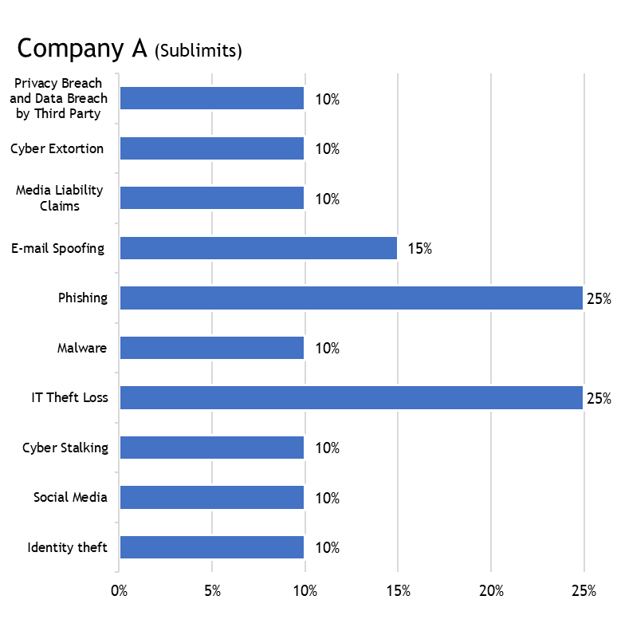
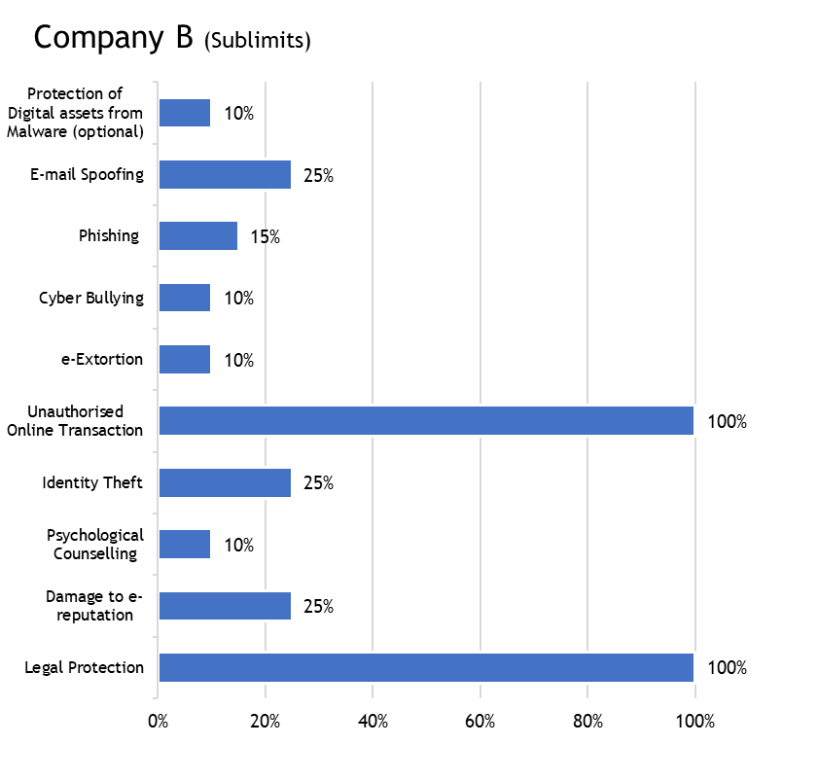
Plans Offered (Example: Company A & B)
Company A:
Sum Insured (SI) Offered:
1/3/5/10/15/20/25/50/75/100 (Rs. Lakhs)
**Additional IT consultant charges: 2.5k to 25k basis SI
Company B:
Sum Insured (SI) Offered:
.5/1/5/20/50/100 (Rs. Lakhs)
www.actuariesindia.org

Slide 25
Gaps in Coverages
Cyber Terrorism: All policies exclude terrorism. Cyber terrorism can cause significant economic disruption. E.g. cyber attack that resulted in blackouts in Ukrain (swamped websites of Ukrainian org – banks, ministries, newspapers, electricity firms) and a Fire at an industrial facility in Germany - hackers manipulated & disrupted control system so that blast furnace could not shut down.
Bodily Injury & Property damage – Coverage for bodily injury / sickness / disease / death or property damage cost arising due to cyber incident (e.g. intrusion into - Healthcare facility, GPS device, food manufacturer, autonomous vehicles etc.)
Bricking Cost – Cover for replacement cost for computer system itself (Computer, Server, Mobile etc.) post cyber incident.
Hardware Betterment Cost – Expenses for betterment of Hardwares e.g. increased memory, better security required to prevent re-occurrence of cyber incident.
www.actuariesindia.org

Slide 26
Gaps in Coverages Contd.
Crypto Currency Payments – Cyber extortion loss which provides coverage for payments in digital currency in respect of extortion payments.
Intentional Acts – Coverage for dishonest or improper conduct of employees, at least for Key Personnel e.g. CEO, CFO, CRO, FA, Heads etc.
Others -
- Sim Jacking, Card Cloning & Skimming
- Online Shopping Frauds
www.actuariesindia.org

Slide 27
Part IV:
Pricing: Challenges & Solution
FACT:- 93% of breaches could have been avoided
www.actuariesindia.org

Slide 28
Pricing of Cyber Risks
Losses and costs covered under Cyber Insurance
Property Damage & Data Restoration
Incident management & Legal Costs
Financial Losses (Frauds and Thefts)
Financial Losses (Extortion)
C Y B E R I N S U R A N C E
www.actuariesindia.org
Notes:
Property Damage - Data Restoration - Business Interruption
- Incident management & Notification Costs - Legal & Defence Costs - Compensation to Injured Parties - Fine and Penalties

Slide 29
Pricing of Cyber Risks
Challenges
Lack of Statistics
Low frequency
High severity
Heterogeneity
Fast paced evolving nature
Solutions
Non-invasive assessment
Benchmarking
Claims feedback
Professional expertise
Scenarios / Simulations
Data Schema / Data Silos
Frequent review/revision
Chief risk-transfer vehicle
www.actuariesindia.org
Notes:
Measurement of Risk Exposure
Fast paced evolving nature of cyber risk
Limited loss experience
Difficulties in assessing policyholder vulnerabilities
Limited ability to account accumulation risk
Cyber Insurance vs Cyber Losses
Quality and Quantity of Data – Probable Solutions
Commonly agreed Data Schema
Anonymised data sharing mechanisms
Reliance on professional judgement incorporating expertise from Cyber Risk specialists and underwriters
Penetration testing by certified Cyber Security company(s)
Market rates to be analysed with a perspective that the horizon is changing rapidly
Experimentation (Regulatory Sandbox) and implementing cutting edge technologies, such as machine learning

Slide 30
Pricing of Cyber Risks
Challenges
Silent Cyber Risks
(Non-affirmative coverage)
Non-standardized policies
Market comparison
Solutions
Named peril policies
Transparency
Gap identification between insurer and re-insurer
Working Group
Standardized definitions
Minimum base rate
www.actuariesindia.org
Notes:
Measurement of Risk Exposure
Fast paced evolving nature of cyber risk
Limited loss experience
Difficulties in assessing policyholder vulnerabilities
Limited ability to account accumulation risk
Cyber Insurance vs Cyber Losses
Quality and Quantity of Data – Probable Solutions
Commonly agreed Data Schema
Anonymised data sharing mechanisms
Reliance on professional judgement incorporating expertise from Cyber Risk specialists and underwriters
Penetration testing by certified Cyber Security company(s)
Market rates to be analysed with a perspective that the horizon is changing rapidly
Experimentation (Regulatory Sandbox) and implementing cutting edge technologies, such as machine learning

Slide 31
Pricing of Cyber Risks
Challenges
Regulatory Challenges
Accumulation of Risks
Reinsurance Challenges
Solutions
Capital sufficiency
Standardized wordings
Rigorous underwriting
Defined loss limits
Reinsurance
Type of reinsurance
Other Risk transfer mechanisms
www.actuariesindia.org
Notes:
Measurement of Risk Exposure
Fast paced evolving nature of cyber risk
Limited loss experience
Difficulties in assessing policyholder vulnerabilities
Limited ability to account accumulation risk
Cyber Insurance vs Cyber Losses
Quality and Quantity of Data – Probable Solutions
Commonly agreed Data Schema
Anonymised data sharing mechanisms
Reliance on professional judgement incorporating expertise from Cyber Risk specialists and underwriters
Penetration testing by certified Cyber Security company(s)
Market rates to be analysed with a perspective that the horizon is changing rapidly
Experimentation (Regulatory Sandbox) and implementing cutting edge technologies, such as machine learning

Slide 32
Pricing of Cyber Risks
APS 21
Appropriate premium rates is a probability statement
Must exercise judgement based on sound techniques
Other considerations
Type of product
Claim costs and expenses
Adequacy of the provisions for acquisition costs and other expenses
Impact of future inflation and legislations
Claim experience
Industry experience
Capital requirements
www.actuariesindia.org
Notes:
3 Premium Rate Components - The Appointed Actuary should also analyse the insurer’s own claims experience and, where possible, compare it with the industry experience. The analysis should consider both claims frequency and claim size. The Appointed Actuary should consider, as far as is practical, the extent to which the insurer’s and [industry’s] reinsurers’ claims experience is influenced by: 6.3.1 Data Quality 6.3.2 Claims Management Policies 6.3.3 Portfolio Mix 6.3.4 Marketing and Underwriting Strategies 6.3.5 Case Reserving 6.3.6 Infrequent large losses; and random variations

Slide 33
Risks
Solutions
Conclusion
www.actuariesindia.org
Notes:
An actuary’s job is to predict the future. In this respect, please allow me to quote an IFoA actuary on Cyber risks. Earthquakes, windstorms and floods, we are trying to think of the cyber equivalents of that. It’s a bit of a challenge as an actuary as we don’t have those nice data sets where you just pick numbers from pretty easily and job done. We really have to think outside the box.
In the recent years, we have seen some pretty exclusive cyber breaches. We have seen the famous online food delivery and review site ‘Zomato’ hacked. We have seen Big Basket data breach, Air India data breach, Dominos Data breach and many other such incidents. While these were data breaches, there were ransomeware attacks as well. India is one of the most affected countries in terms of ransomware attacks, according to a global survey by cybersecurity firm Sophos called “The State of Ransomware 2021. It’s the intention of the hacker that’s a worry, be it in terms of collecting money or be it causing damage to the company, people or the country. The traditional warfare that was fought using physical weapons is now becoming more of cyber warfare. There is a case for kind of Geneva Convention equivalent for cyber. Most of the cyber attacks that occur on daily basis are financially motivated but what is more scarier are the attacks which are meant to cause destruction. The potential consequences of a wide-spread internet outage or a hack that results in power outage or a hack that results in nuclear meltdown are vast. We as actuaries, as insurance industry should be working with our researchers, government agencies and internet service providers to try and understand the problem better and work out if it’s something where we can provide better coverage for or is it something that we are not ready to do because the potential is bigger than our balance sheets. It’s a balance between traditional statistical skills and also researching the topic and approaching it from more a hypothetical point of view about what could happen.
There are various sources of risks that can cause cyber attacks, including state-sponsored groups of hackers or accidental hackers. So many industries rely on technology these days. During Covid-19 pandemic, almost all of the companies initiated Work from home protocols for the safety of their employees. Any cyber attack can cause system failure for any companies thus resulting in physical losses for both the company and it’s consumers. If such attacks take place on public systems, such as power supply, water supply etc, the results could be catastrophic for any country including India. We, as actuaries are trying to cut through the problem and get the facts but the question remains, what is the probability of such a thing happening, is it 0.1% or 1% or 10%. We, as actuaries and as an insurance industry should be working to bring more sense to this. We are in the business of doing educated guessing about the future. We really have to go beyond the data and figure out how to do it without data. It’s an interesting challenge.

Slide 34
Thank You
www.actuariesindia.org

Slide 35
References
Insurance Disputes over Cyber Claims by Robert D. Chesler and Christina Yousef
Cyber: getting to grips with a complex risk by Swiss Re Sigma Institute (2017)
Exposure Measures for Pricing and Analyzing the Risks in Cyber Insurance by Michael A. Bean – A CAS research paper
Cyber Risk Underwriting by IAIS (2020)
https://timesofindia.indiatimes.com/companies/startups-smes-most-vulnerable-in-india-to-cyberattacks-report/articleshow/78831062.cms
Cyber underwriting tools – How cyber risks are evaluated by Cyber Insurance Academy
Deloitte’s Cyber Insurance Underwriting
IRDAI working group Report on Cyber Liability Insurance
Cyber insurance in India by DSCI https://www.dsci.in/ucch/resource/download-attachment/13/Cyber%20Insurance%20in%20India
https://m.economictimes.com/small-biz/sme-sector/a-cyber-security-incident-can-becatastrophic-for-small-businesses/amp_articleshow/67995513.cms
https://www.gbainsurance.com/BIPD-Insurance-Tech-Cyber-717
Other sources present on the internet
www.actuariesindia.org

Slide 36
References
Insurance Disputes over Cyber Claims by Robert D. Chesler and Christina Yousef
Cyber: getting to grips with a complex risk by Swiss Re Sigma Institute (2017)
Exposure Measures for Pricing and Analyzing the Risks in Cyber Insurance by Michael A. Bean – A CAS research paper
Cyber Risk Underwriting by IAIS (2020)
Cyber underwriting tools – How cyber risks are evaluated by Cyber Insurance Academy
Deloitte’s Cyber Insurance Underwriting
Many other sources present on world wide web
www.actuariesindia.org

