Slide 1


5th Webinar on General Insurance
26th August 2021
1600 – 1800 IST
Impact of IFRS 17 on Reinsurance Business and Accounting

Slide 2




Secretory – General Insurance Advisory Group
Sourav Roy, Secretory,
Advisory Group on General Insurance, IAI
Sourav is currently the Appointed Actuary of Shriram General Insurance.
He has over 15 years of experience in actuarial and finance areas. He specializes in the areas of reserving and financial modelling and its application in wider areas of enterprise risk management and strategic decision making.
www.actuariesindia.org

Slide 3


Moderator
Ashwani Kumar Arora, Member,
Advisory Group on General Insurance, IAI
Ashwani Kumar Arora is currently working in the capacity of Appointed Actuary for Chola MS General Insurance, India. Prior to this, he has taken the Appointed Actuary role for Future Generali General Insurance, India. He has a total experience of 13 years in General Insurance space.
Ashwani is a fellow from Institute of Actuaries of India and Institute of Actuaries (UK) with specialization in GI. He has done Mathematics (Hons.) from Hansraj College, Delhi University.
www.actuariesindia.org

Slide 4
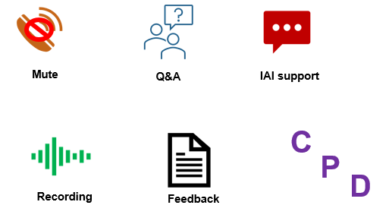
Housekeeping Points
www.actuariesindia.org
www.actuariesindia.org

Slide 5
Program Schedule
26 August 2021
No | Time | Sessions | Speaker
1 | 04-00 PM to 04-05 PM | Introductory Address | Mr. Hiten Kothari, Chairperson, AGGI, IAI
2 | 04-05 PM to 04-10 PM | Presidential Address | Mr. Subhendu Bal, President, IAI
3 | 04-10 PM to 05-40 PM | Presentation: Impact of IFRS 17 on Reinsurance Business and Accounting | Mr. Amitabha Ray, Head Client Markets P&C, Swiss Re, India Miss. Prerana Sadarangani, Corporate Actuarial Analyst, Head of P&C Reserving, Swiss Re, India Mr. Mahipal Choudhary, Manager, P&C Business Management, IFRS Actuarial Implementation
4 | 05-40 PM to 05-55 PM | Questions and Answers CPD Questions | Mr. Ashwani Kumar Arora, Member, AGGI, IAI
5 | 05-55 PM to 06-00 PM | Closing Remarks | Mr. Sourav Roy, Secretary, AGGI, IAI
www.actuariesindia.org

Slide 6

Speakers Profile
Mr. Amitabha Ray, Head of P&C Client Markets, Swiss Re, India
Amitabha Ray is the Head of Client Markets for P&C reinsurance business in India. Based in Mumbai, he is responsible for driving Swiss Re's non-life reinsurance business together with a team of Client Managers in India.
Prior to this, he was the Head of Property Treaty Underwriting for Southeast Asia, India, South Korea, Hong Kong and Taiwan, where he managed the property treaty portfolio with a team of underwriting professionals and developed alternative risk transfer solutions with a team of structurers. He was also involved in the design of parametric and index covers in the public private-partnership space.
A 22-year veteran of Swiss Re, he has worked mainly in the property reinsurance business in his career. During his career, he has held various roles in Zurich, Singapore, Hong Kong, Mumbai and Johannesburg in areas including facultative, alternative risk transfer and business development within Swiss Re.
Amitabha holds an MBA from Melbourne Business School in Australia, a Bachelor's degree in Electrical Engineering and a Master's degree from the Indian Institute of Foreign Trade.
www.actuariesindia.org

Slide 7

Speakers Profile
Ms. Prerana Sadarangani, Corporate Actuarial Analyst, Swiss Re, India
Prerana is responsible for the Reserving and Statutory Reporting for the Property & Casualty business of Swiss Re’s India branch. She is also responsible for reserve reviews for some of the special lines of business in Asia and has previously worked for the EMEA region.
Prerana also has experience in reinsurance pricing for Property business for the India market. Prior to Swiss Re, she has worked in a direct insurance company in a Corporate Actuarial role.
www.actuariesindia.org

Slide 8

Speakers Profile
Mr. Mahipal Choudhary, Manager P&C BM, IFRS Actuarial Implementation, Swiss Re
Mahipal is a qualified actuary and has been working in the Actuarial field for the past six years out of his professional experience of eleven years. He is a computer engineer by degree.
Mahipal is currently a part of the IFRS implementation team at Swiss Re prior to which he has was working on the reserving side for the EMEA market.
www.actuariesindia.org

Slide 9
Impact of IFRS 17 on Reinsurance Business and Accounting
26 August 2021
5th Webinar on General Insurance
Amitabha Ray, Head P&C Client Markets, Swiss Re, India
Prerana Sadarangani, Corporate Actuarial Analyst, Swiss Re, India
Mahipal Choudhary, Manager, IFRS17 Implementation, Swiss Re

Slide 10



Agenda
00 | Opening address
01 | Why is IFRS 17 important
02 | Key elements of IFRS
03 | Impact on financial accounting and KPIs
04 | Policy development & Challenges
05 | Reinsurance impact under IFRS17
06 | Conclusion

Slide 11
Poll Question 1: True or False?
IFRS-17 will change the way reinsurance works for cedants in terms of ultimate protection

Slide 12


IFRS17 is an accounting standard
The economic protection provided by reinsurance remains same under IFRS17 as now.
Reinsurance protection remains necessary.
Only its representation in your accounts is changing

Slide 13
Why is IFRS 17 important
01

Slide 14





Why IFRS?
High relevance and ambitious goals drive the significant magnitude of change
IFRS is the globally dominant accounting framework, many clients and for local statutory reporting. Many of our clients are looking for both accounting and system related advice as well as reinsurance solutions
The objective of IFRS (17) is to provide consistency, comparability, transparency and better information about profitability - across geography, insurance companies and even industries. However, as a principles-based standard, it leaves broad room for interpretation…
The IFRS 17 model combines a current balance sheet measurement of insurance contracts with recognition of profit over the period that services are provided. The IFRS 17 view on profitability is future-oriented, based on economic principles.
Separation is a key concept in IFRS 17, with the standard providing specific guidance on the separation and measurement of things like: assumed vs ceded insurance, investment components, non-insurance services, etc.
Contractual obligations are key, though some concessions on this new accounting view are made to recognize the nature / substance of the business
  Risk pooling (some grouping of contracts to report profitability)
  Splitting of components (allocation of multi-line contracts to LoB portfolios)

Slide 15

Geographical distribution of IFRS
IFRS has developed into the de-facto global language of financial reporting
UK
Ireland
Jersey
Slovakia
China
Hong Kong
Singapore
Malaysia
India
Japan
South Korea
Canada
Brazil
Mexico
Colombia
US GAAP for publicly traded companies
IFRS required for domestic public companies
Australia
New Zealand
South Africa
IFRS permitted (Japan) or local standards substantially converged to IFRS (e.g. China, Indonesia)
Today, 144 out of 166 jurisdictions researched by the IFRS Foundation have adopted IFRS

Slide 16
Key elements of IFRS for insurers
02

Slide 17


IFRS 17 – Introduction
Objective is to highlight the most important changes that IFRS 17 is bringing and start introducing the key underlying concepts
The focus is on the financial statements and the impact IFRS 17 will have
IFRS 17 is a major change compared to all other existing accounting approaches. The section is only providing a quick overview.

Slide 18
Balance sheet linkage to building blocks (insurance contract liability)
Cash inflows
Cash outflows
Unearned profit recognised over coverage period
Purpose of CSM is to report profitability from the portfolio over time (no day-one profit)
CSM floored at zero; losses from onerous contracts are recognised in P&L immediately
Interest accreted on CSM is based on locked-in rates
Discounting
Risk adjustment for non-financial risk
Balance sheet
Cash and cash equivalents
Insurance contracts issued that are liabilities
Investments
Reinsurance contracts that are liabilities
CSM
Insurance contracts issued that are assets
Debt issued
Reinsurance contracts held that are assets
Income taxes payable
Best estimate of present value of future cash flows from premiums, claims and benefits and expenses
RA reflects compensation for bearing uncertainty in timing and amount of cash flows arising from non-financial risks
CSM at inception is measured as the net difference of fulfilment cash flows, floored by zero
Goodwill
Deferred tax liabilities
Income taxes recoverable
Other liabilities
Deferred tax assets
Equity
Fulfilment cash flows (FCF)
Other assets
Insurance contract liability
Total assets
Total liabilities and equity

Slide 19

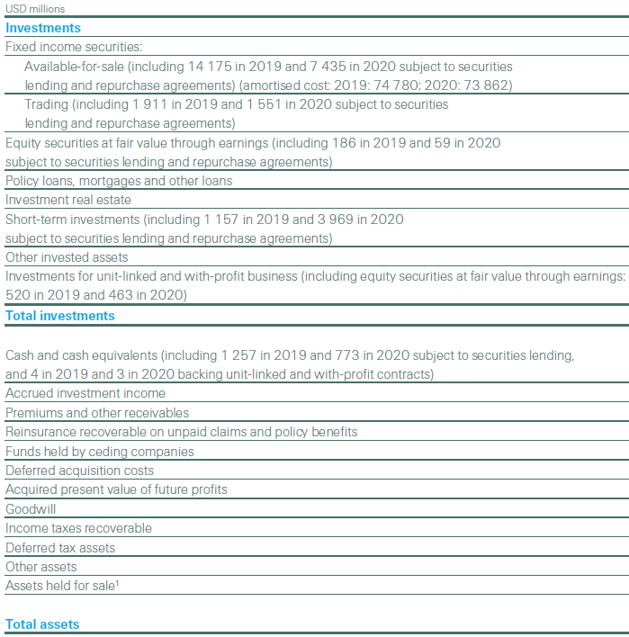
Balance sheet: Assets
Current
New
Main changes
Assets
in USD millions, as of December 31
Cash and cash equivalents (including X in 2024 and Y in 2023 subject to securities lending and repurchase agreements)
Investments
Fixed income securities (including X in 2024 and Y in 2023 subject to securities lending and repurchase agreements)
Equity securities (including X in 2024 and Y in 2023 subject to securities lending and repurchase agreements)
Mortgages and other loans
Investment property
Other invested assets
Total investments
Insurance contracts issued that are assets
Reinsurance contracts held that are assets
Goodwill
Income taxes recoverable
Deferred tax assets
Other assets
Total assets
Overall, fewer line items under IFRS 17
Insurance receivables/ payable part of the insurance contracts assets/liabilities ​
Assumed and reinsured business shown separately
Split of insurance contracts portfolios in net asset or liabilities position - split done based on management reporting level
There are a lot of details in the relevant notes...! ​

Slide 20
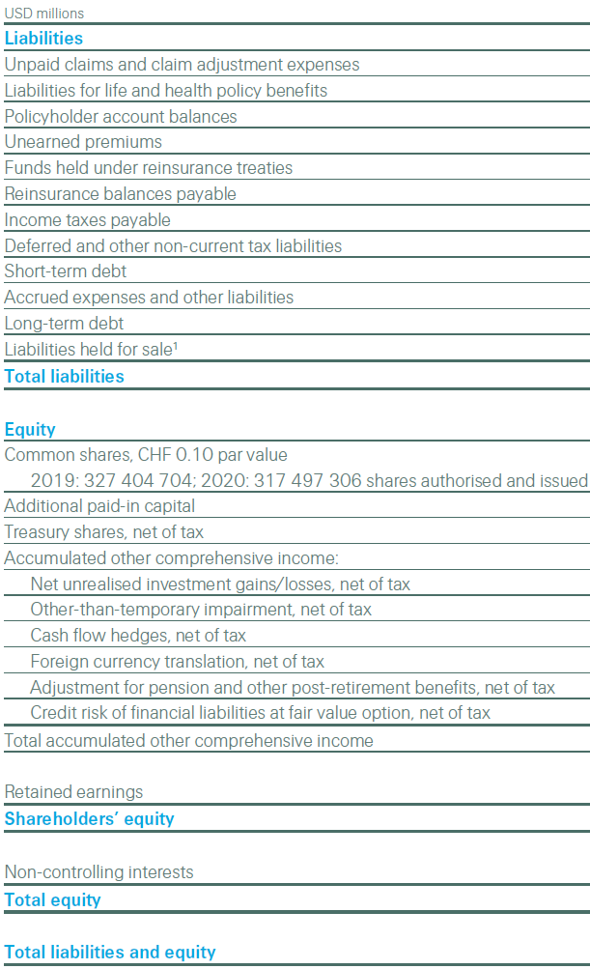
Balance sheet: Liabilities and Equity
Current
New
Main changes
IFRS 17 combines all expected cash flows related to contracts issued in a single line item, reducing the number of line items shown in the liabilities section
Insurance receivables/ payable part of the insurance contracts assets/liabilities ​
Assumed and reinsured business shown separately
Split of insurance contracts portfolios in net asset or liabilities position - split done based on management reporting level
The liability for incurred claims and liability for future claims are not reflected separately
There are a lot of details in the relevant notes...! ​
in USD millions, as of December 31
Liabilities
Insurance contracts issued that are liabilities
Reinsurance contracts held that are liabilities
Debt issued
Income taxes payable
Deferred tax liabilities
Other liabilities
Total liabilities
Equity
Common shares
Additional paid-in capital
Treasury shares, net of tax
Accumulated other comprehensive income
Foreign currency translation, net of tax
Cash flow hedges, net of tax
Fair value reserve, net of tax
Insurance finance reserve, net of tax
Unrealised investment gains/losses, net of tax
Accumulated adjustments for defined-benefit pension plans, net of tax
Retained earnings
Shareholders' equity
Non-controlling interests
Total equity
Total liabilities and equity

Slide 21
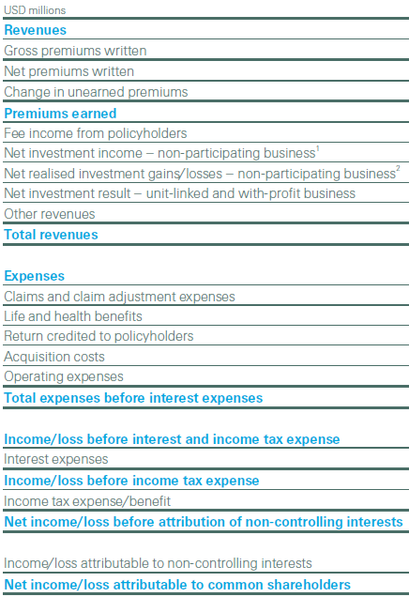
Income statement
Current
New
Main changes
Insurance service result is the central revenue metric – no more gross premiums written
Required to split between insurance service result (insurance, non-market) and insurance financial result (market related movements)
Reinsurance held income (amounts recovered) and expense (premiums paid) can be shown net or gross
Other expenses = Expenses overheads​ (not directly attributable expenses)
A lot of details in the relevant notes…!
in USD millions, as of December 31
Insurance revenue
Insurance service expense
Insurance service result before reinsurance contracts held
Allocation of reinsurance premiums
Amounts recoverable from reinsurers for incurred claims
Net income/expenses from reinsurance contracts held
Insurance service result
Finance income/expenses from insurance contracts issued
Finance income/expenses from reinsurance contracts held
Insurance financial result
Net investment income
Net un/realised investment gains/losses
Investment result
Other operating income
Other operating expenses
Interest expenses
Income/loss before income tax expense/benefit
Income tax expense/benefit
Net income/loss before attribution of non-controlling interests
Income/loss attributable to non-controlling interests
Net income/loss attributable to common shareholders

Slide 22
Roll-forward: Movements in measurement components – insurance contracts issued
Main highlights:
The insurance contracts amounts, with the tracking of the 3 building blocks (not req. for PAA) Info shown based of service period: past/present/future Underwriting experience is very transparent Impact of changes in expectations for the future clearly disclosed Experience adjustments (in current services) shows actual vs expected
All figures in the presentation are for illustrative purposes only

Slide 23
Roll-forward: Movements in type of liabilities – insurance contracts issued
Main highlights:
Split by type of liability gives insights into portion of the business relating to remaining coverage (profitable and onerous) and incurred claims Actual vs expected analysis possible for incurred claims
All figures in the presentation are for illustrative purposes only

Slide 24
New business: Effect of IFRS 17 contracts initially recognized in the year
Effect of insurance contracts initially recognized in the year:
Main highlights:
Shows the estimates of the measurement components for new business (insurance contracts issued and reinsurance contracts held) for the reporting period Depending on the level of disaggregation chosen, can show cross-subsidizing across lines of business Support for many new business KPIs e.g. new business profit, NB volume, NB CSM
Effect of reinsurance contracts held initially recognized in the year:
All figures in the presentation are for illustrative purposes only

Slide 25
Contractual service margin (CSM) emergence
Main highlights:
Gives insights into when the company expects to recognize profit over the coverage period of its IFRS 17 contracts Must split for insurance contracts issued and reinsurance contracts held One of the disclosure tables where more detailed split by LOB could be useful
All figures in the presentation are for illustrative purposes only

Slide 26
IFRS 17 - Key features
An economic accounting model
Insurance contracts are held at market value, using current risk-free rates + an illiquidity premium
The valuation of insurance contracts is based on 3 buildings blocks, a present value of Best Estimate Cash Flows (BECF), Risk Adjustment (RA) and Contractual Services Margins (CSM)
01
A transparent accounting model
This disaggregated view of the insurance contracts into 3 building blocks is the subject of extensive disclosures, bringing a lot of transparency regarding the underwriting performance of the company, the sources of profit
02
Profit recognition
The profit recognition is driven by the insurance services provided, which are often defined as the amount of coverage. Hence, for an insurance policy with a constant sum insured for its duration, the profits are expected to emerge evenly
03
Insurance Revenue (“Top line”)
Instead of being the inflows (premiums), the IR is made of the expected outflows, which are the insurance services expenses, together with the release of RA and CSM. This means a greater reliance on actuarial figures in determining the top line. Non-distinct investment components (NDIC) are excluded from the Insurance Revenue. It will have a major impact on treaties with profit commissions.
04
Reinsured Business
The accounting for reinsured business is done separately from the underlying business, which is a source of potential profit mismatch.
Reinsurance is quite transparent, being shown separately in the financial statements
05

Slide 27
Impact on financial accounting and KPIs
03

Slide 28






Financial accounting impact overview
IFRS will impact various business aspects
Transparency
Transparency
Increases through disclosure requirements and there is more visibility into margins
The financial risk in the insurance business is reflected quickly in the results as the market conditions change and ALM mismatch becomes more transparent in investment results
Transparency increases through additional disclosure requirements
The financial risk in the insurance business is reflected in the results as market conditions change and ALM mismatch becomes more transparent in investment results
Volatility
Volatility
Earnings volatility expected to increase for the whole industry¹⁾. However, CSM serve as a volatility buffer. The longer the coverage period, the stronger the CSM effect
Volatility in P&L reflects underlying economic volatility of the business since IFRS 17 offers options to address most accounting mismatches
Earnings volatility expected to increase for the whole industry. However, CSM serves as a volatility buffer. The longer the coverage period, the stronger the CSM buffer effect
Volatility in P&L reflects underlying economic volatility of the business since IFRS 17 offers options to address most accounting mismatches
Equity
Equity
Equity is influenced by various internal (e.g. cost of capital, level of aggregation, risk tolerance) and external factors (e.g. discount rate)
Discounting on P&C and L&H reserves have an opposite effect, which reduces the overall impact on equity.
CSM range at transition will provide flexibility for equity at IFRS introduction
Equity is influenced by various internal (e.g. cost of capital, level of aggregation, risk tolerance) and external factors (e.g. discount rate)
Discounting of P&C and L&H reserves has compensating effects on transition, which reduces the net transition impact on shareholders’ equity
Different transition approaches will create materially different transitional CSM balances, judgment will be required
Non-insurance topics
Non-insurance topics
Financial instrument classification and measurement under IFRS 9 expected to yield results similar to US GAAP
Financial instrument classification and measurement under IFRS 9 expected to yield results similar to US GAAP
KPIs
KPIs
Some KPIs (e.g. ROE) are impacted by IFRS others such as SST remain unchanged
Under IFRS a new set of KPIs will have to be developed
Some metrics (e.g. RoE) are impacted by IFRS, others such as SST remain unchanged
Under IFRS, a new set of KPIs may have to be developed
Profit emergence
Profit emergence under IFRS 17 will, in general, be more expedited than US GAAP
Profit runoff patterns will more closely resemble the runoff of the risk

Slide 29

KPIs: Impact on financial highlights as per current external financial reporting
KPI | Degree of IFRS change | Future IFRS state of equation | Ability to influence via accounting policy formulation
Net income attributable to common shareholders |  | Continues as defined
Gross premiums written |  | No IFRS KPI – may change to an “APM”
Premiums earned and fee income |  | Does not exist (alternative required)
Earnings per share |  | Continues as defined
Shareholders’ equity |  | Continues as defined
Return on equity in % |  | Continues as defined
Return on investments in % |  | Continues as defined
Net operating margin in % |  | Need to re-define
Combined ratio in % |  | Need to re-define
Gross cash generation |  | Continues as defined
Value of new business |  | New but definitions may diverge more than the past
Insurance service result |  | New
Renewals |  | Need to re-define
None
Low
Medium
High
Full
29

Slide 30
Policy development – and Challenges
04

Slide 31

IFRS policy recommendation development
Important to have an internal committee to advise on Policies, and explain to Regulators and Auditors
crucial to link Actuarial Reserving and Pricing, Finance, Underwriters and Legal teams
Overarching points:
Reinsurance held
Principle based nature allows greater customization, but requires increased interpretation
Important strategic objectives related to IFRS conversion (incl. comparability with peers and steering the business)
Appropriate consideration of operational implementation aspects (Data, System, Process, People)
Crucial link to IFRS 9 – ALM considerations
Close collaboration across Finance and BM confirmed vital
Contractual service margin (CSM)
Cash Flows
Financial statement presentation
Non-Distinct Investment Components
Level of aggregation
Significant insurance risk & separation of components
Business shifts
Onerous contracts
Others
Discounting
Contract boundaries
Transition
Disclosures
Risk Adjustment
31

Slide 32

Level of Aggregation and Reinsurance held

Slide 33
Level of aggregation
Level of Aggregation
Background & relevance
For illustration: Portfolio definition - impact
The IASB's decisions about level of aggregation in IFRS 17 were driven by considerations about the timing of recognising profits and losses on insurance contracts.
The accounting result depends on the level of aggregation, because adjustment amounts that would offset each other within the measurement of a group of insurance contracts would be treated differently (and hence not offset each other) if contracts were measured individually
As set out below, the level of aggregation requires us to split or separate our business into portfolios, which are further subdivided into annual groups of contracts. This has a significant impact on profit recognition:
The pattern of recognition of the contractual service margin is determined at the level of annual groups of contracts, so there is a performance dependency between all contracts within a group
Onerousness after inception is determined at the level of groups of contracts
The definition of groups of contracts also determines when the impact of derecognition of a contract within the group is recognised. For instance, when a cedant recaptures a reinsurance treaty and this treaty forms part of a group of other contracts that continue, a portion of the gain or loss upon recapture is deferred until the last contract in the group is derecognized

Slide 34
Level of Aggregation
Grouping of contracts
The level of aggregation determines how the insurance contracts are grouped together for CSM calculation purposes. A fundamental feature for the profit recognition.
Assessment is done at contract inception – no subsequent re-assessment
1
Portfolio of contracts
Subject to similar risks (e.g. product line)
Managed together
Portfolio A | Portfolio B | …
 | No significant possibility of becoming onerous | No significant possibility of becoming onerous
Other profitable | Other profitable | Other profitable
Onerous at inception | Onerous at inception | Onerous at inception
2
Portfolio divided into: Onerous, NSPO, other
2021
Portfolio A | Portfolio B | …
 | No significant possibility of becoming onerous | No significant possibility of becoming onerous
Other profitable | Other profitable | Other profitable
Onerous at inception | Onerous at inception | Onerous at inception
At least three groups:
Onerous at inception
No significant possibility of becoming onerous (NSPO) after inception
Other contracts
2022
Portfolio A | Portfolio B | …
No significant possibility of becoming onerous | No significant possibility of becoming onerous | No significant possibility of becoming onerous
Other profitable | Other profitable | Other profitable
Onerous at inception | Onerous at inception | Onerous at inception
2023
3
“Group”
No grouping of contracts issued more than one year apart (‘annual cohorts’)
Basis for subsequent tracking, releasing CSM
Group of contracts
34

Slide 35
Reinsurance held
Background & relevance
Source of mismatches
IASB concluded that an entity needs to account for a group of reinsurance contracts held separately from the underlying contracts,
accounting and economic ‘mismatches’ arise from reinsurance held against the underlying contracts
very different from the current existing practice under US GAAP which account for reinsurance contracts held using a ‘mirroring approach’, essentially matching reinsurance contract revenue, costs, assets and liabilities the to underlying insurance contracts
contract boundaries and level of aggregation may be different from underlying contracts
Initial recognition date may be different from underlying contracts [IFRS 17.62];
reinsurer non-performance risk [IFRS 17.63];
risk adjustment (non-financial risk) transferred to reinsurer [IFRS 17.64];
negative CSM without immediately to recognise in P&L (with one exception) [IFRS 17.65, 68]; CSM for (net cost) or net gain on purchasing reinsurance held
to allow for a loss-recovery component, [IFRS 17.66, 66A]

Slide 36
Transition

Slide 37

Background and relevance
Transition
An opening balance sheet needs to be determined one year before, as of the 1st January 2022
The expectations are to apply the IFRS 17 standards in their integrality, where practical
A key element is to calculate/determine the opening CSM balance, which is one of the most important drivers for the level of equity and profit in the upcoming years
1/1/2022(23)
1/1/2023(24)
Transition date
Beginning of the annual reporting period immediately preceding the date of initial application
Date of initial application
Beginning of the annual reporting period in which an entity first applies IFRS 17

Slide 38
Transition: Estimating CSM on transition – key requirements
Step 1
Step 2
If FRA is impractical – Option #1 Modified Retrospective Approach (MRA)
Full retrospective approach (FRA)
When not all historical information is available
Several modifications are included (e.g., level of aggregation, cash flows, discount rates, CSM release). Only those individual modifications are allowed where FRA is impracticable -> maximising the use of available information
However, modifications require ‘reasonable and supportable information’ -> otherwise use FVA!
Required if it is practicable to perform the calculations retrospectively (sufficient historical data exists and hindsight is not required)
As if IFRS 17 had always been applied
If FRA is impractical – Option #2 Fair Value Approach (FVA)
CSM is the difference between the fair value of the insurance contracts asset/liabilities (according to IFRS 13) and their IFRS 17 fulfilment value (= Best estimate cashflows + Risk adjustment).
CSM is predominantly created by the difference of perception of the risks in the portfolios by the market and Swiss Re.
Use if no “reasonable and supportable information” to apply the MRA can be obtained
FVA considerations:
CSM depending on specific current market environment, Value is sensitive to assumption changes and can vary significantly over time
Trade-off between future profits and equity -> transition impact modelling is key!
Sustainability aspect of earnings should be in line with and support the wider investor story
38

Slide 39
Important Considerations

Slide 40
Considerations & Challenges
Challenges
Systems & Skills
Interpreting the standard and deriving policy recommendations where there is some choice or ambiguity
Delivering the systems that can perform the IFRS 17 calculations (ex: FPSL which has been co-developed with SAP)
Adjusting source systems to correctly capture policy information as well as to ensure that actuarial systems are capable of delivering the baseline cashflows at the right level of granularity
Need of Business & IT controls
Strong Governance and workflow management;
Reviewing the end-to-end control framework and quarter end close schedules
Calculation of opening balances
Training and upskilling of staff;
Closer cooperation between Actuaries and Accountants
Best Estimate Cashflows & Risk Adjustment
Cashflow pattern changes will directly impact the P&L
More importance to be given to pattern changes
Risk Adjustment will impact CSM and therefore needs an appropriate assessment
AAs need to report confidence intervals, require an understanding of the reserve distribution

Slide 41
Importance of CSM for Actuaries
For P&C, future expected profits are highly dependent on current & prior year loss ratio assumptions
APLR updates on latest UY will impact the CSM
Payment pattern changes and volume updates to business which has unearned exposure will also impact CSM
Level of Aggregation (LoA)
LoA will have an impact on the speed of actual and expected profit recognition
Larger portfolios will have more possibility to diversify adverse assumption changes impacting the CSM
LoA may not match reserving segmentation, but still need to explain results at LoA level
Judgement may be required for allocation to LoAs for large multiline or complex treaties; complications for business shifts, acquisition of portolios, LPTs/ADCs
Importance of Initial Onerousness Testing
If classified incorrectly:
-Directly impacts P&L on day one
-External and Internal stakeholders would be interested
-Management would have special focus on onerous business and factors behind it
-Analysts would comment on proportion of onerous business and future profitability of overall business
-Regulators may have biased outlooks especially when compared with peers, may lead to external scrutiny
Incorrect Risk adjustment and expense factors may make seemingly good business look onerous
Cross-subsidizing contracts would come under pressure to look non-onerous, may lead to pricing bias
Considerations & Challenges
Challenges

Slide 42

Reinsurance impact under IFRS17
05

Slide 43
Poll Question 2: True or False?
Both insurance contracts issued & reinsurance contracts held
which have overall net losses
must be recognized upfront

Slide 44

Cost of reinsurance is amortized over time as service is delivered rather than being recognized upfront as a loss
The exception to this is when the reinsurance contract held is a retrospective cover involving claims that have already been incurred; in such cases the cost of reinsurance must be recognized upfront

Slide 45
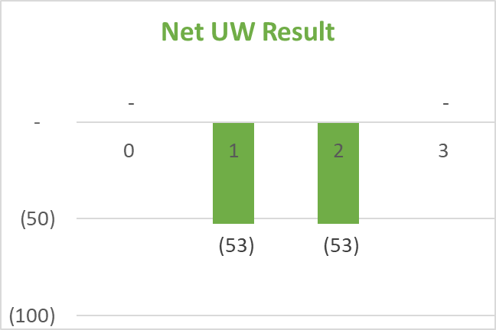
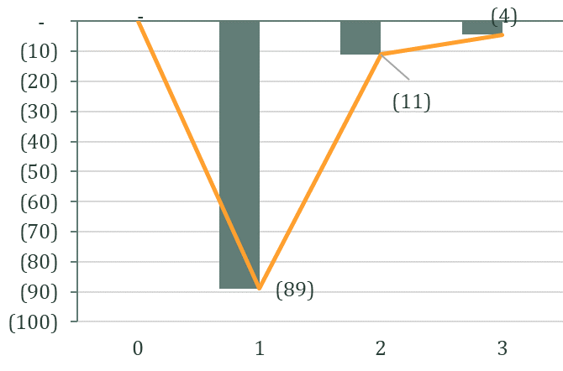
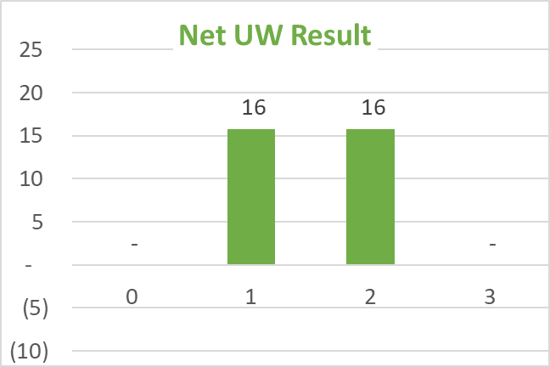
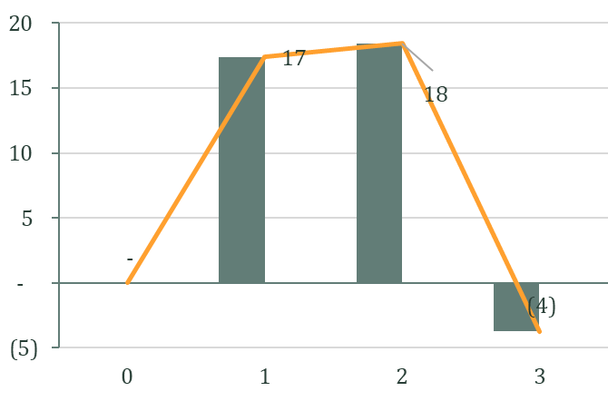
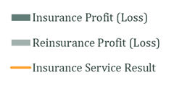
Losses generated by Onerous insurance contracts have to be recognized upfront under IFRS17
IFRS4 (current)
IFRS17
For a loss-making business, the upfront (or a.s.a.p.) recognition of losses largely shifts the earnings pattern
LR 88%
For a profit-making business, there is not much change between IFRS17 and IFRS4
LR 75%

Slide 46
Reinsurance is represented independently from the insurance performance
What are the implications?
Onerous contracts
  RI contracts cannot be onerous
  RI recoveries can be offset from onerous contracts, reducing the hit to the Net Income… but requires a match between RI cover and Insurance cover
Admin burden of computing IFRS17 accounts: PAA vs GMM
  If the insurer can demonstrate that there would be no material difference in the accounts using PAA (or RI contract held are equal to or less that 1 year duration), it can use PAA (“similar to UPR used currently”)
  Otherwise GMM must be used
PAA: Premium Allocation Approach
GMM: General Measurement Model

Slide 47

Proportional reinsurance: mind the commission
Visibility in accounts
Income statement
3 lines representation : large amounts if proportional cession is significant versus the size of your book
1 line: only shows ceded margin, thus much smaller amount
Reinsurance Commission (RI Comm): fixed & provisional deducted from premium paid to reinsurer, adjustment to sliding scale is added to amounts recovered from reinsurer
Impact on KPI (bottom line & key ratios)
Bottom line: similar impact as IFRS4 except discounting, thus minor change
UW result: overall similar: minor change but split between "expected from new business written" and "adjustments for past business" ⇒ evolution of book quality becomes transparent
New ratios vs old ones:
Points of attention
Accounting simplicity versus risk exposure: Aiming for automatic PAA eligibility may create mismatch in your protection
Reinsurance benefit can be fully recognized upfront for new business in case that business is onerous
RI comm: Fixed or variable
Accounts level detail: 1 or 2 lines
ROE | Combined Ratio
Net income Equity | Ins. service expense* (ISE) Ins. revenue*
=
*Net of reinsurance

Slide 48

Non-Proportional reinsurance: limited changes
Visibility in accounts
Income statement
Movements in the Present Value of Future Cash Flows - PVFC (new to IFRS17)
Impact on KPI (bottom line & key ratios)
No significant change
No significant change
Contractual Service Margin
Points of attention
More transparency on book improvement or deterioration
Expected recoveries and reinsurance efficiency (CSM and PVFC)
Accounting simplicity versus risk exposure: Aiming for automatic PAA eligibility may create mismatch in protection
Cash outflows
Risk Adjustment
Discounting
(Ceded Prem. -
Fixed RI Comm & Prov. RI Comm)
Cash inflows
(Ceded Claims, Sliding comm., - non-perf. risk)
PVFC
PVFC is impacted by elements estimated, especially Expected Ceded Claims, from which the expected RI comm may result and depending on which the Risk Adjustment and CSM will be adjusted: impacts the analysis of achieved vs expected
Note that this only applies to GMM, thus those using PAA would not face this issue

Slide 49

MY XoL
Main question: contract boundaries
  Underlying business is 1-year policies
  RI is a 3-year deal (or other MY)
“Creates a mismatch between RI held and underlying policies”
RI
Underlying policies
Initial recognition? Fear that the insurer has to account for PVFC for RI? (3 years means more premium paid out?)
  Issue if the insurer grows less than planned… but not too different from now (constructive with client)
Allocating the losses to the cover is not an issue as policies covered are clearly identified
Primary business on risk attaching basis and RI on loss occurring basis would be more an issue: what happens when a primary policy is on the book and no reinsurer want to write that book at “favourable conditions” for the next loss Occurring year of protection?
  Again nothing different from now

Slide 50
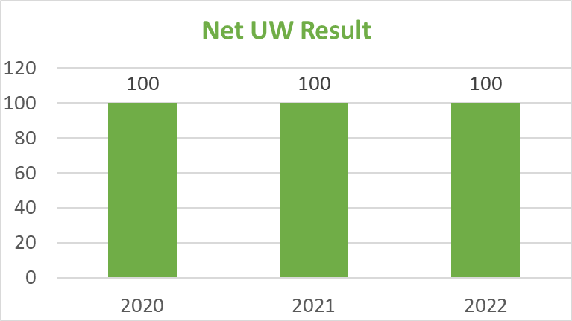
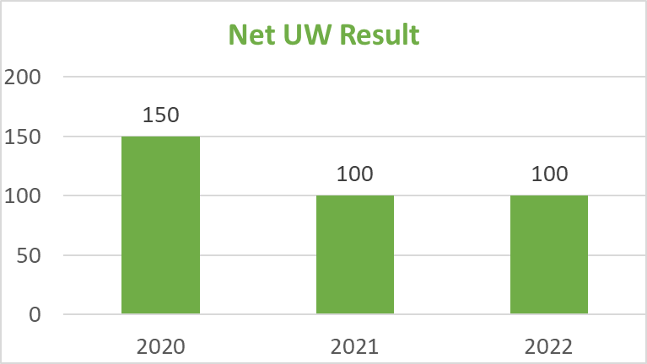
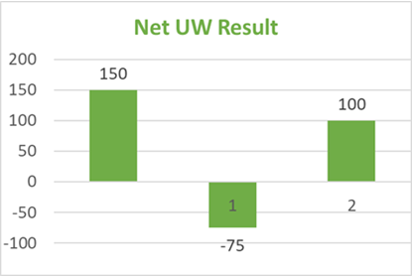

Fire 3 Years XoL… what happens really to the PC?
Premium 1000, Gross LR @40%, XoL: 200xs100 at 50% RoL for 4 year return period
Current IFRS
Initial view: all numbers are “planned”
End of Year 1: no claims in Y1, rest is still with planned numbers
End of Y2, the large claim occurred
          Year 3: Net UW result remains unchanged
Initial view: all numbers are “planned”
  Ceded premium: 100 each year
  Ceded claims: 50 each year
  Reinstatement premium: 25 each year
  PC: 50% of upfront premium + reinst prem – claims = 75
Large claims:
  No claim in Y1 => PC accumulates more than planned
  Large claim in Y2: 150 ; 75 reinst prem
  No claim in Y3

Slide 51
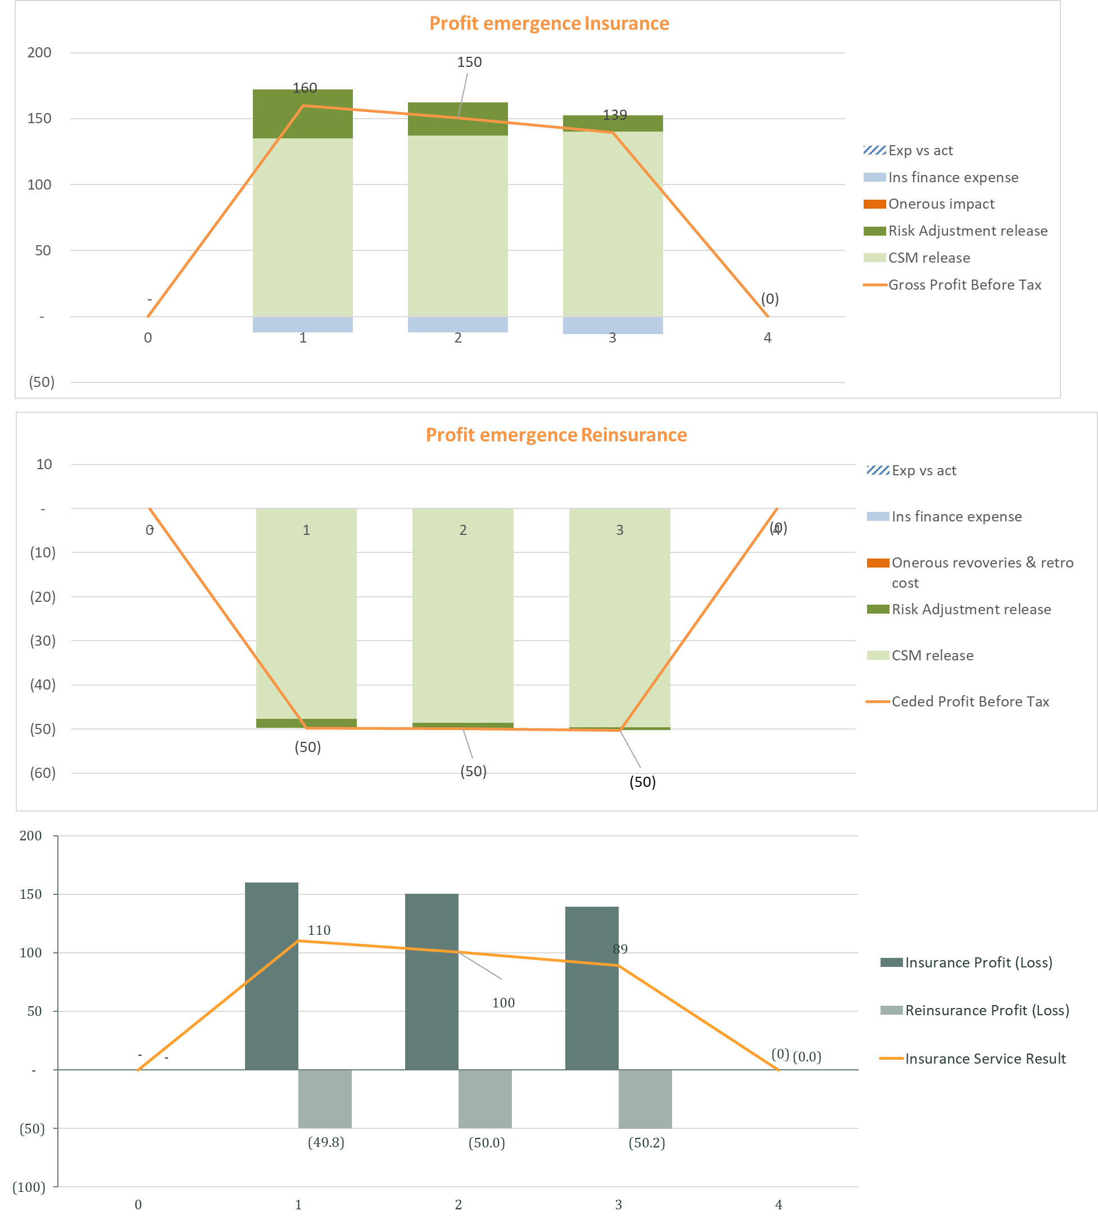
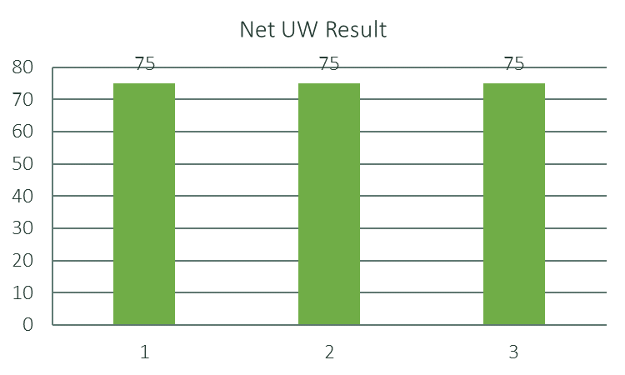
MYML with PC and adverse claims
Initial
IFRS 17
Expected
All numbers are “planned”
KPI | Each Year
Gross premium | 1000
Gross claims | 450
Gross expenses | 400
Ceded premium | 100
Ceded claims | 50
Reinstatement premium (50% RoL) | 25
PC [50% of upfront premium + reinst prem – claims] | 25
Current IFRS
Similar values between IFRS4 Net UW result and IFRS17 Ins. service result

Slide 52
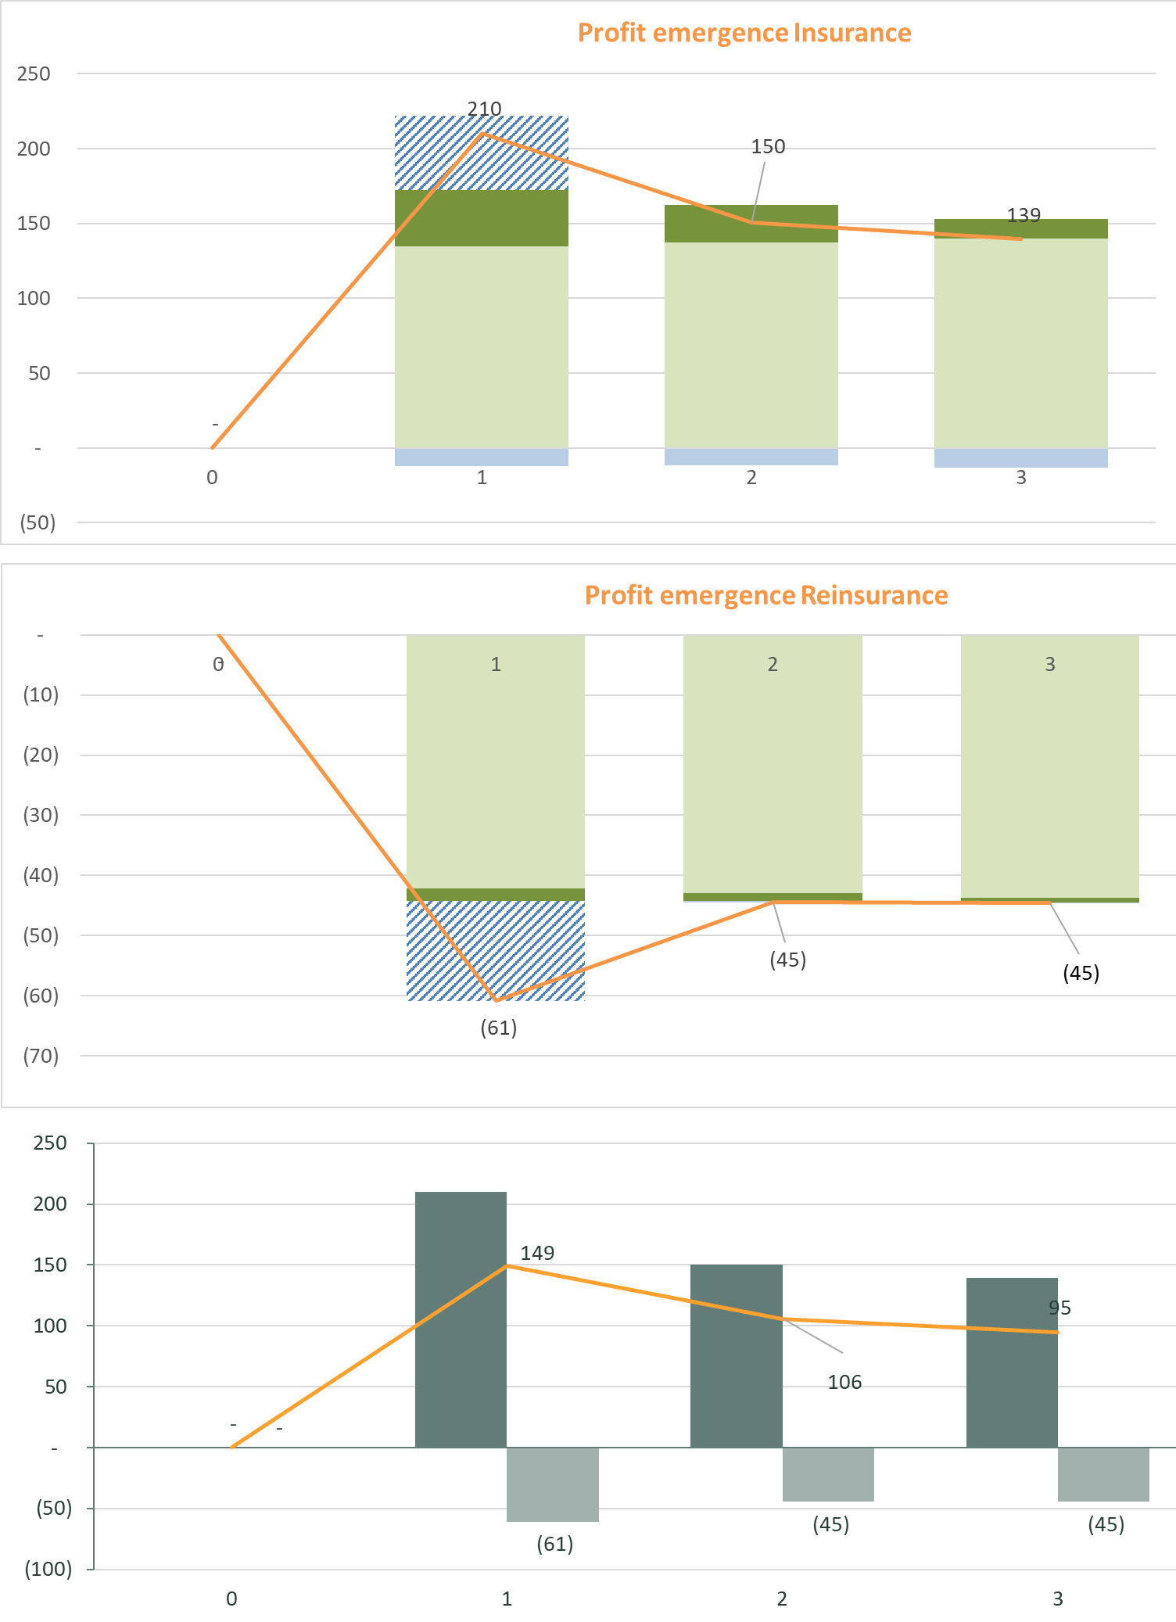
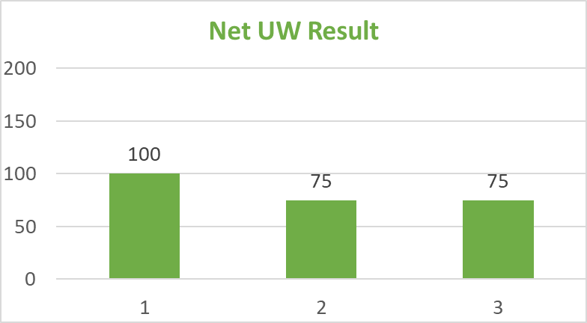
MYML with PC and adverse claims
At the end of Y1
IFRS 17
Expected
Only Y1 changed numbers are “planned”
KPI | Y1 | Y2 – Y3
Gross premium | 1000 | 1000
Gross claims | 400 | 450
Gross expenses | 400 | 400
Ceded premium | 100 | 100
Ceded claims | 0 | 50
Reinstatement premium (50% RoL) | 0 | 25
PC [50% of upfront premium + reinst prem – claims] | 50 | 25
Current IFRS, the “local way”, i.e. PC at end
IFRS17 recognizes the good performance in Y1 (PC linear); not IFRS4

Slide 53
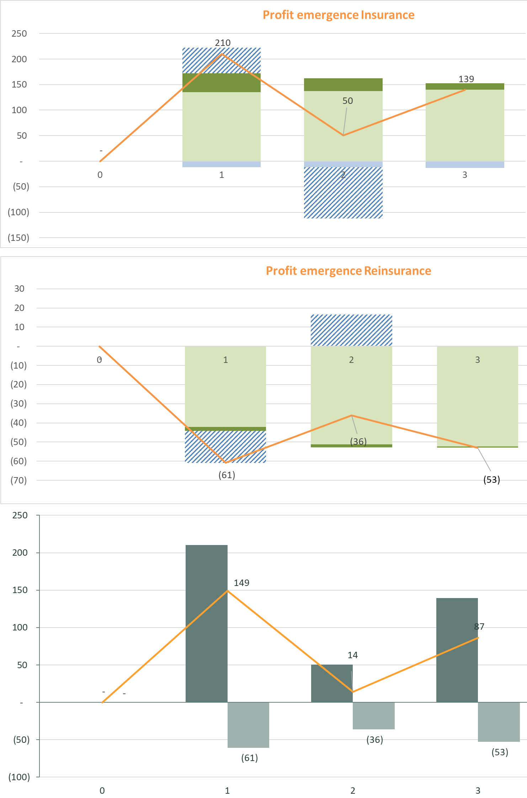
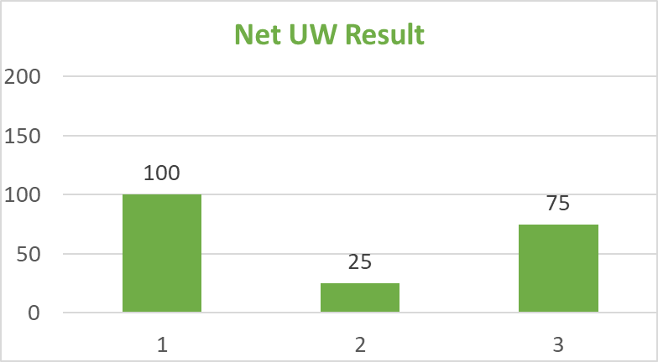
MYML with PC and adverse claims
At the end of Y2
IFRS 17
Expected
Only Y3 remains unchanged, numbers are “planned”
KPI | Y1 | Y2 | Y3
Gross premium | 1000 | 1000 | 1000
Gross claims | 400 | 550 | 450
Gross expenses | 400 | 400 | 400
Ceded premium | 100 | 100 | 100
Ceded claims | 0 | 150 | 50
Reinstatement premium (50% RoL) | 0 | 75 | 25
PC [50% of upfront premium + reinst prem – claims] | 50 | -25 | 25
Current IFRS, the “local way”, i.e. PC at end
Increased volatility because of large claim in Y2 (PC adjusted); less impact in IFRS4

Slide 54
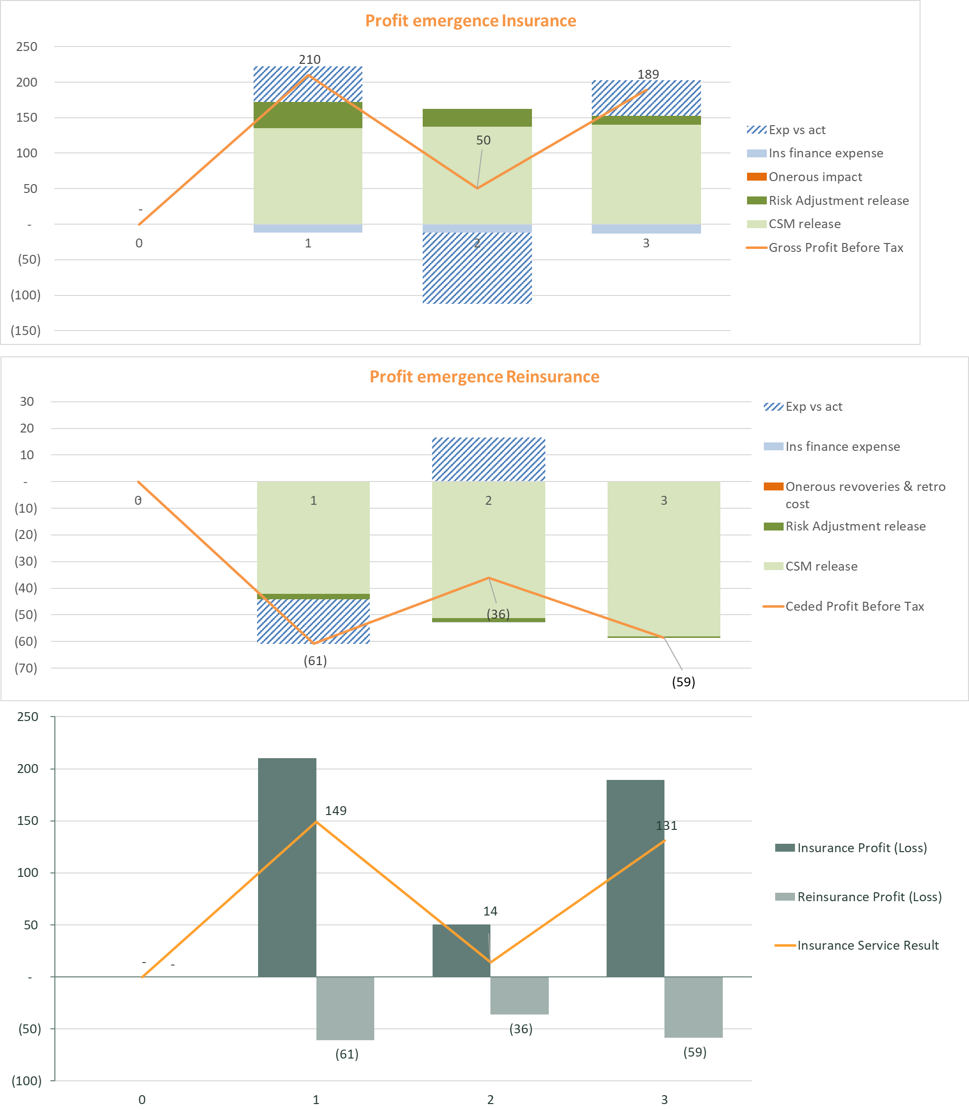
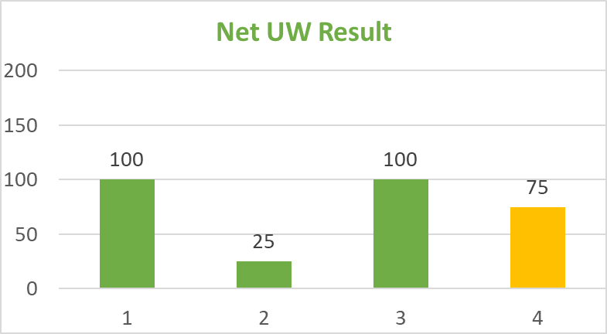
Illustration 6 – MYML with PC and adverse claims
At the end of Y3
IFRS 17
All years are known
KPI | Y1 | Y2 | Y3
Gross premium | 1000 | 1000 | 1000
Gross claims | 400 | 550 | 400
Gross expenses | 400 | 400 | 400
Ceded premium | 100 | 100 | 100
Ceded claims | 0 | 150 | 0
Reinstatement premium (50% RoL) | 0 | 75 | 0
PC [50% of upfront premium + reinst prem – claims] | 50 | -25 | 50
Current IFRS, the “local way”, i.e. PC at end
IFRS17 recognizes the good performance in Y3 IFRS4 gets PC coming form nowhere, adding “pleasant” volatility

Slide 55

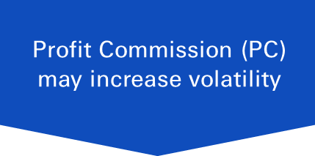

Structured Reinsurance may prevent the automatic PAA eligibility, thus more work for your accounting and actuarial teams to account for such treaties
Profit Commission (PC) may increase volatility
Multi-Year treaties help reduce volatility over time
Difficult upfront recognition in case of onerous business
Expected recoveries and IBNR complex to assess
Help reduce volatility
PC to be recognized linearly
Yearly adjustments to expected PC add volatility
Combine the Term years together: no automatic PAA eligibility*
Treaty boundary more than 1 year: no automatic PAA* eligibility
Capacity and rate guaranteed over the Term help reduce volatility
Actual vs planned estimations generate complexity
Multi-line (ML) treaties may help reduce volatility
The economic benefits of such structures remain
Time for reassessing the cost / return of such structures, not to forget about them
*PAA: Premium Allocation Approach: its eligibility would have to be demonstrated

Slide 56
Conclusion
06

Slide 57
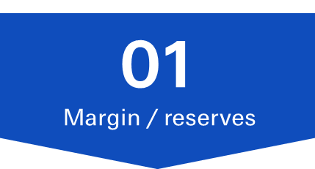

Increase of volatility in the accounts because of IFRS 17
02
Onerous contracts
03
Discounting
At transition, excess reserves will be released straight into Equity
After transition, auditors will have their means of calculating prudency margins
Cedants may not have excessive margins or reserves with disclosure in auditor’s report or notes to FS
IFRS-17 requires upfront recognition of onerous contracts, including in-force contracts that have turned onerous during policy lifetime
Upfront recognition might generate P&L volatility
Regular updating of discounting at each reporting period
Impact reflected in the P&L under OCI
01
Margin / reserves
More transparent & granular information will create issues of volatility
Reinsurers can help clients to reduce the volatility of underlying portfolio & protect ROE decline

Slide 58





Overall Recap
IFRS-17 recognises revenue & earnings overtime as services are delivered - premiums collected upfront no longer serve as basis for revenue or profitability
P&C insurers will use either the GMM or PAA approach, the latter if the RI contract is <1 year
Onerous contracts will result in adverse upfront accounting losses; RI QS contracts can reduce that impact
XoL treaties will need proper modelling of expected recoveries to prevent RI from looking too expensive especially if ceded IBNRs are underestimated
Structured treaties will be more difficult to book under IFRS-17, but the economic protection remains – the value brought by such treaties might still be worth the effort

Slide 59


Q&A
?

