Slide 1
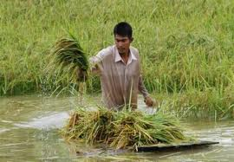
Webinar on June 26, 2020
Time 1600 to 1730 IST
Crop Insurance Pricing
A V Karthikeyan Appointed Actuary
Reliance General Insurance
The Institute of Actuaries of India

Slide 2
Welcome Instructions
Mute
Q&A
IAI support
C
P
D
Recording
Feedback
www.actuariesindia.org

Slide 3
Setting the tone
INR 30k cr or USD 4b annual premiums.
Tool for smoothing consumption and continuing food security.
Substantially reinsured portfolio.
Pricing but not reserving-intensive, due to short-tail nature.
More pricing dynamics need greater investment in underwriter’s modelling skills.
www.actuariesindia.org

Slide 4
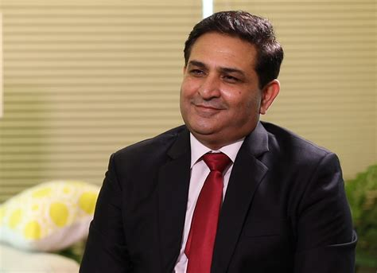
Introductory comments
Sunil Sharma
President, Institute of Actuaries of India
www.actuariesindia.org

Slide 5
Speaker’s profile
A V Karthikeyan
Appointed Actuary, Reliance General Insurance
A V Karthikeyan is the Appointed Actuary of Reliance General Insurance. He has more than 15 years’ work experience in the Indian General Insurance industry with significant work exposure in underwriting, product designing and actuarial functions.
Karthikeyan is a FIAI and a CERA. Before the actuarial qualifications, he holds a MBA and a Bachelors in Agricultural Sciences [BSc (Agriculture)].
www.actuariesindia.org

Slide 6
Key questions
Would it be necessary for a pricing actuary to understand agronomy (including plant physiology) and phenology as compared with the present practice of determining crop insurance premium rates from burning cost?
Would risk assessment become superior if the pricing approach changes as above?
www.actuariesindia.org

Slide 7
Poll Question 1
Which parameters are currently modelled by crop insurers?
Weather only
Crop Yield only
Both
Both + one-off events like locust swarm, Covid-19, etc.
www.actuariesindia.org

Slide 8
Poll Question 2
How important is it for the pricing actuary to know plant physiology (during germination, standing time, harvesting) while pricing insurance risks?
Not important
Somewhat important
Important
Very important.
www.actuariesindia.org

Slide 9
Poll Question 3
Please match the type (linear, ordinal, categorical) of independent variable with the associated risks.
X. Linear | Rainfall
Y. Ordinal | ii. Locust swarm
Z. Categorical | iii. No. of continuous days of hail
X-i, Y-iii, Z-ii
X-ii, Y-i, Z-iii
X-iii, Y-ii, Z-i
X-iii, Y-ii, Z-i
www.actuariesindia.org

Slide 10
PMFBY - Introduction
Pre Sowing / Germination Stage
1. Prevented Sowing due to adverse weather
2. If > 75% of the notified area remain unsown then 25% of the SI is payable. Policy terminates.
Standing Crops Stage
1. Area Approach i.e. Yield shortfall measured using CCEs at Insurance Unit level
2. Claims settled based on the below formula (calculated at IU level):
Claims = (TY – AY) / TY * SI
3. SI determined by Scale of Finance
Post Harvest Stage
1. Weather related impact on crops lying in the filed post harvest up to 14 days (cut and spread / small bundles)
2. Excess Rainfall > 20% over long term average is the primary trigger.
Other Key Features:
Compulsory for Loan Farmers. Optional for non-loan farmers
Premium rates are not capped. But farmer shares are capped.
Key stakeholders: Farmer, Central Government, State Government, Insurer (and Reinsurers) and Financial Institutions
Other Covers are – Localised Losses (hailstorm, landslide, inundation, cloud burst and natural fire due to lighting) and On Account Payment due to Mid Season Adversity (if , due to adverse weather events the yield is expected to less than 50% of Normal Yield. Claim Payable is 25% of the expected claims)

Slide 11
PMFBY - Introduction
Cluster 1
District 1 (CCE = 24)
Taluk/ Tehsil Block1 (CCE = 16)
Block2
District 2
Block n
Mandal / Revenue Circle/Firka/Hobli (CCE sample = 10)
GP (CCE Sample = 4)
Clusters (as per operational guidelines):
Must contain high risk and low risk districts
Districts of different agro climatic zones
ESI for each cluster must be similar
May be left unchanged for 3 years

Slide 12
PMFBY – a Risk Perspective
Pre Production
Production
Post- Production
Biological Risks / Weather Risks
Credit Risks/
Market Risks
Human / Personal Risks
Poor Quality Inputs like Seeds, Fertilizers and Manures
Water Availability
Impact of Previous Crop
Result: Lower Area Sown, Failed Germination, Lower Yield , Poorer quality of produce (?)
Pests, Weeds,
Pollinators activity
Diseases, Wind Parameters
Irrigation inputs like fertilizers etc
Result: Mid Season Failure, Lower Yield, Requirement of more inputs like more irrigation or pesticide pushing up cost (?), Effect on the next crop( ?), Poorer Quality (?)
Weather parameters like temperature, wind etc, Pest
Result: Loss of produce in the field, Loss of produce post transportation, Storage or in processing (?), Processing cost increase (?) Quality degradation (?)
Cost of inputs is inflation prone,
Access to institutional credits
Results: Higher Cost of Inputs (higher scale of finance but with a lag), less than required inputs resulting in crop failure
Similar to pre production phase
Results: Higher Cost of Inputs (higher scale of finance but with a lag), less than required inputs resulting in crop failure
Lower realisation for the produce, inadequate post production processes
Results: Financial Losses (?) and impact on the next season (?) and cost escalations (?)
Personal Risks like Accident sickness etc / Systemic risk like non availability of labour, Skills and Knowledge
Result: Adverse Yield (personal losses are not covered, systemic losses do get covered in the form of lower yield), Adoption of mechanisation
Same like pre production + new technologies and ability to use knowledge based inputs
Result: Adverse Yield (personal losses are not covered, systemic losses do get covered in the form of lower yield), increased costs (?)
Delay in post harvest production / wrong post harvest production
Result: Longer exposure time in the fields especially due to seasonal labour non availability
Can result in poor quality output (?)

Slide 13
PMFBY as a part of Risk Management
Risk Transfers and Risk Retained
PMFBY / RWBCIS
Other Social Insurance Schemes like Health, PA, Life and Assets
Credit and Market Support
Agricultural Loan and Land Development Loans
Procurement Support like MSPs
Institutional Infrastructure and Policy Support
Budgetary Allocation for Various Risk Alleviation Mechanisms
Effective Institutitions to administer, support and manage schemes with overseeing mechanisms
Infrastructure development – Agricultural Extensions & Advisory, Weather and Agro Forecasting and Irrigation development
Input Credits and other subsidies
Relief Schemes and Disaster Funds

Slide 14
Pricing Policy Determinants
RI capacity in place vs budgets (if deviated, reasons)
Net Protection arrangements
RI panel and credit rating
Past treaty performances and balances
Loss sharing clauses, Single state clauses
State to State implementation machinery Variations
Past Loss Experience
Agro infrastructure development e.g. Any investment in dams / irrigation, water levels in Dams especially for downstream riparian states
Company strategy, capabilities and past performances
Reinsurance arrangements in place and aspects like RI commission and past treaty performances
Scheme Nature, Covers and SI changes
State Selection – any scheme choices exhibited by the state, level of disputes etc
Competition – strategy and capacity supply
Past Performance
Balance sheet and solvency strength
Basis for budgeting
Reserving approaches and adequacy
Investment of the Company in strengthening UW, Sales and Claims
Process controls - CCE approaches, outsourcing vs in-house, reconciliations, dispute handling approaches
Scheme rules can change with respect to:
Indemnity Level
Crops covered
Tenure
Scale of Finance
Revamped Scheme from Kharif 2020 -21
Past results
Solvency position
RI terms and capacity
Team changes

Slide 15
New Changes in PMFBY (2020-21 onwards)
Scheme Options | Until 2019-20 | Kharif 2020-21 | Trends in tenders released until 15 th June 2020
Tenure | Preferable: 3 Yrs Min: 1 year | Min: 3 Year | No Deviations
Selection Options | Compulsory for Loanee Voluntary for Non Loanee farmers | The cover is optional for all farmers. | No Deviations
Covers | Basic: Prevented Sowing + Standing Crop + Post Harvest Losses + Localised Calamities Optional: Crop Loss due to Wild Animals Attack | Basic: Standing Crop Optional: Prevented Sowing, Post Harvest Losses, Localised Calamities States can also take single peril covers like hailstorm | Most states has taken the Basic (until 2019-20) covers and has not unbundled the covers
TY Calculations | Fixed TY | Fixed TY Laddered TY Variable TY | Except for 1 state, so far all other states has opted Fixed TY

Slide 16
New Changes in PMFBY (2020-21 onwards)
Scheme Options | Until 2019-20 | Kharif 2020-21 | Trends in tenders released until 15 th June 2020
Central Govt Subsidy | Apart from Farmer's Share, the rest is equally shared by the state and the central | Subsidy will be still equally shared up to a cap on the premium rate. The cap is 30% for unirrigated areas/crops and 25% for irrigated areas/ crops. NE Indian states alone are eligible up to 90% central subsidy | No deviations
Smart Sampling (Strateified Sampling) to optimise CCEs | Allowed (States can...) | Directed (States have to...) | Adoption to be seen
Two step process of Loss Estimation to be adopted based on "Deviation Matrix" using specific triggers like weather indicators, satellite imagery etc for targeting CCE | Not mentioned | Newly intorduced | Detailed guidelines awaited
In case of non provision of yield data beyond cut off date, the Insurer can settle claims using yield estimated by technology solutions | Not mentioned | Newly introduced | Detailed guidelines awaited

Slide 17
State is the most important selection
Cluster and Data level Definitions
Yield data level vs IU definitions
Clusters definitions
Crops included in the scheme
New crops
Clarity on yield calculations e.g. Number of pickings, with / without pods etc.
Type of Scheme
PMFBY/RWBCIS
State Schemes
TY calculations
Options now available
Fixed TY/ Laddered TY/ Variable TY
Indemnity Levels
70%, 80%, 90%
Can become complex in case of new district / crop
SI basis
Scale of Finance
NAY*MSP or Farm gate price
Perils Covered
Prevented Sowing
CCE Mechanisms
Departments involved in CCE
Optimisation
Dispute Mechanisms
Appeal Mechanisms
Litigation Nature and Past Trends
Localised Calamity
Mid Season Adversity
Post Harvest losses
Single Peril losses
Two Step Process for CCE estimation

Slide 18
Pricing Component of PMFBY
Historical Burn Cost + Add on Covers
Heterogeneity Loading + CAT Loadings
Commercial Premiums
Administrative Costs + Capital Costs
Long Term Consideration
Tactical Consideration

Slide 19
Steps in Burn Cost calculation
Yield data by crop, IU for 7 years or more
Insured Area for the past years
Sowing Areas for the past year
Past premiums and Claims
Sum Insured in the past and proposed
Rainfall and other key weather parameters
Cluster Selection + Seasonal Forecast
Yield Data - Collection and Validation
Threshold Yield (TY) Calculation
Yield De-trending
Historical Burn Cost
Total ESI and its fitment with overall business objectives
Past Experience of the Cluster
Main Crop Mix and Irrigated : Rain-fed mix
Past rainfall patterns
Company’s preparedness
Present forecasts like El Nino and IOD
Past sources of disputes and how are they addressed at present (like localised calamities and CCEs )
Three options of TY:
Fixed TY
Laddered TY
Variable TY

Slide 20
Understanding Various TYs
Year | 2013 | 2014 | 2015 | 2016 | 2017 | 2018 | 2019
Yields | 1000 | 1000 | 1600 | 1900 | 1850 | 1400 | 1200
Indemnity Level : | 70%
Fixed TY = (Average of Best 5 Years) * 70% = 1113
2. Laddered TY:
Laddered TY for Year 1 = Fixed TY = 1113
Laddered TY for Year 2 = Fixed TY * (1+ Average Yield Growth Rate in latest 7 years)
= 1113 * { 1 + [ (1000/1000-1) + (1600/1000-1).....+(1200/1400-1)]}
= 1113 * {1+0.0625} = 1183
Laddered TY for Year 3 = 1183 * {1+0.0625} = 1257
3. Variable TY:
Variable TY for Year 1 = Fixed TY = 1113
Variable TY for Year 2 = recalculate TY including yield data of Year 1
Variable TY for Year 3 = recalculate TY including yield data of Year 1 & Year 2

Slide 21
De-Trending Yield Data
De-trending:
A trend is a change in the mean over time in the observations of a time series. De-trending is a statistical process that aims to remove the effect of this change and re-state the observations ‘on par’, so that the de-trended data is useful for further modelling / predictions.
In Crop Insurance, we typically use linear de-trending techniques. The following formula could be set up easily in typical spreadsheet applications like MS excel:
Slope * (Latest Year – Observation Year) + Actual Data for the Observation Year
When do we de-trend
Which Statistic to depend upon
How much of the Trend to allow for
At what granularity level trending to be done

Slide 22
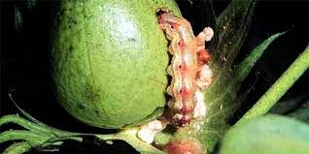
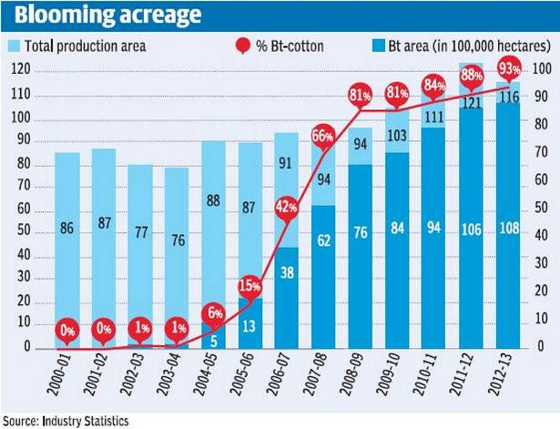
De-trending the Data – case of Bt Cotton in Gujarat
Case of Gujarat Cotton Crop
Year | Cotton Yield (Kg/Ha of Lint) | Area in Lakhs Ha | Rainfed Cotton Yield (Kg/Ha of Lint) | Rainfed Area in Lakhs Ha | Irrigated Cotton Yield (Kg/Ha of Lint) | Irrigated Area in Lakhs Ha | Proportion of Irrigated Areas
1996 | 265 | 14 | 140 | 9 | 504 | 5 | 34%
1997 | 304 | 14 | 175 | 9 | 534 | 5 | 36%
1998 | 356 | 15 | 232 | 10 | 575 | 5 | 36%
1999 | 400 | 16 | 264 | 11 | 635 | 6 | 36%
2000 | 230 | 15 | 136 | 9 | 378 | 6 | 39%
2001 | 122 | 16 | 63 | 11 | 233 | 6 | 35%
2002 | 165 | 17 | 99 | 11 | 268 | 7 | 39%
2003 | 175 | 16 | 102 | 10 | 285 | 7 | 40%
2004 | 417 | 16 | 219 | 10 | 703 | 7 | 41%
2005 | 494 | 19 | 265 | 11 | 783 | 8 | 44%
2006 | 581 | 20 | 311 | 11 | 883 | 9 | 47%
2007 | 564 | 23 | 257 | 10 | 776 | 14 | 59%
2008 | 581 | 24 | 282 | 9 | 770 | 15 | 61%
2009 | 507 | 23 | 247 | 10 | 683 | 14 | 60%
2010 | 511 | 24 | 198 | 7 | 527 | 19 | 77%
2011 | 637 | 26 | 308 | 6 | 738 | 20 | 77%
2012 | 587 | 30 | 271 | 9 | 726 | 21 | 69%
2013 | 343 | 24 | 147 | 9 | 463 | 15 | 62%
2014 | 685 | 26 | 388 | 8 | 827 | 18 | 68%
2015 | 544 | 28 | 265 | 10 | 694 | 19 | 65%
Period of negative Growth
Period of Positive Growth
Yield Plateau

Slide 23
Poll Question 4
When is de-trending NOT NECESSARY in the situations below?
The district in the past 5 years has started adopting some new seeds variety that will increase the drought resistance of the crops
The district has been affected by wide spread hailstorm in the past and has been fortunately not affected in past 3 years
Over pumping of ground water has reduced water table in the district and increased salinity due to sea water influx. This has started reducing yields in the last 5 years.

Slide 24
De-trending P vale vs RSQ
2 alternative criterions used:
F Test with P – Value < 5%
Excel Formula for the T Statistic: Slope (of observations) / Index (Linest ( observations range, Observation Year range, , True),2) .... Basically slope / SSEs
P Value = TDIST (T Statistic , Number of Years (i.e. Degree of freedom), 2 (i.e. Two tailed)
Simple Linear Trending with Coefficient of Determination > 70%
How much of calculated trend is to be allowed... Do we want to remove all randomness?

Slide 25
Heterogeneity in Yield Data
Causes:
The granularity level of data used for pricing and for settling claims are different. The pricing data is at higher level of granularity (e.g. Block / district) and the claims is settled at a lower level of hierarchy (e.g. Gram Panchayat)
Sometimes, data for pricing is only partially available at the lowest level of hierarchy (like it is available for 3 - 4 years only)
As the lower levels of granularity lacks statistical credibility, it can bring about more volatility in the experience and can increase the pricing risks.
Alternative approaches to arrive at heterogeneity loadings:
A standard pricing matrix – based on GIC Re’s recommended pricing methodology
Simulation based method – reference: presentation made by “Mr. Shashank Kaushik at the IAI’s Capacity Building Seminar in Crop Insurance on 26^{h} September 2019”
Credibility based method – reference: “ WPS5986, World Bank, Daniel J Clarke, Oliver Mahul and Niraj Verma”

Slide 26
Heterogeneity loading
Heterogeneity should be calculated for each year of data per district per crop separately.
For the year under consideration, only distinct values should be considered to find the level of data. Classification of various level is hereunder:
Level 1 - District Level
Level 2 - Tehsil or equivalent level
Level 3 - Block or equivalent level
Level 4 - Gram panchayat or equivalent level.
The heterogeneity loadings for a District-Crop for a particular year under consideration, should be as per the below matrix:
Final Heterogeneity load will be the simple average of heterogeneity values calculated for each
year per district per crop.
e. Pure Premium after heterogeneity loading = Pure Premium * (1+ average calculated above in step d)
Particulars |  | Implementation Unit (IU)
 |  | Level 1 | Level 2 | Level 3 | Level 4
Data Availability of Pricing | Level 1 | 0% | 15% | 20% | 30%
 | Level 2 | 0% | 0% | 15% | 20%
 | Level 3 | 0% | 0% | 0% | 15%
 | Level 4 | 0% | 0% | 0% | 0%

Slide 27
Simulation Methodology for removing Heterogeneity
1 . Identify years in which data at GP level and at higher level (say block)
 | Area | Y1 | Y2 | Y3 | Y4 | Y5 | Y6 | Y7 | Y8 | Y9 | Y10 | TY
GP1 | 0.1 | 2,085 | 2,338 | 1,981 | 1,950 | 2,603 | 2,259 | 2,550 | 2,208 | 2,258 | 1,401 | 2,057
GP2 | 0.13 | 2,085 | 2,338 | 1,981 | 1,950 | 2,603 | 2,259 | 2,372 | 2,063 | 3,350 | 1,592 | 2,143
GP3 | 0.06 | 2,085 | 2,338 | 1,981 | 1,950 | 2,603 | 2,259 | 2,614 | 1,981 | 2,997 | 1,413 | 2,122
GP4 | 0.07 | 2,085 | 2,338 | 1,981 | 1,950 | 2,603 | 2,259 | 1,499 | 2,208 | 2,219 | 1,369 | 1,985
GP5 | 0.33 | 2,085 | 2,338 | 1,981 | 1,950 | 2,603 | 2,259 | 1,706 | 1,956 | 2,288 | 1,303 | 1,964
GP6 | 0.2 | 2,085 | 2,338 | 1,981 | 1,950 | 2,603 | 2,259 | 2,677 | 2,634 | 2,546 | 2,196 | 2,175
GP7 | 0.11 | 2,085 | 2,338 | 1,981 | 1,950 | 2,603 | 2,259 | 2,550 | 1,989 | 1,484 | 1,338 | 1,997
Block level |  | 2,085 | 2,338 | 1,981 | 1,950 | 2,603 | 2,259 | 2,204 | 2,153 | 2,424 | 1,544
2 . For the GP years, calculate the ratio of the GP level yield to that of the block and using these ratios, calculate the Average and Standard Deviations for each GP
 | Ratio of GP to Block |  |  |  | Ratio Mean | Ratio SD
 | Y7 | Y8 | Y9 | Y10
GP1 | 1.16 | 1.03 | 0.93 | 0.91 | 1.005 | 0.113
GP2 | 1.08 | 0.96 | 1.38 | 1.03 | 1.112 | 0.187
GP3 | 1.19 | 0.92 | 1.24 | 0.92 | 1.065 | 0.171
GP4 | 0.68 | 1.03 | 0.92 | 0.89 | 0.877 | 0.144
GP5 | 0.77 | 0.91 | 0.94 | 0.84 | 0.868 | 0.075
GP6 | 1.21 | 1.22 | 1.05 | 1.42 | 1.228 | 0.152
GP7 | 1.16 | 0.92 | 0.61 | 0.87 | 0.890 | 0.224

Slide 28
3 . Using the above Mean and SDs, simulate 100 GP values using normal distribution assumptions. If the year is a GP year, duplicate the yield value 100 times, otherwise multiply the simulated value with Block Level yields.
Using the above simulated values, calculate the burn costs at each GP level and take an average at each GP level (outliers are to be excluded, say at p2 and p98 of the ratios).
 | BurnCost based on Actual Data
 | Y1 | Y2 | Y3 | Y4 | Y5 | Y6 | Y7 | Y8 | Y9 | Y10 | Overall (average)
GP1 | 0% | 0% | 4% | 5% | 0% | 0% | 0% | 0% | 0% | 32% | 4%
GP2 | 3% | 0% | 8% | 9% | 0% | 0% | 0% | 4% | 0% | 26% | 5%
GP3 | 2% | 0% | 7% | 8% | 0% | 0% | 0% | 7% | 0% | 33% | 6%
GP4 | 0% | 0% | 0% | 2% | 0% | 0% | 24% | 0% | 0% | 31% | 6%
GP5 | 0% | 0% | 0% | 1% | 0% | 0% | 13% | 0% | 0% | 34% | 5%
GP6 | 4% | 0% | 9% | 10% | 0% | 0% | 0% | 0% | 0% | 0% | 2%
GP7 | 0% | 0% | 1% | 2% | 0% | 0% | 0% | 0% | 26% | 33% | 6%
 | BurnCost based on Simualted Data
 | Y1 | Y2 | Y3 | Y4 | Y5 | Y6 | Y7 | Y8 | Y9 | Y10 | Overall (average)
GP1 | 3% | 0% | 6% | 7% | 0% | 1% | 0% | 0% | 0% | 32% | 5%
GP2 | 3% | 1% | 4% | 6% | 0% | 1% | 0% | 4% | 0% | 26% | 5%
GP3 | 4% | 2% | 6% | 6% | 0% | 1% | 0% | 7% | 0% | 33% | 6%
GP4 | 10% | 4% | 13% | 14% | 3% | 5% | 24% | 0% | 0% | 31% | 10%
GP5 | 8% | 2% | 12% | 13% | 0% | 4% | 13% | 0% | 0% | 34% | 9%
GP6 | 1% | 0% | 1% | 1% | 0% | 0% | 0% | 0% | 0% | 0% | 0%
GP7 | 15% | 13% | 19% | 21% | 6% | 13% | 0% | 0% | 26% | 33% | 15%
 | Y1 | Y2 | Y3 | Y4 | Y5 | Y6 | Y7 | Y8 | Y9 | Y10 | Overall (average)
Block level with Heterogenity Load | 6% | 3% | 9% | 10% | 1% | 3% | 6% | 1% | 3% | 25% | 7%
Block level without Heterogenity Load | 1% | 0% | 4% | 5% | 0% | 0% | 6% | 1% | 3% | 25% | 5%

Slide 29
Poll Question 5
Which of following is NOT preferred in heterogeneity loading?
It should not be sensitive to the number of years in which historical yield data is in different level of granularity
It should be sensitive to the number of years in which historical yield data is in different level of granularity
It should be sensitive to volatility of yields between IUs

Slide 30
Credibility Theory based method for removing heterogeneity
A heterogeneity loading must have these qualities:
Loading to be higher, if more number of years are having higher level of hierarchy (say district)
Loading to be higher, if the district is exhibiting agronomical heterogeneity
Loading to be higher, if the districts is getting broken in more and more smaller IU’s (because the volatility of the results changes)
Loading to be higher, if the volatility within a block / GP (i.e. Lower level of hierarchy) is higher
Empirical Bayesian Credibility Factor can address these requirements

Slide 31
Credibility Theory based method for removing heterogeneity (2)
 | Y1 | Y2 | Y3 | Y4 | Y5 | Y6 | Y7 | Y8 | Y9 | Y10 | Mean | Variance
GP1 | 2,776 | 2,669 | 2,335 | 2,053 | 1,724 | 1,755 | 2,550 | 2,208 | 2,258 | 1,401 | 2,173 | 1,96,949
GP2 | 2,666 | 2,560 | 2,032 | 1,040 | 2,107 | 2,525 | 2,372 | 2,063 | 3,350 | 1,592 | 2,230 | 3,96,164
GP3 | 2,295 | 2,397 | 1,581 | 1,599 | 1,904 | 1,794 | 2,614 | 1,981 | 2,997 | 1,413 | 2,057 | 2,57,400
GP4 | 2,047 | 2,734 | 2,437 | 1,220 | 2,460 | 1,845 | 1,499 | 2,208 | 2,219 | 1,369 | 2,004 | 2,57,292
GP5 | 1,678 | 2,167 | 1,735 | 1,862 | 2,885 | 2,518 | 1,706 | 1,956 | 2,288 | 1,303 | 2,010 | 2,14,107
GP6 | 2,087 | 2,182 | 2,321 | 1,886 | 3,017 | 2,363 | 2,677 | 2,634 | 2,546 | 2,196 | 2,391 | 1,10,137
GP7 | 1,892 | 2,294 | 1,645 | 1,194 | 2,860 | 1,954 | 2,550 | 1,989 | 1,484 | 1,338 | 1,920 | 2,84,419
 |  |  |  |  |  |  |  |  |  | Means | 2,112 | 2,45,210
 |  |  |  |  |  |  |  |  |  | Sample Variance | 26,264
Scenarios | Base Scenario | Agronomically more hetergenous | Less volatility within each GP
N (Number of GPs) | 7 | 7 | 7
n (Number of Years) | 10 | 10 | 10
X (Average of sample means) | 2,112 | 2,112 | 2,112
VAR (Sample Variance) | 26,264 | 50,000 | 26,264
E[S^2 (𝛉)] | 2,45,210 | 2,45,210 | 1,96,168
Var [m(𝛉))] i.e. Max (VAR - E[S^2 (𝛉)]/n , 0) | 1,743 | 25,479 | 6,647
K i.e. E[S^2 (𝛉)] / Var [m(𝛉))] | 141 | 10 | 30
Z i.e. n/(n+K) | 6.64% | 50.96% | 25.31%
Note:
Heterogeneity Loading = 1 + (A+B*Z)*(7 – number of years at GP level)
A & B are constants that can be chosen by the Actuary

Slide 32
Poll Question 6
In your opinion, which loss is MOST COMMONLY captured in the historical yield data?
Standing Crop Losses
Prevented Sowing
Post Harvest Losses
Localised calamities

Slide 33
Losses not captured by Yield data
1. Post Harvest Losses:
Eligibility: These claims are payable on individual plot basis in case of unseasonal Hailstorm, Cyclone etc... Damaging harvested crop lying in the field in “Cut and Spread Condition” or “Small Bundled Condition” up to 2 weeks since harvest. Trigger: 20% excess Rainfall over and above LTA for the district
Important to understand post harvest practices for crops.
In general, on field mechanical harvesting (such as using of combined harvester) reduces need for “ cut and spread conditions”.
Legume crops like Soybean, Green Gram, Tur Dal etc, needs to be harvested slightly ahead of complete drying of pods, these crops needs to dried for a few days before threshing.
Groundnut also need to “ pulled out” and cured in heaps, making these crops more susceptible for post harvest losses.
Cotton is a crop that is less susceptible for post harvest losses as it is hand picked and post harvest process do not involve on field drying.
Proposed Modelling Approach:
Off season rainfall in excess of 20% could be probably modelled using techniques similar to WBCIS. Strike point being 20% LTA for the block / district or lesser. In fact, strike point of about 15% should be modelled because of possibility of dispute in claims.
Severity of loss: Different crops will be differently impacted. Since many insurers has been writing this business for about 4 -5 years now, the portfolio experience at crop level would be a good starting point to parameterise severity
Period of loss: Cropping cycles and sowing dates must be considered

Slide 34
Losses not captured by Yield data (2)
2. Prevented Sowing:
Eligibility: Insured area is prevented from sowing/ planting/germination due to deficit rainfall or adverse seasonal/weather condition. Claim payable if more than 75% of area is affected within 15 days of enrolment end date
Proposed Modelling Approach:
Off season rainfall in excess of requirement of the top 3 crops of the district (different crops are differently affected due to lack of water). Also sowing period delay itself will impact longer duration crops more than shorter duration (as shorter duration crops, still have a chance to recoup). However, the call is with the state government to determine which crops have failed (when there is an adverse weather)
Severity of loss : 25% of the SI

Slide 35
Poll Question 7
Which is NOT a description of the NDVI?
Normalised Difference Vegetation Index
It is a remote sensing index
Satellite imagery is commonly used to calculate it
It is an Actuarial concept

Slide 36
Poll Question 8
As an Actuary working in crop insurance, who are all the experts with whom you can expect to work with and take advice from?
Satellite imaging specialists from IMD/ ISRO
Plant Physiologists from ICAR and similar institutions
Representatives from Farmer’s Associations involved in scheme advisory / awareness creations
All of the above

Slide 37
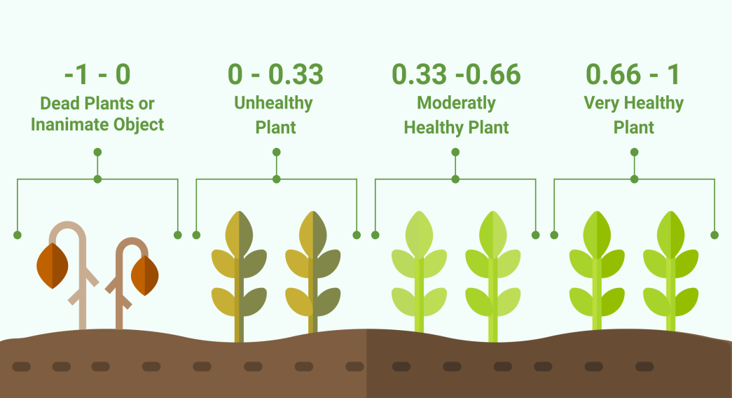
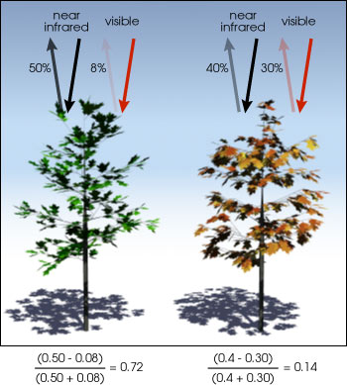
Using Satellite Imagery (remote sensing) and Rainfall Data for Yield Modelling
NDVI (and similar indexes like NDWI etc) are dimensionless remote sensing measurements. Typically these depend upon spectral absorbance and reflectance by objects on the ground. For example, leaves, if healthy, leaves tend to absorb more red spectrum ( wavelength of 400 to 700 nanometres) but heavily reflects back near infra red spectrum (700 to 1100 nanometres). This property has been used in NDVI calculations.
NDVI = (Near Infra Red – Red ) /(Near Infra Red + Red)
Range = - 1 to 1. Typically values above 0.7 to 1 means healthy vegetation. Values approaching -1 may mean water bodies and 0 may mean urban areas! But no clear demarcation and ground-truthing becomes important.
Possible to use the NDVI and similar indexes like NDWI along with historical rainfall parameters to set up regression models to arrive at long term yield series. Once sufficiently confident / trained model, can be used for predictive purposes.
Issues to consider are: which satellite image to use, ground truthing, resolutions, cloud covers. NDVI data are available for sufficient number of historic years. Deliberations on whether to use NDVI/ NDWI
Uses: Yield prediction, reserving, CCE optimisation and Catastrophic load parameterisation

Slide 38
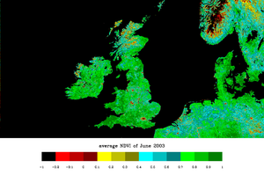
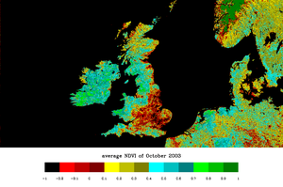
Using Satellite Imagery (remote sensing) ... An example (Source: Wikipedia)
Observe, the difference between June 2013 and October 2013 in the below pictures
In the Indian context, MNCFC – Mahalanobis National Crop Forecast Centre website do provide NDVI maps... Also MNCFC also plays a major role in crop insurance as a technical advisory.

Slide 39
Possible COVID impact
Labour Migration:
Will labour be available in the same way as the past? Will this result in change in cropping patterns?
Example - ICRISAT Study: “One example in the Vidarbha region of Maharashtra illustrates this trend – particularly in relation to the cultivation of less labour intensive crops. Farmers in this region have traditionally cultivated cotton which up until 2006-07 occupied three-fifths of the total cropped area. Now (in 2016) they have switched to soybean cultivation which occupies 70% of the total crop area in the rainy season. This is also supplemented by growing chickpea in 14% of the crop area.”
The benefits of this shift are tangible: cotton growing requires around nine months for production and is harvested over four or more pickings. Soybean on the other hand requires only 80 to 105 days depending on the varieties used for cultivation.
The dramatic shift in cropping patterns during the period 2007-8 to 2014-15 resulted in per hectare labour use in cotton production reduced by 43% (from 153 person-days to 87 person-days).
During the same period labour use in soybean production was reduced by 58% (from 55 person-days to 23 person-days) and in pigeon-pea production by 52% (from 48 person-days to 23 person-days), due to the increased reliance on machinery for tillage, harvesting and threshing operations and the introduction of herbicides to control weeds.”

Slide 40
Possible COVID impact
2. Credit Risk
Credit risk increases for the banks? What will this mean to agricultural financing? Will there be waivers and write offs – if yes, how much?
3. Economy Slow Down
Systemic factor that will end up affecting all our lives? Is crop insurance immune to it?
(Atmanirbhar Bharat reliefs for the sector is aimed at Rs. 30000 crore as additional working capital through NABARD, Rs. 2 Lakh Crore for 2.5 crore farmers under KCC, various schemes for improving infrastructure...)
4. Enhance Reinsurance Risk
Reinsurance dependence is quite high? What are the alternatives? What is the role of the Actuary in RI program design?
5. Funding Risks for PMFBY
How many states are implementing the schemes? More scrutiny on the Scheme performance? What are the risks that are not covered by the Scheme?

Slide 41
CPD questions
www.actuariesindia.org

Slide 42
Wrap Up
Plans from the Advisory Group on Sustainable Development and Microinsurance
Upcoming webinars – Ayushmaan Bharat
Feedback
www.actuariesindia.org

Slide 43
Upcoming Webinars
Webinar | Date | Time (IST) | CPD | Members
Presidential Town Hall Meeting with Students | 28 June, 2020 | 1100–1200 | Non CPD Event | For Students
Webinar On Adapting to trends in Life Insurance | 1 July, 2020 | 1000-1200 | 120 minutes (Technical – Life Insurance) | Members & Non-members
Tech Talk on Compensated Absences and other long term Employee Benefits | 9 July, 2020 | 1700-1800 | Non CPD Event | Student, Associates & Non-Members
Impact of IFRS 17 on Product Design and Pricing | 16 July, 2020 | 1600-1730 | Any | Members & Non-members
Webinar on Ayushman Bharat Health Insurance Scheme | 24 July, 2020 | 1600-1730 | 90 minutes (Technical – Health Insurance) | Members & Non-members
www.actuariesindia.org

Slide 44
Q&A
www.actuariesindia.org

