Slide 1

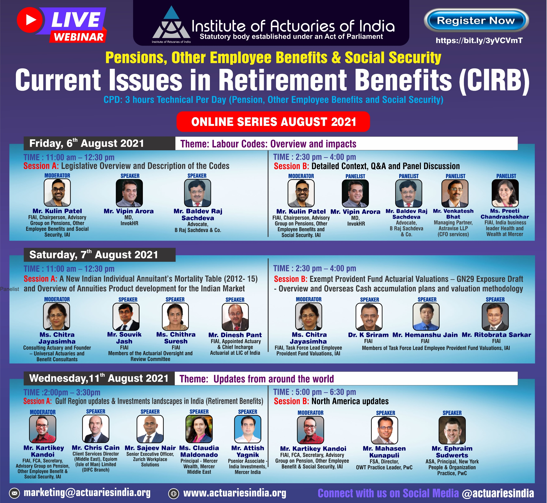

18th Current Issues in Retirement Benefits
Online Series – August 2021

Slide 2








Introduction
Mute
Q&A
IAI support
C
P
D
Recording
Feedback
www.actuariesindia.org

Slide 3


Introductory Comments
Subhendu Bal
President, Institute of Actuaries of India
www.actuariesindia.org

Slide 4
18th Current Issues in Retirement Benefits
6 August 2021
Labour Codes: Legislative Overview and Description of the Codes

Slide 5

Speaker Introductions
Vipin Arora
Managing Director, InvokHR
Specialist Advisor -HR Governance, HR Policy, Total Rewards
25+ years work exp. across diverse industry segments across MNCs and Indian conglomerates (Resideo, Honeywell, Global Vantedge, Daksh eServices (later IBM), Case New Holland Tractors, Siel Limited)
Providing HR solutions in different business cycles - start-ups, expansions, integration, M&A and close-downs.
Strategy deployment, Policy Framework, M&A, Innovative
Compensation solutions and Benefits harmonization across Asia-Pacific region.
Exposure to Board functioning, Angel Investing and start-up advisory.
National Scholarship holder, an Engineer by qualification, alumni of XLRI, Jamshedpur
Six Sigma Green Belt, certified Profilor® 360Deg Coach
Certified Independent Director
www.actuariesindia.org

Slide 6

Speaker Introductions
B. R. Sachdeva
Advocate, B Raj Sachdeva & Co
Member of Bar Council of Delhi and Member of Supreme Court of Bar Association, New Delhi
He has been panel Advocate of Regional Provident Fund Commissioner, New Delhi
Total industry experience of more than 3 decades in Accounting, Finance, Audit, Legal, Compliances and Litigation
Specialization in Labour Laws, Corporate Laws, Securities Laws, Insolvency & Bankruptcy laws and Valuation of Business / shares for statutory requirements
Former Chairman of The Institute of Company Secretaries of India - Noida Chapter and former Chairman/ Member of Industrial Laws Committee, Corporate Laws Committee and Legal Affairs Committees of various reputed Chamber of Commerce like NCR Chamber of Commerce, PHD Chamber of Commerce etc.
B.Com, LL.B., FCS, ACIS(London), Diploma in Financial Management
Qualified as Insolvency Professional – IBBI, Registered Valuer (SFA) from Insolvency & Bankruptcy Board of India
Independent Director of The Indian Institute of Corporate Affairs.
www.actuariesindia.org

Slide 7
CIRB
August 6, 2021
Legislative Overview and Description of the Codes

Slide 8

Labour Codes - Objectives
Simplification of laws, avoiding multiplicity
Use of technology
Ease of compliance
Effective enforcement
Transparency and equity

Slide 9
Labour Codes - Subsumption of existing laws
The Code on Wages, 2019
The Code on Social Security, 2020
The Occupational Safety, Health and Working Conditions Code, 2020
The Industrial Relations Code, 2020
Existing 29 Labour Acts

Slide 10
Labour Codes - Timelines
Notification Date: August 08, 2019
The Code on Wages, 2019
Notification Date: September 29, 2020
The Code on Social Security, 2020
The Occupational Safety, Health and Working Conditions Code, 2020
The Industrial Relations Code, 2020
Next steps:
Central and State Rules
Implementation date to be notified
‘Labour – employment, welfare, dispute…..’ is on concurrent list

Slide 11
Overview of Codes

Slide 12
Labour Codes - Subsumption of existing laws
The Code on Wages, 2019
The Equal Remuneration Act, 1976
The Minimum Wages Act, 1948
The Payment of Wages Act, 1936
The Payment of Bonus Act, 1965

Slide 13
Key Highlights – Code on Wages
Changes | Impact
New definition of Employees | Coverage of managerial, supervisory category – financial impact, change in policies, process
New definition of Employers | ‘direct or indirect employment’ added
Revised definition of Wages | Multiple interpretations removed Impact on wage structure – may need revision, Many allowances need to be reviewed/modified/ removed Financial impact on employer (on liabilities like Gratuity and Leave Encashment) Taxation or take-home salary impact on employee
Minimum wages | National level floor wages
Exit definitions inclusions of ‘voluntary’ | Change in payroll process – settlement in 2 days
Compliance | Claim period and records, penalties - process
Statutory bonus | New limits – yet to be notified
Overtime | Financial impact due to increased coverage
Impact – Primarily Financial and secondary on Process changes

Slide 14
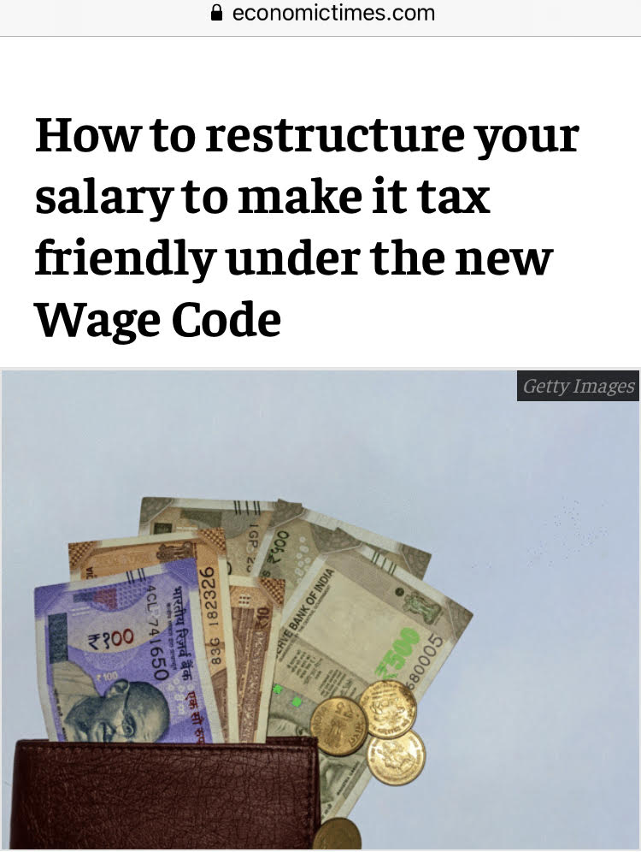
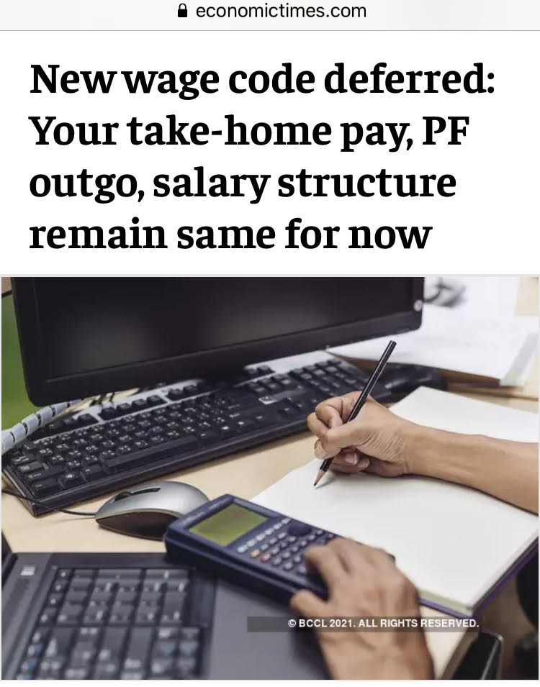
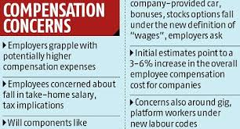
Quiz 1
Does Code on Wages mandate corporates to restructure compensation with ‘Basic Salary+DA’ as 50% of CTC?
A) YES
B) NO
C) CAN’T SAY

Slide 15
Quiz 2
What is correct definition of CTC?
A
B
C
All are correct
All are wrong

Slide 16
KEY CHANGES - NEW Definition of Wages
One uniform definition of ‘Wages’ prescribed vs multiple definitions among various legislations (Acts)
COVERS | EXCLUDES | SPECIAL CONDITION
All salary components expressed in terms of money or capable of being so expressed and includes: Basic Dearness Allowance Retaining Allowance *remuneration in kind to the extent it does not exceed 15% of total wages shall be included in wages | Bonus Payable under any law House Rent Allowance Conveyance Allowance Overtime Commission Light, water, medical attendance Value of Travel Concession Provident fund/ Pension contribution Any award settlement (court or agreement) Sum paid to defray special expenses Amenity/ service excluded by appropriate government Gratuity Retrenchment/termination payout | Limit on exclusions 50% except gratuity and retrenchment/termination pay-outs

Slide 17
KEY CHANGES
NEW definition of Employee and Worker
Employee
Worker
Covers any person (other than an apprentice
engaged under the Apprentices Act, 1961),
Covers any person (except an apprentice under the
Apprentices Act, 1961) employed in any industry to
employed on wages by an establishment to do any skilled, semi-skilled or unskilled,
do any manual, unskilled, skilled, technical,
operational, clerical or supervisory work but does
not include any person:
manual, operational, supervisory, managerial, administrative, technical or clerical work for hire or reward, whether the terms of employment be express or implied.
► who is employed mainly in a managerial or
administrative capacity; or
► who is employed in a supervisory capacity drawing
wage of exceeding INR 15,000/ 18,000 per month or
an amount as may be notified by the Central
Government from time to time.
Covers all irrespective of role / level /
Covers only non-managerial /
non-supervisory staff
nature of duties / salary

Slide 18
Labour Codes - Subsumption of existing laws
The Code on Social Security, 2020
The Employees' Provident Funds and Miscellaneous Provisions Act, 1952
The Employees' State Insurance Act, 1948
The Payment of Gratuity Act, 1972
The Maternity Benefit Act, 1961
The Employee's Compensation Act, 1923
The Employment Exchanges (Compulsory Notification of Vacancies) Act, 1959
The Cine-Workers Welfare Fund Act, 1981
The Building and Other Construction Workers' Welfare Cess Act, 1996
The Unorganised Workers' Social Security Act, 2008

Slide 19
Key Highlights– Code on Social Security
Changes | Impact
New groups added | Coverage of ‘gig’ and ‘platform’ workers List of aggregators introduced as digital intermediaries with mandatory contribution to social security fund
Definition of ‘employee’ included | This was missing in some acts like Maternity Benefit, Welfare Fund Act
Gratuity coverage enhancement | For fixed term employees, Expats, Contract labour – increased financial impact to employer
Compliance | Appeal procedure and limitation period curtailment
PF & related schemes continuity | 1 year period provided at same level thereafter increased contribution
Opt-in and opt-out in voluntary coverages | Change in process/policy
ESI coverage | New limits to be notified Coverage may be extended to unorganized sector, gig-workers and even self-employed
Introduction of Career centres | Job vacancies and vocational guidance for job seekers
Impact – Mix of Financial and Process changes

Slide 20
Labour Codes - Subsumption of existing laws
The Occupational Safety, Health and Working Conditions Code, 2020
1. The Factories Act, 1948
2. The Contract Labour (Regulation and Abolition) Act, 1970
3. The Inter-State Migrant Workmen (Regulation of Employment and Conditions of Service) Act, 1979
4. The Plantations Labour Act, 1951
5. The Mines Act, 1952
6. The Working Journalists and other Newspaper Employees (Conditions of Service) & Misc. Provisions Act,
1955
7. The Working Journalists (Fixation of Rates of Wages) Act, 1958
8. The Motor Transport Workers Act, 1961
The Beedi and Cigar Workers (Conditions of Employment) Act, 1966
The Sales Promotion Employees (Conditions of Service) Act, 1976
11. The Cine-Workers and Cinema Theatre Workers (Regulation of Employment) Act, 1981
12. The Dock Workers (Safety, Health and Welfare) Act, 1986
13. The Building and Other Construction Workers (Regulation of Employment & Conditions of Service) Act, 1996

Slide 21
Key Highlights - Code on Occupational Safety, Health and Service Conditions
Changes | Impact
Applicability of Contract Labour | Definition of ‘core activity’ – may impact workflow and many operations
Migrant workers | Benefits on portability of ration
Licence procedure | Electronic, validity period
Night shifts for women | Relaxation but on consent and safety / working conditions prescribed
Provisions of facilities - changes | Cafeteria, creche – changes in process, financial impact
Health standards | Prescribed manner, annual health check-ups
Appointment letters | Mandatory information – change in policy/process
Leave Encashment - introduction | Provisions introduced for annual encashment / carry forward
Overtime - conditions | Consent introduced, definition of employee may get impacted
Impact – Many Process and Compliance changes, major financial impact only on OT

Slide 22
Labour Codes - Subsumption of existing laws
The Industrial Relations Code, 2020
The Industrial Disputes Act, 1947
The Industrial Employment (Standing Orders) Act, 1946
3. The Trade Unions Act, 1926

Slide 23
Key Highlights - Code on Industrial Relations
Changes | Impact
New definition of ‘worker’, the term ‘workmen’ removed | Increased coverage and threshold from INR 10,000 to INR 18,000
Concept of ‘negotiating unions’ | New feature added – membership of 51% workers required to negotiate.
Strikes/lockouts provisions | Notice period changes to 60 days
Layoff/ retrenchment provisions | Threshold changes – relaxation
Grievance committee role enhanced | Mandatory for worker to approach Grievance committee before reaching Conciliation officer
Disciplinary Proceedings | Time limit fixed as 90 days vs no such mention earlier, needs internal process improvements
Standing orders | Union’s role added, threshold increased from 100 to 300 workers
Impact – mostly procedural changes

Slide 24
Summary of Session
Codes bring in simplicity, better alignment with business realities and are forward-looking
There is an attempt to strike fine balance of needs among all stakeholders – employees, employers, government
Codes need to be looked at together as there are some areas of overlaps/ cross-references
3 Codes (Wages, Social Security, OSH) apply to all employers and employees. Code on Industrial Relations applies to all ‘workers’.
New definition of “Wages” may have an impact on overall wage cost of organization. It also has impact on liabilities as some aspects like gratuity, leave encashment on ‘retrospective basis’
If any change is planned in compensation structure, consideration needs to be given to balancing ‘taxation aspects’ and ‘take-home salary’
More clarity is required in understanding key aspects of overtime, working hours application in WFH/hybrid working environment
State rules are not yet notified so, implementation date is still unknown

Slide 25


Q&A
www.actuariesindia.org

Slide 26
Thank you!
CPD Question
See you later at 2.30pm
www.actuariesindia.org

Slide 27
18th Current Issues in Retirement Benefits
6 August 2021
Labour Codes: Q&A, Panel Discussion and Detailed Context

Slide 28
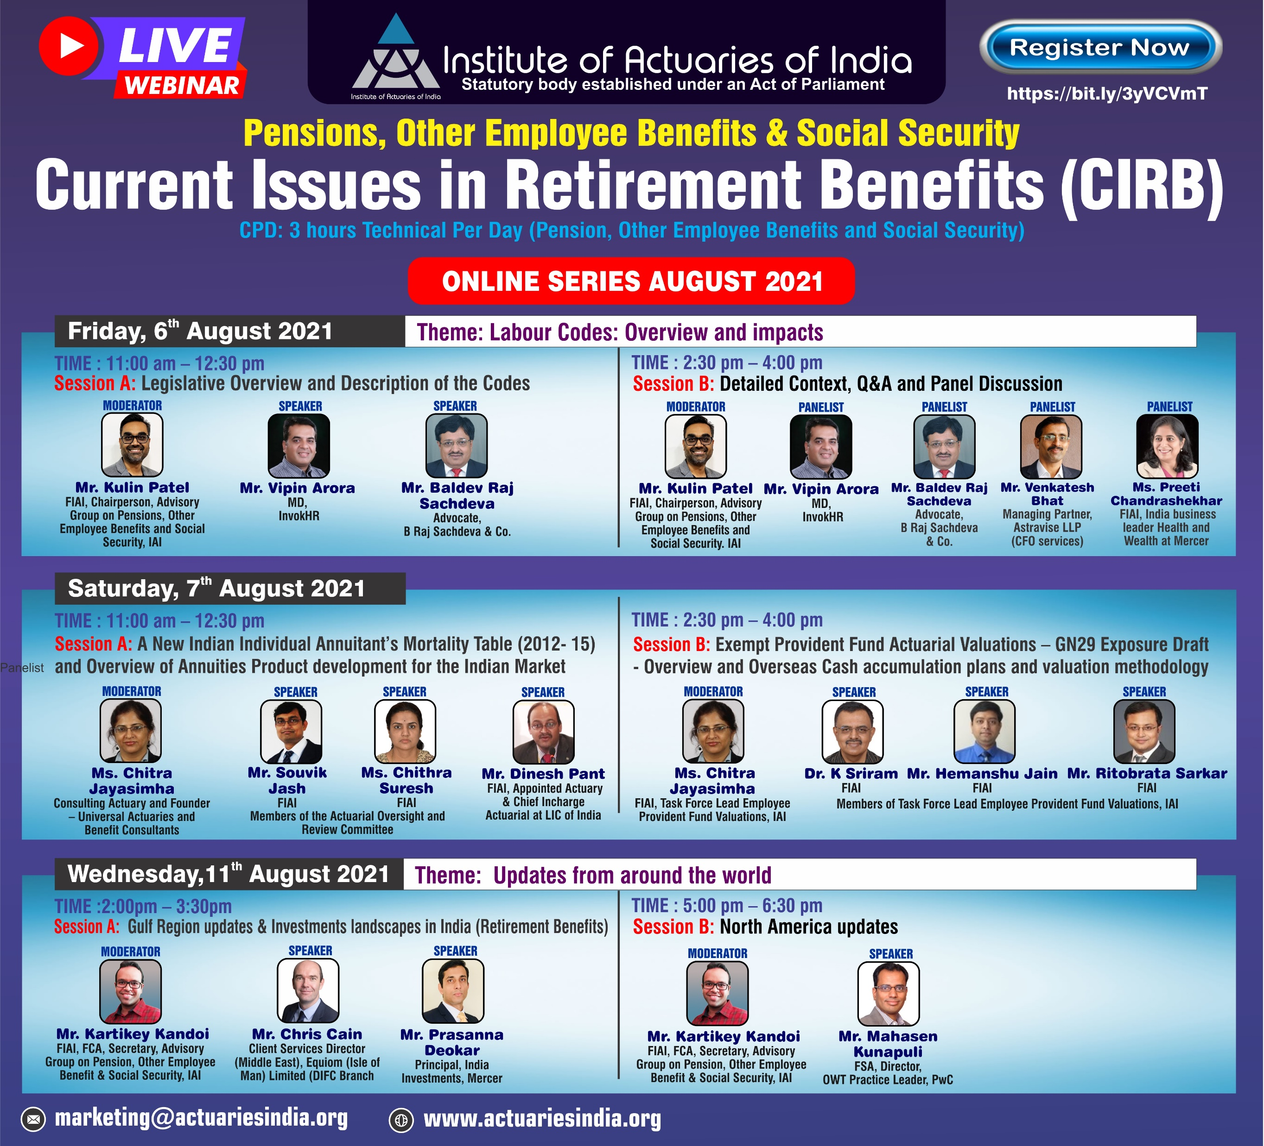
Esteemed Panel
www.actuariesindia.org

Slide 29

Panelist Introductions
Preeti Chandrashekhar
India Business Leader, Health and Wealth, Mercer
30+ years of experience in insurance and consulting industry
13+ years consulting in Pensions and other employee benefits
Consulting actuary for employee benefit plans in India.
Subject matter expert in implementation of large technology programs across the life insurance and pension industry globally.
She is a regular speaker at client and industry events of financial and actuarial issues and has been quoted in media.
Current Honorary Secretary and Member of Council at IAI
Preeti holds an M.Phil in Statistics from University of Delhi and is a Fellow Member of the Institute of Actuaries of India.
www.actuariesindia.org

Slide 30

Panelist Introductions
Venkatesh Bhat
Managing Partner, Astravise LLP
Managing Partner of Astravise LLP headquartered at Bengaluru
Provides strategic CFO services to the startups in early growth phase
Started career with HUL in 1993 and later worked in Whirlpool and GE
Chief Finance Officer positions for more than a decade, first in ACT Fibernet and later in BlackBuck and held Board positions in group companies
Part of the Task Force set up by Ministry of Information & Broadcasting to oversee Phase 3 & 4 Digitalization in the country
Previously an Executive Council member of ISP Association of India
Recognized as one of the top 100 Most Influential CFOs in India in 2016 by CIMA.
Chartered Accountant by profession and topped All India and South India respectively in CA Intermediate & Final Examinations.
Attended Executive Education courses in Wharton University & London Business School.
www.actuariesindia.org

Slide 31
Thank you to our esteemed Panel
www.actuariesindia.org

Slide 32
Upcoming Webinars
Webinar | Date | CPD
Webinar on Current Issues in Retirement Benefits (CIRB) | 6,7,11 August, 2021 | 9 hrs (Pension)
Actuaries Day 2021 | 21st August 2021 | NA
Webinar on General Insurance | 25th & 26th August 2021 | 3.5 hrs (GI)
Webinar on Banking, Finance & Investments | 4th September, 2021 | 1.5 hrs (Any)
Webinar on Data Science & Analytics | 18th September, 2021 | 1.5 hrs (Any)
Webinar on Life Insurance | 22nd September 2021 | 2 hrs (Life)
Current Issues in Health Care Insurance | 29th September 2021 | 4 hrs (HCI)
Webinar on IFRS 17 | 08th October 2021 | 2 hrs (Life)
Webinar on Data Science & Analytics | 09th October 2021 | 2 hrs
Webinar on Risk management | 15th October 2021 | 2 hrs
Webinar Series on General Insurance | 22,23,29,30 October, 2021 | 2 hrs
www.actuariesindia.org

Slide 33
Thank you!
CPD Questions
See you tomorrow!
www.actuariesindia.org

