Slide 1
Webinar Name: Webinar on General Insurance
Venue: Webex
Date: 11th June 2020
GI Industry: Lockdown and way forward
Speakers:
Sanjay Datta: Chief - Underwriting, Claims & Reinsurance - ICICI Lombard General Insurance
Milind V Kolhe: Chief Underwriting and Reinsurance Officer - Bharti AXA General Insurance

Slide 2
Welcome Instructions
Mute
Q&A
IAI support
C
P
D
Recording
Feedback
www.actuariesindia.org

Slide 3
Learning, Challenges and Business Response
Leanings
Business continuity plans, well tested and were largely successful
Innovation and technical advancements
People and businesses are forced to adapt
Agility in business is an important factor
Fewer cars on the road does not mean lower risks
Challenges
Limited physical interaction with partners and customers impacting new business
Post-Covid-19, more private cars, more new drivers, higher risks
Automobiles sales in April 20 were Zero. May 20, de-growth of 85%
Domestic travel restrictions will result in lower conversions of new accounts
Business Response
Usage of technology to service the customers. Surveyors appointed for virtual survey through live videos of site or affected property/vehicle.
Inability to conduct risk assessment for motor, health and commercial lines. However, alternate methods have been deployed.
Regulatory relaxation to customers and industry.
www.actuariesindia.org

Slide 4
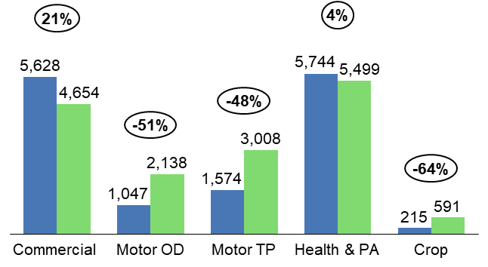
Gross Premium: April 20 vs April 19
Overall 11% drop in gross premium
Significant drop in Motor premium (51%), due to de-growth in new vehicle premium
21% positive growth in Commercial lines, led by property insurance
Fire: growth of 41%
De-growth in Marine (-18%) and Engineering business (-5%)
Marginal growth in Health (4%).
Travel insurance down by more than 82%
Apr’20
Apr’19
In FY 19-20, the insurance sector witnessed a growth of 13% for Indian non-life industry
www.actuariesindia.org

Slide 5
Trends and opportunities
Changing consumer and business risk, needs, behaviors, and expectations
Response by the industry by redefining and accelerating digital transformation
New products and services
Redefine risk management and underwriting
Competitive implications
Work from home as a new normal
SME segment will be heavily impacted during the slowdown as small companies struggle to sustain their activity or even go out of business.
Decline on the international transfers and reduction in exports will impact Marine business
Lower economic growth and liquidity crunch in the market may result in delay in start of new and completion of existing projects
Opportunity to expand on digital front; higher digital sales
Increased Cyber risk
Demand for new product
Pricing pressure on Marine and Group Health business
There will be additional pressure on capital as growth levels will affect absorption of overhead expenses
Impairment of investments and portfolio correction
www.actuariesindia.org

Slide 6
Let’s stay focused
We will go through the challenge together and successfully come out of it!!
STAY SAFE!
Thanks
www.actuariesindia.org

