Slide 1
36th India Fellowship Webinar
Date: 28th January, 2022
Case study 5: Analysis of implication of change in method of accounting for UPR
Guide : Rohit Ajgaonkar, FIAI
Presented By :
1. Neel Doshi
2. Jatin Aggarwal
3. Piyush Devgun
4. Shruti Jain
5. Ruchin Jain

Slide 2
Introduction to Guide
Our Guide for this presentation is Mr. Rohit Ajgaonkar, FIAI
Rohit is currently the Appointed Actuary of Raheja QBE General Insurance
Rohit has about 11 plus years of experience spread across life insurance, General insurance and consulting.
Prior to Raheja QBE General Insurance, Rohit has worked as Chief Actuary of Edelweiss General Insurance and also in consulting firms like Ernst & Young.
www.actuariesindia.org

Slide 3
Case study
An analysis on the implication of changing from the current 1/365th method of accounting for UPR to the percentage of net written premium method as prescribed in the regulation
You are the appointed actuary of growing general insurance company in India which writes property, motor and health insurance business.
Your CEO has asked you to look into the Insurance Regulatory and Development Authority of India (Preparation of Financial Statements and Auditor’s Report of Insurance Companies) (First Amendment) Regulations, 2021 and conduct an analysis on the implication of changing from the current 1/365th method of accounting for UPR to the percentage of net written premium method as prescribed in the regulation.
Discuss the impact of change in UPR estimation on:
Earnings
Premium and claim liabilities
Profit/loss
Solvency
www.actuariesindia.org

Slide 4
Agenda
UPR – background and change in method of accounting
Impact on motor business
Impact on property business
Impact on health business
Impact on solvency
Conclusion
www.actuariesindia.org

Slide 5
Agenda
UPR – background and change in method of accounting
Impact on motor business
Impact on property business
Impact on health business
Impact on solvency
Conclusion
www.actuariesindia.org

Slide 6
Background
As per Section 2(p), Chapter 1 of The Insurance Regulatory and Development Authority (General Insurance – Claims),
“Unearned premium reserve means the amount set aside from premiums written before the accounting date to cover risks incurred after that date.”
Unearned premium shall be shown separately under the head ‘Current Liabilities’ and appropriate disclosures regarding management’s basis of assessment shall be made in the financial statements.
As per the IRDAI (Preparation of Financial Statements and Auditor’s Report of Insurance Companies) (First Amendment) Regulations, 2021, the UPR for segments other than marine hull shall be computed as:
50% of net written premium during the preceding 12 months; or
On the basis of the 1/365th method on the unexpired period of the respective policies
www.actuariesindia.org

Slide 7
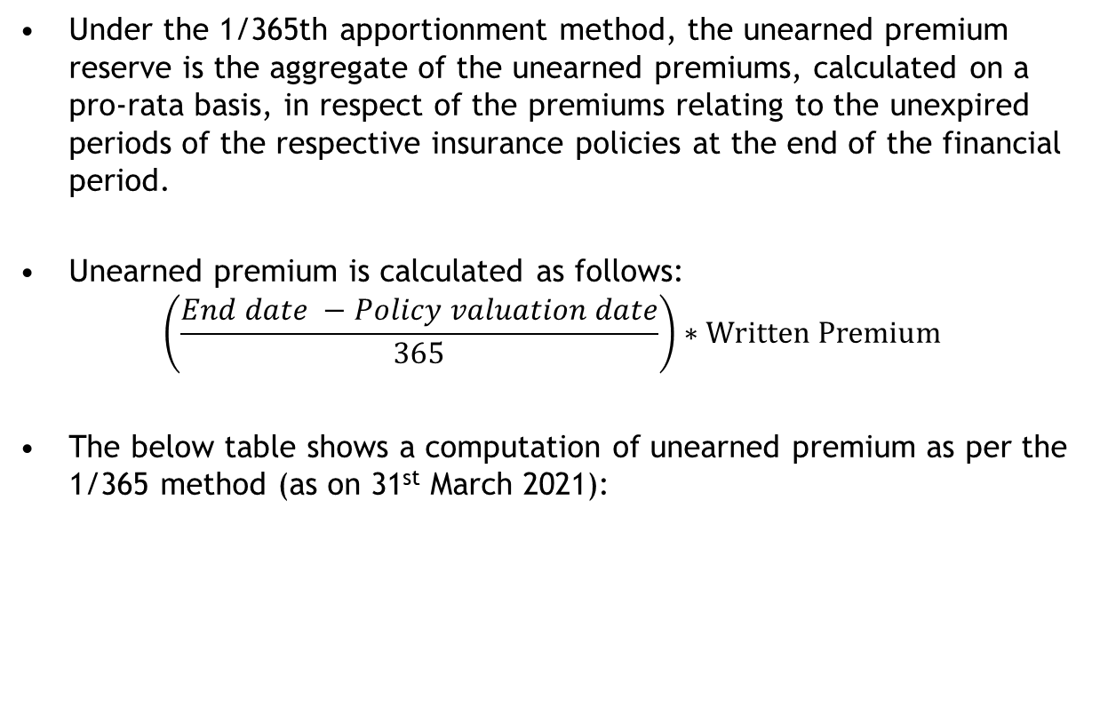
1/365 method
Under the 1/365th apportionment method, the unearned premium reserve is the aggregate of the unearned premiums, calculated on a pro-rata basis, in respect of the premiums relating to the unexpired periods of the respective insurance policies at the end of the financial period.
Unearned premium is calculated as follows:
$$\left(\frac{End date −Policy valuation date}{365}\right)∗Written Premium$$
The below table shows a computation of unearned premium as per the 1/365 method (as on 31st March 2021):
Policy | Premium | Start date | End date | Earned premium | Unearned premium
1 | 500 | 28-Jun-20 | 27-Jun-21 | 378.08 | 121.92
2 | 898 | 1-Feb-21 | 31-Jan-22 | 142.70 | 755.30
www.actuariesindia.org

Slide 8
50% method
This method is also known as the flat rate method. The unearned premium reserves are determined by applying a 50% weightage on the premiums written.
Unearned premium is calculated as follows:
$$50\% ∗Written Premium$$
The below table shows a computation of unearned premium as per the 50% method (as on 31st March 2021):
Policy | Premium | Start date | End date | Earned premium | Unearned premium
1 | 500 | 28-Jun-20 | 27-Jun-21 | 250 | 250
2 | 898 | 1-Feb-21 | 31-Jan-22 | 449 | 449
www.actuariesindia.org

Slide 9
Summary
As can be seen from the previous two slides, the portion of earned and unearned premiums can vary significantly under both the methods.
Hence the change in methodology would be expected to have an impact on earnings, profit/loss, solvency.
As a part of the next sections, we will looks at the how the change impacts various business lines differently.
www.actuariesindia.org

Slide 10
Agenda
UPR – background and change in method of accounting
Impact on motor business
Impact on property business
Impact on health business
Impact on solvency
Conclusion
www.actuariesindia.org

Slide 11
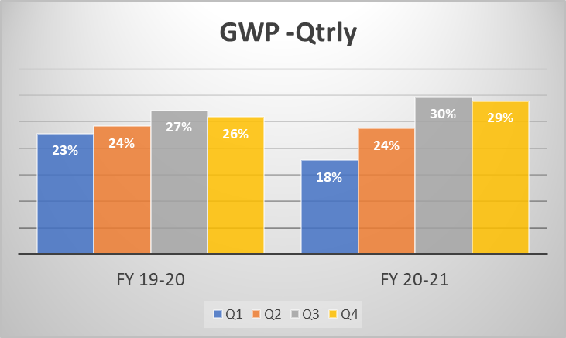
Motor Business - Seasonality
Premium distribution
Overall industry wise trend suggests more business being written in 3rd and 4th Quarter of the year.
Relatively higher business in Q3 is probably due to the festive season and discounts given on vehicles.
FY 20-21 is more skewed towards Q3 and Q4, could be an impact of covid.
Similar trend is observed on both OD and TP business.
Based on industry wise segment level data
Source: https://www.irdai.gov.in/
www.actuariesindia.org

Slide 12
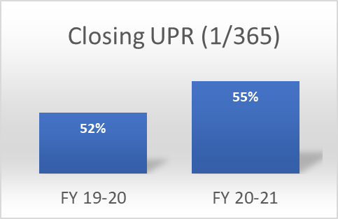
Impact on Motor Business
UPR/Earnings
As more business is written in second half of year, UPR based on 365 basis would be higher than 50% as shown below.
UPR would be underestimated due to change in the methodology to 50% basis and overestimate the earned premium.
FY 20-21 is more skewed, covid impact.
Increased earnings in 1st year with less earnings left for future years.
Assumption: uniform business within quarter
taken as approximation for 1/365th method.
www.actuariesindia.org

Slide 13
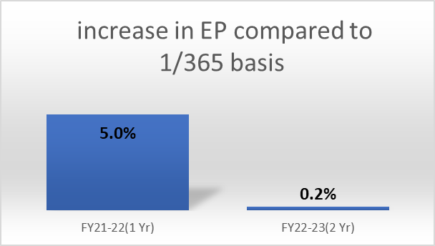
Impact on Motor Business
Premium
Assuming growing business, a projected estimate suggests in 1st Yr - significant increase in Net EP, due to mismatch in opening UPR on 365 basis(high) and closing UPR on 50% basis(low).
In next year, Earned premium stabilizes as both opening and closing UPR would be on consistent basis.
In scenario of significant dip in NWP, decrease in NEP on 50% basis would be more significant.
Assumption:
FY 21-22 – 1st year of change in methodology
Business is growing and premium distribution based on past data
www.actuariesindia.org

Slide 14
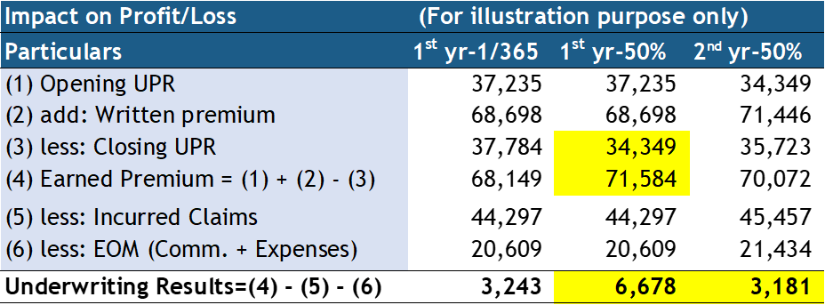
Impact on Motor Business
Claims
Higher EP improves the Loss ratios initially, though any claims arising in future when no, or less earnings left might distort the performance.
Claims ratio might look better in the 1st year due to significant increase in NEP and revert to consistent lines in subsequent years.
Profit/Loss
1st year shows significant increase in profits due to increase in Earned premium.
Impact of change in methodology on profits reduces in 2nd year as NEP stabilizes.
Profits increased from 5% of EP to 9% of EP in 1st year and next year again reduces
to 5% of EP.
Assumptions:
EOM as 30% of WP
LR is assumed to be constant at 65%.
No change assumed in IBNR.
Business is growing.
Industry level data taken for illust’n.
www.actuariesindia.org

Slide 15
Motor : Conclusion
Motor business is slightly skewed towards second half of year.
If business increasing, Changing the UPR methodology to 50% method would underestimate the UPR and overstate the earnings.
If there is dip in business, earnings by 50% method will be lower.
Higher earnings lead to lower loss ratios, though claims in future with less earnings might distort the portfolio performance.
Increase in Earned premium due to change in methodology will have incremental temporary impact on profits in first year.
Earned premium and Profits will revert to consistent lines in the subsequent years.
Notes
Multi year TP policies considered to be earned on yearly basis.
No change is assumed in reserving methodology.
PDR may need to be relooked at based on overall performance of the company.
www.actuariesindia.org

Slide 16
Agenda
UPR – background and change in method of accounting
Impact on motor business
Impact on property business
Impact on health business
Impact on solvency
Conclusion
www.actuariesindia.org

Slide 17
Property: Types of Coverages
Fire
Engineering
Hull
Others
(AIT, Cargo, etc)
www.actuariesindia.org
Notes:
Group Health plans start from

Slide 18
Seasonality of the Property Business
Fire Business is skewed towards the first half of the financial year
Marine Hull business is skewed towards the second half of the financial year
Engineering book is written fairly uniformly over the year
www.actuariesindia.org

Slide 19
Setting Context – “ABC“ Insurance company
Our company ABC insurer:
Started writing property book in Year 0
Premium volumes have steadily grown over the years
It used 1/365th method to estimate UPR till the end of Year 2
Switched to 50% method to estimate UPR in Year 3
Continued using 50% method from Year 2 closing onwards
www.actuariesindia.org

Slide 20
Comparison – 1/365th vs 50% Methodology
Assumptions:
Expenses are 20% of written premium
Loss ratio is assumed to be constant at 60%
No change assumed in IBNR
www.actuariesindia.org

Slide 21
Profitability Pattern
* Marine Hull, 100% of the written premium is considered for UPR
www.actuariesindia.org

Slide 22
Property: Impact on Profit/Loss
www.actuariesindia.org

Slide 23
Conclusion
Property insurance is an umbrella term and can encompass a variety of lines of business.
As we saw earlier, Fire, Marine Hull and Engineering lines of business all are different in terms of the seasonality of business written
Fire – Skewed towards the first half
Marine Hull – Skewed towards the second half
Engineering – Written uniformly
However, Fire business will often form the bulk of the premium volume, and therefore the closing UPR under 1/365th basis will be lower compared to 50% basis. The extent to which this happens will be driven to large extent by the portfolio mix of an Insurer.
The change in methodology although will not impact the overall profitability, but would impact the recognition of the profits
www.actuariesindia.org

Slide 24
Agenda
UPR – background and change in method of accounting
Impact on motor business
Impact on property business
Impact on health business
Impact on solvency
Conclusion
www.actuariesindia.org

Slide 25
Health: Types of Coverages
Health – Group and Retail
Personal Accident
Travel – Corporate and Retail
Credit Linked Health Plans
www.actuariesindia.org
Notes:
Group Health plans start from

Slide 26
Health: Premium written by quarter
Majority of health insurance premium is written in Q3 and Q4 with an exception of FY2020-21.
Based on Standalone Health Insurers data: Source: https://www.irdai.gov.in/ADMINCMS/cms/frmGeneral_List.aspx?DF=MBFN&mid=3.2.8 The percentages may not add to 100% due to rounding off.
www.actuariesindia.org

Slide 27
Health: Difference in Earning Computation
Difference is calculated as new 50% method less old 1/365th method of the calculation of unearned premium.
Initial 3 quarters – huge difference in UPR
As premium dips in Dec -19, the UPR for 50% method becomes higher than 1/365th method.
Based on Top 6 companies from private players in GI, Standalone health and PSUs: Source: https://www.irdai.gov.in/ADMINCMS/cms/frmGeneral_List.aspx?DF=SWDN&mid=3.2.13
www.actuariesindia.org

Slide 28
Health: Comparison of 2 scenarios
Scenario 1: Increase in premium every quarter by 10% after March 2021
Scenario 2: Decrease in premium every quarter by 10% after March 2021
The loss ratio as per the reserving exercise is assumed to be constant at 75%.
Loss ratio as per 50% method is lower in the first year and it goes higher in the second year before coming close to the actual loss ratio in the third year.
If the business increases, 50% method would lead to higher earnings in premium to support the claims, hence lower loss ratios and vice versa.
www.actuariesindia.org

Slide 29
Health: Impact on Profit/Loss
Assuming Expenses of Management (EOM) of 25% of written premium.
Assuming the business is growing by 10% every quarter, the loss coming in from the underwriting decreases from 4% of earned premium to about 1% because of the increase in UPR.
The next year, the loss again increases to 4% of earned premium.
www.actuariesindia.org

Slide 30
Health: Conclusion
Group Health and Corporate Travel coverages are written at the start of the year but will be recognized as only 50% earned.
Retail Travel has short term policies most of which would have expired in the year but will now count towards UPR.
About 60% of retail health business is written in last two quarters, hence, using 50% method will lead to higher earnings as compared to 1/365th method.
Multi-year health insurance policies and credit linked health plans will also get 50% earned in the underwriting year leading to lower UPR.
If the business is increasing, the earnings by 50% method will be higher leading to lower loss ratios and vice versa.
The premium deficiency reserve may be required to allow for lower UPR being kept under the 50% method if there is a large difference between the UPR calculated by the two methods.
Even when the premium earnings change, the reserving assumes to be on the same basis.
The increase in profit or reduction in loss in the first year will only be a temporary change.
www.actuariesindia.org

Slide 31
Agenda
UPR – background and change in method of accounting
Impact on motor business
Impact on property business
Impact on health business
Impact on solvency
Conclusion
www.actuariesindia.org

Slide 32
Solvency Computation
Components of Solvency in Indian regime
Available Solvency Margin (ASM) : Excess of assets over liabilities, subject to key specific adjustments like disallowance of inadmissible assets
Required Solvency Margin (RSM) : Estimated at line of business level using the prescribed formula, taking into account
Gross and net written premiums, and gross and net incurred claims
Taking higher of premiums-based and claims-based RSM calculations
Aggregating individual RSMs for all lines into the INSURER’s total RSM
Solvency Margin : Ratio of ASM to RSM with a minimum required level of solvency ratio set at 150% breaching which can lead to regulatory actions
www.actuariesindia.org

Slide 33
Impact on Solvency- ASM
Unearned Premium Reserves (UPR) : depending on the business and pattern, it is expected to increase/decrease. For Health, we expect a significant change (decrease) in UPR with movement from 1/365th method to 50%. For motor, the UPR should decrease slightly, whereas for property business, we expect minor increase in UPR.
ASM Impact expected: As majority of Indian companies write significant proportion of Motor and Health business, the overall ASM is expected to increase.
Assumption: We have assumed there would be no change in tax and deferred taxes, along with other technical reserves like PDR due to changes in UPR accounting.
LOB | Impact on ASM
Motor | Slight increase
Health | Significant increase
Property | Slight decrease
Overall | Increase
www.actuariesindia.org

Slide 34
Impact on Solvency- RSM
No impact expected on RSM :
Written Premium : No change due to change in earnings
Incurred claims : No change expected
No change in IBNR claims reserve assumed and hence, incurred claims will not change
www.actuariesindia.org

Slide 35
Impact on Solvency- Illustration
Amounts in INR Crores
Items | With UPR @1/365 | With UPR @ 50%
NWP | 614 | 614
UPR | 340 | 307
UPR/NWP | 55% | 50%
RSM | 129 | 129
ASM | 247 | 280
Solvency | 191% | 217%
The above values are shown for illustration only. It shows the impact on solvency when a company transitions from 1/365th UPR approach (assumed UPR/NWP ~55%) to 50% UPR approach. The solvency ratio shows increase from 191% to 217%.
www.actuariesindia.org

Slide 36
Agenda
UPR – background and change in method of accounting
Impact on motor business
Impact on property business
Impact on health business
Impact on solvency
Conclusion
www.actuariesindia.org

Slide 37
Conclusion
Health
Motor
Health
Solvency
Motor
Property
Property
As more business is written in the second half of the year, UPR estimated using a 1/365th basis will be higher than 50% of the written premium
Hence, UPR is expected to reduce and earnings are expected to increase
As more business is written in the second half of the year, UPR estimated using a 1/365th basis will be higher than 50% of the written premium
Hence, UPR is expected to reduce and earnings are expected to increase
Due to past trends indicating approx. 60% of health business is written in last 2 quarters, UPR is expected to reduce and earnings are expected to increase
Portfolio mix between corporate (or group) and retail will be a major determinant.
As more business is written in the first half of the year, UPR estimated using a 1/365th basis will be lower than 50% of the written premium
Switching from 1/365th basis to 50% basis is expected to result in reduction of profit recognized in that year
Due to past trends indicating approx. 60% of health business is written in last 2 quarters, UPR is expected to reduce and earnings are expected to increase
Group Health, Corporate Travel and Personal Accident coverages may have minimal impact
No impact on RSM
Overall ASM expected to increase for most of the companies which predominantly write Motor & Health business.
As more business is written in the first half of the year, UPR estimated using a 1/365th basis will be lower than 50% of the written premium
www.actuariesindia.org

Slide 38
Thank you
Case study 5: Analysis of implication of change in method of accounting for UPR
Questions?

