Slide 1
36th India Fellowship Webinar
Date: 28th January 2022
Pricing Review of Health Product (COVID)
Guide: Mr Gopal Kumar
Presented By:
1. Saurabh Bansal
2. Kunal Kant Bansal
3. S Vani
4. P Veeraputhiran

Slide 2
Meet our guide
Practicing actuary and management consultant
Fellow member of the Institute of Actuaries of India
Post graduate in Finance and Econometrics from University of Delhi.
Chairman, Advisory Group On Communication, IAI
Author of Book - Actuarial Aspects of Product Development published by Insurance Institute of India.
Board Member – Investor Education and Protection Fund Authority, Ministry of Corporate affairs, Government of India
Mr Gopal Kumar
www.actuariesindia.org
Notes:
A large number of mutations have been identified in the Omicron variant
2
1

Slide 3
Agenda
Introduction of the case study
Initial considerations
Analysis of recent underwriting experience
Considering future outlook
Considering stakeholders’ needs
Other Considerations
Recommending reprice
Monitoring the experience
Questions
www.actuariesindia.org
Notes:
A large number of mutations have been identified in the Omicron variant
3
1

Slide 4
Agenda
Introduction of the case study
Initial considerations
Analysis of recent underwriting experience
Considering future outlook
Considering stakeholders’ needs
Other Considerations
Recommending reprice
Monitoring the experience
Questions
www.actuariesindia.org
Notes:
A large number of mutations have been identified in the Omicron variant
4
1

Slide 5
Introduction of the Case Study
You are the Appointed Actuary of a mid-sized health insurance company in India.
It has been a year since several parts of the world started vaccinating their population against the novel coronavirus. Yet, less than half the world is fully vaccinated against the disease and there is immense vaccine inequity.
Against this back drop you are involved in repricing the company’s flag ship product ‘Healthsure’. Discuss approach to performing a pricing review considering:
The SARS CoV-2 virus impacted last 2 underwriting years’ experience.
Much is still unknown about ‘long Covid’.
Expected Omicron wave and risk from new variants.
Preliminary data has raised apprehension over the effectiveness of vaccines against the new Variant of Concern, Omicron and future unknown variants.
Many infectious disease experts have pointed out it is ‘impossible to get rid of SARS CoV-2’ and that the virus will become endemic.
Development of new anti-viral treatments.
We have assumed that ‘Healthsure’ product offers both Group & retail product and is an Indemnity based pay-out product.
www.actuariesindia.org
Notes:
A large number of mutations have been identified in the Omicron variant
5
1

Slide 6
Agenda
Introduction of the case study
Initial considerations
Analysis of recent underwriting experience
Considering future outlook
Considering stakeholders’ needs
Other Considerations
Recommending reprice
Monitoring the experience
Questions
www.actuariesindia.org
Notes:
A large number of mutations have been identified in the Omicron variant
6
1

Slide 7
Initial considerations
Flagship product; key for the Company’s success
Key issue of increase in claims and Covid uncertainties, reprice needs to balance:
Shareholder: Restore profitability, yet competitive
Policyholder: Value for money, clear T&Cs e.g. exclusions
Regulator: Any restrictions on premiums, allowable exclusions
Relevant IRDAI (Appointed Actuary) Regulations, APS 21, PCS considerations:
Equitable premiums: neither excessive nor inadequate
Allow for expected claims and expenses, including inflation
Apply judgement using sound techniques, specially with Covid uncertainties
Provide impartial advice
www.actuariesindia.org
Notes:
A large number of mutations have been identified in the Omicron variant
7
1

Slide 8
Agenda
Introduction of the case study
Initial considerations
Analysis of recent underwriting experience
Considering future outlook
Considering stakeholders’ needs
Other Considerations
Recommending reprice
Monitoring the experience
Questions
www.actuariesindia.org
Notes:
A large number of mutations have been identified in the Omicron variant
8
1

Slide 9
Approach to Pricing
Analysis of underwriting experience
Considering future outlook
Considering stakeholders’ needs
Other consideration
Recommending reprice
Monitoring the experience
www.actuariesindia.org
Notes:
A large number of mutations have been identified in the Omicron variant
9
1

Slide 10
Analysis of recent underwriting experience (1 of 2)
During Q1 2021, Stand-alone Health Insurers’ Gross Claims ratio increased to c.90% compared to pre-covid levels of c.50%
i.e. Higher burning cost vs previous years & pricing expectations
Factors that increased the total claims payout:
Frequency: Increase in number of Covid-19 related claims
Severity: Higher average claims cost
Preference of single room over shared
Volatility in claims inflation (demand / supply imbalance)
Higher Inflation even on Non Covid-19 claims
Fraudulent claims / suspicious billing activities
Factors that reduced the total claims payout:
Lockdown reduced accident and non Covid -19 related claims
Deferred hospitalizations/planned surgeries, increase in future claims?
Government restriction or maximum cap on charges by hospitals
www.actuariesindia.org
Notes:
A large number of mutations have been identified in the Omicron variant
10
1

Slide 11
Analysis of recent underwriting experience (2 of 2)
Analysis of Expense
Increased staff sickness / hire temporary staff
Operational issues in claims management
Key points to consider in using recent data
Data Quality:
Credibility: 2 years’ COVID experience
Completeness: Reporting and settlement delays
Accuracy: Covid / Non-Covid claim split
Relevance: ever changing outlook
Future Policyholder actions due to increased awareness:
Anti Selection
Higher Persistency / Selective Lapsing
More demand along with affordability issues: Unit cost assumption
Business mix: additional applications from older population
www.actuariesindia.org
Notes:
A large number of mutations have been identified in the Omicron variant
11
1

Slide 12
Agenda
Introduction of the case study
Initial considerations
Analysis of recent underwriting experience
Considering future outlook
Considering stakeholders’ needs
Other Considerations
Recommending reprice
Monitoring the experience
Questions
www.actuariesindia.org
Notes:
A large number of mutations have been identified in the Omicron variant
12
1

Slide 13
Future Outlook
Allowance of forward looking view in pricing:
COVID 19 future uncertainties:
Cases of ‘Long Covid’
Risk from new variants
Questions on the effectiveness of vaccines
Will it become an Endemic
Development of new anti-viral treatments
Industry Benchmarking
Reinsurance rates and views
These factors are discussed in following slides.
www.actuariesindia.org
Notes:
A large number of mutations have been identified in the Omicron variant
13
1

Slide 14
Long Covid (1 of 3)
COVID – 19 symptoms continue for more than 12 weeks
Hard to diagnose - it is a diagnosis by exclusion and clinical judgement of the clinicians.
Impacts Multiple organs
Long term damage to body
Future burden of morbidity and mortality
Additional impact of reduced access to other healthcare services
The long tail of covid is likely to be substantial
Different studies use different definition
www.actuariesindia.org
Notes:
A large number of mutations have been identified in the Omicron variant
14
1

Slide 15
Long Covid (2 of 3)
Impact on Experience
Still have High frequency / low severity in nature
Data challenges to determine the impact
Chance that treatment for long COVID remains undiagnosed especially for those that were asymptomatic
Difficulty of predicting who will be at future risk for long COVID
Long term consequences, and best practice for diagnosing and managing
Experience data needs adjustment in Repricing of policies
www.actuariesindia.org
Notes:
A large number of mutations have been identified in the Omicron variant
15
1

Slide 16
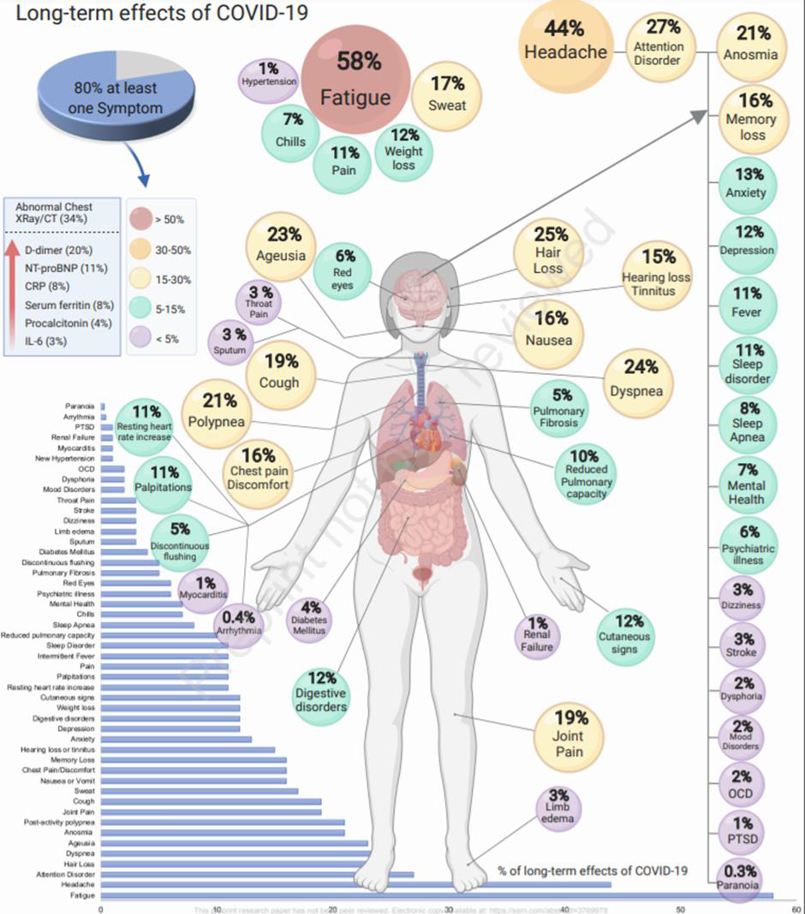
Long Covid (3 of 3)
www.actuariesindia.org
Notes:
A large number of mutations have been identified in the Omicron variant
16
1

Slide 17
Expected Omicron wave and risk from new variants
New variants make the future outlook uncertain:
Omicron spreads quicker but has less severe impact.
Risk of mutation where a more severe variant which spreads quickly
Effectiveness of current vaccines on new variants?
Higher Risk for Anti Selection:
Increased sales due to increase awareness and presumed demand by the policy holders;
High Increase in premiums leads to high Selective lapsing
Moral Hazard: Behavioral change after joining the risk group. Increased propensity to claim
Further pressure on Medical Inflation
www.actuariesindia.org
Notes:
A large number of mutations have been identified in the Omicron variant
17
1

Slide 18
Effectiveness of vaccines (1 of 3)
Concerns about effectiveness against new variant(s):
Vaccine inequality: Globally and in India
Large number of mutations – decrease in vaccines’ effectiveness
Rapid increase of cases / reinfections
Vaccinated population getting infected:
Reduced effectiveness against mild illness, severe illness and deaths
www.actuariesindia.org
Notes:
A large number of mutations have been identified in the Omicron variant
18
1

Slide 19
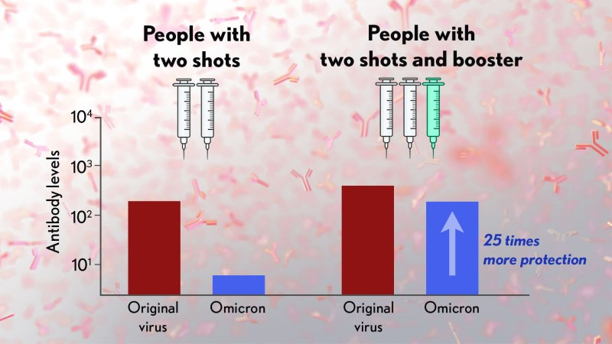
Effectiveness of vaccines (2 of 3)
Source (NIH)
www.actuariesindia.org
Notes:
19
1

Slide 20
Effectiveness of vaccines (3 of 3)
Considerations for Indian market
Presently, concerns around protection against Omicron with single/double dose of vaccination
Future New variants: unknowns about timing, severity etc.
Vaccine available to 15+; inequality amongst states
1 dose+: Around 90% of the eligible population
2 dose: Around 65% of the eligible population
Booster dose: Started in January 2022, limited eligibility
Vaccination drive to be stepped up.
Omicron and future new variants are potential cause for concern for the Health Insurance market.
www.actuariesindia.org
Notes:
20
1

Slide 21
Pandemic >> Endemic?
Definition of Pandemic: Pandemic is an epidemic of an infectious disease that has spread across a large region, for instance multiple continents or worldwide, affecting a substantial number of individuals.
Definition of Endemic: Infection is said to be endemic in a population when that infection is constantly maintained at a baseline level in a geographic area without external inputs.
Short term: Likely to be Pandemic stage
Transition to Endemic:
Difficult to predict timing, medium term?
Large population need immunity (vaccination or natural)
Implication for Health Insurance:
Short term: Covid related uncertainties expected
Medium term: lower Covid related hospitalizations expected
More stable experience expected in Endemic stage
Need for regular monitoring and agile pricing
www.actuariesindia.org
Notes:
21
1

Slide 22
Development of new anti-viral treatments (1 of 2)
India
Approved vaccines: Covishield, Covaxin and Sputnik V
Two more vaccines under emergency use authorization
Approved antiviral drug, Molnupiravir in December 2021 (to be prescribed with caution)
Many pharma companies are in various stages of development of covid vaccine in India
USA
Researching COVID-19 treatments
670+ drug development programs in planning stage out of which 50 are antiviral treatment programs
470+ trials reviewed by FDA
14 treatments currently authorized for emergency use
www.actuariesindia.org
Notes:
22
1

Slide 23
Development of new anti-viral treatments (2 of 2)
What it means for Insurers
Uncertain outlook:
Cost of new treatment(s)
Effectiveness
Side effects
Availability; timing and supply
Regulatory approvals
As before, the impact of such treatments may not be easy to quantify. Hence, regular monitoring and agile pricing is needed.
www.actuariesindia.org
Notes:
23
1

Slide 24
Agenda
Introduction of the case study
Initial considerations
Analysis of recent underwriting experience
Considering future outlook
Considering stakeholders’ needs
Other Considerations
Recommending reprice
Monitoring the experience
Questions
www.actuariesindia.org
Notes:
A large number of mutations have been identified in the Omicron variant
24
1

Slide 25
Considerations for Stakeholders
Company
Competitive and profitable product
Compatibility of Pricing structure
Allowance for underwriting philosophy
Customers
Meeting PRE, for example, stable renewal premiums
Affordable / Value for money
Clear Policy T&Cs e.g. exclusions
Simple claim process
Distributors
Attractive product, meeting customer needs
Competitive remuneration
Competitive premiums
Regulator
Treating customer fairly (TCF)
Restrictions on premium rates (if any)
Risk of retrospective changes e.g. allowed exclusions
Reporting & approval
Reinsurer(s)
Reinsurance capacity and terms
www.actuariesindia.org
Notes:
A large number of mutations have been identified in the Omicron variant
25
1

Slide 26
Agenda
Introduction of the case study
Initial considerations
Analysis of recent underwriting experience
Considering future outlook
Considering stakeholders’ needs
Other Considerations
Recommending reprice
Monitoring the experience
Questions
www.actuariesindia.org
Notes:
A large number of mutations have been identified in the Omicron variant
26
1

Slide 27
Other considerations
Premium rates of peers
Industry wide experience
Risk Appetite: reinsurance; cost vs volatility
Marketing Strategy: volumes vs margin
Level of Underwriting: cost vs benefit
Government sponsored medical benefits
Government restrictions on hospital charges
www.actuariesindia.org
Notes:
A large number of mutations have been identified in the Omicron variant
27
1

Slide 28
Agenda
Introduction of the case study
Initial considerations
Analysis of recent underwriting experience
Considering future outlook
Considering stakeholders’ needs
Other Considerations
Recommending reprice
Monitoring the experience
Questions
www.actuariesindia.org
Notes:
A large number of mutations have been identified in the Omicron variant
28
1

Slide 29
Recommendation for Pricing (1 of 2)
To summarise, our recommendation for the Pricing would be to have a credibility factor based approach for estimation of the Price. Where,
Price = x% * Historic Experience + (1-x%) * Future Expectations
+ Profit / Commercial considerations
Credibity weighting will be based on expert judgement, allowing for MAD
Historic experience based on latest experience analysis
Future expectations based on
Covid related uncertainties
Adjustment for data quality and policy holders’ actions
Profit / Commercial: Based on
Balancing stakeholder’s needs
Availability of reinsurance
Reinsurance terms
Industry Benchmarking
www.actuariesindia.org
Notes:
A large number of mutations have been identified in the Omicron variant
29
1

Slide 30
Recommendation for Pricing (1 of 2)
Sensitivity
Sensitivity test to be performed for profit by using the revised premium by changing the following parameters:
Claim incidence rate due to Covid
Average claim amount due to Covid including expected new variant
Change in expenses due to both internal and increased claim process by TPA
Cost of capital as increased reserve requirement due uncertainties in future experience
This will help us to identify:
The key risks and their materiality
Possible risk mitigating tools
www.actuariesindia.org
Notes:
A large number of mutations have been identified in the Omicron variant
30
1

Slide 31
Agenda
Introduction of the case study
Initial considerations
Analysis of recent underwriting experience
Considering future outlook
Considering stakeholders’ needs
Other Considerations
Recommending reprice
Monitoring the experience
Questions
www.actuariesindia.org
Notes:
A large number of mutations have been identified in the Omicron variant
31
1

Slide 32
Continuous Monitoring
An effective continuous monitoring framework required
Effective systems to capture, store, analyze and utilize all the data
Uncertain environment: frequent monitoring of key risk indicators (KRIs) required, for example:
Burning cost
Profitability
Actual sales vs plan
Price benchmarking to competitors
Review pricing if indicated by KRI's
Appropriateness of policy T&Cs
More frequent experience analyses, for example business accepted at standard rates
Underwriting system and performance
www.actuariesindia.org
Notes:
A large number of mutations have been identified in the Omicron variant
32
1

Slide 33
Agenda
Introduction of the case study
Initial considerations
Analysis of recent underwriting experience
Considering future outlook
Considering stakeholders’ needs
Other Considerations
Recommending reprice
Monitoring the experience
Questions
www.actuariesindia.org
Notes:
A large number of mutations have been identified in the Omicron variant
33
1

Slide 34
Thank you for your time!
Any questions?
www.actuariesindia.org
Notes:
34
1

