Slide 1
36th India Fellowship Webinar
Case Study
Valuation of health insurer for investment
Guide : Palreddy Vishnu Vardhan
Presented By :
Ajay Goyal
Rachit Goyal
Nishi Unadkat
Shryans Baid

Slide 2
Case Study – Health Insurance
Star Health & Allied Insurance Company (“Star Health”) is a leading health insurance company in India.
As a health insurance specialist at an investment banking firm, advise the MD whether the firm should invest Rs 2,500 crore in Star Health by purchasing a 5% stake in the company at a price of Rs 825 per share. The firm has time till January 5th to exercise on the offer.
Submit a report ASAP, focusing on
Future potential of health insurance in India
Growth possibilities for Star Health over 5-year and 10-year horizon
ESG score of the company
Valuation of the company considering Covid & your recommendation on the above proposal
www.actuariesindia.org
Notes:
New India is the largest public health insurer while Star Health and HDFC Ergo are the largest standalone and private health insurers.
The government sponsored scheme constitutes 7% of health premiums, covering c. 343m lives.

Slide 3
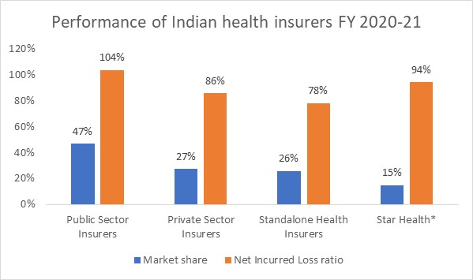
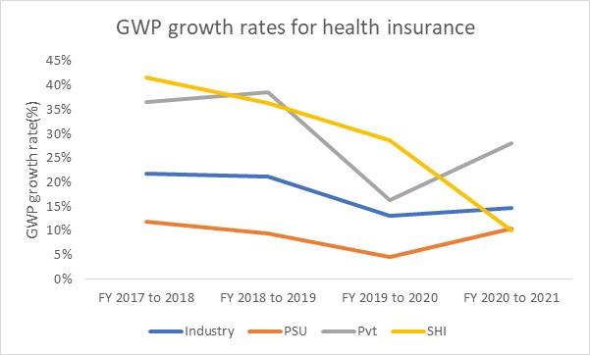
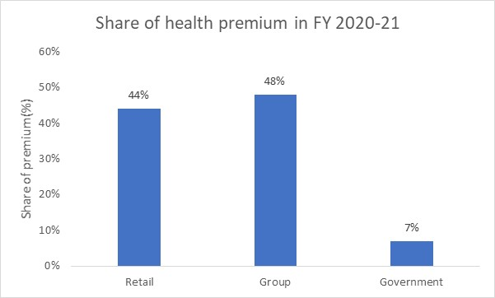
Health insurance in India
Health insurance business in India had an annual turnover of INR 58.2k crores in FY 2020-21, covering c. 514m lives. which was 32% of all general insurance premiums.
Market share dominated by the 4 public insurers who have a higher loss ratio (LR) of c. 25% points.
On average stand alone health insurers (SHI) and private insurers have grown at 30% and public insurers at 9% from 2016-2020. In FY 2021, health premiums grew by 15%.
44% of health premiums are from retail business, which is the most profitable segment.
As per GIC Council, Star Health has a 32% market share in this segment as at Nov 2021.
*All figures exclude personal accident and travel insurance
** All figures based on IRDAI Annual report 2020-21, unless mentioned
www.actuariesindia.org
Notes:
New India is the largest public health insurer while Star Health and HDFC Ergo are the largest standalone and private health insurers.
The government sponsored scheme constitutes 7% of health premiums, covering c. 343m lives.

Slide 4
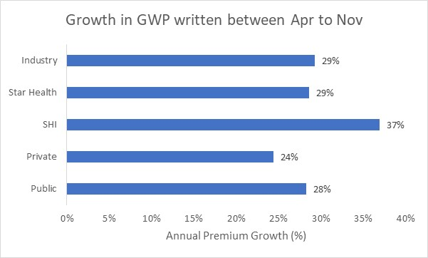
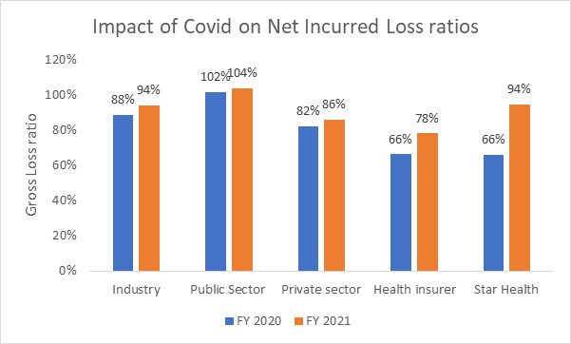
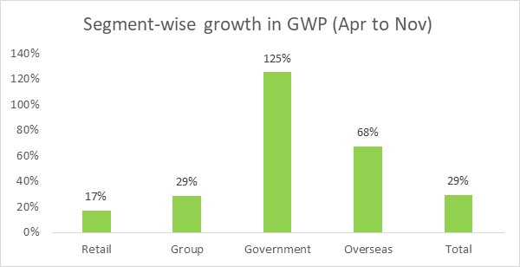
Impact of Covid-19 on health insurers
In India, hospitalisation due to Covid-19 is covered under health insurance products. Additionally, IRDA has made it mandatory for insurers to sell Corona Kavach and Corona Rakshak policies.
For the period Apr 2021 to Nov 2021, health insurance is the largest general insurance class in terms of gross written premium.
Health premiums grew by 29%, across all players in the market, with a 125% increase in government scheme premium over this period while retail health business grew by 17%.
Deterioration in Star Health’s performance is the driver of 12% LR points increase for stand alone health insurers in FY 2020-21
*All figures exclude personal accident and travel insurance
** All figures in chart on left hand side based on IRDAI Annual report 2020-21
*** All figures in charts on right hand side based on data from General Insurance Council of India
www.actuariesindia.org

Slide 5
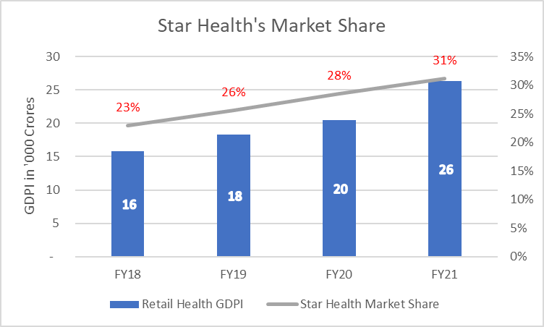
Retail Health Market Leader - Star Health
Largest Standalone Health Insurer and largest Retail Health Insurer in India*
In FY21, 89% business from Retail Health, 11% from Group Health*
Excellent Growth in Market Share over last 4 years, 31% in FY21 with GDPI of 8,207 Crores**
Retail Health Market has grown by 66% in the last 4 years, now at 26,301 Crores in FY21**
*(Source : Draft Red Herring Prospectus – Star Health www.sebi.gov.in)
**(Source : Segment wise Report Mar’19-Mar’21 from GI Council www.gicouncil.in)
www.actuariesindia.org

Slide 6
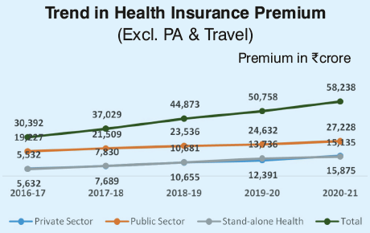
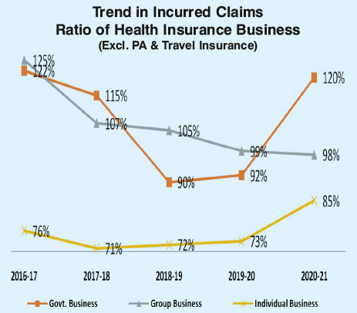
Trends in Health Insurance Market
Premiums
Stand Alone Health Insurers share increased from 18% to 26% in 5 Years
Premiums have increased by 274% from FY17 to FY21
(Source : IRDA Annual Report 2020-21)
Claims
Individual Business persistently lower than govt and group business, however increase in FY21 to 85%
Govt and group business in line earlier
Now Group business stable
(Source : IRDA Annual Report 2020-21)
www.actuariesindia.org

Slide 7
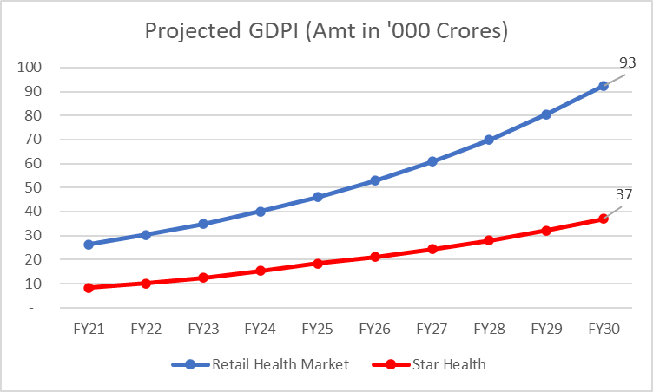
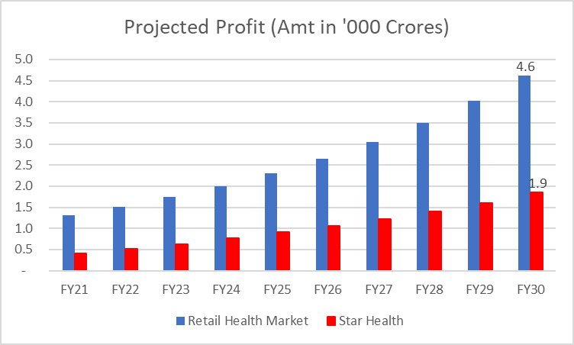
Retail Health Market Growth Possibilities (1/2)
Assumed Retail Health Market GDPI Growth at 15% p.a. and profit margin at 5%
Star Health’s Market share assumed to grow steadily from current levels, capped at 40%
www.actuariesindia.org

Slide 8
Retail Health Market Growth Possibilities (2/2)
Opportunities
Better market penetration due to increased awareness from the pandemic
Increase in FDI from 49% to 74%, bringing in more capital & expertise of foreign players
Wearable Technology provides opportunity for improved risk selection and real-time monitoring
Can easily attract large educated audience online, with lower expense per policy
Large uninsured population of India – simple products that cater to specific needs can bring massive premium volumes
Risks
“Covid-19” – After effects still unpredictable as newer variants continue to emerge
Risks from Increased Government Expenditure on Healthcare leading to introduction of simple products at cheap prices. Middle Class market may quickly switch to these schemes
Risks from negative publicity related to regulatory non-compliances, unsatisfactory customer service etc results in loss of confidence in the industry
Competitive Pricing as new players enter the market or existing players seek to increase market share
www.actuariesindia.org

Slide 9
ESG Value proposition
ENVIRONMENT
Energy and emissions
Water usage
Customer satisfaction
Employee management
GOVERNANCE
Compliance and disclosures
Management control
Resource use and bio diversity
Waste management systems
Community Welfare
Supply Chain ecosystem
Board independence
SOCIAL
Assessment of risk through factors related to:
Top 50 ESG companies have consistently outperformed Nifty 50¹
Finance ministry working towards calculating ESG score for LIC ahead of IPO²
Companies like ICICI Lombard and HDFC have started publishing ESG reports
¹https://economictimes.indiatimes.com/markets/stocks/news/top-50-esg-investments-outpace-benchmark-index-nifty50/articleshow/86971097.cms?from=mdr
²https://economictimes.indiatimes.com/markets/ipos/fpos/govt-working-on-esg-ranking-for-lic-ahead-of-public-offer/articleshow/88744950.cms
www.actuariesindia.org

Slide 10
ESG Risk Assessment for STAR Health
(Environmental)
Criteria | Assessment*
GHG emissions/ Carbon footprint | Values not disclosed; Use of LED technology and energy efficient AC units
Use of renewable energy in office spaces | Not publicised in ESG segment of annual report
Sustainable water management systems | Implemented sensory based taps
Waste management systems | Segregation of dry/wet waste; use of bio-degradable materials
Green Investments | Not publicised in ESG segment of annual report
Underwriting of carbon heavy portfolios | Health insurance by its nature does not impact the environment adversely
Digitised work environment | Use of online and end-to-end digital solutions
Overall Environmental Assessment- Average
*Based on publicly available information from Star Health’s DRHP and FY21 Annual reports
www.actuariesindia.org

Slide 11
ESG Risk Assessment for STAR Health
(Social)
Criteria | Assessment*
Gender Diversity | Only 2 out of 15 board members are female
Gender pay gap | No available details; DRHP mentions equal employment policy
Employee friendly work environment | Awarded the best employer brand award and ‘Vajra’ award
Employment friendly offices for differently-abled | Not publicised in ESG segment of annual report
Community Welfare | Several engagements as part of CSR initiatives
Procedures/committee for handling sexual harassment cases | Committee created to handle such complaints but no such complaints were received
Rural footprint | 17% premiums from rural sector vs obligated 7%
Innovative products for policyholders | Products for autism, cancer
Ensuring safety of policyholders | Policyholder protection committee
Overall Social Assessment-Good | Average
*Based on publicly available information from Star Health’s DRHP and FY21 Annual reports
www.actuariesindia.org

Slide 12
ESG Risk Assessment for STAR Health
(Governance)
Criteria | Assessment*
Existence of internal audit function | Yes
Various governance committees | Yes, as per IRDAI’s Corporate Governance guidelines
Proportion of members attending board meetings | All
Compliance with IRDA and SEBI rules | Yes
Whistle-blower policies | Yes
IRDA stewardship policy | Not Applicable
Controversy involvements | None
Board independence | Yes
Cyber security | No recent breaches
Overall Governance Assessment-Excellent | Excellent
*Based on publicly available information from Star Health’s DRHP and FY21 Annual reports
www.actuariesindia.org

Slide 13
Future ESG outlook
Business Responsibility & Sustainability Reporting disclosures prescribed by SEBI to be compulsory from 2022-23 onwards for 1000 largest listed firms by market cap
Improvement in ESG practices may increase future profits, brand value, customer retentions
Best ESG practices may command significant premiums in share price valuations
Due to inadequate ESG data for Star Health, the current ESG assessment is not used in the valuation exercise
www.actuariesindia.org

Slide 14
Valuation - Approaches used
We have projected the valuation using a combination of multiples and future value discounted method
Given the limited time, we use broad brush approach based on transaction/stock multiples
Method | Summary | Pros | Cons
Future Value Discounted Method | Project a valuation using future value discounted methodology based on projections of STAR’s financials | Values a company based on future projections and ability to earn profits | Sensitive to discount rate selection, growth assumptions
Price to Earnings | Earning per share is the total profit per unit of equity share | Helps compare valuations of one company to another | Does not indicate future success of a company
Price to Gross Premium | Values a company based on the business written | Less volatile than P/E | Does not consider profitability of the company
Price to Book value | Represents the minimum value of a company's equity share | Provides a stable metric even during a period with negative earnings | Value of intangibles are not captured
www.actuariesindia.org

Slide 15
Valuation - Transaction multiples in Non-Life insurance
Given Star Health’s dominant position, growth and ROE profile a premium Star will have a premium over the historical multiples in Non-life insurance
Date | Insurance Company | Seller | Buyer | Valuation (in crs) | Annual Report Date | P/E^ | P/B | P/GWP
Jun-17 | ICICI Lombard | Fairfax | Warburg Pincus | 20,300 | 31-03-2018 | 29.00 | 4.60 | 1.64
Jun-18 | Star Health | Promoter | WestBridge, Rare | 6,500 | 31-03-2018 | 38.00 | 6.80 | 1.56
Sep-18 | SBI General | SBI | Premji and Axis MF | 12,050 | 31-03-2018 | 30.00 | 7.80 | 3.40
Feb-19 | Max Bupa | Max India | True North | 1,000 | 31-03-2019 | 44.00 | 3.90 | 0.80
Jan-20 | Apollo Munich | Apollo Hospitals | HDFC | 2,920 | 31-03-2019 | 261.00 | 6.70 | 1.33
Jun-20 | Religare Heallth | Religare Ent | Kedaara | 4,180 | 31-03-2020 | 96.00 | 7.60 | 1.75
Jul-20 | Raheja QBE | Prism & johnson, QBE Australia | Paytm | 570 | 31-03-2020 | NA | 3.80 | 3.60
Aug-20 | Bharti AXA | Bharti AXA | ICICI Lombard | 4,600 | 31-03-2020 | NA | 6.10 | 1.47
05-01-2022 | ICICI Lombard | NA | NA | 71,092 | 31-03-2021 | 45.00 | 9.00 | 4.96
 |  |  |  |  | Median | 41.00 | 6.70 | 1.64
 |  |  |  |  | Range* | 29 – 45 | 3.8 – 9.0 | 1.33 – 4.96
*excludes Max Bupa for Range due to it being an outlier
^P/E is rounded to the nearest integer
Source: Annual reports/IRDA disclosures and Economic Times
www.actuariesindia.org

Slide 16
Valuation - Assumptions & Methodology
Given the growth in Star Health’s valuation from 2018, valuation is done based on future earnings.
Assumptions
Discount Rate | 10%
Growth in overall health insurance market | 15%
Profitability | 5%
Gwp in Dec – Mar months is in the same proportion as in 2020-21
Rate of growth in market share of Star Health will gradually slow
Highlights of Star’s Business and Financial performance
Agency driven model
Star Health has delivered 15%+ RoE
It has a high solvency ratio of 2.5, which is the highest in SAHI companies and next to only ICICI and Bajaj in general insurance companies
Avg sum insured increased at 11.7% CAGR from FY19-FY21
values in Rs. crs
 | 2020-21 | 2021-22 (E) | 2022-23 | 2025-26 | 2028-29 | 2029-2030
Retail Health | 8,208 | 10,345 | 12,729 | 21,550 | 32,775 | 37,691
Group health | 996 | 1,483 | 1,825 | 3,212 | 5,184 | 5,962
Govt Health | 0 | 0 | 0 | 0 | 0 | 0
Travel | 1 | 0 | 0 | 1 | 1 | 1
GDPI | 9,204 | 11,828 | 14,554 | 24,763 | 37,960 | 43,654
Profit % | -9.0% | 4.0% | 4.5% | 5.0% | 5.0% | 5.0%
PAT | -826 | 473 | 655 | 1,238 | 1,898 | 2,292
 | Min | Max
GWP (2020-21) | ₹ 9,204 crs
P/GWP | 3.6x | 5.0x
Equity Value | 33,136 | 46,022
Share price | ₹ 605 | ₹ 840
Book Value* (2020-21) | ₹ 64.14/share
P/B | 9.0x | 14.0x
Share Price | ₹ 577 | ₹ 898
35x – 45x
₹621–798/share
34,018 – 43,738
Discounted
Equity value
80,214 – 1,03,132
*Book value excludes Covid-19 related losses
www.actuariesindia.org
Notes:
Discount Rate
Source: https://www.topstockresearch.com/INDIAN_STOCKS/DIVERSIFIED/PriceRangeOf_ICICI_Lombard_General_Insurance_Company_Ltd.html
http://www.worldgovernmentbonds.com/country/india/
10yr govt bond yield = 6.5%
Beta of ICICI Lombard = 0.734
Stock return of ICICI Lombard = 11.09
Disc rate = 6.25 + 0.734 * (11.09 – 6.25) = 9.8
Considered discount rate = 10%

Slide 17
Conclusion
Implied equity value per share
Multiple
Reference company
35x – 45x
3.6x – 5.0x
9x – 14x
Proposed valuation of Rs.825/share is on the higher end of the proposed valuation range.
Additional points to consider
Covid-19 adds to the uncertainty in valuation
Detailed ESG assessment will throw light on whether further premium needs to be considered for the valuation
A more detailed exercise can be done for a better estimate of the valuation
For eg. Project future earnings under various scenarios and calculate an net present value
It does not consider the risk appetite of the investing firm, investment time horizon and the size of fund
www.actuariesindia.org

Slide 18
Thank You
www.actuariesindia.org

