Slide 1
Assessing Value For Money of Investment funds and Managing Single Factor Risks
19 June 2020
Assessing Value-For-Money of Investment Funds
Brandon Horwitz B.Sc. M.Sc. FFA
19 June 2020

Slide 2
Agenda
Introduction and Overview
Value-for-Money and Authorised Funds
Examples of Value Statements
What Next?
www.actuariesindia.org

Slide 3
Poll #1: What makes a service value-for-money?
Investing a client’s money is a service, similar to many other types of services available in the market
What factors do you think are important when assessing if any service offers value-for-money?
Please select from the following (you can choose as many as you like):
Price (i.e. lower fees than other similar services)
Quality (i.e. what the service delivers)
Clarity (i.e. clear explanation of the service works and knowing what to expect)
Customer service (i.e. how the service is delivered)
Brand (i.e. who the company is who provides the service)
www.actuariesindia.org

Slide 4
1. Introduction and Overview

Slide 5
The journey from product sales to customer outcomes
www.actuariesindia.org
Notes:
The past 20 years in financial services has seen regulation increasingly aimed at addressing the sins of the past, specifically mis-selling scandals of financial products, with measures introduced over time to incrementally move from product sales towards delivering on promised customer outcomes.

Slide 6
Timeline of regulation and key market events
Increasing focus on client outcomes, charges and value-for-money
Regulation
Fair value & governance of workplace pension funds
2015
Asset Management Market Study 2018
Stakeholder pensions (charges cap) 2001
Fair treatment of longstanding customers 2016
First value assessments published 2020
Treating Customers Fairly (TCF) 2006
Retail Distribution Review (RDR) 2012
1980 / 90s Pensions mis-selling
1990s / 2000s PPI misselling
2000s Pension switching scandal
2008 - 2018 Long bull market in equities
2020
Covid-19 impact on financial markets
2007 / 2008 Global financial crisis – equity market crash & falling interest rates
Market events
Bad timing?
www.actuariesindia.org
Notes:
Regulation has evolved over time to address issues in the market, especially various mis-selling scandals which typically included features such as mis-selling, both moving consumers from products like DB pensions or stakeholder pensions to more expensive (and/or reduced features) like personal pensions. PPI is also a key turning point because it represented a product which while arguably meeting some consumers’ needs, was very poor value for money, as evidenced by very low claims rates and payouts by providers.
The common theme in regulation has been a movement to increased focus on product features and charges, including tightened up FCA product regulation with an explicit focus on appropriateness of product features for a target market of consumers (both MiFID II and PRIIPS regulations) and an explicit requirement to consider value-for-money in a number of contexts, especially in terms of pension funds and more generally ‘authorised’ funds

Slide 7
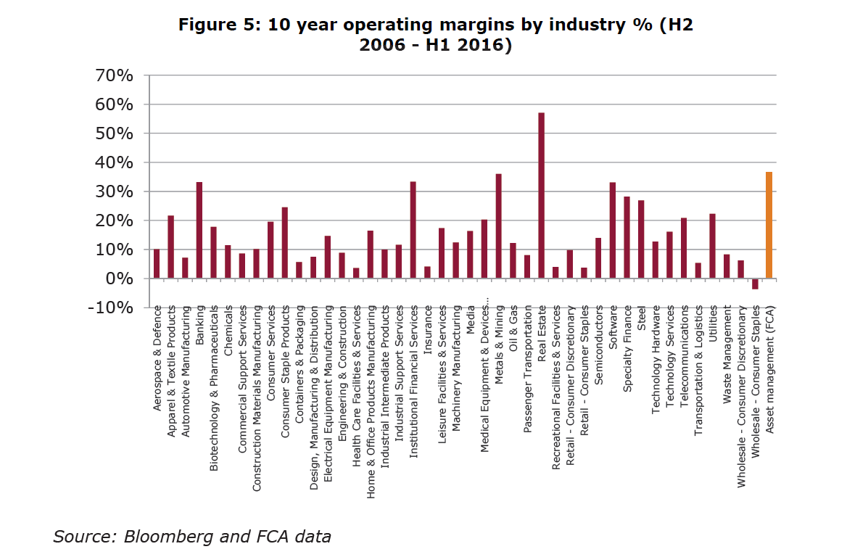
Why did the regulator focus on asset management?
Relatively high profit margin
www.actuariesindia.org
Notes:
The past 20 years in financial services has seen regulation increasingly aimed at addressing the sins of the past, specifically mis-selling scandals of financial products, with measures introduced over time to incrementally move from product sales towards delivering on promised customer outcomes.

Slide 8
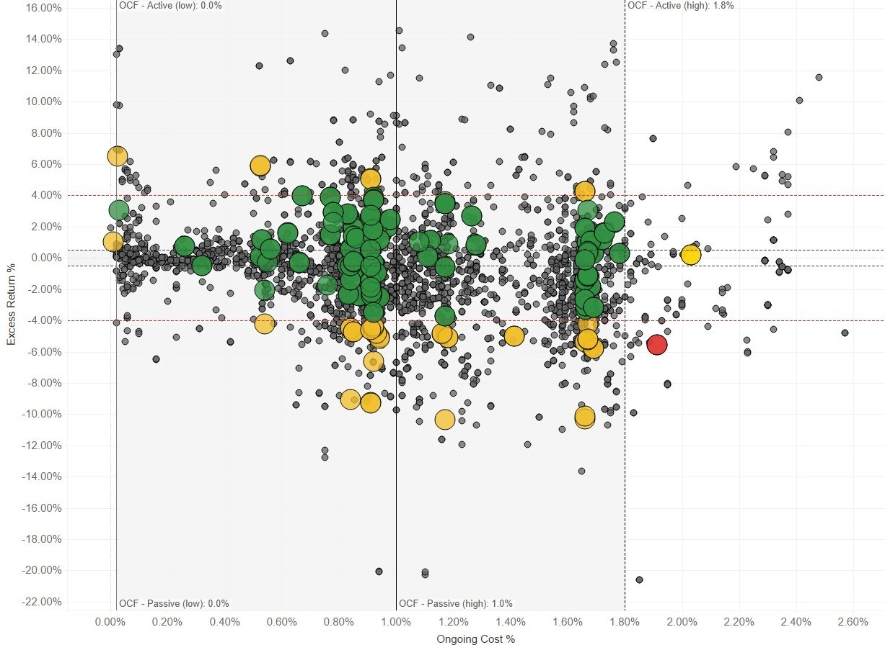
Why did the regulator focus on asset management? (2)
Excess Return over Benchmark %
Clustering of charges (e.g. around 1%) – evidence of weak price competition?
Questions around whether actively managed funds were delivering above-index returns (given their charges are higher than index-tracking funds)
Examples of relatively high charges (even post Retail Distribution Review when many funds’ charges came down by c. 0.50% to 0.75%)
OCF %
Source: EY – illustrative population of active and passive funds total charges vs. excess return
www.actuariesindia.org
Notes:
The data available at the time suggested to the regulator, and many industry commentators, that charges for funds (and actively managed funds in particular) may not be delivering value … with:
Clustering around certain price points such as 1% p.a. (and the question of why so many different funds and fund providers should be charging the same level when they should arguably have different propositions, costs etc)
Concerns about whether actively managed funds (which charge a premium) deliver above-benchmark returns (and the concerns of so-call ‘closet trackers’ which charge fees for active management but take positions very similarly to indices and/or don’t outperform
Persistent examples of high charges, even when some have reduced significantly since 2013 where the cost of distribution and product/platform charges were removed resulting in ‘clean’ fund charges which reduced by 0.50% to 0.75% p.a. typically

Slide 9
2. Value-for-money and Authorised Funds

Slide 10
Authorised Funds
An authorised fund is a type of collective investment scheme authorised by the FCA (the Financial Conduct Authority, one of the two key UK financial services regulators).
The two most common structures are authorised unit trusts and open-ended investment companies (OEICs)
Authorised funds enable individuals to invest in a diversified portfolio of securities (like equities and bonds) and certain other assets (like real estate). Investors’ contributions are pooled and invested on their behalf by professional investment managers.
The UK governance structure for authorised funds is built around the segregation of duties between the:
Authorised Fund Manager (AFM): who is responsible for investment decisions and compliance with relevant regulation, and
Depositary: who is responsible safeguarding of the assets of the authorised fund and oversight of key areas of AFM activities
Life and pension funds (unit-linked funds) are similar economically to authorised funds, but fall under different regulation
www.actuariesindia.org

Slide 11
FCA’s Asset Management Market Study Findings
“We find weak price competition in a number of areas of the asset management industry”
“We consider value for money for asset management products typically to be some
form of risk-adjusted net return. This can be broken down into performance achieved,
the risk taken on to achieve it and the price paid for the investment management
services.
Investors' awareness and focus on charges is mixed and often poor.
There are a significant number of retail investors who are not aware they are paying charges for their asset management services.”
“…analysis suggests that there is no clear relationship between charges and the gross performance of retail active funds in the UK”
“We have concerns about how asset managers communicate their objectives to clients, in particular how useful they are for retail investors”
Source: FCA’s Asset Management Market Study Final Report 2017 - https://www.fca.org.uk/publication/market-studies/ms15-2-3.pdf
www.actuariesindia.org

Slide 12
FCA’s VFM Remedies
“There is an existing duty on AFMs to act in the best interests of fund investors. In our view, as part of fulfilling this duty, AFMs should assess and justify to their fund investors the charges taken from the funds they manage in the context of the overall service and value provided.
We believe this is important as AFMs are the agents of the investors in their funds; they are not just product providers.
In CP17/18 we called this a consideration of ‘value for money’ (VfM). We have found that AFMs generally do not consider robustly whether they are delivering VfM, despite their existing obligations.”
“For many retail and institutional investors, making informed investment decisions can be hard. To protect those investors that are not well placed to find better value themselves, we consulted on proposals to strengthen and clarify AFMs’ duty to act in the best interests of fund investors.
Specifically, we said that they must assess the VfM of each fund against a non-exhaustive list of prescribed elements, conclude that each fund offers good VfM or take corrective action if it does not, and explain the assessment annually in a report made available to the public.”
Source: FCA’s Asset Management Market Study remedies and changes to the handbook- https://www.fca.org.uk/publication/policy/ps18-08.pdf
www.actuariesindia.org

Slide 13
FCA’s Value Assessment Criteria and Key Questions
Value assessment criteria | Key questions to ask
1. Quality of service: the range and quality of services provided to investors | Are services provided by a strong and well governed organisation with highly experienced staff? Is service quality high and are customers satisfied? What features are available and how do investors benefit from them?
2. Performance: the Fund’s performance after deduction of all charges, considered over an appropriate timescale and having regard to the Fund’s investment objectives, policy and strategy | How has the Fund performed and what controls are in place to monitor performance? What action is taken to address periods of underperformance?
3. Authorised Fund Manager (AFM) costs: for each charge, the cost of providing the service to which the charge relates | Are the charges paid by investors reasonable in light of the cost of providing the services they receive? Are costs robustly controlled?
4. Economies of scale: considering whether the AFM is able to achieve savings and benefits from economies of scale, whether they have been achieved, and whether such savings have been or will be passed on to investors | Have economies of scale been identified and, if so, have they been passed on to investors?
5. Comparable market rates: a comparison of the Fund’s charges against the market rates of similar funds | How do the Fund’s charges compare with similar funds on the market?
6. Comparable services: considering the Fund’s charges against those applied for comparable services provided to other clients of the AFM and those of its associates | What does the Manager, or its associates, charge for comparable funds or investment services to other customers?
7. Classes of units: considering if it is appropriate for investors to hold units in classes subject to higher charges than those applying to other classes of the same fund with substantially similar rights | Are some investors in the Fund invested in a more expensive share class than others?
www.actuariesindia.org

Slide 14
Introducing independent Non-Executive Directors
“AFM boards must balance the interests of their fund investors and shareholders.
The market study suggests that this balance is not always being struck appropriately, and we believe this is in part due to the fact that AFM boards are generally staffed exclusively by executives of the firm.
To rebalance this and to help make sure that the best interests of investors are subject to greater scrutiny and challenge, we proposed rules requiring AFMs to appoint independent directors to their board.
We proposed that AFMs appoint a minimum of two independent directors and for them to comprise at least 25% of the total board membership”
www.actuariesindia.org

Slide 15
3. Examples of Value Statements

Slide 16
More than One Way to Tell a Story
While the FCA prescribed seven criteria to consider when assessing value, they did not prescribe how exactly fund managers had to do so, nor how they should report their results…
Wide variety of presentation approaches ranging from more visual to more text based reports
Common features are a summary of the assessment and the ‘remedies’ applied to address issues identified such as:
Reducing charges on some funds
Moving investors to lower charge versions of funds
Reviews or changes to investment strategies to improve performance
We briefly consider a few examples
www.actuariesindia.org

Slide 17
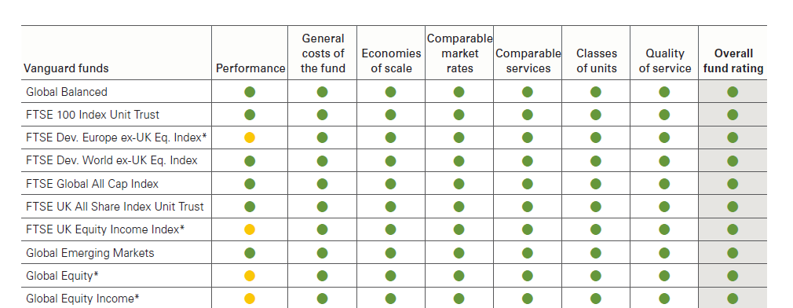
Vanguard
www.actuariesindia.org

Slide 18
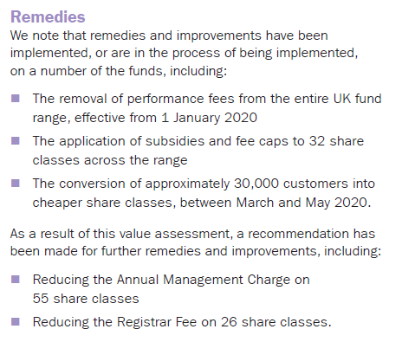
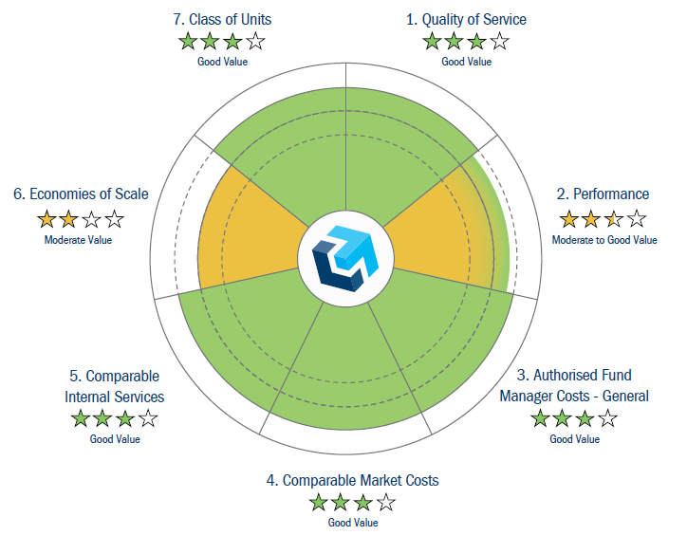
Columbia Threadneedle
www.actuariesindia.org

Slide 19
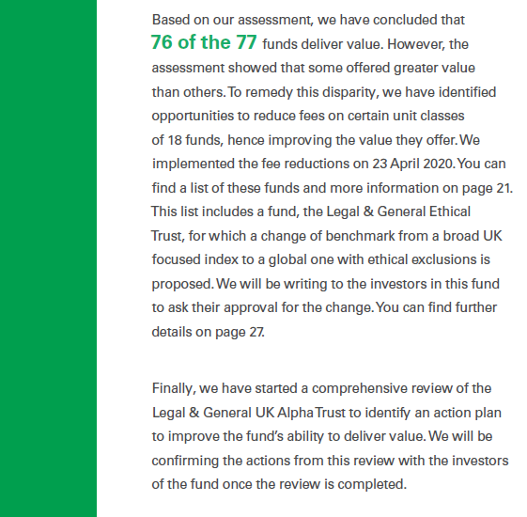
Legal & General Investment Management
www.actuariesindia.org

Slide 20
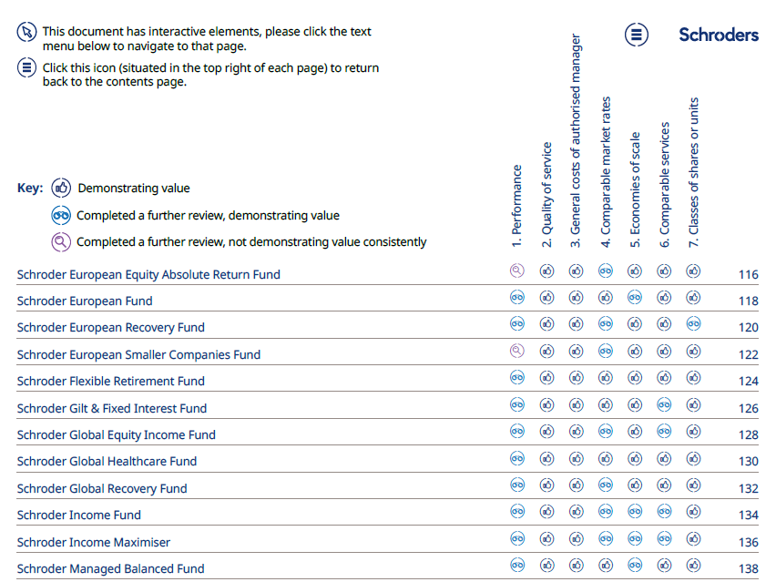
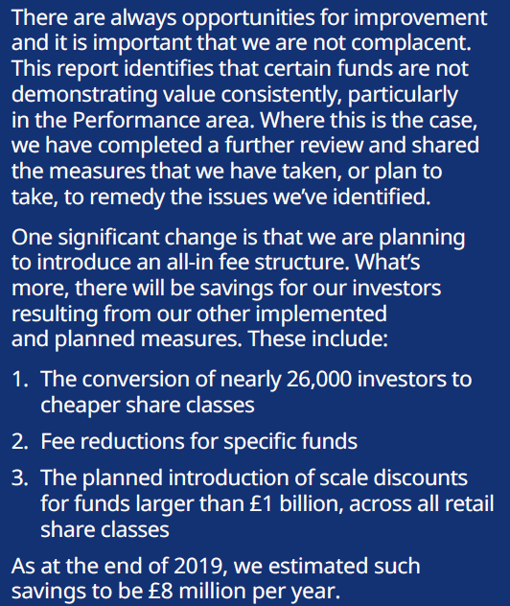
Schroders
www.actuariesindia.org

Slide 21
4. What Next?

Slide 22
Assessing the Value Assessments
While some fund managers have already published, many are still to publish over H2 2020
Many commentators and consultants have commented on these, but the FCA have yet to formally publish a report and may only do so in late 2020 or 2021 (e.g. with their views on good / poor practices)
Positive action has been demonstrated with examples of fund managers:
Reducing charges of some funds
Addressing the performance of some funds (and closing/merging funds where appropriate)
Improving their governance and increasing their focus on customer outcomes
While all of these actions arguably do benefit end-investors, a key question is whether the average customer ‘on the street’ will have engaged with published value statements
www.actuariesindia.org

Slide 23
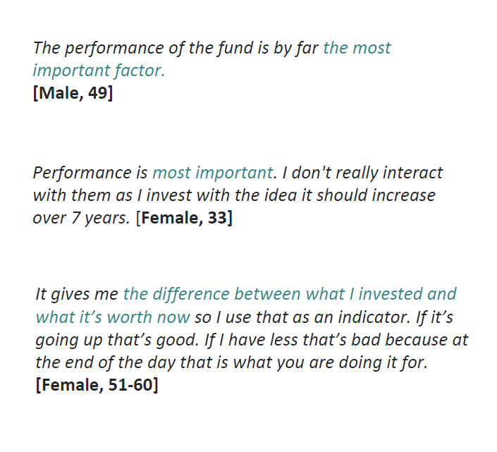
Final Thought – Does it All Come Back to Performance?
Includes:
Customer service, communications, resources and brand/reputation
Includes:
The range of products and good overall experience
What makes you say [your provider] offer value for money? [Open response]
Base: 1,510 responses. Those not specific in their answer have been removed
Source: Boring Money research 2020
www.actuariesindia.org

