Slide 1
2nd Webinar on
Banking Finance & Investments
19th June, 2020,1500 to 1630 (India Time)
Assessing Value-For-Money of Investment Funds and Managing Single Factor Risks

Slide 2
Welcome Instructions
Mute
Q&A
IAI support
C
P
D
Recording
Feedback
www.actuariesindia.org

Slide 3
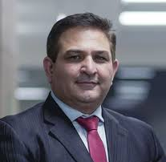
Presidential Address
Sunil Sharma
President, Institute of Actuaries of India
www.actuariesindia.org

Slide 4
Chair - Advisory Group Banking Finance & Investment
Phanesh Modukuru, Chairperson, Advisory Group for Banking Finance and Investments, IAI
Qualified Actuary with about 28 years experience in the Indian Insurance Industry
Currently an Independent Consultant
Held previously positions like Appointed Actuary and CFO in life insurance companies
www.actuariesindia.org

Slide 5
Speaker Profile
Brandon Horwitz, M.Sc, B.Sc, FIA
Principal consultant, NomBon Consulting Limited
Brandon is also an independent non-executive director of London & Colonial Assurance and Options Pensions, two businesses offering retirement planning products and services. His previous roles include leading the launch of the Vitality Invest proposition, an exciting new entrant to the UK market combining managing wealth and health. Prior to this Brandon was Head of Financial Planning at HSBC UK Retail Banking and Wealth Management, with responsibility for design and management of retail investment/retirement planning products and advice propositions.
Other roles include:
Asset management Technical Specialist at the FSA (now the FCA),
Relationship Manager and investment Portfolio Manager at Morgan
Investment consulting Analyst at Watson Wyatt (now Willis Towers Watson).
Brandon is a qualified actuary and holds a
M.Sc. in Finance and Economics from the London School of Economics
B.Sc. (Honours) in Actuarial Science/Maths of Finance from WITS university.
Brandon’s Non-Executive Director experience includes being
Chair of the Institute & Faculty of Actuaries Finance & Investment Board from 2014-2016 as well being a Board member since 2009.
He also chairs an IFoA Working Party focused on Long Term Product Guarantees.
www.actuariesindia.org

Slide 6
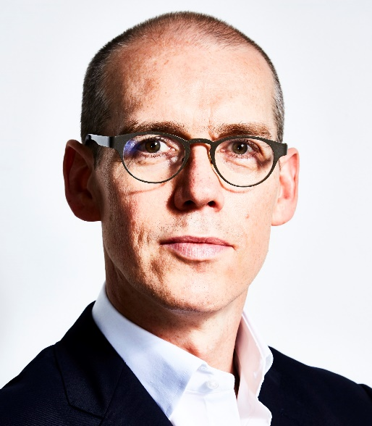
Speaker Profile
Paul Sweeting , FIA, CFA, PhD., CERA
Chief Risk Officer, Hassana Investment Company
Paul Sweeting is Chief Risk Officer for the Hassana Investment Company and an Honorary Professor of Actuarial Science at the University of Kent. Before joining Hassana, Paul worked full-time as a Professor of Actuarial Science at the University of Kent, where he was also Head of Actuarial Science. He also acted as an independent consultant on investment, longevity, pensions and risk issues. Paul has held a number of roles in pensions, insurance and investment.
Prior to the University of Kent he was Head of Research at Legal & General Investment Management, before which he was European Head of the Strategy Group and a Managing Director at J.P. Morgan Asset Management. He was also responsible for developing the longevity reinsurance strategy for Munich Reinsurance, and was Director of Research at Fidelity Investments’ Retirement Institute. Paul is a Fellow of the Institute and Faculty of Actuaries, and has served as a member of Council for the UK Profession.
He also helped design the subject SP9, Enterprise Risk Management, for which he wrote the textbook and also served as principal examiner.
Paul has chaired a number of actuarial boards, committees and working parties, and served as Honorary Secretary for the Institute of Actuaries prior to its merger with the Faculty of Actuaries.
www.actuariesindia.org

Slide 7
CPD Questions
4 minutes
No marks (for now!)
From slides and what speaker will have said
www.actuariesindia.org

Slide 8
Upcoming Webinars
Webinar | Date | Time | CPD | Members
Webinar on Pricing of Crop Insurance | 26th June, 2020 | 04:00pm-05:30pm IST | 1.5 hrs (Technical- General Insurance) | Members & Non-members
Presidential TownHall Meeting with Students | 28th June, 2020 | 1100 – 1200 IST | Non CPD Event | Students
Webinar On Adapting to trends in Life Insurance | 1st July, 2020 | 10.00 am- 12.00 am IST | 120 minutes (Technical – Life Insurance) | Members & Non-members
TechTalk on Compensated Absences and other long term Employee Benefits | 9th July, 2020 | 05:00pm-06:00pm IST | Non CPD Event | Student, Associates & Non-Members
www.actuariesindia.org

