Slide 1
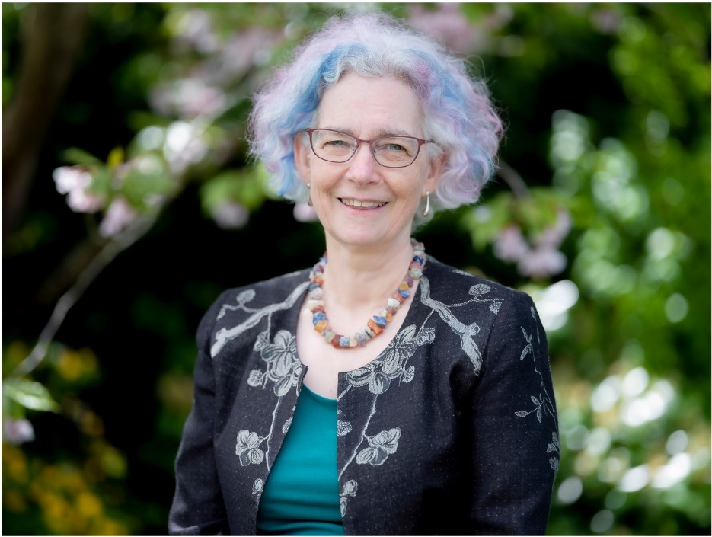
The role of actuaries in managing sustainability and climate risk
Louise Pryor, President, IFoA

Slide 2
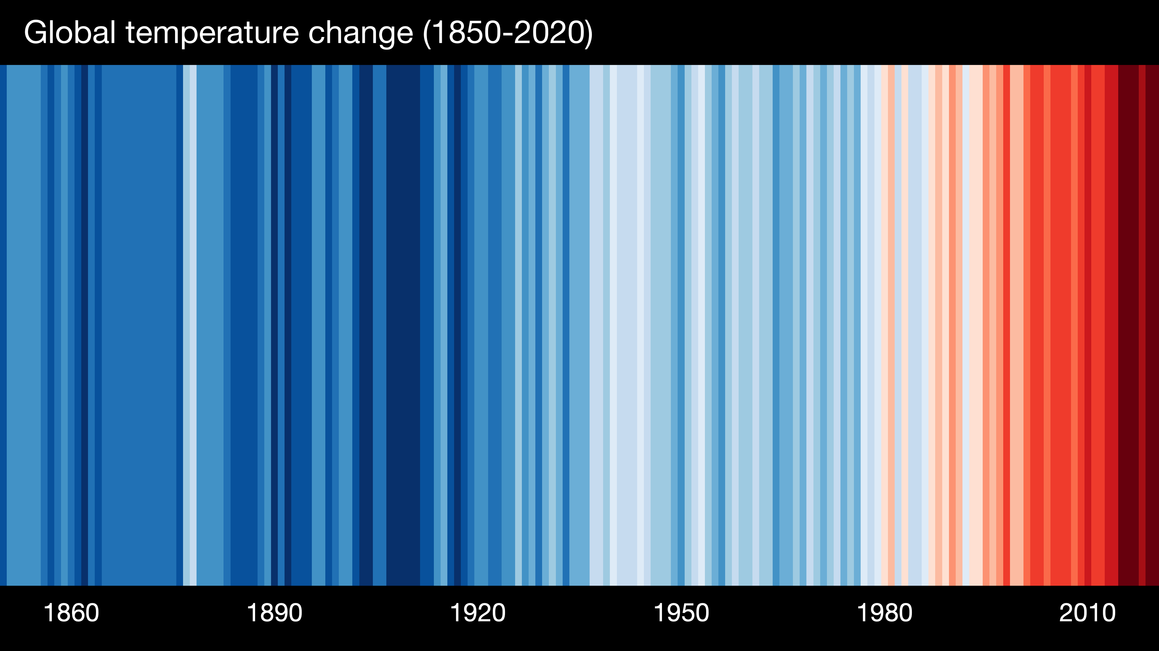
Climate change
Driven by greenhouse gas emissions
Impacts vary greatly by location
1C rise since pre-industrial period
Current path is for a 5C rise if no further action is taken
Paris agreement to limit overall rise to “well below” 2C
Net zero by 2050
Will require major policy action with significant societal changes
Source: Global warming stripes 1850-2020 https://showyourstripes.info/

Slide 3
Biodiversity loss
Current extinction rates 100 – 1000 times higher than baseline rates
Need 1.6 Earths to maintain current living standards
Around US$4 – 6 trillion per year of subsidies that damage Nature
Source: IPBES The Global assessment Report on Biodiversity and Ecosystem Services Summary for Policymakers https://ipbes.net/global-assessment
Source: https://www.gov.uk/government/publications/final-report-the-economics-of-biodiversity-the-dasgupta-review

Slide 4
Types of sustainability risk
Physical risk: direct impacts from climate change / biodiversity loss
Storms, floods, drought, changing agriculture, health effects...
Transition risk: risks from adaptation or mitigation, including transition to a lower-carbon economy
Government policies, reputational risks, changes in consumer demand, disruptive technologies, stranded assets...
Liability risk: compensation for effects of climate change / biodiversity loss
Corporations or governments held liable for causing climate change, or for not considering the impacts
IFoA guide: Climate Change for Actuaries: An Introduction

Slide 5
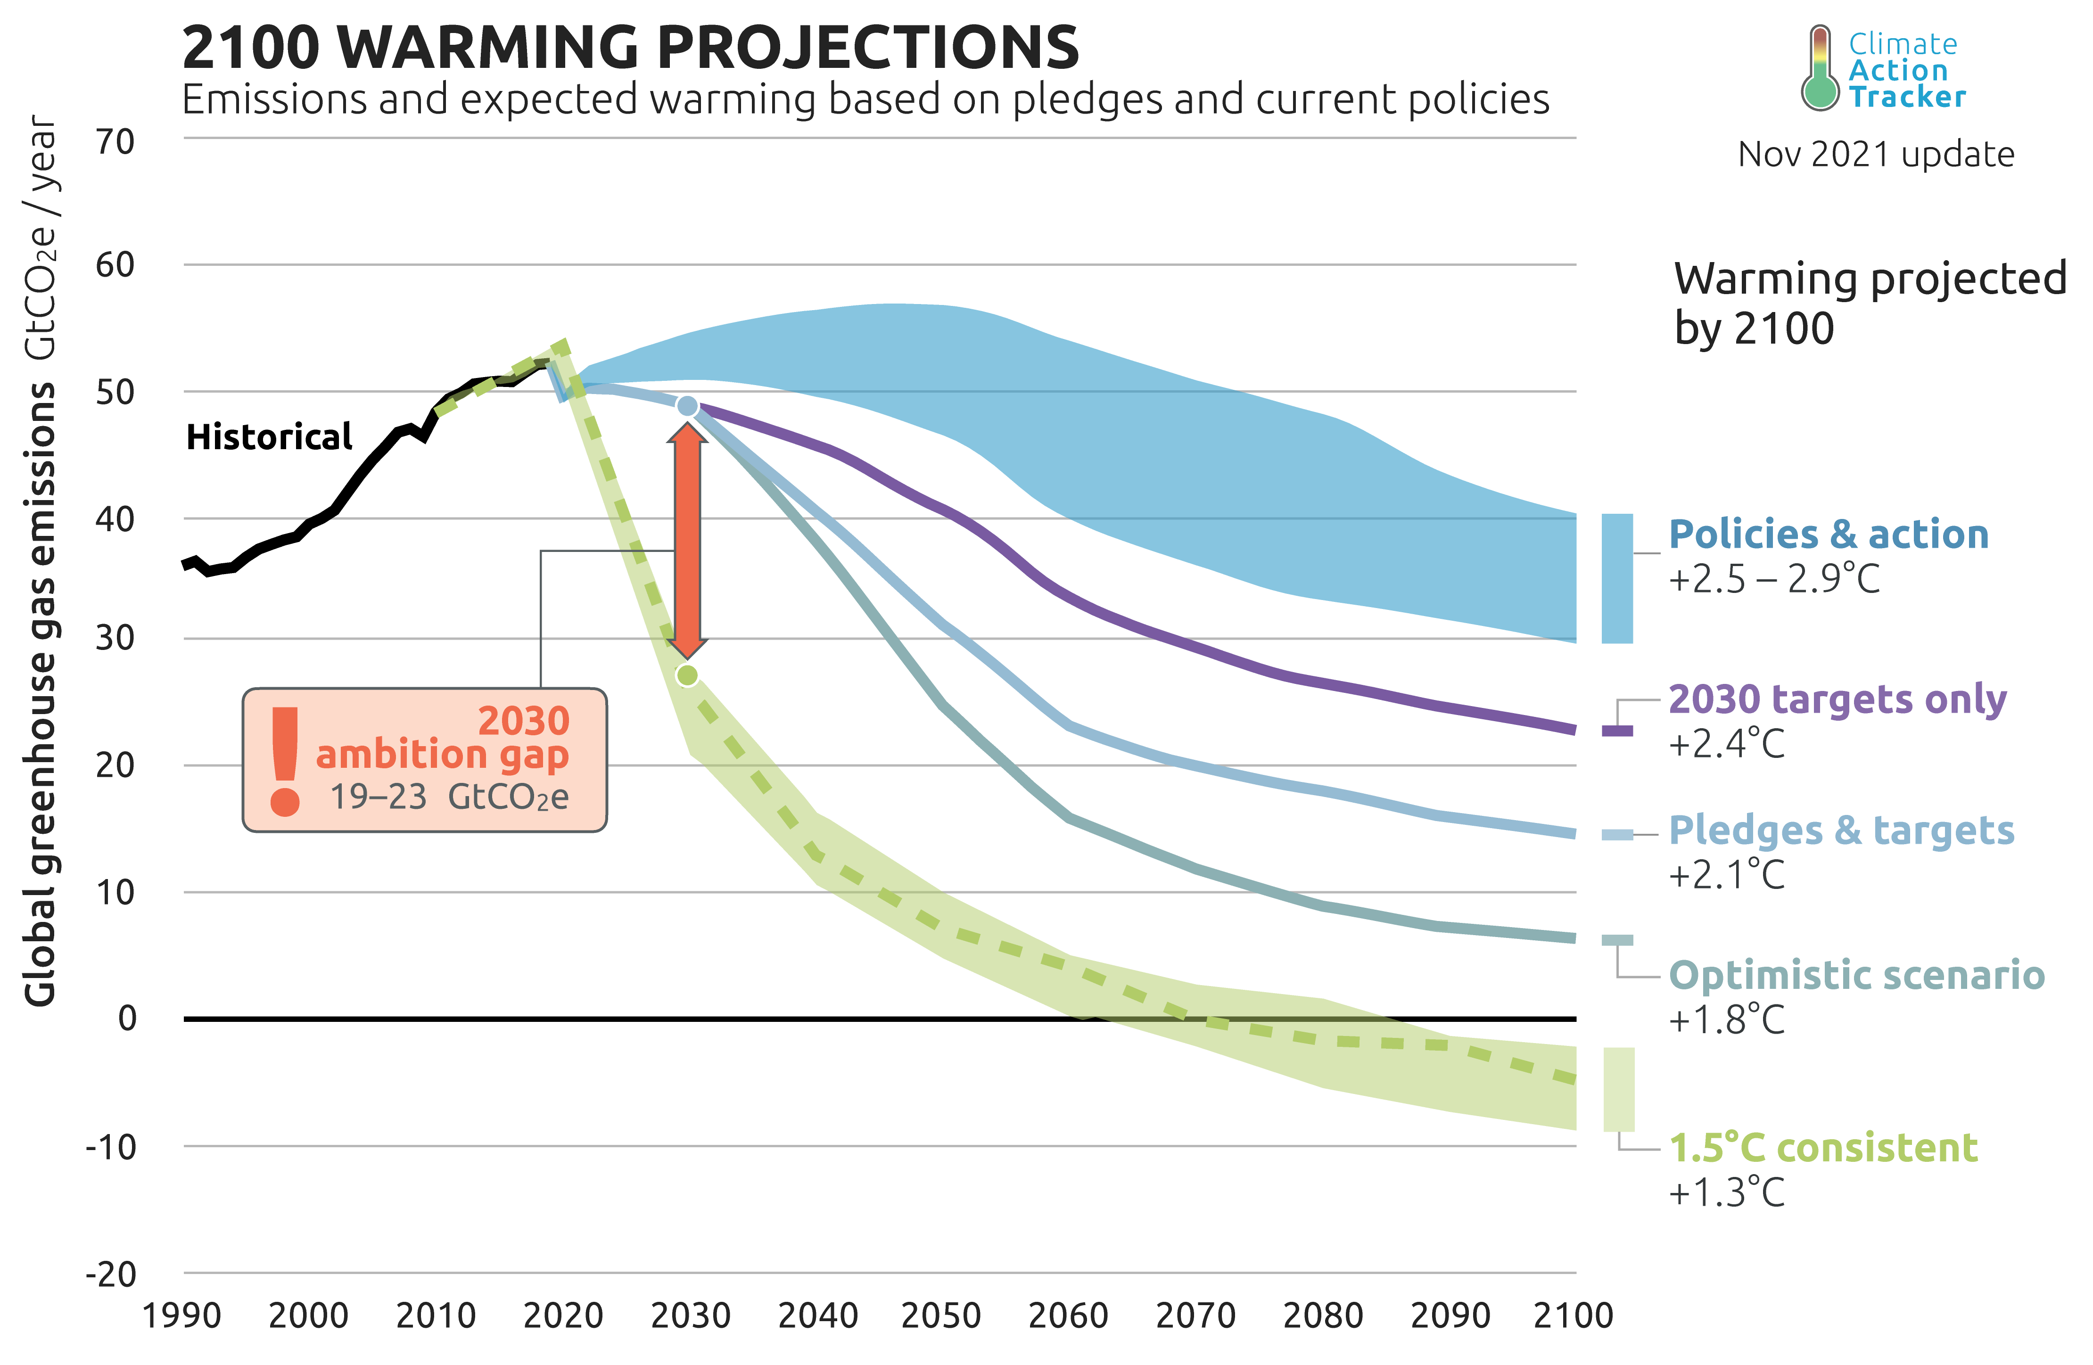
What might happen
Source: Climate Action Tracker, https://climateactiontracker.org/global/temperatures/

Slide 6
Mitigation and adaptation
Mitigation
Our impacts on the environment
Adaptation
Manage the unavoidable
Reduce emissions / biodiversity loss
Handle changing climate / biodiversity
Avoid the unmanageable
Environment’s impacts on us

Slide 7
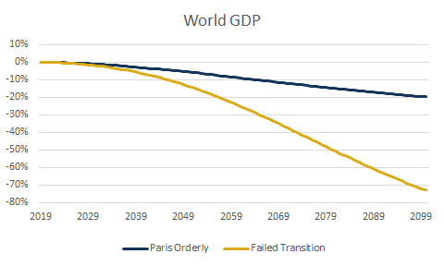
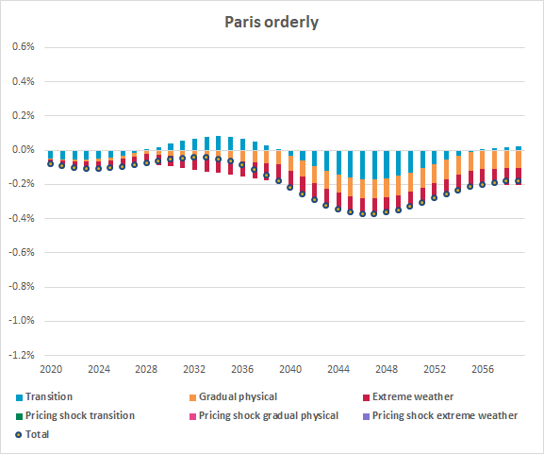
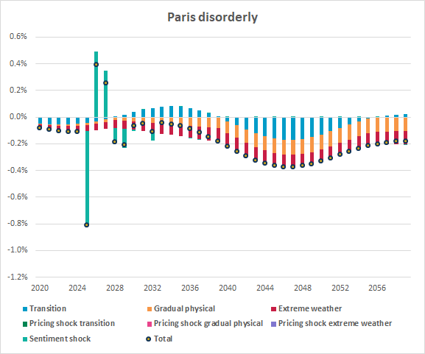
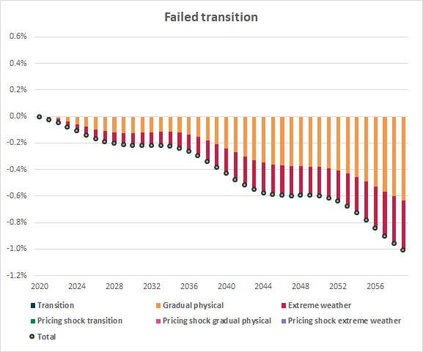
GDP impacts in a failed transition IFoA/Ortec Finance paper on financial assumptions, June 2020
Figure 4: Climate-adjusted GDP growth across regions and climate pathways (cumulative difference to climate-uninformed baseline pathway)
Figure 15: Percentage difference in the level of UK GDP explained by the various climate risk drivers (difference to climate-uninformed baseline pathway)
Source: “Climate change considerations for actuarial financial assumptions and the role of scenario analysis”, June 2020 (Ortec Finance)
Notes:
and how long have you been involved in sustainability related work?
what kind of client problems have you practically solved?
another part of your journey has been working with the IFoA to create a TASK force
when and how did this start?

Slide 8
A risk management problem
Economic Collapse
Low carbon
transition
Climate change is a certainty…
… but its impacts pose risks in the short and long terms…
Severe weather events, agricultural and health effects
Changing regulations
Starvation, mass migration, civil unrest
Changes to consumer demand, business models, financial system, economy
… and transition poses risks too
Actuaries cannot ignore the risks!
The biggest risk is inaction today.
Mark Carney

Slide 9
At the IFoA
IFoA climate change statement
https://www.actuaries.org.uk/climate-change-statement
IFoA policy statement
We are a profession specialising in risk management, and climate change is one of the greatest risks facing our world today. Mitigating this risk is urgent. Future outcomes are uncertain, but the best value insurance premium that society can pay is to reduce our emissions today in order to avoid the irreversible consequences of unmitigated climate change tomorrow.
Actuaries should treat climate risk as a primary risk
Climate risk included in core exams
Lifelong learning resources
Practical guides, curated library, sustainability certificate (forthcoming)
Thought leadership webinars
Active area of research
Target for operational net zero
Sustainability hub
https://www.actuaries.org.uk/about-us/sustainability-hub

Slide 10
Regulatory environment
Financial regulators increasing their emphasis on climate risk
Financial disclosures
ESG investing (Environmental Social and Governance)
Do we invest money into the practices that take us deeper into this crisis or in the solutions that could get us out of it?
David Attenborough
The financial sector is an enormously powerful and effective force, and can be a force for good.
Mark Carney

Slide 11
Business environment
Every value chain is based on energy
Changing business models will mean changing insurance requirements
Over 50% of GI insurance worldwide is built environment or motor
Climate change has become a defining factor in companies’ long-term prospects.
Larry Fink, BlackRock

Slide 12
What can actuaries do?
Help organisations manage their own risk
Help organisations support society in managing the wider risk
Be people

Slide 13
Organisations managing their own risk
Investment
Operations
Products and services

Slide 14
Organisations managing society’s risk
Supporting and enabling activities that help or hinder
Speaking out
Insurers are risk managers of our society.
Gabriel Bernardino, EIOPA Chair
In any case, we have no choice: a 2°C world might be insurable, a 4°C world certainly would not be.
Henri de Castries, CEO AXA 2015

Slide 15
Be people
Think about your lifestyle
Speak out
Be actuaries!
Ask questions

Slide 16
Challenge and opportunity
Changing risk landscape
The biggest business and career opportunity in several lifetimes

