Slide 1
6th Webinar in Risk Management (WRM)
Sustainability & Climate Risk
11 January 2022
Profitable business opportunities for the Insurance Sector
Cherie Gray
Global Lead, Sustainability & Market Development
Swiss Re

Slide 2
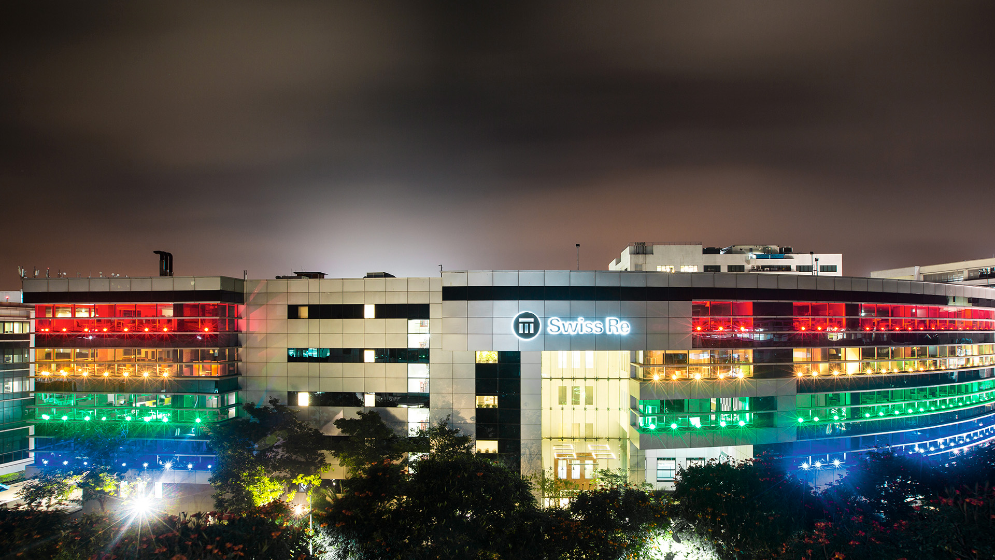
About Swiss Re
and our Sustainability Ambition
www.actuariesindia.org

Slide 3
About Swiss Re
Swiss Re one of the world’s leading providers of reinsurance, insurance and other forms of insurance-based risk transfer. Through our work with government, corporate and insurer clients, we fulfil our vision of helping to make the world more resilient.
Today, 75% of risks – from natural catastrophes and climate change, to ageing populations – remain uninsured.
We aim to change that…
www.actuariesindia.org

Slide 4
Economic losses from natural catastrophes and weather events keep increasing
Climate risks could increase weather-related property losses in advanced markets 30-60% by 2040
Insured vs uninsured losses
1970-2020, in USD billion at 2020 prices
Source: Swiss Re Institute
www.actuariesindia.org

Slide 5
Protecting nature is critical – as it is the ultimate resilience and service provider
55% of global GDP is dependent on biodiversity and ecosystem services
USD 272 billion the estimated cost of global storm damage without functioning coral reefs
USD 36 billion the economic value provided by coral reefs through tourism related activities
15 million people the number of lives protected by mangroves each year
Source: Swiss Re Institute
www.actuariesindia.org

Slide 6
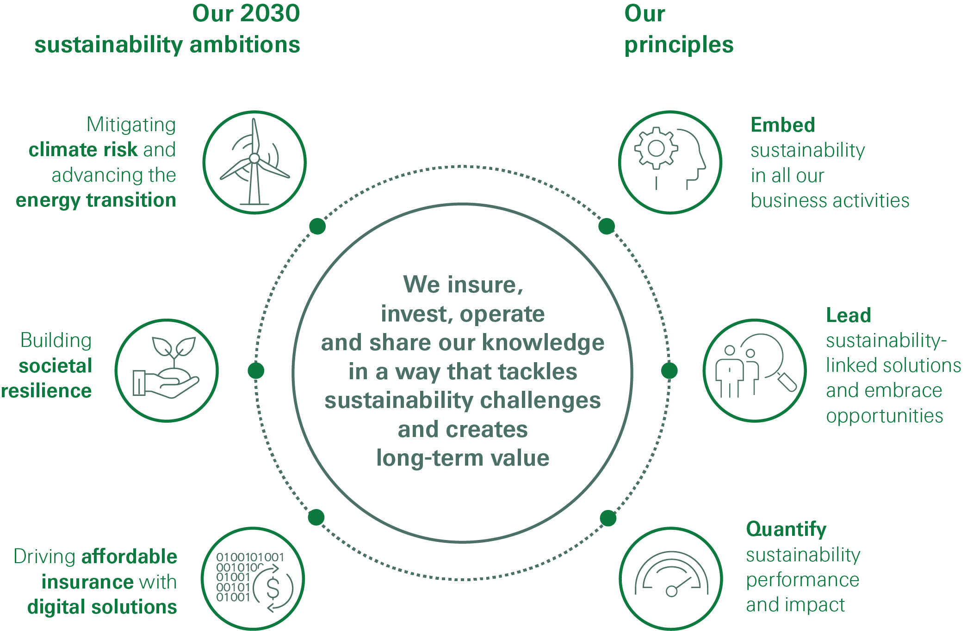
Swiss Re Group Sustainability Strategy
www.actuariesindia.org

Slide 7
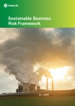
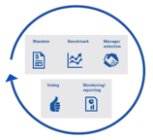
Internal actions – increasing insights, adapting our operations and balance sheet
Adopted FSB TCFD recommendations
Reduced investing in thermal coal companies
SRI Biodiversity & Eco-Services (BES) Index launched
Signing of
Net-zero GHG emissions in operations
Signing of
Reduced providing re/insurance to thermal coal
100% of power from renewable sources
2003
2009
2015
2017
2019
2021
2050
1979
2007/08
2012
2016
2018
2020
2030
100% GHG neutral
Commitment to
Swiss Re joins TNFD
Taskforce for Nature-related Financial Disclosures
Net-zero GHG emissions across entire business
Formal Sustainable Business Risk Framework developed
Shift of investment portfolio to follow ESG investment benchmarks
Commitments to UN Climate Action Summit
www.actuariesindia.org

Slide 8
Setting the baseline –
our Sustainable Business Risk Framework
SBR Framework
Ensures responsible and sustainable business practices by identifying, mitigating and eliminating potential ESG risks inherent to our business transactions and investments
Applies to all lines of business of the insurance portfolio as well as investments and is fully embedded in our standard operating procedures
Sustainability umbrella policies
Sector specific guidelines
Human rights
We do not want to do business with countries and companies that are complicit in severe human rights violations
Animal testing
Mining
Dams
Nuclear weapons proliferation
Environmental protection
We do not want to involve ourselves with companies that cause irreversible damage to the environment and in particular ecologically sensitive areas
Defence industry
Oil and gas (revised in 2019)
Forestry and logging (revised in 2021)
Thermal coal (revised in 2020)
Company and country/industry exclusions
Sustainable Business Risk (SBR) process
www.actuariesindia.org

Slide 9
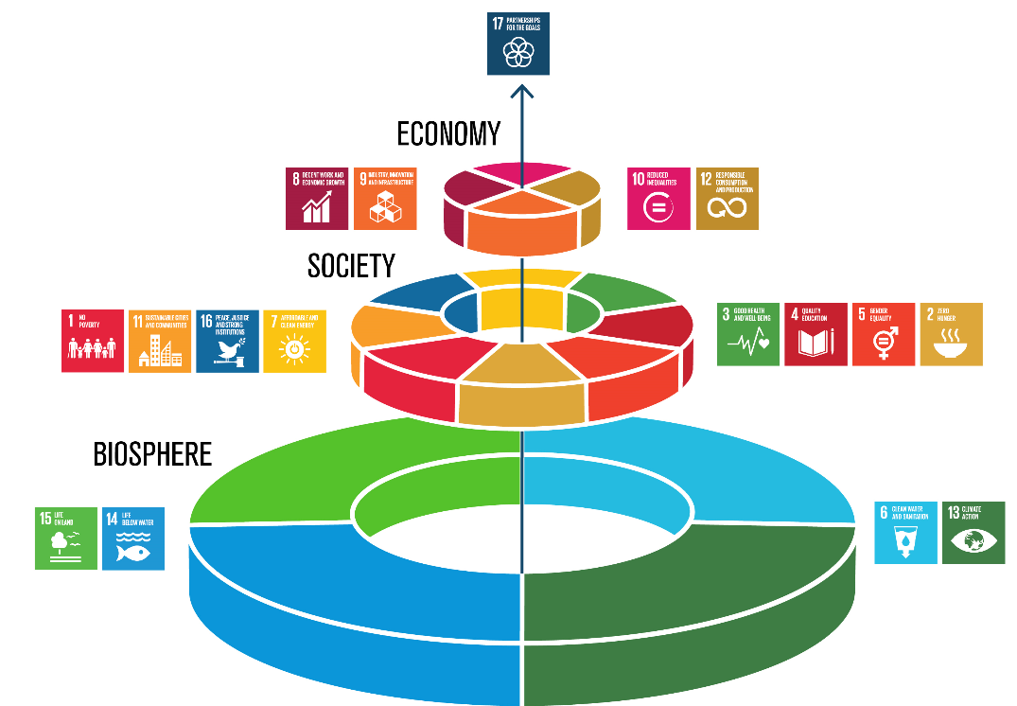
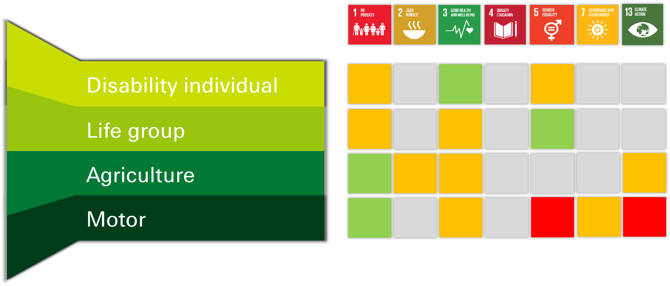
Aligning with the UN
Sustainable Development Goals (SDGs)
17 Goals across economic, environmental and social themes
Used to steer portfolio decision-making
Achievements are measured by positive, negative or neutral impact
www.actuariesindia.org

Slide 10
Opportunities for Profitable Growth
www.actuariesindia.org

Slide 11
Key steps towards Profitable Growth
Adjust to the new narrative
Identify the new problems, new needs and new markets
Build the right foundations
www.actuariesindia.org

Slide 12
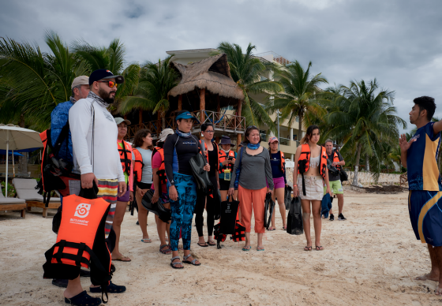
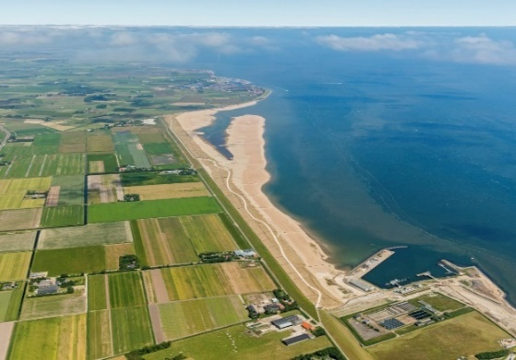
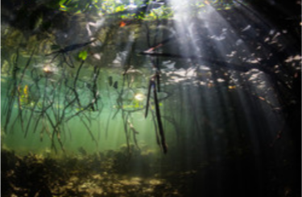
Insurance solutions to help protect nature, build resilience and enable growth
User Need | Awareness, insights and identification | Insurance solutions to build resilience | Insurance as an enabler to build back better | Solutions to support and scale carbon removal
Insurance Value Proposition | Insights to identify vulnerable ecosystems, to inform planning and decision-making. | Index-based structures to enable quick recovery, clean-up and restoration costs after nat cat events | Construction and engineering covers to de-risk adaptative and resilient infrastructure projects, and attract investment | Solutions to protect and scale carbon credit projects, operators and credit buyers, leveraging agriculture and engineering expertise
Proof Points
www.actuariesindia.org

Slide 13
Swiss Re’s Climate Action Plan delivers strong commercial benefits
Ambition
Initiatives
Key 2020 achievements
Mitigating climate risk and advancing the energy transition
Leading risk transfer products on physical climate risk
USD 10.7bn
Total amount of climate protection
offered to (sub-)sovereigns
Leading provider of re/insurance solutions for low-carbon transition opportunities
>5,600
Wind and solar farms insured
Partnering to develop scalable solutions to mitigate and adapt to climate change
>400
Dialogue engagements with clients on thermal coal reduction
www.actuariesindia.org

Slide 14
Conclusions & Taking Action
WHY
Insurability: increased frequency and severity of events leads to increased claims costs, which in turn, leads to increased premiums and market contraction, which challenges affordability and access to insurance.
Growth: new problems and new opportunities – which can be supported by insurance and risk transfer solutions.
Longevity: integrated sustainable practices make companies more attractive to investors, consumers and partners
HOW
Avoid harmful and unsustainable practices
Provide products and solutions that support sustainable outcomes and build resilience
Reduce and remove your own carbon emissions
www.actuariesindia.org

Slide 15
Legal notice
©2021 Swiss Re. All rights reserved. You may use this presentation for private or internal purposes but note that any copyright or other proprietary notices must not be removed. You are not permitted to create any modifications or derivative works of this presentation, or to use it for commercial or other public purposes, without the prior written permission of Swiss Re.
The information and opinions contained in the presentation are provided as at the date of the presentation and may change. Although the information used was taken from reliable sources, Swiss Re does not accept any responsibility for its accuracy or comprehensiveness or its updating. All liability for the accuracy and completeness of the information or for any damage or loss resulting from its use is expressly excluded.

Slide 16
CPD Questions
What percentage of global GDP is dependent on biodiversity and ecosystem services?
40%
55%
75%
Answer = b) 55%
What does NetZero mean?
offsetting your emissions
removing your emissions
increasing your emissions
Answer = b) removing your emissions

