Slide 1


8th Capcity Building Webinar in Retirement Benefits
Online Edition 2022
13th March 2022
Session1 (Overview of GN 29 v2.0 including Disclosures)– 4.00 pm – 4.45 pm, India time
Session 2 (working example in breakout Rooms plus discussions) - 4.45 pm – 6.00 pm, India time

Slide 2







Housekeeping Points
Mute
Q&A
IAI support
C
P
D
Recording
Feedback
www.actuariesindia.org
www.actuariesindia.org

Slide 3

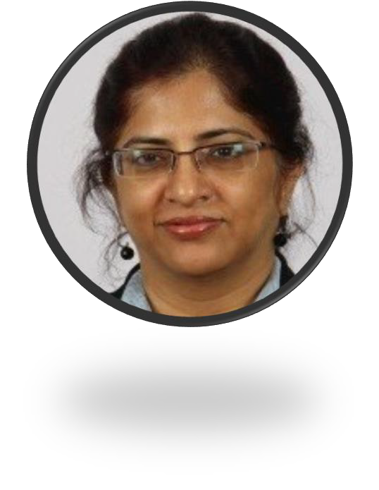

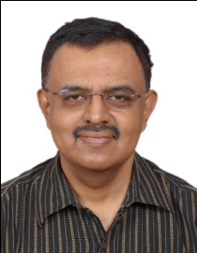
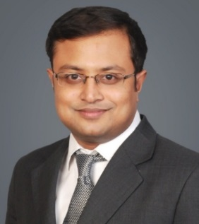
Speakers and Facilitators
Chitra
Jayasimha
Hemanshu
Jain
Ritobrata Sarkar
Kartikey
Kandoi
Dr K Sriram
www.actuariesindia.org

Slide 4

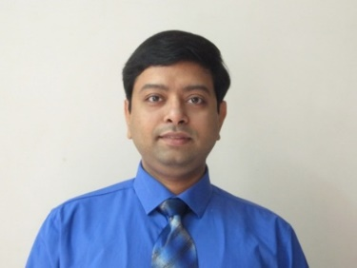
Speaker Introductions
Hemanshu Jain,
Lead Actuary , Mercer India
Hemanshu is a Lead Consultant & Actuary with Mercer India Retirement Practice and has over 14 years of management consulting experience in Retirement and Employee benefit industry.
He is Fellow with Institute of Actuaries of India with specialization in employee benefits.
He has rich experience in International Pension Actuarial practice and worked in all major accounting standards like IFRS, USGAAP, AS15 and now INDAS.
Experience
  Coordinating and performing actuarial valuations for accounting of pension costs under Indian and international GAAP
  Helping clients understand Financial Risks of various types of Employee Benefits
  Helping clients in evaluating financial impact of various organization level policy changes
  Business cost projections and impact analysis of different alternate scenarios of benefits.
  Feasibility study of funding benefit schemes.
  Harmonization study of benefits across group\merged entities.
  Transfer liability calculations w.r.t employee movement between entities.
  Signing actuarial valuations of over 200+ clients in India.
  Member of the Advisory Group for Pension, Other Employee Benefits and Social Security of IAI.
Education
Hemanshu is a Silver Medallist in Bachelor of Engineering from Delhi College of Engineering.
He is also a Fellow with Institute of Actuaries of India, and all India topper for both specialization and technical exams (SA & ST) on the subject of Pensions and other Employee Benefits.
www.actuariesindia.org

Slide 5
Speaker Introductions
Dr K Sriram
K. Sriram is a Consulting Actuary engaged in Employee Benefits Consulting Practice since 2007.
From January 2010 to April 2012, Sriram was the Appointed Actuary of Max Bupa Health Insurance Company. From 2001 to 2006 Sriram was the Chief Actuary of MetLife India Insurance Company. He was also the Appointed Actuary of this company for a period of two years.
Overall Sriram has about 25 years of experience in actuarial engagements related to Insurance and Pensions and 15 years of teaching, training & consulting experience in Financial Services & Corporate Finance.
Sriram is a Fellow Member of the Institute of Actuaries of India. He holds a Post Graduate Diploma in Management from the IIMB (1982). Sriram holds a Doctorate Degree in Management from the Bharathidasan University . He is an Associate Member of the Institute of Cost & Management Accountants of India
Sriram has been a member of the committee constituted by IRDA [Insurance & Regulatory Development Authority of India] on “Macro Prudential Surveillance of the Insurance Sector”. He has been the Chairperson of the Committee constituted by IRDA on “Economic Capital for the General Insurance Industry in India”.
Sriram has published several papers in the areas of Insurance, Employee Benefits & Investments. He has authored a book on “Leasing, Hire Purchase & Factoring” published by the Institute of Chartered Financial Analysts of India.
His current research interest is Enterprise Risk Management in Insurance & Banking Verticals.
www.actuariesindia.org

Slide 6
Speaker Introductions
Ritobrata Sarkar
Head of Retirement – India and Managing Partner, Willis Towers Watson
Ritobrata is a Consulting Actuary with about 20 years of experience in the Indian retirement and employee benefits market. He has worked extensively on actuarial valuations of pension schemes as well as general benefits and actuarial consulting, where he has assisted clients in the design, implementation, financing and administration of pension and benefit schemes.
He has worked at Willis Towers Watson India since 2010 and is currently the Managing Partner of the Actuarial LLP. Prior to joining Willis Towers Watson, Rito was with Deloitte Consulting, where he set up and led their Actuarial and Rewards practice that supports Deloitte's US-based and other global clients. During this time, he managed several large actuarial valuations under US Funding Regulations. Between 2001 and 2006, Rito worked with Watson Wyatt Worldwide and was the account manager for several key accounts. He has deep knowledge with actuarial valuations for accounting purposes including AS15 (revised), IAS19 and FAS87.
General experience
  Accounting for pension costs and reporting under Indian Accounting Standard (AS15), Ind AS 19, IAS19 and ASC715
  Benefits design such as defined benefit pension encashment values, conversions to defined contribution and flexible benefits
  Benefits due diligence and audits in corporate transactions
  Employee communications and education on pension plan roll outs for clients
  Funding of pension and benefit schemes in India
Education and professional qualification
  BSc. Hons in Statistics from Presidency College, Calcutta
  Fellow of the Institute of Actuaries of India
www.actuariesindia.org

Slide 7
Program Schedule
Overview of GN 29 V2.0 – Hemanshu Jain
Disclosures Under GN 20 V2.0 – Dr K Sriram
Breakout Rooms – Working Exercise (Excel File Shared )- 30 mins
Sample Disclosure Solution Discussion Hemanshu Jain
Q&A
Closing Remarks – Ritobrata Sarkar
CPD Question
www.actuariesindia.org

Slide 8



Today is not your normal webinar…
Main Session/”Meeting”
1
Recording
Transitions
Automatic
x
Breakout
Rooms
Breakout
Rooms
Breakout
Rooms
Breakout
Rooms
2
No recording
Transitions
Automatic
Main Session/”Meeting”
3
Recording
Specific
Unmute only
1 x McQ for CPD
IAI support
Attendance at BOTH topics needed for CPD
Feedback Email to follow
www.actuariesindia.org

Slide 9
8th Capcity Building Webinar in Retirement Benefits
Online Edition 2022
Date 15-03-2022
Quick Overview of GN29 v2.0

Slide 10
GN29 V2.0– Scope
GN29 revised provide guidance to actuaries for valuation of Interest rate guarantee. It also include guidance on measurement, recognition and disclosures for the same as per relevant accounting standards (AS15R, INDAS19).
www.actuariesindia.org

Slide 11
GN29 V2.0– Accounting treatment
Based on Paragraph 26(b) of AS15R and 29(b) of Ind AS19, GN29 revised clarify that treatment of Exempt PF should be as Defined benefit plan.
Treatment of Exempt Provident fund plan is a post employment benefit plan. Thus under Ind AS19 recognition of gains/losses will be via OCI.
www.actuariesindia.org

Slide 12
GN29 V2.0– Measurement
Plan assets should be measured at fair value and the liability should be actuarially valued.
This is consistent with Ind AS19
Gains/losses of assets are recognized via OCI.
www.actuariesindia.org

Slide 13
GN29V2.0 – Measurement
Methodologies recommended for measuring interest rate guarantee:
  Deterministic modelling approach
  Cashflow modelling approach (new)
  Option pricing approach
  Stochastic modelling approach
www.actuariesindia.org

Slide 14
8th Capcity Building Webinar in Retirement Benefits
Online Edition 2022
Date 15-03-2022
Disclosure Requirements GN29 V 2.0

Slide 15

GN 29 V2.0 Disclosure Requirements: Guidance
  Consistency with disclosure requirements for other DB plans
  Key building Blocks
    Mixture of DC and DB elements
    Fair Value Approach
    Realized Losses/Gains
    Unrealized Losses/ Gains
  Sources of Unrealized Losses/Gains
  Treatment of Unrealized Losses/Gains
www.actuariesindia.org

Slide 16
Disclosure Guidance: Computing Selected Line Items
Line Item | Description of the formula
Opening Present Value of Obligations (PVO) | = Accumulated PF Balance (BoP)+Value of the interest rate guarantee on the Accumulated PF Balance (BoP) where BoP stands for the Beginning of the Reporting Period
Service Cost | = Employer’s Contribution to EPF during the reporting period [estimated as at the beginning of the reporting period]+Value of the Interest Rate Guarantee on Employer and Employee contributions (including voluntary contributions) during the reporting period
Interest Cost | = Discount Rate (BoP) *[Opening PVO +0.5*Employer Contributions to PF during the reporting period +0.5*Employee Contributions (including voluntary contributions) during the reporting period +0.5*”Transfer-In during the reporting period – 0.5*Benefits Paid during the reporting period]
Closing Present Value of Obligation (PVO) | = Accumulated PF Balance (EoP)+Value of Interest Rate Guarantee on the Accumulated PF Balance (EoP) where EoP denotes “End of the Reporting Period”
Interest Income on Plan Assets | =Discount Rate (BoP) *[Opening FVPA+0.5*Employer’s Contribution to PF during the reporting period +0.5*Employee contributions including voluntary contributions during the reporting period +0.5*Transfer-In during the reporting period – 0.5*Benefits paid during the period] Where FVPA denotes Fair Value of Plan Assets
www.actuariesindia.org

Slide 17
Disclosure Requirements: Guidance
  Additional Disclosures
    Paragraph 145 of Ind AS19
  Sensitivity Analyses
    Discount Rate
    Expected Investment Return
    Guaranteed Rate of Interest
    Volatility Parameter
    Withdrawal Rate
  Asset Liability Matching Strategies
  Funding Arrangements
  Maturity Profile of the DB obligations
www.actuariesindia.org

Slide 18
8th Capcity Building Webinar in Retirement Benefits
Online Edition 2022
Date 15-03-2022
GN29 V2.0 – Disclosures – Working Example

Slide 19
Working example
Structure of exercise include three parts.
Background about the exercise
Data – include all elements required for disclosure preparation.
Disclosure – section for participants to update disclosure elements. Fill only highlighted cells, others are formula driven.
www.actuariesindia.org

Slide 20
Sample Disclosure Worksheet
Case Study
The purpose of this case study is to give hands on experience to participants about preparation of INDAS19 disclosures for an Exempt Provident Fund scheme as per Revised GN 29 v2.0.
Background
You are an Actuary with a reputed Consulting firm working in employee benefits space. Your firm has been supporting a large manufacturing company (client) for many years now in actuarial valuations of different employee benefits. One of schemes offered by the client is Recognized Exempt Provident fund as per The Provident Fund Act, 1952. The scheme has been established several years ago and client has been reporting its financials as a defined benefit scheme. You had been supporting the client in past for valuation of Exempt Provident Fund and in your work you had been using guidance note GN29 v1.0.
As per guidance you had been reporting the financials in your report as per:
1. Deterministic model for evaluation of Interest rate guarantee.
2. Disclosure for scheme only scheme defined benefit obligation and book value of assets. No detailed disclosures has been provided in past.
In the subsequent sections you are to prepare the disclosure as per GN29 V2.0 . Section 'Data' reflects available data from actuarial valuation exercise. Section 'Disclosure' to be used for preparing key sections of INDAS19 disclosure. Only one year of disclosure is required to be prepared for this exercise.
www.actuariesindia.org

Slide 21
Sample Disclosure Worksheet
 | In INR ('000)
Obligation related -
· Total defined benefit obligation at end of year | 878,600
· Total account balance at end of year | 845,900
· Total account balance for actives at end of year | 800,000
· Total defined benefit obligation for actives at end of year | 820,000
· Total defined benefit obligation at beginning of year | 790,400
· Value of interest rate guarantee on opening PF balance | 24,000
· Total account balance for actives at beginning of year | 725,000
· Total defined benefit obligation for actives at beginning of year | 740,000
· Total cashflows for future years
Year 1 | 245,000
Year 2 | 70,000
Year 3 | 55,000
Year 4 | 60,000
Year 5 | 60,000
Year 6 - 10 | 365,000
www.actuariesindia.org

Slide 22
Sample Disclosure Worksheet
Asset details
· Total fair value of plan assets at end of year | 890,000
· Total market value of plan assets at end of year | 890,000
· Break up of total market value by investments:
o Equity MF | 15,000
o G-Sec bonds | 90,000
o Money market | 25,000
o Private bonds | 215,000
o PSU Bonds | 90,000
o Special Deposit scheme | 60,000
o State bonds | 320,000
o Cash at bank | 25,000
o Accrued interest on investments | 50,000
· Total fair value of plan assets at beginning of year | 830,000
www.actuariesindia.org

Slide 23
Sample Disclosure Worksheet
Other actual transactions
· Total employee contribution during the year | 46,000
· Total employer contribution during the year | 34,000
· Total benefit transferred out from the plan | 10,800
· Total benefit transferred in the plan | 11,200
· Total benefit payment from plan | 72,000
Membership data
· Headcount of employees active at opening | 900
· Headcount of employees inactive at opening | 50
· Average active employee past service (in years) | 4
· Average age of active employees | 36
· Average age of inactive employees | 44
· Headcount of employees active at closing | 880
· Headcount of employees inactive at closing | 40
· Average active employee past service (in years) | 5
· Total Salary (Basic) of active employees at closing | 400,000
· Total Salary (Basic) of active employees capped at 15,000 at closing | 150,000
www.actuariesindia.org

Slide 24
Sample Disclosure Worksheet
Assumptions
Discount rate at beginning of year | 6.00%
Discount rate at end of year | 6.50%
Other details
Disclosure date prior year | 31-03-2021
Disclosure date current year | 31-03-2022
Absolute change in interest rate guarantee by 25BP inc. in discount rate | 5,000
Absolute change in interest rate guarantee by 25BP dec. in discount rate | 4,500
Absolute change in interest rate guarantee by 25BP inc. in guaranteed rate | 7,500
Absolute change in interest rate guarantee by 25BP dec. in guaranteed rate | 7,000
www.actuariesindia.org

Slide 25
Sample Disclosure Worksheet
A. | Change in defined benefit obligation
 | 1. | Defined benefit obligation at end of prior year |  | -
 | 2. | Service cost
 |  | a. Current service cost |  | -
 |  | b. Past service cost
 |  | c. (Gain) / loss on settlements
 | 3. | Interest expense |  | -
 | 4. | Cash flows
 |  | a. Benefit payments from plan assets |  | -
 |  | b. Benefit payments from employer
 |  | c. Settlement payments from plan assets
 |  | d. Settlement payments from employer
 |  | e. Participant contributions |  | -
 |  | f. Administrative expenses included in the DBO
 | 5. | Other significant events
 |  | a. Increase (decrease) due to effect of any business combinations / divestitures / transfers |  | -
 |  | b. Increase (decrease) due to plan combinations
 | 6. | Remeasurements
 |  | a. Effect of changes in demographic assumptions
 |  | b. Effect of changes in financial assumptions
 |  | c. Effect of experience adjustments |  | -
 | 7. | Effect of changes in foreign exchange rates
 | 8. | Defined benefit obligation at end of year |  | -
www.actuariesindia.org

Slide 26
Sample Disclosure Worksheet
B. | Change in fair value of plan assets
 | 1. | Fair value of plan assets at end of prior year |  | -
 | 2. | Interest income |  | -
 | 3. | Cash flows
 |  | a. Total employer contributions
 |  | (i) Employer contributions |  | -
 |  | (ii) Employer direct benefit payments |  | -
 |  | (iii) Employer direct settlement payments |  | -
 |  | b. Participant contributions |  | -
 |  | c. Benefit payments from plan assets |  | -
 |  | d. Benefit payments from employer |  | -
 |  | e. Settlement payments from plan assets |  | -
 |  | f. Settlement payments from employer |  | -
 |  | g. Administrative expenses paid from plan assets
 | 4. | Other significant events
 |  | a. Increase (decrease) due to effect of any business combinations / divestitures / transfers |  | -
 |  | b. Increase (decrease) due to plan combinations
 | 5. | Remeasurements
 |  | a. Return on plan assets (excluding interest income) |  | -
 | 6. | Effect of changes in foreign exchange rates
 | 7. | Fair value of plan assets at end of year |  | -
www.actuariesindia.org

Slide 27
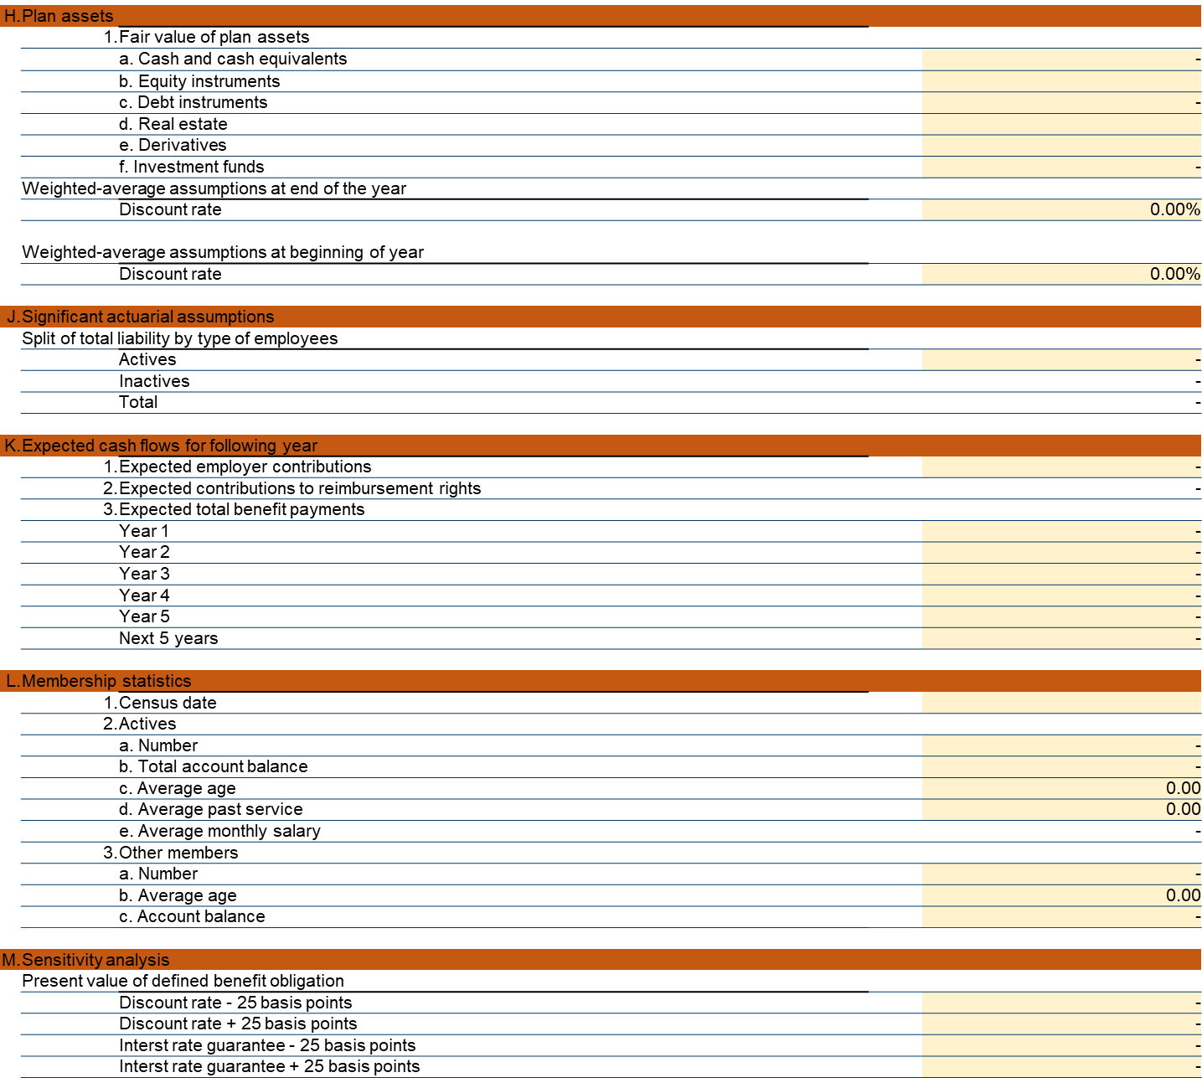
Sample Disclosure Worksheet
www.actuariesindia.org

Slide 28
8th Capcity Building Webinar in Retirement Benefits
Online Edition 2022
Date 15-03-2022
GN29 V2.0– Disclosures – Breakout Rooms

Slide 29
“Breakout Rooms”
Groups assigned
Mix of Fellows/Associates/Students/Others
Where possible tried to include someone in the practice area
9
Speakers / Faculty
To help clarify expectations
Make sure sufficient progress made
Will rotate between their allocated Rooms
Tips
DO NOT “Leave Room” or “Leave Meeting” in Rooms
Rooms will be opened/closed automatically
A 5 minute warning message will pop up on screens for information
www.actuariesindia.org

Slide 30
Let us go into break out rooms and discuss…
In the break out room
Unmute yourselves so you can exchange views
Choose a person, who will share screen and collate all points. The person can speak later in the Webinar.
Discuss the assigned task. Collate all thoughts, including views and counter views
Chosen person to prepare points to speak for after the break out sessions get over.
When back from break out rooms
The chosen person will be asked to share views of the group
The chosen person will be asked to Unmute to be able to speak
Stick to the time limit of 3 to 4 minutes. Exceeding time limit will result in session being over-run
Do not answer any questions raised (including on chat). Just share out the points discussed in the group.
www.actuariesindia.org

Slide 31

“Breakout Rooms”
Group 1 | Group 2 | Group 3 | Group 4 | Group 5 | Group 6
SAMBASIVA I RAO | HARSHIT AGARWAL | KATHAN JEETENDRA JAIN | MAYUR ANKOLEKAR | NANDAN SURESH NADKARNI | A N THANAWALA
TAMANNA GOEL | SUBBULAKSHMI V | NAVIN VISHWANATH IYER | K K WADHWA | SRINIVASAN NAGASUBRAMANIAN | S KRISHNAN
NASRAT KAMAL | ARPAAN BEGDAI | N SEETHAKUMARI | ARCHANA DHEERAJ SONAIKAR | VIKAS RAMJANM SINGH | SANTHOSH
Liyaquat Khan | PADMAJA R | RUCHIR DEEPAK SHAH | Sumeet Shah | Sabharwal Yash Paul | Aditi Sanghvi
CHITRAKSH MAHESH AMRUTE | G N AGARWAL | SHIRIN ARORA | SACHIN SOMANI | MANOHAR LAL SODHI | ANIRUDH BANSAL
SUBHA NEELAKANTAN | A K GARG | K K DHARNI | R KANNAN | RIPUDAMAN R SETHI | A P PEETHAMBARAN
SURANJAN BANERJEE | VARSHINEE M | VICHITRA MALHOTRA | P S KARTHIKEYAN | HRISHIKESH ARUN JADHAV | MUKUL BISHT
Harshita Agrawal | SIVARAM KAIPA | Aayush Agarwal | Punit Jagtani | BELARANI OJHA | Twinkle Agarwal
Aayush Agarwal | Arpaan Begdai | Surbhi Jindal | Dribjot Singh | Khushwant Pahwa | JINAL HEMANT SHETH
www.actuariesindia.org

Slide 32
8th Capcity Building Webinar in Retirement Benefits
Online Edition 2022
Date 15-03-2022
GN29 V2.0 – Disclosures – Sample solution

Slide 33
Sample solution - (1/7)
www.actuariesindia.org

Slide 34
Sample solution – (2/7)
www.actuariesindia.org

Slide 35
Sample solution – (3/7)
www.actuariesindia.org

Slide 36
Sample solution – (4/7)
www.actuariesindia.org

Slide 37
Sample solution – (5/7)
www.actuariesindia.org

Slide 38
Sample solution – (6/7)
www.actuariesindia.org

Slide 39
Sample solution – (7/7)
www.actuariesindia.org

Slide 40
Q&A
www.actuariesindia.org

Slide 41
CPD question : -
In accordance to GN29 v2.0 , when preparing disclosures for Exempt PF under INDAS19, which of the following are some of the advisable element(s) to be included:
Present value of Obligation to include accumulated PF balance plus interest rate guarantee on the accumulated PF balance.
Inclusion of P&L and OCI related disclosures
Significant actuarial assumptions incl. but not limited to: Discount rate, Expected return on plan assets, Guaranteed rate of interest etc.
Segregation of plan assets in main asset classes
All of the above.
www.actuariesindia.org

