Slide 1
8th Capacity Building Webinar in Retirement Benefits
Online Edition 2022
Module 2
Date : 16th March 2022
Time: 1600 – 1800 hrs
Defined Benefit Post Retirement Pension

Slide 2
Housekeeping Points
Mute
Q&A
IAI support
C
P
D
Recording
Feedback
www.actuariesindia.org
www.actuariesindia.org

Slide 3
Program Schedule
No | Time | Sessions | Speaker
1 | 04:00 PM to 05:00 PM | Overview of Government /Public Sector Defined Benefit Pension | Mr Kishore Singh , AGM , Personnel Management State Bank of India
2 | 05:00 PM to 06:00 PM | Actuarial aspects and calculation of Government /Public Sector Defined Benefit Pension | Mr Jayesh Pandit, Partner, K A Pandit Actuaries and Consultants

Slide 4
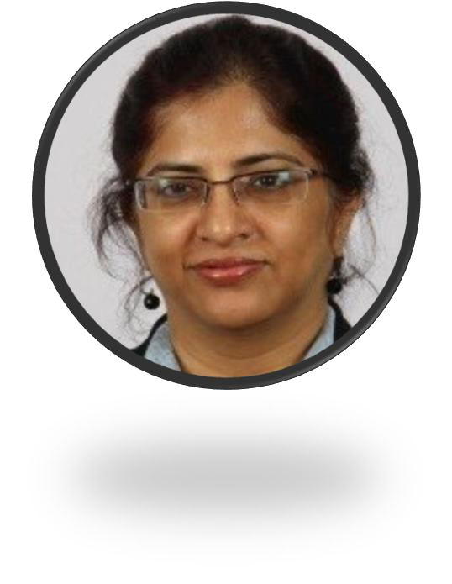
Chitra Jayasimha, Member, Advisory Group for Pensions, Employee Benefits and Social Security, IAI
Chitra is a Senior Consulting Actuary and Founder of Universal Actuaries and Benefit Consultants with 30 plus years of experience in Actuaries and Benefit Consultants.
She has extensive experience in Employee Benefits in both funding and accounting Actuarial Valuations under Indian GAAP, IFRS, US GAAP & other country Specific local GAAPs for Sri Lanka, Pakistan, Bangladesh, Nepal, Thailand, Indonesia, Middle East, Philippines, Australia & Turkey.
She has also worked in areas of Life Insurance & Reinsurance business, costing, pricing, basis for terms of trade & experience analysis, Valuation of Liabilities under UK regulations, Embedded Value calculations, analysis of surplus, Economic Capital and Life underwriting.
In the Benefits Consulting space she has worked in large M&A deals, due diligence of statutory and other benefits, Retirement solutions, B-to-B financial wellness, Benefits Design, Redesigns, etc.
She has worked in the past for MNC firms including Aon Consulting – India, Mercer Consulting – India, Swiss Re India, Paternoster (UK) and ING Life

Slide 5
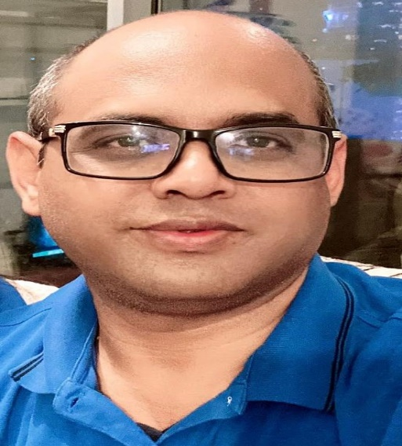
Speaker
Kishore Singh, AGM, Personnel Management, State Bank of India
Kishore Singh is a banker having more than 2 decades in banking, investment, portfolio management, Investment Banking, Private Equity and Human Resources.
Currently Mr Singh is working as Assistant General Manager (Pensioners Management Department) at State Bank of India and is responsible for Policy level interventions for pensioners and other compliance requirements, data preparations, compilation, audit and actuarial valuation. SBI has more than 2,80.000 pensioners at present.
Mr Singh is a postgraduate in economics and holds various certifications with respect to financial markets.
He was instrumental in setting up infrastructure fund “ Neev” in his stint as joint CEO at SBICAP Ventures Private Limited and was also involved in setting up of National Investment and Infrastructure Fund.

Slide 6
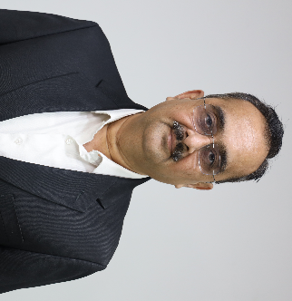
Speaker
Jayesh D.Pandit , Partner, K A Pandit Actuaries & Consultants
Jayesh D.Pandit is a practicing chartered accountant having experience of more than 3 decades and is principal in the M/S.K.A.Pandit Consultant and actuary.
By qualification he is FCA, Msc. Actuarial Science, CAA from IFOA and is holding diploma in Information System Audit from ICAI , he also holds diploma in actuarial science from University of Leicester London
He was instrumental in establishment of Banking sector pension scheme and also had amended income tax rule to suit the banking sector pension scheme.
He is also certified by World Bank for use of PROST pension projection software.
He has been faculty in teaching actuarial subject at DSAct ed for MSc and BSc in actuarial science YCMOU

Slide 7
8th Capacity Building Webinar in Retirement Benefits
Online Edition 2022
Date 16-03-2022
Overview of Government / Public Sector Defined Benefit Pension

Slide 8
Agenda
Computation of Pension
Management of Pension Obligation
Other facets of Pension
www.actuariesindia.org

Slide 9
Computation of Pension
Basic Pension
Government Sector – 50% of last drawn Salary
Nationalised Banks – 50% of average of last 10 month’s Salary
SBI – 50% of average of last 12 months salary upto a ceiling and 40% of last 12 months salary thereafter.
www.actuariesindia.org

Slide 10
Computation of Pension Contd
Dearness Allowance
Computation of Dearness Allowance (Basis CPI, Formula for computation)
Applicability Dearness Allowances rates on various pensioners in Public Sector Banks including SBI.
DA Neutralisation
www.actuariesindia.org

Slide 11
Management of Pension Obligation
Liability Management (Active employees, Pensioners, Family Pensioners)
Cash flow Management (Estimation, Fund Placement, Disbursement)
Asset Management (Duration gap, Yield enhancement, liquidity management etc.)
Pension Obligation Risk Management (Independent Acturial Valuation, inflow and Outflow monitoring, stress assessment, future strategies.)
www.actuariesindia.org

Slide 12
Other Facets of Pension
Family Pension to Dependents other than spouse
Pension Obligation after 1 year of service instead of 20 years in case of death
Full family pension upto 65 years or family pensioner.
Revision in Salary.
Special Revisions- Family Pension (uniform computation @ 30% instead of 15/20/30 slabs with cap)
www.actuariesindia.org

Slide 13
Questions
www.actuariesindia.org

Slide 14
Poll Question
What is the ceiling to be considered for valuation of PSU Gratuity?
20,00,000
18,00,000
Dynamic
No limit
www.actuariesindia.org

Slide 15
Poll Question
What is the maximum contribution allowed for PSU retirement benefits?
30%
27%
15%
No limit
www.actuariesindia.org

Slide 16
8th Capacity Building Webinar in Retirement Benefits
Online Edition 2022
Date 16-03-2022
Actuarial aspects and calculation of Public sector/Government Defined benefit Pension

Slide 17
Agenda
Public sector DB pension
Government DB Pension
Other benefits in PSU
www.actuariesindia.org

Slide 18
Major Assumptions
Salary escalation
Pay
DA
Pension escalation
DA
Additional quantum pension
DA Neutralization
Attrition
Mortality Post and Pre retirement
Government DB Pension
Other benefits in PSU
www.actuariesindia.org

Slide 19
Major Assumptions Contd
Age difference
Deferred pension
www.actuariesindia.org

Slide 20
Other Points
Salary revision
Restriction in total contribution
Gratuity indexation
www.actuariesindia.org

Slide 21
Questions
www.actuariesindia.org

Slide 22
CPD Question
What is the Family pension payable to the spouse on death of pensioner
30% of pension
60% of pension
15% of pension
50% of pension
www.actuariesindia.org

