Slide 1
4th Webinar on General Insurance
25th and 26th August 2021
1600 – 1730 IST
Reinsurance Structure of a General Insurance Company
Madhulika Bhaskar GM & Director, GIC Re

Slide 2
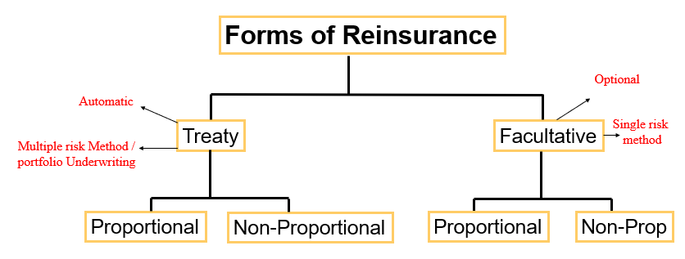
www.actuariesindia.org

Slide 3
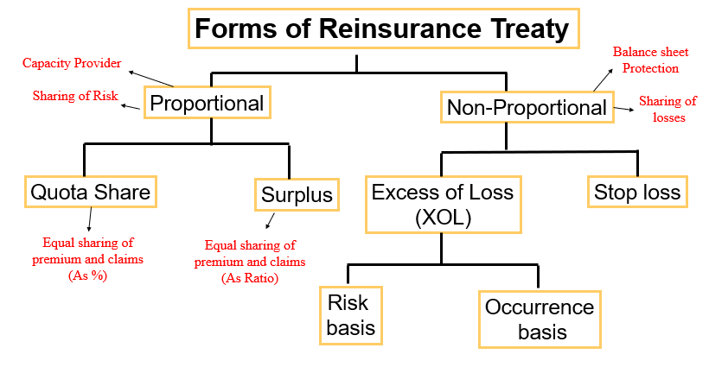
www.actuariesindia.org

Slide 4
Treaty Structure of a GI Co - multiple LOBs
Depends on cedant
Quota Share for New Class and New Company
Quota cum Surplus used to make Gross retentions meaningful
Surplus for established portfolio and Company
New Cos need upfront automatic capacity
XOL for high severity, low frequency
Stop Loss for high volatility
Law of the land- Mandatory quota share
www.actuariesindia.org

Slide 5
Multi Year Multi Line ( MYML)
Diversified portfolio
Difference in behavior of classes
Difference in tail
Flexibility in setting exposure
Longer term to recoup losses
Total capacity usually fixed
Fine tuning of capacity within lines
Reduces volatility
Better overall experience
Capital conservation
www.actuariesindia.org

Slide 6
Performance assessment of treaties
Usual metrics
Loss ratios, by sub class, FY, UY wise, ULR
Net result . Combined ratio
Sliding scale /profit commission vs loss ratio
Breach of loss caps / limits.
Cash flow assessment
Risk assessment
Effectiveness of SI / PML basis
Blind spirals
Per event CAT
Per event risk
www.actuariesindia.org

Slide 7
Performance assessment contd….
Performance Gross / Net of retrocession
Accumulation
Risk accumulation
Geographical
Line of business
Long term performance
Return on investment / capital
Years to recoup
Expected Reinsurer Deficit
Capital assessment
www.actuariesindia.org

Slide 8
Factors affecting treaty renewal
Reinsured and Reinsurer are on opposite sides of the table.
Finding a win-win solution – challenging
Factors affecting decision:
Capacity / Protection requirement
Past performance
Hard/Soft market
Management decision
Law of the land
Offered terms and conditions (premium, loss corridor, commission, attachment point, cover limits….)
Solvency position
Accumulation/Exposure control
www.actuariesindia.org

Slide 9
RI pricing – Reinsurer’s perspective
Based on types of contract
Proportional
Not much scope in pricing
Loss caps / corridors
Sliding scale / profit commission
XOL
Experience / Exposure based, attachment points, limits
Stop Loss
Actuarial pricing. Attachment points, limits
Expected reinsurer deficit-based pricing
Capital assessment based
www.actuariesindia.org

Slide 10
CAT modelling
Agencies – Risk Management Solutions (RMS), AIR Worldwide (AIR) and EQECAT
Various CATs modelled are EQ, Hurricane, Flood etc.
Given the exposures, the models help understand the expected losses and in turn the protection programe size
It helps optimize the exposure
It gives an indication on pricing adequacy.
www.actuariesindia.org

Slide 11
Impact of Covid-19
Health / Life portfolios impacted
Delay in assessing Economic impact
Exposed the loopholes in treaty wordings
Claims Judgement delivered in countries like SA, still in reserve state in London
BI claims paid without associated Material Damage claims
Explicit reserving provisions made in books of accounts
Still impact is not fully evident in India
www.actuariesindia.org

Slide 12
Entry of FRB’s
10 FRBs +1 Lloyds branch registered in India
Total reinsurance written premium INR 63,712 Cr*
Biggest attraction in India 64VB (cash and carry)
Growing market – huge potential
Indian reinsurance market is largely proportional
FRB’s write largely non-proportional, hence GIC still the market leader with 80.09% market share*
FRBs support specialized lines e.g., Cyber insurance
Not much product innovation yet in General RI mkt.
*IRDAI annual report 2019-20 Page 32
www.actuariesindia.org

Slide 13
Hard & Soft Market
Availability of RI capacity is a function of profitability, this is eminently cyclical in nature
SOFT MARKET: In absence of cat losses, if reinsurers make profits, then more reinsurers enter the market with capacity or existing reinsurers increase their capacity. This leads to a situation of more capacity less business and leads to fall in the rates and reinsurance becomes cheaper
HARD MARKET: Lesser premium to service more risks, losses in the subsequent years could put reinsurers to hard situation and lead to exit of some of the reinsurers and capacity. This will harden the market and leads to increase in rates.
www.actuariesindia.org

Slide 14
Hard & Soft Market
Reinsurance markets are Dynamic in nature
Entry of Alternate Third-Party Capital (CAT Bonds, ILW (Industrial Loss Warranty), ILS (Insurance Linked Security), Side Cars, Hedge funds, Pension funds and other collateralised structures.
Above distorts the cyclical nature of Reinsurance Mkt.
Impact different for different lines of business as some niche mkts support specialized classes.
Impacted by global events
Catastrophes
Airline crash
Covid-19 judgements
www.actuariesindia.org

Slide 15
Questions ?
www.actuariesindia.org

Slide 16
Thank You
www.actuariesindia.org

Slide 17
Forms of Reinsurance Treaty
Balance sheet
Protection
Capacity Provider
Sharing of Risk
Proportional
Non-Proportional
Sharing of
losses
Quota Share
Surplus
Excess of Loss
(XOL)
Stop loss
Equal sharing of
premium and claims
(As %)
Equal sharing of
premium and claims
(As Ratio)
Risk
basis
Occurrence
basis

