Slide 1


4th TechTalk in Retirement Benefits
December 09, 2021
The Role of a Global Consolidating Actuary

Slide 2









Welcome!
Thank you for joining us today
Some housekeeping rules
www.actuariesindia.org
2

Slide 3

Global Actuarial Consolidation
Relevance of the session for Actuaries in India
Greater Governance by HQ’s of multinational companies
Actuaries in India support Indian subsidiaries of global Multinational companies for valuations under IFRS / US GAAP
Greater governance and higher oversight by headquarters (HQs) of multinational companies, mainly driven by headcount growth and salary inflation in India
Gradual increase in liabilities, especially given open schemes, leading to breach of materiality thresholds. May further increase if labour codes implemented
More collaboration required with global consolidating actuaries, and understanding of the bigger picture
Indian MNC’s with global presence
Significant increase in Indian MNC’s in the last two decades
Actuaries advising Indian MNC’s need to have oversight on global retirement plans
Need for better understanding of the role and the process involved in global consolidation
www.actuariesindia.org
3

Slide 4
Session Objectives and Agenda
Role of the Global Actuary providing consulting advice to headquarters (HQs) of multinational companies
Phases involved in the Global Actuarial Consolidation Process
Case study of a global consolidation process under US GAAP for a large Fortune 100 Company
Overview of technical aspects involved in the consolidation process, including setting assumptions and dealing with special events
Important issues for local actuaries to watch out for and raise with the global actuary
Evolving role of the global actuary
www.actuariesindia.org
4

Slide 5

Welcome Today’s Speaker
Palak Chauhan, FIAI
Associate Director, Integrated & Global Solutions
Willis Towers Watson
New York, United States
Fellow of IAI and a member of IFoA UK
Holds Bachelor of Science (Statistics Honrs.) from Lady Shri Ram College, Delhi University
Currently working as an international employee benefits consultant. Previously worked at Willis Towers Watson India office
Has over 13 years of experience advising multinationals in a wide range of HR issues, including design, implementation, financing, of DB & DC plans, health & welfare plans and financial wellbeing programs globally.
Also advises HQs of MNCs on various other retirement and other employee benefits related topics including global governance, mergers and acquisitions.
www.actuariesindia.org
5

Slide 6

What does a Global Actuary actually do?
Helping HQs solve many topics
Focus of today’s discussion
“Traditional Work”
“Non-conventional” areas
- Coordinating pension actuarial work products done by actuaries around the world for a multinational company client
  Global pension project management
  Review of locally completed valuations
  Evaluation of local pension initiatives (settlements, plan amendments and terminations)
- Coordinating pension actuarial work products done by actuaries around the world for a multinational company client
  Global pension project management
  Review of locally completed valuations
  Evaluation of local pension initiatives (settlements, plan amendments and terminations)
- M&A due pension diligence reports in connection with a corporate transaction
- Design and funding of Cross-border vehicles e.g. IPP / ISV
- Pension de-risking
- Local Defined contribution plan design, administration and communication
- Assistance with setting corporate global rewards philosophy
- Supporting with global governance and oversight
- Reviewing retirement benefits from the perspectives of:
  Diversity Equity & Inclusion (DEI)
  Environmental, Social & Corporate Governance (ESG)
  User Experience
  Other emerging focus areas
Financial wellbeing
Global Support with other elements of Total Rewards
Photo credit
www.actuariesindia.org
6

Slide 7

A strong collaboration between global and local teams
Global actuarial consolidation and financial reporting
Consistent application of global policies
Highlighting key risks and opportunities
XYZ HQ Team
Global Actuary
Global polices and goals
Business updates
Approval of local requests
Local plans financial reporting
Local developments and trends
Issue escalation
Rationalization of local decisions misaligned with group policies
Request for approvals
Communication of policies
Approval of local requests
Instructions & project management
Secondary review of financial reporting
Support with local initiatives
Global Actuarial Consolidation
XYZ Local Country Teams
Local actuaries
Data & information
Local actuarial valuations & other support
www.actuariesindia.org
7

Slide 8
Global Overview of Defined Benefit Plans
Includes DB Pension schemes and Termination Indemnities (TI)
TI plans are usually mandatory and prevalent in Southeast Asia, Middle East, Africa, Eastern Europe, LATAM
More traditional DB Pension schemes (mostly closed) are prevalent in the US, UK, Western Europe
  These typically constitute the largest liabilities
www.actuariesindia.org
8

Slide 9
Poll Question 1
How are you currently involved in a global actuarial consolidation project?
  Work as a local Indian actuary and provide results to global actuary
  Work as a global consolidating actuary
  No involvement yet
www.actuariesindia.org
9

Slide 10

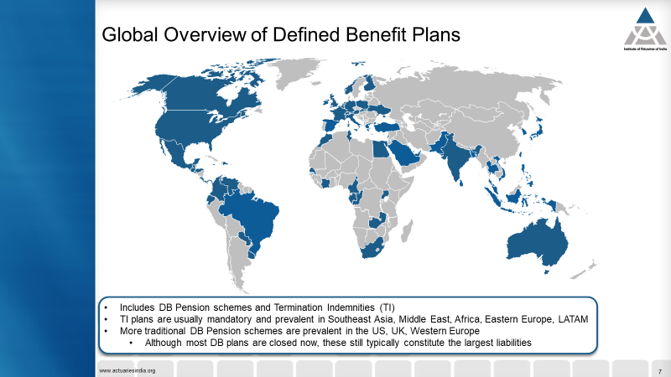





Who can be a global actuary?
Typical non-technical skills needed / to be developed
Photo credit
Mile wide & an inch deep
#1
Strong Project Management skills are critical
Photo credit
#2
Understanding cultural nuances are very important for cross border collaboration
#3
Taking a bird’s eye view
#4
Staying abreast with regulatory changes and emerging global trends in retirement space
Inch wide & a mile deep
www.actuariesindia.org
10

Slide 11
Case Study
Client XYZ
FYE2020 Consolidated USGAAP Disclosures
11

Slide 12

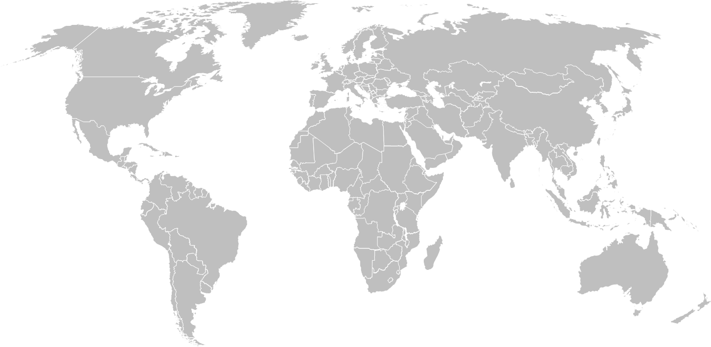
Overview of Client XYZ’s global retirement plans landscape
50,000
employees
Located across
countries
50+
Scope
DB Pension Plans consolidated under USGAAP (ASC715-30)
December 31 year-end date
Results consolidated in USD
DB Pension plans categorized into Tiers 1/2/3 based on materiality and complexity
Tier 1 plans (around 45 plans) constitute ~90% of total PBO and Assets (at 12/31/20)
128
DB Pension plans across 27 countries included in USGAAP consolidation
out of total 180 DB plans sponsored by XYZ globally across 40 countries
$9.5bn
DB pension PBO
$8.7bn
DB pension Assets
$60m
DB pension cost
www.actuariesindia.org
12

Slide 13



Global Accounting Coordination Process
Planning
Preliminary Assumptions
Preliminary Disclosures
Final assumptions & disclosures
Debrief
%
$
Internal team kick off
Planning meeting with client
Kick off with local actuaries
Submission by local actuaries
Review by global actuary
Recommendations discussion with client
Approved assumptions communication with locals
Submission by local actuaries
Review by global actuary
Preliminary disclosures provided to client
Assumptions updated based on year-end market conditions
Disclosures updated for final assumptions, final asset values, final cashflows
Actuarial Certifications
Auditor discussions
Debrief meeting with client
Feedback from local actuaries
Debrief meeting internal
September - October
October - November
November - December
January
February - March
www.actuariesindia.org
13

Slide 14
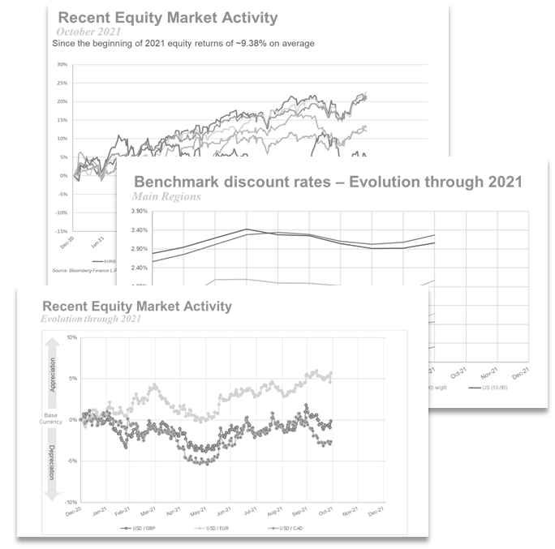

Planning
Preliminary Assumptions
Preliminary Disclosures
Final assumptions & disclosures
Debrief
Project Planning
Internal team kick-off discussions
Team
Timeline
Previous year debrief items / process improvements
Systems set up
Planning meeting with client
Process overview
Timeline
Business updates from clients
Any country specific issues or updates
Market condition updates since last valuation date
  Benchmark discount rate movements
  Typical equity market movements
  Typical exchange rate movements
  Expected mortality table releases
Valuation methodology
SAMPLE
Kick-off with local actuaries
Team
Process & timelines
Outline of scope
Quick Tip
Inform the global actuary about any special events as soon as you are made aware of the same
Photo credit
Discuss any special events with client at or before planning meeting. This helps significantly with getting timely information and ultimately timely submissions of results and impact on P&L expense
Photo credit
www.actuariesindia.org
14

Slide 15
Planning
Preliminary Assumptions
Preliminary Disclosures
Final assumptions & disclosures
Debrief
Assumptions proposal
Request from local actuaries
Preliminary proposed assumptions based on preliminary market condition date e.g. October 31
Impact of change in assumptions on PBO and service cost
Global Actuary Review
Compliance with ASOP 27 (economic assumptions) and ASOP 35 (demographic and other
noneconomic assumptions)
Overview of assumptions setting and review process
Assumptions | Typical assumption setting methodology | Typical assumption setting process | Typical assumption review checkpoints
Discount Rate | Developed markets – match expected cash flows to spot rate curve Emerging markets – government bond yield + credit risk premium | Determined by local actuaries or global actuary, using plan specific cashflows / duration | DR model outputs Government bond yields and credit risk premium data points review Movement in benchmark yields
Expected Return on Assets | As per Company’s expectation of future investment performance | Developed markets – provided by client Emerging markets – Provided by local actuaries, in consultation with local client / fund managers | EROA models outputs based on plan’s target asset allocations Movement in market (equity / debt etc.)
Mortality Rates | In line with latest version of published tables | Proposed by local actuary | Change since previous year latest version of published tables Benchmark survey data
Other Economic Assumptions (e.g. Inflation, Salary increase rate, Social Security Increase rate, Pension increase rates) | Based on company’s own experience and future expectations Usually based on building block approach with inflation as base | Determined by local actuaries, in consultation with local client | Change since previous year General economic environment Benchmark survey data Inputs from global client
Other Demographic Assumptions (e.g. retirement, disability, % married, age difference, Lump Sum (Commutation) Election Rate) | Based on Company’s own experience Disability rates are typically based on latest version of published tables | Determined by local actuaries, in consultation with local client | Change since previous year General economic environment Benchmark survey data Inputs from global client
www.actuariesindia.org
15

Slide 16
Planning
Preliminary Assumptions
Preliminary Disclosures
Final assumptions & disclosures
Debrief
Assumptions proposal
Recommendations to HQ
Presentation to client, including rationale and commentary for key assumptions
Formal approval from client
Approved assumptions communication to local actuaries
Along with next steps and timelines
SAMPLE
www.actuariesindia.org
16

Slide 17
Planning
Preliminary Assumptions
Preliminary Disclosures
Final assumptions & disclosures
Debrief
Preliminary disclosures review process
Preliminary disclosures based on preliminary assumptions
Submitted by local actuaries in local currency
Global Actuary Review
Overview of review process
Disclosure | Typical review checks
Overall | Opening balances match prior year closing
Membership | Sense check of movement since last year, considering approved valuation schedule AFWL / ARLE consistent with prior year – also review the correct basis to use for amortizing unrecognized (gain)/loss in next year’s expense
Assumptions | Matches approved preliminary assumptions Duration consistent with prior year
PBO reconciliation | Assumption (gain)/loss: impact of change in assumptions in line with what was communicated to client previously Experience (gain)/loss: typically investigate further if >5% Special events / business events reflected correctly ABO/PBO ratio consistent with prior year Split of PBO by membership consistent with prior year Sensitivities consistent with prior year
Asset reconciliation | Actual asset returns in line with expectations Asset allocations consistent with prior year; any changes explained Special events / business events reflected correctly
AOCI reconciliation | Recognition amounts reflected correctly Special events / business events reflected correctly
Disclosure | Typical review checks
Net Periodic Benefit Cost / (Income) | Current year’s expense matches what was disclosed last year, unless there was a special event / business event Next year expense matches what is expected based on disclosures (and components of AOCI recognition calculated correctly)
Cashflows (benefit payments, employer contributions, plan participant contributions) | Consistent with what is expected based on last year’s disclosures, considering any special events / business events
Special Events | Review special event accounting in detail (settlement/curtailment thresholds and treatment)
Quick Tip
To reduce time spent on answering queries and back & forth, provide detailed commentary to global actuary on any unexpected events e.g. special events, business events, high actuarial experience (gains) / losses, significant changes in cashflows etc. along with providing results
Provide commentary to client for each event and discuss & confirm accounting approach
www.actuariesindia.org
17

Slide 18
Poll Question 2
What are some possible reasons why current year’s expense may not match what was disclosed last year?
  Curtailment event recognized during the year
  Settlement event recognized during the year
  Business unit spin-off
  All of the above
www.actuariesindia.org
18

Slide 19
Special events (US GAAP specific)
Plan Amendments
Prior service cost (PSC) arises whenever benefits are changed (and change is retroactive)
Amortize PSC over the average future service (AFS) of the active participants
Negative plan amendment arises when benefits attributable to past service are reduced or eliminated
  Recognition of Negative PSC by first reducing unrecognized PSC; amortize excess negative PSC using same principles as for positive PSC
Settlement
Employer no longer has obligation for the benefit and no significant risk associated with that benefit e.g. Pay lump sum benefits, annuities purchases
Settlement accounting must be followed if sum of all settlements >= service + interest cost for the plan
Settlement credit/charge = % of PBO being settled X Unrecognized G/L
Make sure to adjust PBO for gains or losses associated with settling benefit obligation prior to recognizing the amount being settled
Curtailment
Event that reduces participants’ future service under the plan e.g. plant closing, sale of division/plant, restructuring , plan amendment
OR
Eliminates future accrual of benefits for significant number of active plan participants e.g. through “freezing” benefits, plan amendment
Accelerate recognition of PSC based on % reduction in Future Service
Unrecognized G/L may be reduced by gain/loss on benefit obligation
Special and contractual termination benefits
Increase in PBO attributable to extra benefits received by participants (i.e., benefits they were not already entitled to receive)
P&L charge is equal to the entire change in PBO due to additional benefits being provided
  Special termination benefits: Cost recognized when employees accept offer
  Contractual termination benefits: Cost recognized when triggering event occurs
http://www.actuarialstandardsboard.org/wp-content/uploads/2014/07/acg2_old.pdf
(refer to page 10 for curtailment accounting flow chart)
www.actuariesindia.org
19

Slide 20

Business events
Business event | Considerations from financial reporting perspective | Typical impact on consolidated USGAAP disclosures
Mergers / Acquisitions | Client acquires or merges with another business which has existing obligations (and possibly assets) for sponsored retirement plans | In case of independent plan(s) being acquired (and depending on client’s materiality threshold), plan(s) may be included in consolidated disclosures. In case of combination with existing plan(s), the acquired PBO (and any assets) are typically reflected via “Acquisition/Business Combination/Divestiture” line item. The expense for the period from acquisition date to year-end is typically added to the overall expense. Actual approach will depend on type of transaction and agreement with client (& auditors)
Divestitures / Spin offs | Client divests or spins-off a business / part-of business. There may be associated retirement plan obligations (and possibly assets) | Similar to above (reflect other way around in disclosures) May trigger special event accounting
Transfers | Typically transfers between business units | Balance sheet and AOCI balances for impacted employees typically shown under “Other” line item. Expense may be updated based on materiality Client may agree to reflect impact under actuarial (experience) (gains) / losses, depending on materiality and internal accounting policy
Record Breaking Global Corporate Transactions
Total value of pending and completed deals announced till end of Q3 2021 had already touched $3.6 trillion; surpassing the full-year tally of $3.59 trillion in 2020
Photo credit
www.actuariesindia.org
20

Slide 21
Planning
Preliminary Assumptions
Preliminary Disclosures
Final assumptions & disclosures
Debrief
Final assumptions and disclosures
Updates to assumptions based on 12/31 year-end market conditions
Varies by client - based on methodology approved by client and their auditors
Assumptions typically updated for year-end are discount rates and inflation rates (typically for UK pension schemes that have a RPI / CPI assumption)
Set by global actuary or provided by local actuary; approved by client
Final disclosures
Disclosures (in local currency) updated to reflect:
  Final assumptions
  Final asset values
  Final cashflows
Local currency disclosures converted by global actuary to USD / another consolidating currency
  FX rates provided by client HQ
Actuarial certifications
Global consolidated report, with global certification delivered to client
Local reports, local certifications may also be delivered – varies by client
Auditor discussions
SAMPLE
www.actuariesindia.org
21

Slide 22

Planning
Preliminary Assumptions
Preliminary Disclosures
Final assumptions & disclosures
Debrief
Project Wrap up
Debrief meeting with client
What went well
Areas for improvements
High level planning for next year
Feedback from local actuaries
Feedback from local client teams based on local actuaries debrief discussions
What went well
Areas for improvements
High level planning for next year
Quick Tip
You can discuss with your clients to help them prepare an Accounting Policy & Methodology Document. Examples of what this document can cover are:
Materiality for including a retirement plan in global consolidation
Tiering of plans based on materiality / complexity
Difference in accounting treatment based on tiering
Threshold for recognition of special events, and any approach for early recognition
Threshold for using AFWL / ARLE
Threshold for updating Discount Rate based on year-end market conditions
Asset roll forward approach
Valuation schedule (full valuation vs roll forward)
The document is typically prepared by global actuary, discussed and approved by client, after discussions with global auditors
Debrief meeting internal
What went well
Areas for improvements
Budget review
High level planning for next year
Photo credit
www.actuariesindia.org
22

Slide 23
Other global actuarial projects
Global consolidation for:
  ASC715-60 – Post retirement medical benefits
  ASC712 – Postemployment Benefits (e.g. Severance benefits, Disability-related benefits)
  ASC710 – Compensation General (e.g. compensated absences, deferred compensation)
  ASC820 - Asset disclosures
  IFRS
Quarterly expense estimates
Expense and balance sheet projections (e.g. projecting to 3 / 5 / 10 years)
Valuations for certain smaller countries e.g. Middle Eastern countries with end-of-service lump sum benefits
M&A related:
  Purchase accounting disclosures
  Carve-outs for potential spin-offs
www.actuariesindia.org
23

Slide 24
Evolving role of the global actuary
Global retirement trends and other opportunities
24

Slide 25
Poll Question 3
How many Fortune 500 companies (%) do you believe currently offer a Defined Benefit Plan to newly hired employees?
  0% - 5%
  5% - 20%
  20% - 50%
  More than 50%
www.actuariesindia.org
25

Slide 26
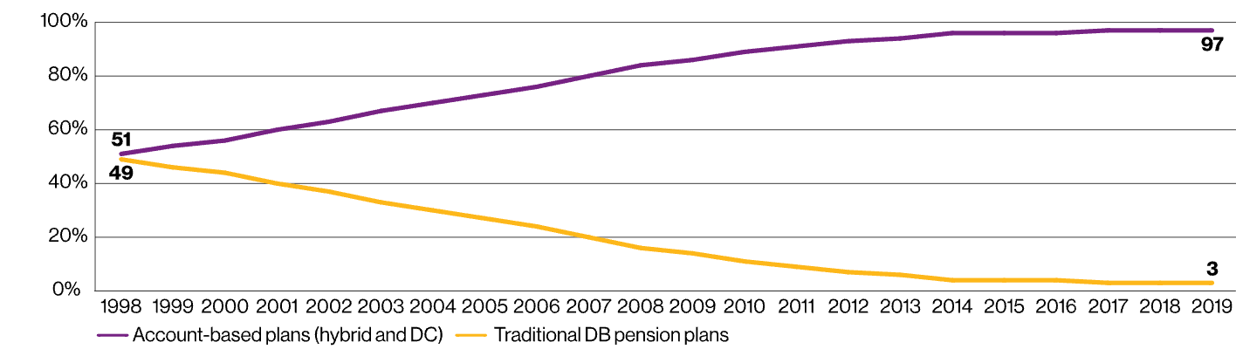
Retirement benefits: Global trends
A DC world
Source: Willis Towers Watson
In 2019, 97% of Fortune 500 employers offered only account-based plans as the primary retirement vehicle to newly hired salaried employees
www.actuariesindia.org
26

Slide 27
Retirement benefits: Global trends
Looking to the future
PAST |  | CURRENT |  | FUTURE
DB |  | DC |  | DC + possibly company match
Paternalistic |  | Increasing individual accountability |  | Individual accountability
Employer sponsored |  | Shifting cost burden to individuals |  | Leveraging group scale + sharing cost burden with individuals
Localized solutions and decisions |  | Centralizing plan governance |  | Global oversight and leverage
Benchmarked to market |  | Fact-based plan design |  | Employee experience and financial wellbeing
One size fits all |  | Varying benefits offered to meet individual needs |  | Emerging innovative solutions
www.actuariesindia.org
27

Slide 28
What does a Global Actuary actually do?
Helping HQs solve many topics
“Traditional Work”
“Non-conventional” areas
- Coordinating pension actuarial work products done by actuaries around the world for a multinational company client
  Global pension project management
  Review of locally completed valuations
  Evaluation of local pension initiatives (settlements, plan amendments and terminations)
  Assistance with hiring of local consultants
- M&A due pension diligence reports in connection with a corporate transaction
- Design and funding of IMEs/expats / Cross-border vehicles e.g. IPP / ISV
- Pension de-risking
- Local Defined contribution plan design, administration and communication
- Assistance with setting corporate global rewards philosophy
- Supporting with global governance and oversight
- Reviewing retirement benefits from the perspectives of:
  Diversity Equity & Inclusion (DEI)
  Environmental, Social & Corporate Governance (ESG)
  User Experience
  Other emerging focus areas
Global Support with other elements of Total Rewards
Financial wellbeing
Photo credit
www.actuariesindia.org
28

Slide 29
Thank You!
Any Questions?
29

Slide 30
CPD question
XYZ Ltd. has closed down a business unit and terminated 20% of the Gratuity scheme plan participants.
How much reduction (%) in future years of service would typically be considered as a threshold to determine if curtailment has been triggered under USGAAP?
  5%
  10%
  20%
  This is clearly a restructuring event, so the impact will be reflected as curtailment gain/loss
www.actuariesindia.org
30

Slide 31
Upcoming webinars
Webinar | Date | CPD
36th India Fellowship Webinar (IFS) | 21-22 Jan & 28-29 Jan, 2022 | 12 hrs
Training sessions | Approx. duration
Machine Learning Program | 120 minutes
CB1 Coaching | 90 minutes
CB2 Coaching | 90 minutes
CS1 Coaching | 90 minutes
CS2B Coaching | 120 minutes
www.actuariesindia.org
31

