Slide 1

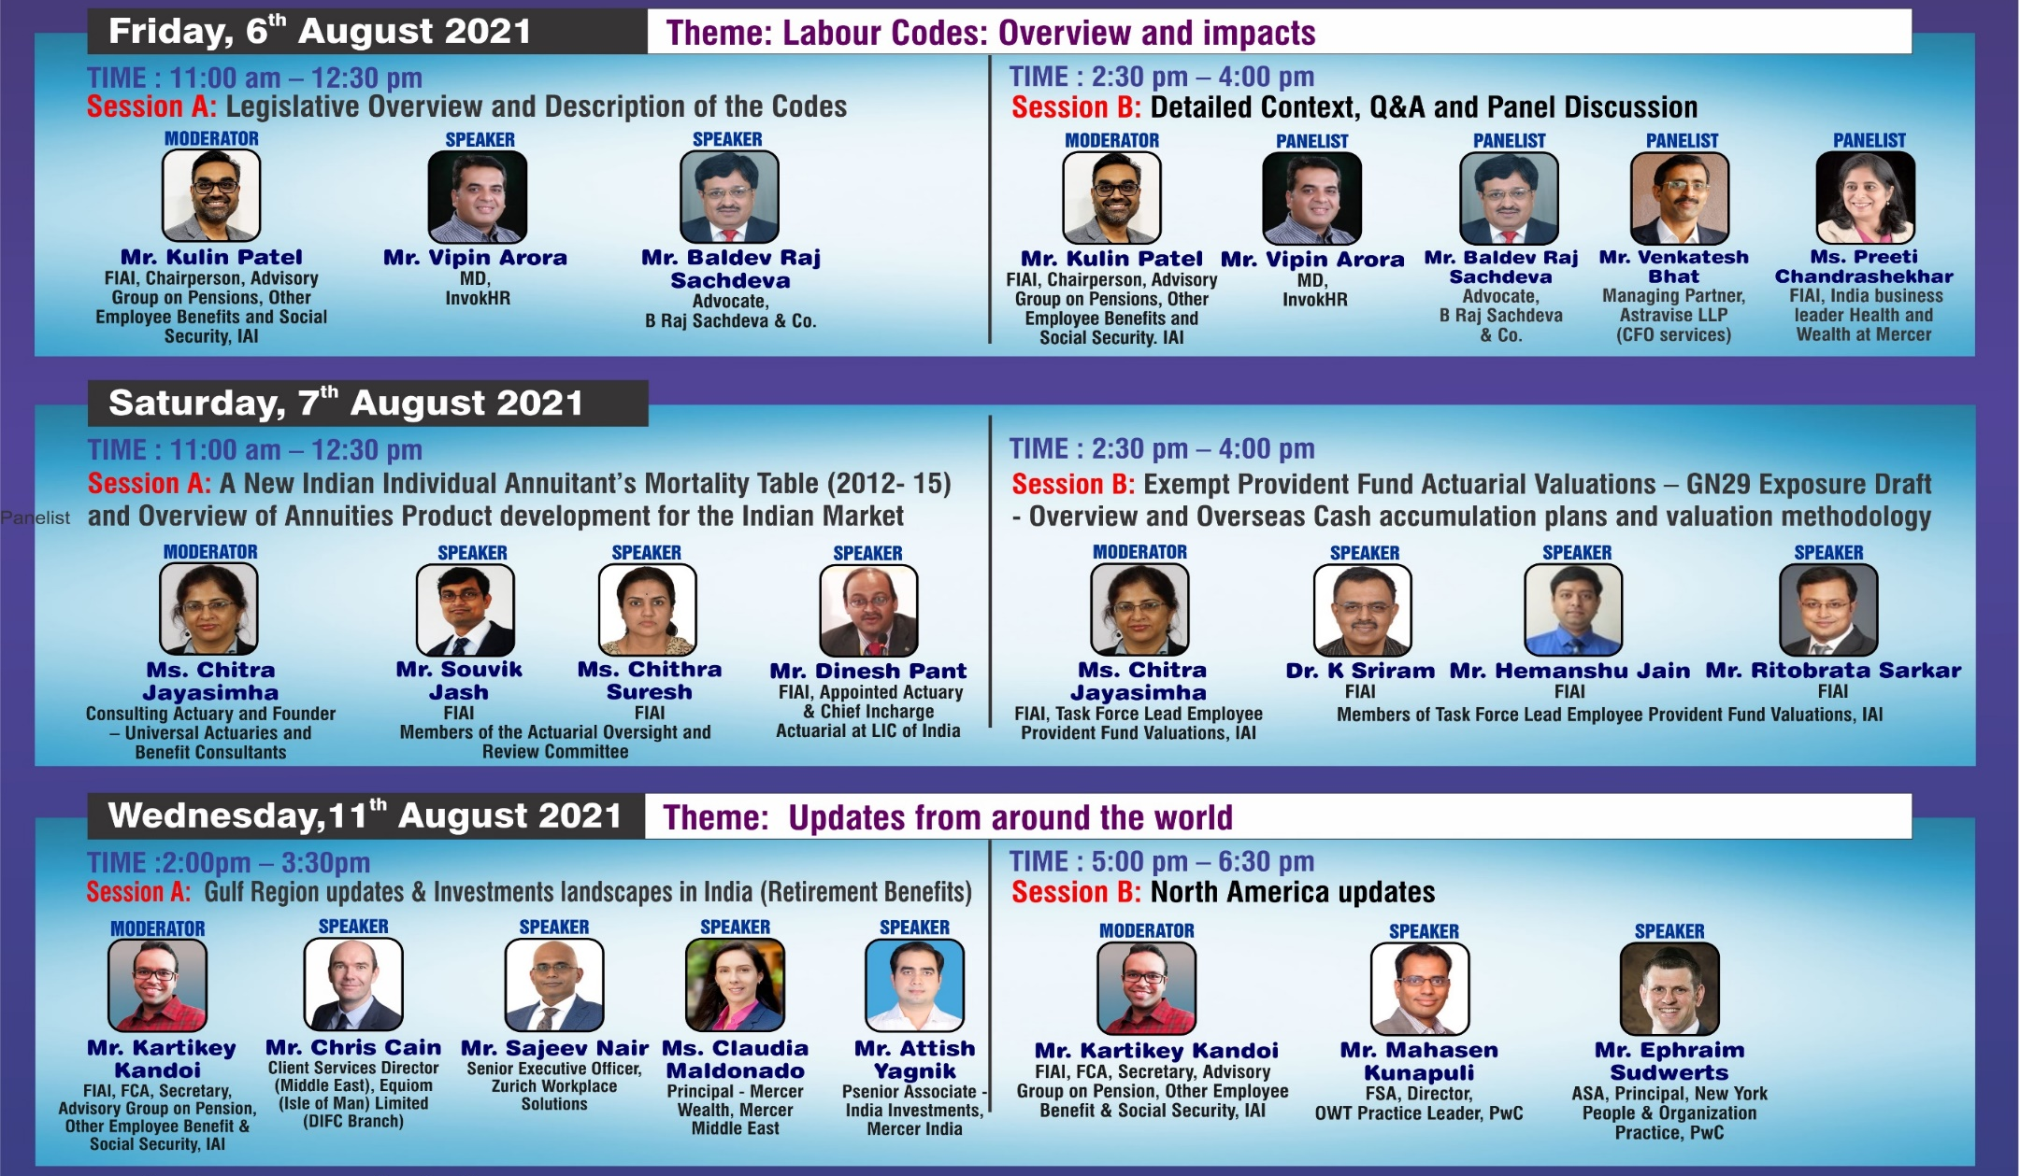

18th Current Issues in Retirement Benefits
Online Series – August 2021

Slide 2








Introduction
Mute
Q&A
IAI support
C
P
D
Recording
Feedback
www.actuariesindia.org

Slide 3
18th Current Issues in Retirement Benefits(CIRB)
Online Series August 2021
11 August 2021
Gulf Region updates - Retirement Benefits
DIFC Employee Workplace Savings (DEWS Plan)
Chris Cain – Equiom
Claudia Maldonado – Mercer Financial Services Middle East Limited
Sajeev Nair – Zurich Workplace Solutions

Slide 4
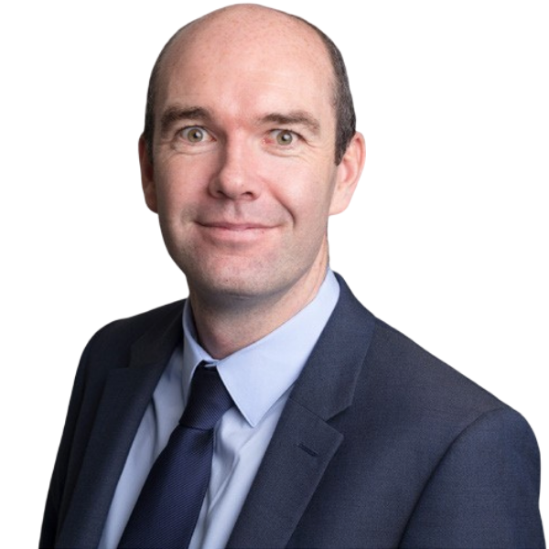
Speaker Introductions
Chris Cain
Client Services Director (Middle East), Equiom
Chris is responsible for ensuring the highest levels of service delivery and client relationship management for Equiom’s diverse Middle East client base.
Chris’ primary focus is the oversight and growth of Equiom’s employee savings/pensions and end of service business line. Working out of Equiom’s DIFC office in Dubai, Chris provides on the ground support to companies in the DEWS (DIFC Employee Workplace Savings) Plan for which Equiom is Master Trustee.
He works closely with local and international pensions and savings plan administrators, providers and advisors to deliver leading employee savings/pension solutions across the UAE and the wider MENA region.
He supports the global business development team and also works closely with Links Group and Equiom Corporate Services (Middle East) Ltd.
Having spent more than 20 years working for a global insurer before joining Equiom, Chris has significant experience in financial services with a specific focus on workplace savings/pension benefits and end of service solutions for employees and employers in the Middle East.
He has worked alongside some of the biggest employers globally, helping them to design and deliver successful solutions. He is a pragmatic problem solver with an extensive professional network.
www.actuariesindia.org

Slide 5
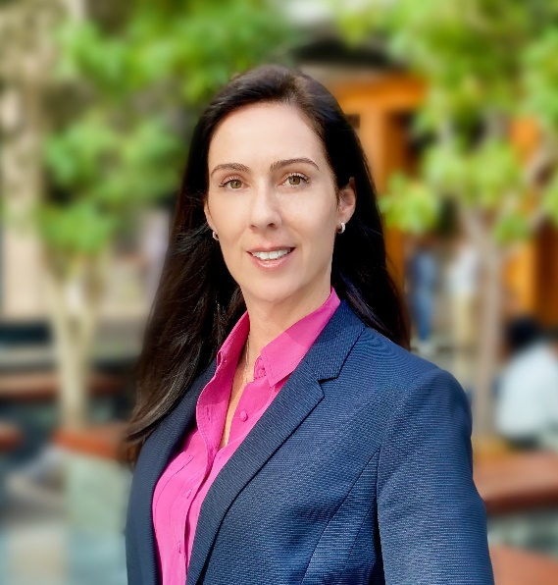
Speaker Introductions
Claudia Maldonado
Principal, Mercer Wealth, Mercer Middle East
She leads Mercer’s defined contribution savings and financial wellbeing initiatives across the region. Claudia is the project lead for Mercer on the DIFC Employee Workplace Savings (DEWS) Plan.
Experience
Claudia has more than 22 years experience in the financial services industry and her areas of experience and expertise include investment consulting and master trust advisory services to large retirement funds and institutional clients as well as business development on a wide range of retirement savings products and healthcare solutions to institutional clients.
Her experience and expertise includes
  governance review,
  plan design,
  investment strategy,
  manager selection,
  communication (member and Trustee/Employer communication)
  reporting and monitoring
Education
Claudia holds a Bachelor of Commerce degree, majoring in Insurance & Risk Management and Marketing from the University of Witwatersrand in Johannesburg, South Africa.
www.actuariesindia.org

Slide 6
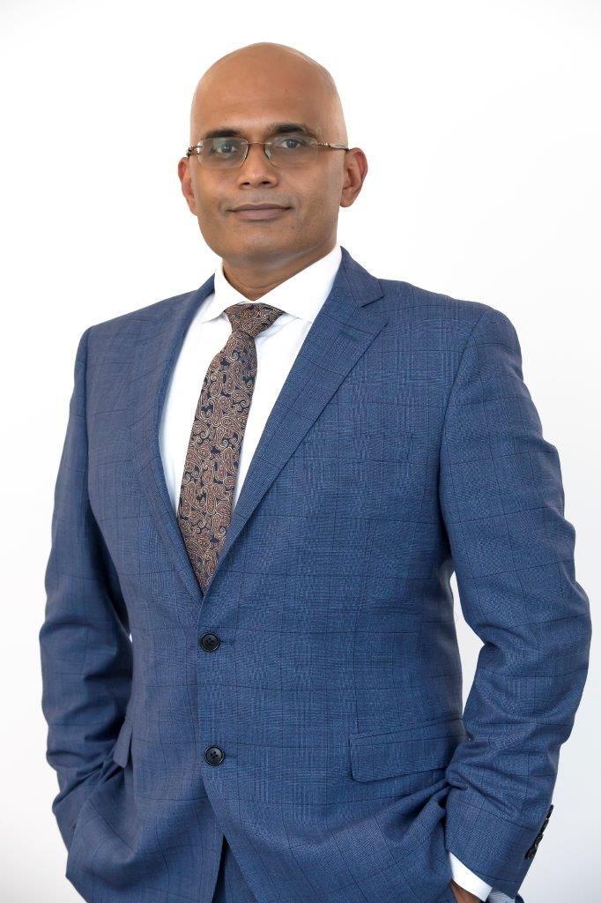
Speaker Introductions
Sajeev Nair
Senior Executive Officer, Zurich Workplace Solutions
He joined Zurich in 2009 as Strategic Sourcing Partner and was the Head of Global Application Development & Maintenance (ADM) before being appointed as SEO of Zurich Workplace Solutions.
Zurich Workplace Solutions was created to act as a plan administrator of the DIFC Employee Workplace Savings (DEWS) Plan.
He has 25 years of senior leadership extensive experience ranging from sales, business development, operational delivery strategy and consulting. His experience spans insurance, banking, pharmaceuticals, technology companies and management consulting.
He holds a bachelor’s degree in mechanical engineering and has completed a number of executive leadership programs with IMD Lausanne and Thunderbird School of Management.
In his last role, Sajeev was responsible for Zurich’s global application portfolio, focusing on improving technology delivery models, simplifying the technology landscape, creating new commercial partnerships as well as driving innovation.
An industry thought leader, Sajeev was a key panellist at WEF 2019 in Davos on “Future of Work: The Radical Agency” and also mentors students of MAS-MTEC at ETH. Sajeev is passionate about helping organizations and staff navigate the fourth industrial revolution, with a specific focus on digital strategies and workforce transformation.
www.actuariesindia.org

Slide 7

Agenda
EoSG in UAE & GCC – Update from DEWS Master Trustee
  Impact of DEWS in building awareness
  Equiom – Focus on the Middle East
DEWS funds and investment update
  Overview of DEWS fund range
  Performance to 30 June 2021
  Commitment to net-zero absolute carbon emissions and impact on the funds
DEWS – One year since launch
  Plan highlights and key metrics
  Looking forward – what to expect from DEWS – New features, functionalities and focus areas
www.actuariesindia.org

Slide 8

EoSG in UAE & GCC
- DEWS Master Trustee
Chris Cain

Slide 9
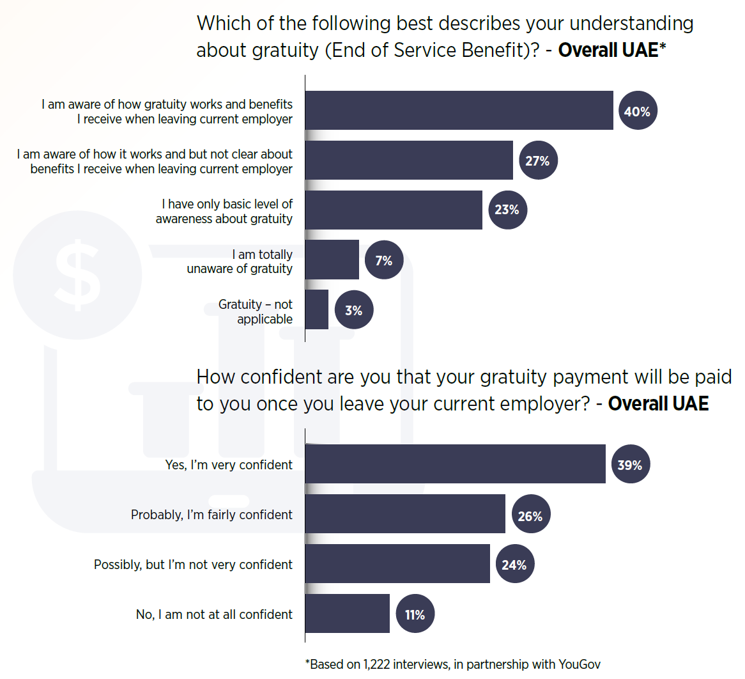
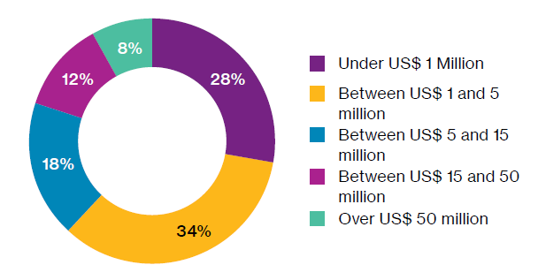
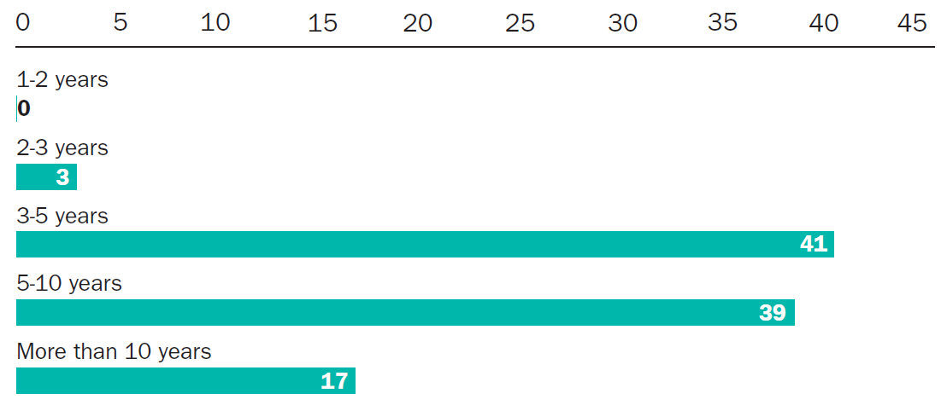
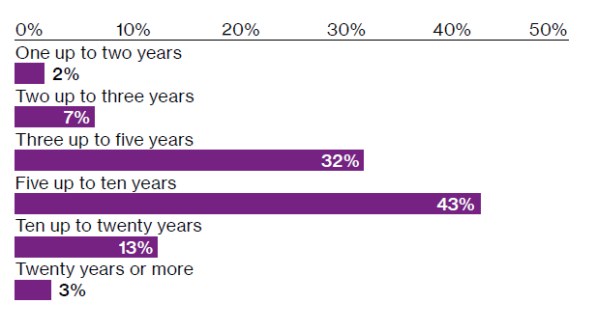

The EoS issue for Governments to solve
Lack of understanding and trust
Existing liability across the GCC of an estimated USD60 billion and growing
Attracting and retaining people in the region
Lack of control of how EoS is treated
Financial independence
Lack of engagement from employers to help employees save
Sources: Willis Towers Watson 2020 End of Service Benefits Survey, United Arab Emirates, Mercer – Rethinking Financial Security and Savings in the UAE report and Insight Discovery Middle East Panorama
Notes:
A lack of understanding of how the benefit works and the calculation method used creates uncertainty and mistrust from employees. CLICK A recent yougov survey conducted in the UAE found only 40% of respondents were confident of how their Eos is calculated and only 39% were confident that they would receive their payment when they leave employment.
CLICK Worryingly around 80 to 90% of employers do not fund their liability externally and instead make payments from regular cashflow. The recent Covid pandemic has highlighted the issues this creates with some companies not being able to afford to make people redundant and some having to make termination payments in monthly instalments. The airlines industry has been one of the hardest hit however, thankfully for Emirates Airlines their provident fund has been setting aside employees end of service liability on a monthly basis for over 20 years and has helped them to better weather the financial storm.
With the liability being based on employment duration and final salary It is a moving target and the total liability in the GCC is estimated at over 60 billion US dollars and growing every year.
CLICK In the latest Willis Towers Watson End of Service benefits survey 8% of the 338 respondent companies reported an existing liability over 50 million US dollars.
With people staying in the country longer as shown in this comparison of the willis reports from 2011 and 2020 and a drive from governments to encourage people to set down roots and retire here instead of returning home it all points to a change in direction for the End of Service benefit to ensure that people have enough money set aside to retire especially when the cost of living is very high.

Slide 10
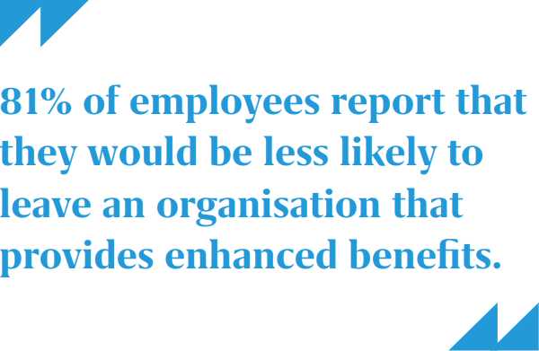
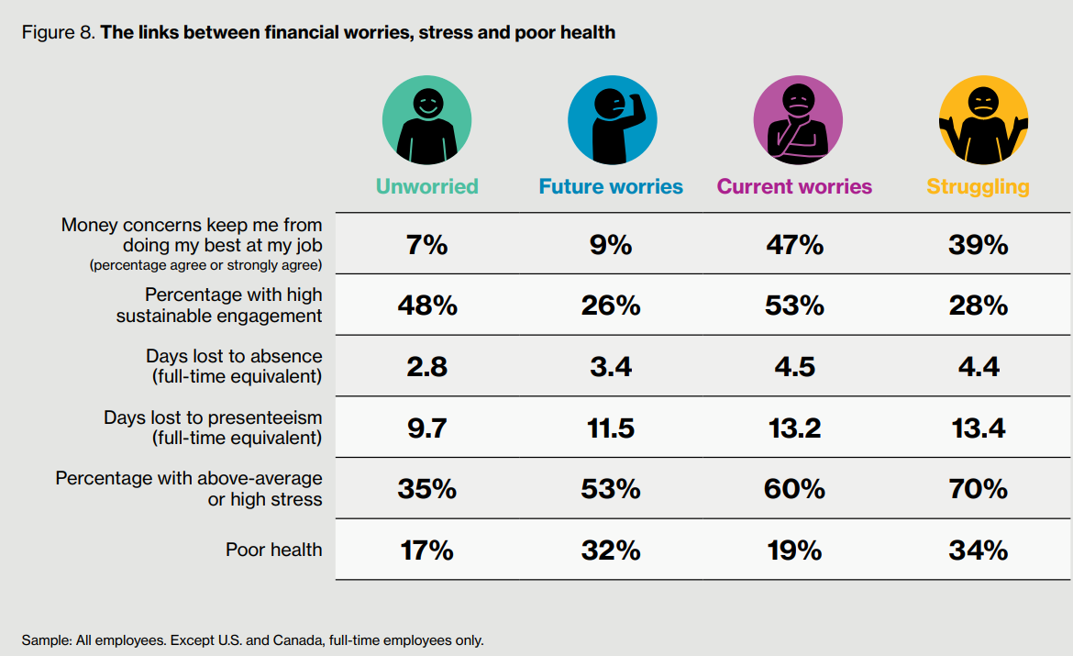
The EoS issues for employers to solve
Funding EoS payments
Getting value out of the EoS Benefit?
Retention
Financial Wellbeing and education
Assuming members are better saving on their own
Where do they start with setting up a plan?
Sources: Willis Towers Watson 2018 Global Benefits Attitudes Survey, United Arab Emirates and Mercer – Rethinking Financial Security and Savings in the UAE report
Notes:
As already mentioned the majority of employers tend to fund their End of Service liability from their cashflow and don’t take the step to fund externally which has knock on effects on their current and future balance sheets.
With employees not understanding the benefit it largely fails in it’s added aim to act as a retention benefit too.
Employers are reluctant to provide Workplace Savings plans for employees which can also be utilised to fund EoS and importantly allow members to contribute voluntarily therefore missing an opportunity to attract and retain key staff. CLICK In a recent Mercer survey it found that 81% of employees would be less likely to leave an organisation if it provided enhanced benefits like Savings and Retirement plans.
CLICK Financial Wellbeing is becoming more and more prominent in the workplace and as this table shows you people who consider themselves to be struggling financially find their money concerns affect their performance at work much more than someone who is unworried with significant impacts on health and presenteeism too.
A large number of employers assume that their employees are better sourcing their own savings plans and those employers that do want to set up a workplace savings plan can struggle to know where to start and how it should look in terms of rules, contribution rates, investment options etc.

Slide 11
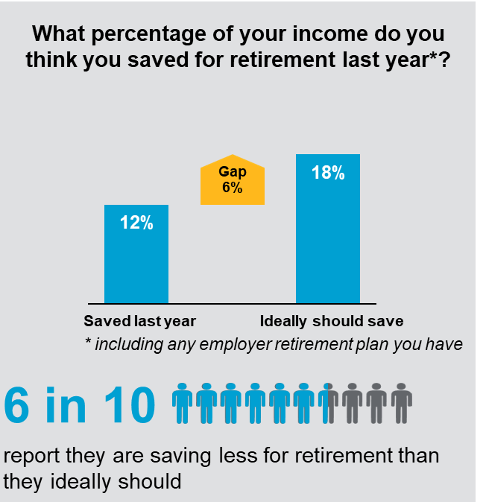
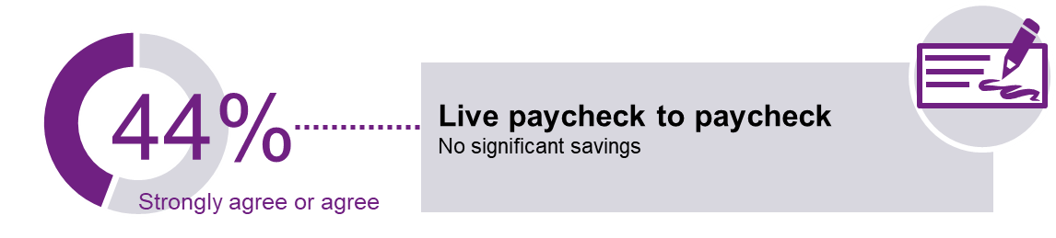
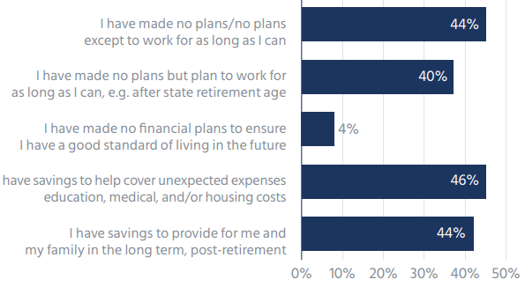
The EoS issues for employees to solve
Understanding their EoS entitlement and what it is worth?
Where do they start?
Who can help, access to initial and ongoing advice. Trust.
Increasing life expectancy
When can they retire?
Lack of flexibility in retail market
Investment decisions?
Sources: Willis Towers Watson 2019 Global Benefits Attitudes Survey, United Arab Emirates and Mercer – Rethinking Financial Security and Savings in the UAE report
Notes:
Employees struggle to know what their EoS entitlement is and how the calculation works.
If they are looking to set up private savings and pension arrangements it can prove difficult with some products in the market being expensive and inflexible mainly driven by high adviser commissions. CLICK 6 in 10 people are saving less for retirement than they consider they should. CLICK With life expectancy increasing it makes the retirement period even more expensive and people are unclear of when they can retire especially when you consider that around 44% of people live paycheck to paycheck.
CLICK And looking at the findings of a Mercer report 44% of respondents have made no long term plans tor retirement other than to work for as long as possible.
For those that do save privately investment decisions can be complex and the cost of advice can be high.

Slide 12
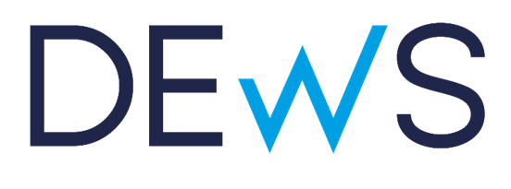

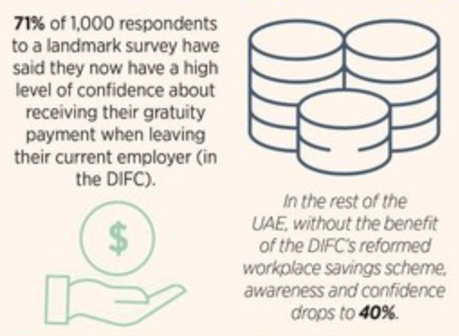
The solution
Where do they start?
Getting value out of the EoS Benefit?
Attracting and retaining people in the region
Who can help, access to initial and ongoing investment advice. Trust.
Financial Wellbeing and education
Financial independence
Understanding the value of the EoS benefit?
When can they retire?
Investment decisions?
Source: Mercer – Rethinking Financial Security and Savings in the UAE report and Insight Discovery Middle East Panorama
Notes:
Around 4 years ago the DIFC set up a working group to look at how the End of Service benefit within the DIFC could be modernized and solve or make improvements to all of the issues that I’ve highlighted. The culmination of this project was the DIFC Employee Workplace Savings Plan better known as DEWS which went live in February 2020 with Mercer acting as the Investment Advisor, Zurich as the administrator and Equiom as the Master trustee. DEWS provides employers and employees access to a modern savings plan that offsets the ongoing End of Service liability on a monthly basis and where voluntary contributions can be included through salary deduction. The process for Employers to join DEWS is easy and the administration is automated, when a member leaves and withdraws their entitlement they liaise with Zurich direct reducing the amount of time and effort for employers. Employees have access to view their contributions and up to date values through the DEWS app, we say that DIFC employees now carry their EoS in their pocket. There are a range of risk rated and Shariah funds available for members to select and tools and guides available to help them understand the benefit and make decisions. A DEWS supervisory Board has oversight of the plan and meets on a quarterly basis to review the administration and investment performance, the board includes an employer and employee representative. CLICK In a recent yougov survey it found that 71% of the people surveyed who were based in the DIFC had a high level of confidence about receiving their EoS payment when they leave employment compared to a figure of just 40% outside of the DIFC which shows the impact that DEWS has had after only one year.

Slide 13

Poll Questions
Does the existing National Pension Scheme / EPF / PPF fulfil EoSB requirements in India?
  Yes
  No
If not, where are the key gaps?
  Education / understanding / uptake
  Scheme architecture
  Providers – service delivery and choice
Would a DEWS like scheme help address any gaps?
  Yes
  No
  Maybe
If so, what areas should a DEWS-like scheme target first?
  Public sector as a new entrant in India
  Private sector as a new entrant in India
  Linking NRI savings in DEWS in UAE with schemes in India post End of Service
www.actuariesindia.org

Slide 14

DEWS funds and investment update
- DEWS Investment Advisor
Claudia Maldonado

Slide 15

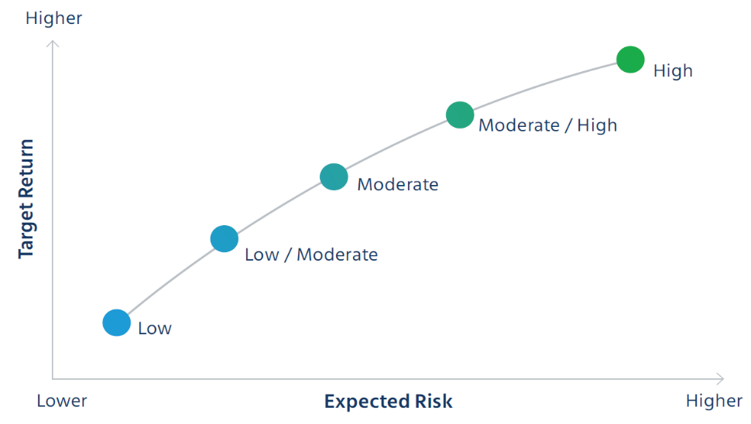
Core range of risk profiled funds
Mercer funds – USD denominated
Focus on growth asset classes (predominantly equities).
Lower / moderate risk multi-asset option.
Default option for the DEWS Plan.
may be more conservative than typical pension plan
  shorter investment horizon – average tenure 9+yrs
  flexibility of access – the full value can be accessed on exit from employment (access not restricted to retirement)
Focus on capital preservation (cash / money market assets).
Copyright © 2021 Mercer Financial Services Middle East Limited. All rights reserved.
Registered With DIFC, License No. CL0939 and Regulated by the DFSA.
www.actuariesindia.org

Slide 16
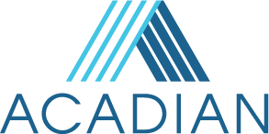




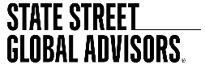
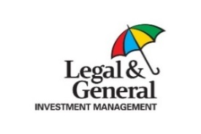
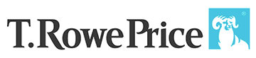


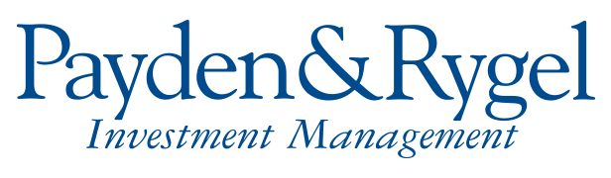
Risk profiled funds
Diversification – asset allocation and asset manager – as at 30 June 2021
Asset Allocation |  | Asset Managers
# of asset managers
1 | 11 | 11 | 7 | 6
Copyright © 2021 Mercer Financial Services Middle East Limited. All rights reserved.
Registered With DIFC, License No. CL0939 and Regulated by the DFSA.
www.actuariesindia.org

Slide 17



Additional investment funds
Sharia compliant options
Money Market (cash) – low growth | Global Sukuk – low/moderate growth | Global Equity – high growth
Copyright © 2021 Mercer Financial Services Middle East Limited. All rights reserved.
Registered With DIFC, License No. CL0939 and Regulated by the DFSA.
www.actuariesindia.org

Slide 18
Interim performance update
As at 30 June 2021
The DEWS Plan is intended as a medium to long term savings vehicle. As such, the performance data shown here is for informational purposes only. In addition, past performance is not a reliable guide to future performance.
Please note that an individual’s performance may differ materially from the performance shown below and will depend on the date when their contributions were invested.
DEWS Strategy | Fund | 1 year | Since Inception | Inception Date
 |  | 30 June 2020 – 30 June 2021 | Since Inception – 30 June 2021
Low Growth¹ | Mercer USD Cash Fund | -1.14% | -1.43% | 23-Mar-20
Low / Moderate Growth (Default)² | Mercer Multi Asset Balanced Growth Fund | 12.31% | 21.87% | 26-Mar-20
Moderate Growth | Mercer Diversified Growth Fund (USD Hedged) | 20.40% | 34.86% | 26-Mar-20
Moderate / High Growth | Mercer Multi Asset Growth Fund (USD Hedged) | 23.68% | 38.19% | 26-Mar-20
High Growth | Mercer Multi Asset High Growth Fund (USD Hedged) | 29.27% | 67.03% | 23-Mar-20
Islamic Money Market¹ | Emirates NBD Islamic Money Market Fund | -0.28% | -0.15% | 02-Apr-20
Islamic Equity | HSBC Islamic Global Equity Index Fund* |  | 5.11% | 08-Apr-21
Global Sukuk | Franklin Templeton Global Sukuk Fund |  | -0.50% | 27-Apr-21
Source: Indicative performance based on unit prices from State Street, the asset managers and Mercer calculations.
* | 30 June 2021 represents the last day for which prices were available at the time of production of this report.
1. | In the current low interest rate environment, performance for the Low Growth fund has been negative net of fees.
2. | The Low / Moderate Growth Fund is the default investment option for the Plan and is where your money will be invested unless you make an active decision to switch to one of the other available fund options.
Copyright © 2021 Mercer Financial Services Middle East Limited. All rights reserved.
Registered With DIFC, License No. CL0939 and Regulated by the DFSA.
www.actuariesindia.org

Slide 19
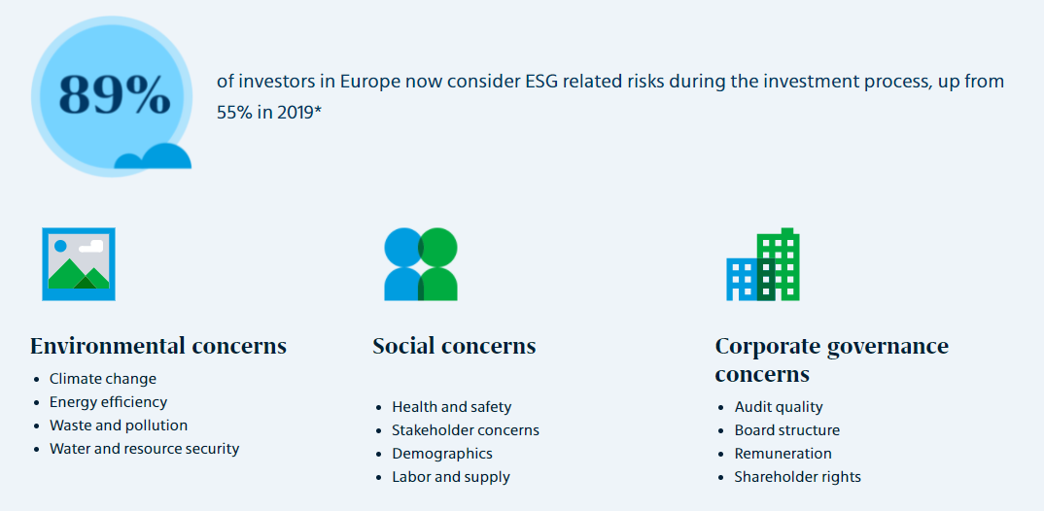
Mercer’s commitment to net-zero absolute carbon emissions
* Source: Mercer, European asset allocation insights 2020
Copyright © 2021 Mercer Financial Services Middle East Limited. All rights reserved.
Registered With DIFC, License No. CL0939 and Regulated by the DFSA.
www.actuariesindia.org
Notes:
Investors are increasingly considering climate change along with issues related to environmental, social and corporate governance (ESG) and diversity, equity and inclusion (DE&I). Motivated by the economic and social interest of their beneficiaries and clients, investors now have the opportunity to use their portfolios and their influence to help guide us towards a low-carbon economy. There is more to this than just simply excluding companies from certain industry sectors. In terms of climate change and the transition to a low-carbon economy for example, we believe it’s important to consider which companies are adapting to this change and those that are not.
Mercer has committed to a target of net-zero absolute carbon emissions by 2050 for its clients domiciled in Ireland
To achieve this, Mercer plans to reduce portfolio relative carbon emissions by at least 45% from 2019 baseline levels by 2030. While the funds continue to maintain an investment objective of seeking income and long-term growth of capital, they also promote environmental characteristics though progressive decarbonisation with a view to achieving net zero emissions by 2050.
This builds upon Mercer’s well-established climate change investment beliefs and scenario analysis work that began in 2014.
This target is supported by a Climate Transition Plan, under which we will work closely with our appointed investment managers towards staged emissions reduction, accompanied by increased portfolio allocations to climate solutions, and stewardship to build transition capacity across sectors, asset classes and funds.

Slide 20
Important notices
References to Mercer shall be construed to include Mercer Financial Services Middle East Limited or any of its affiliates
© 2021 Mercer. All rights reserved.
This contains confidential and proprietary information of Mercer and is intended for the exclusive use of the parties to whom it was provided by Mercer. Its content may not be modified, sold or otherwise provided, in whole or in part, to any other person or entity, without Mercer’s written permission. The findings, ratings and/or opinions expressed herein are the intellectual property of Mercer and are subject to change without notice. They are not intended to convey any guarantees as to the future performance of the investment products, asset classes or capital markets discussed. The value of investments may fall as well as rise and the amount returned may be less than the amount invested. Income from investments may also fluctuate in value. Where charges are deducted from capital, the capital may be eroded or future growth constrained. Changes in investment strategy are likely to incur transaction costs. The value of investments in a foreign currency will vary as a result of changes in currency exchange rates. Past performance does not guarantee future results.
The information contained herein may not adequately take into account the recipient’s particular investment objectives, financial situations, or needs. Prospective investors should consult their legal, tax and financial advisers as to the consequences of an investment. Any manager mix and portfolio structure which may be provided herein are for illustrative purposes only and subject to change. The inclusion of any investment herein does not represent a recommendation of that investment. All investments experience gain or loss. An investor may lose all or a substantial part of its investment in any private investment vehicle. There can be no assurance that the investment objectives of any fund managed by Mercer will be achieved.
This does not contain investment advice or constitute individualized investment advice relating to your particular circumstances. No investment decision should be made based on this information without first obtaining appropriate professional advice and considering your circumstances. While the information is believed to be reliable, Mercer has not sought to verify it. As such, Mercer makes no representations or warranties as to the accuracy of the information presented and takes no responsibility or liability (including for indirect, consequential or incidental damages), for any error, omission or inaccuracy in the data supplied by any third party.
This does not constitute an offer or a solicitation of an offer to buy or sell securities, commodities and/or any other financial instruments or products or constitute a solicitation on behalf of any of the investment managers, their affiliates, products or strategies the information of which may be contained herein. Such an offer may be made only by delivery of separate confidential offering documents to accredited investors, professional investors or other qualified institutional investors pursuant to the applicable private placement provisions in each jurisdiction. The contents and information contained herein have not been endorsed nor is it intended that they will be endorsed by any regulatory authorities.
This marketing material is distributed by Mercer Financial Services Middle East Limited (‘MFSMEL’), which is regulated by the DFSA. The financial products or services to which this material relates will only be made available to Professional Clients or Market Counterparties, as defined by the DFSA, and no other Person should act upon it. For Mercer’s conflict of interest disclosures, contact your Mercer representative or see www.mercer.com/conflictsofinterest
Registered with DIFC, License No. 0939 and Regulated by the DFSA
www.actuariesindia.org

Slide 21

One year since launch
- DEWS Plan Administrator
Sajeev Nair

Slide 22

AUA
$ 182 million
Notable trends
Launch of DEWS has led to increased awareness of EoSG and increased confidence of payment.
Trust in plan and performance grows - more companies transferring accrued gratuity.
Uptick in member engagement with over 77% of the members having logged into the member portal
Voluntary contributions increasing with companies putting in place the requisite processes.
Only 33% of members have registered beneficiaries.
New employers in DIFC. In 2021, we have seen a net increase in membership.
1251 employers
21,236 members registered
1,903 withdrawals
$10 mn paid out
Note: all numbers as at end of June 2021

Slide 23
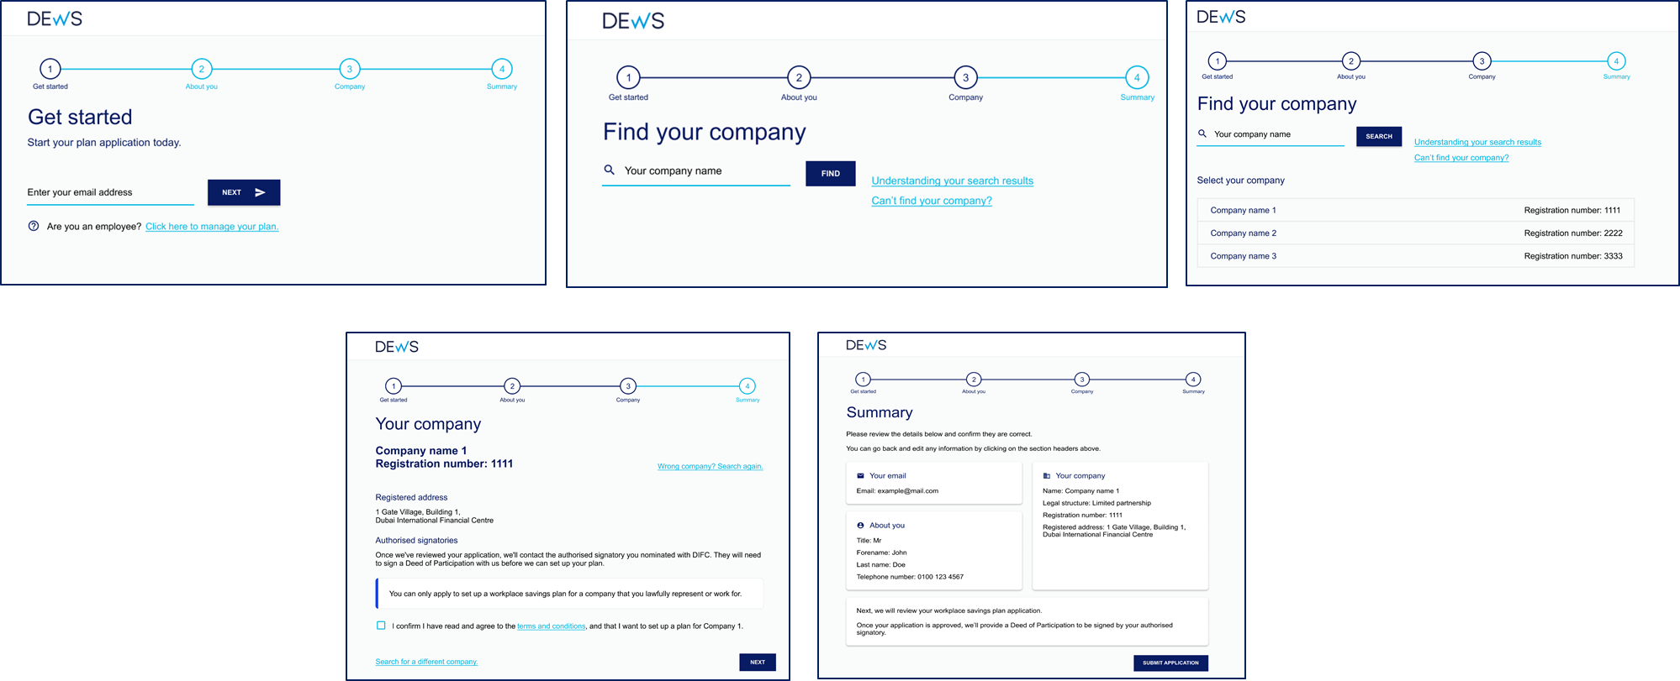
Successful launch and smooth enrolment of DIFC companies
DEWS Plan successfully launched during the lockdown period, with 1,100 companies being able to enroll themselves and their employees through a fully online process.
On the very first day of the launch, 101 companies enrolled into the plan.
Over 90% positive rating on survey conducted with Employers services
15-member team seamlessly transitioned to work-from-home from 10th March.
210 companies and 7166 members enrolled into the plan in the last 10 days leading up to the deadline.

Slide 24
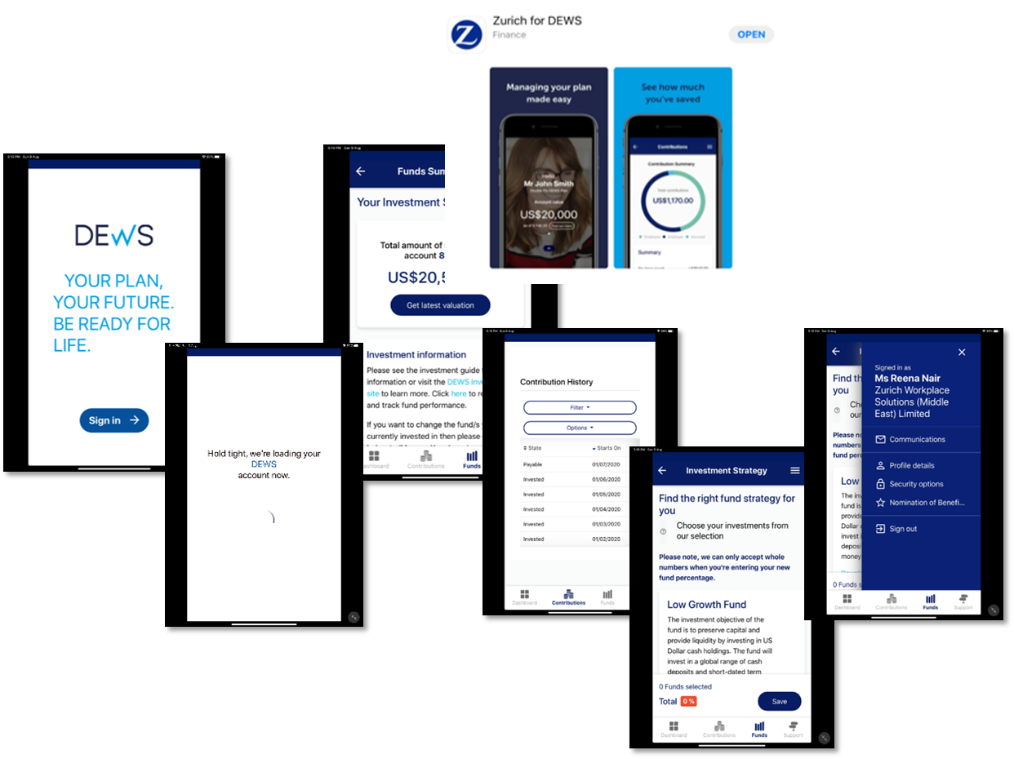

Fully functional member app
“Zurich for DEWS”
Biometric login
Ability to view valuations
Manage investments – Switch holdings
Nominate beneficiaries
Update personal details
Link to the website, fund information, FAQ and DEWS Portal
Launched - May 2021
Available on App Store & Google Playstore

Slide 25
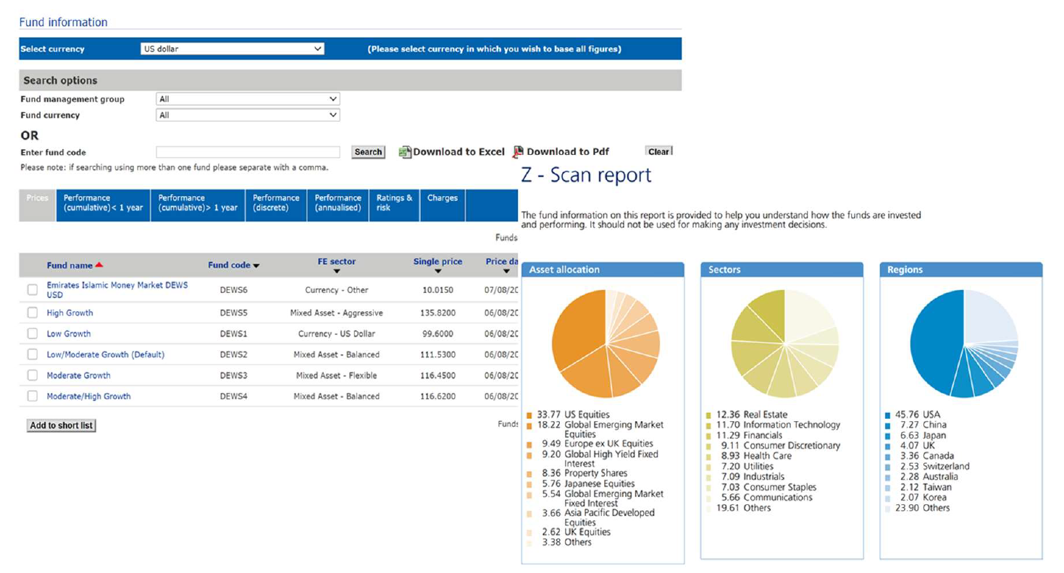
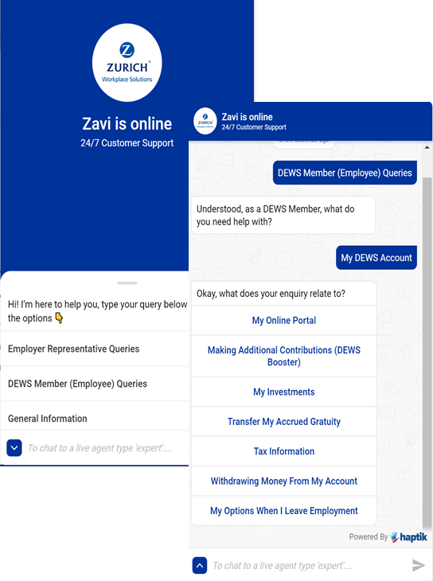
Zurich Fund Centre
A tool provided in collaboration with Financial Express which gives the members the ability to track fund prices, performance etc.
Zavi – The chatbot (Intelligent Virtual Assistant)
Assisting employers and members.
24x7, 365 day support
Ability to address over 90 query types across various transactions.

Slide 26
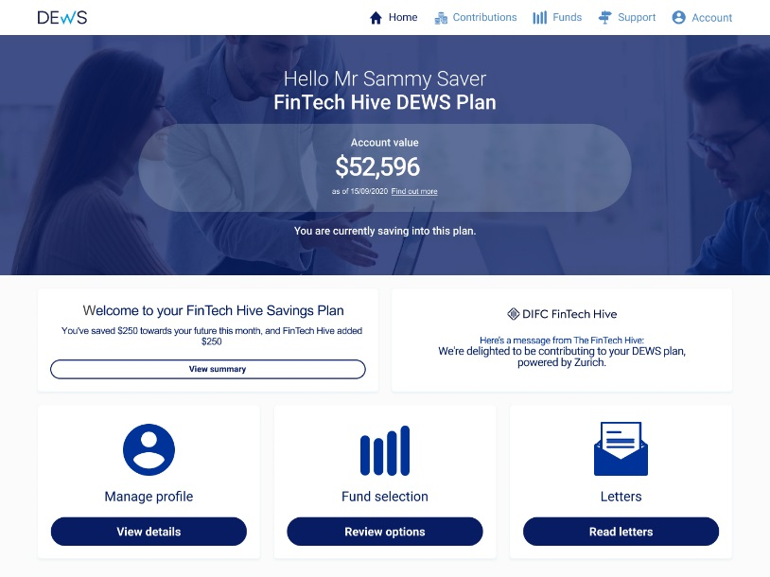
Enhancements to member portal
Capture & Edit of Tax information
Simplification of switching screens
Addition of new funds, and full automation of Sharia switches
Annual & Exit statements (customized to DFSA regulations)
Education & Awareness campaigns
Reminders for Tax information
Importance of beneficiary nomination
DEWS Anniversary campaign
Educate on Voluntary Contributions
Awareness/Education on the Accrued Transfer feature

Slide 27

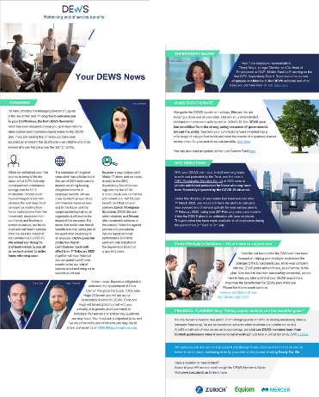
Contribution reminders
Complying with DFSA regulations
Upcoming deadline reminders
5, 30 and 60 day missed / delayed payment reminders to employers
60 day non-payment notification to members
DEWS NEWS
Quarterly newsletter for members
Latest updates on DEWS
Investment Performance and outlook
Messages from Supervisory Board members
Tricks and Tips, Upcoming changes

Slide 28
Poll Questions
How do you view a DEWS-like scheme in the Indian context?
  Execution, change management, fund range and implementation expertise is differentiated and can be deployed in the Indian context
Regulatory regime and uptake could be a challenge
  Mature space with limited opportunities for new entrants
How likely are you to recommend the DEWS scheme in its current construct to your clients / customers or government bodies?
(rate on a scale of 1 to 5, 5 being the highest)
  1 – Not likely
  2 – Somewhat likely
  3 - Likely
  4 – Very likely
  5 – Definitely
www.actuariesindia.org

Slide 29
Thank you
www.actuariesindia.org

Slide 30

Q&A
www.actuariesindia.org

Slide 31
Thank you!
CPD Question
www.actuariesindia.org

