Slide 1





Organizer
19th Global
Conference of Actuaries
30th – 31st January, 2018 | Mumbai, India
Georgio Mosis, PhD MBA
Head of Innovation Management

Slide 2


19th Global
Conference of Actuaries
30th – 31st January, 2018 | Mumbai, India
InsurTech:
Digital Transformation of the Insurance experience
January 2018, Mumbai
A journey through the innovations at the intersection of Health & Wellbeing, Insurance and Technology. This presentation will deal with 3 areas of the emerging transformations
marketing innovation, i.e. transformations in the way we buy and sell insurance products and solution
Product innovation, new propositions that integrated technology as part of the proposition
Process Innovation, focusing on taking frictions out of the process

Slide 3

CONTENT
19th Global
Conference of Actuaries
30th – 31st January, 2018 | Mumbai, India
Innovation – a look into RGAx: Why, How and What
Digital transformation of Insurance experience
  Marketing Innovation
  Product Innovation
  Process Innovation
The road ahead

Slide 4
RGAx: RGA’s Innovation Accelerator
19th Global
Conference of Actuaries
30th – 31st January, 2018 | Mumbai, India
Significantly Expands Innovation Capabilities, and Potential

Slide 5
CONTENT
19th Global
Conference of Actuaries
30th – 31st January, 2018 | Mumbai, India
Innovation – a look into RGAx: Why, How and What
Digital transformation of Insurance experience
  Marketing Innovation
  Product Innovation
  Process Innovation
The road ahead

Slide 6
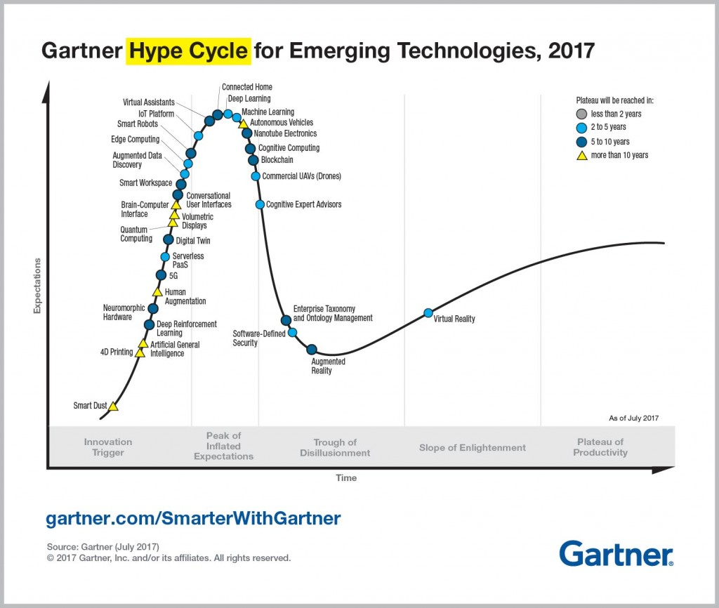
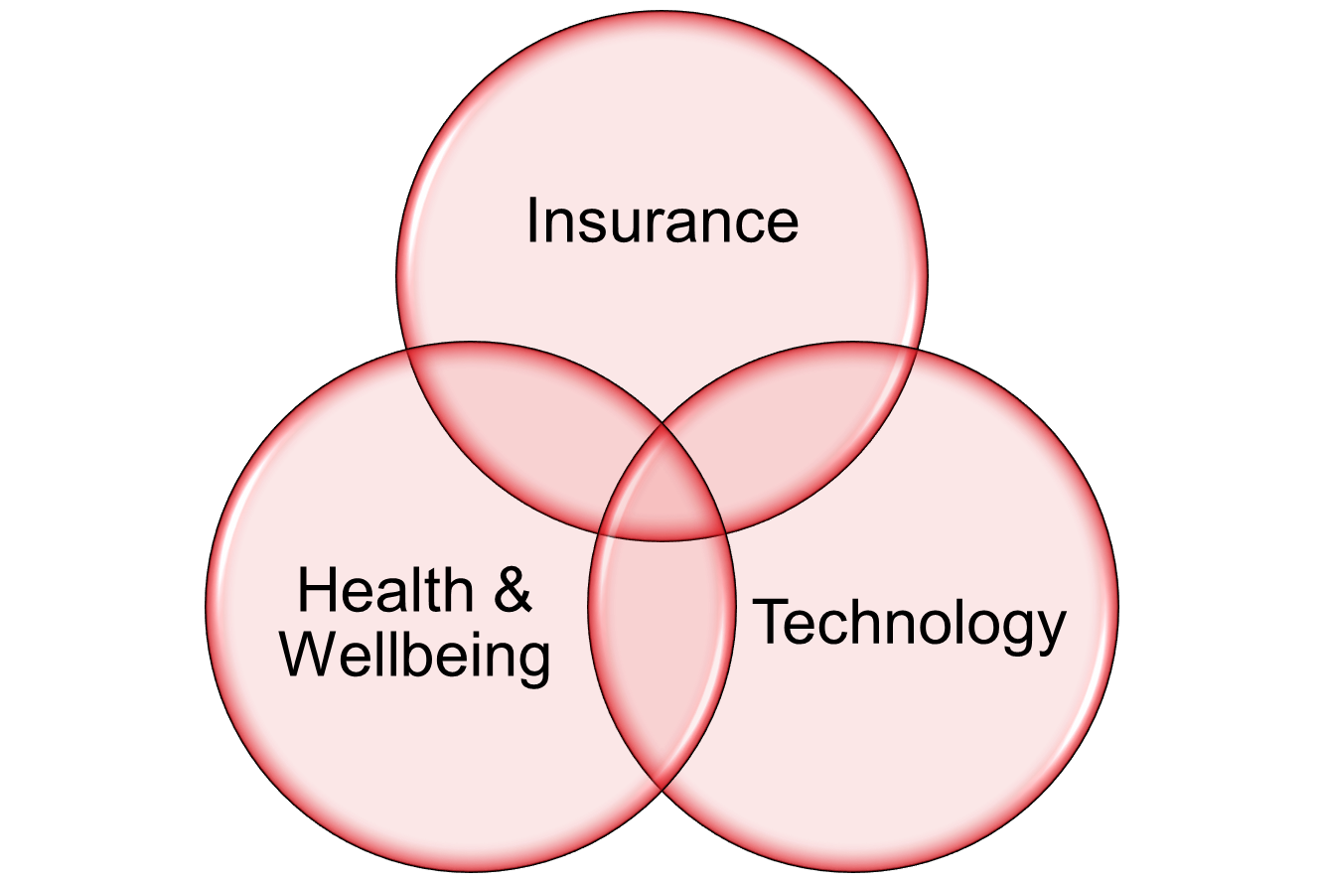
InsurTech
Scope: Life and Health
19th Global
Conference of Actuaries
30th – 31st January, 2018 | Mumbai, India
At the intersection of Health, Insurance and Tech
Exploring avenues that incumbents have less incentive to explore and exploit
Maturation of technology innovations enabling new insurance business models

Slide 7

MARKETING INNOVATION

Slide 8
InsurTech
Marketing Innovation
19th Global
Conference of Actuaries
30th – 31st January, 2018 | Mumbai, India
Transforming the way we sell and buy insurance
Context
Markets
Customer
Targeting
Collaborators
Company’s Competence
Positioning
Competition
Segmentation
Exploring avenues that incumbents have less incentive to explore and exploit
Maturation of technology innovations enabling new insurance business models
Refined U/W solution
D-U/W and “live”-U/W
Inclusion (Impairments
Micro-targeting
Cross/ upselling
O2O platform
Holistic Solution
O2O platform
Products, D-Price, Promotion, Place

Slide 9
InsurTech
19th Global
Conference of Actuaries
30th – 31st January, 2018 | Mumbai, India
Marketing Innovation
Every aspect of the insurance value chain is being disrupted
Exploring avenues that incumbents have less incentive to explore and exploit
Maturation of technology innovations enabling new insurance business models

Slide 10
CONTENT
19th Global
Conference of Actuaries
30th – 31st January, 2018 | Mumbai, India
Innovation – a look into RGAx: Why, How and What
Digital transformation of Insurance experience
  Marketing Innovation
  Product Innovation
  Process Innovation
The road ahead

Slide 11

PRODUCT INNOVATION

Slide 12



InsurTech
19th Global
Conference of Actuaries
30th – 31st January, 2018 | Mumbai, India
Product Innovation
Enabling novel insurance experience
Insurance product
Technology enabling
Services
Data and Analytics Platform supporting technology enabled services
Exploring avenues that incumbents have less incentive to explore and exploit
Maturation of technology innovations enabling new insurance business models

Slide 13

InsurTech
19th Global
Conference of Actuaries
30th – 31st January, 2018 | Mumbai, India
Product Innovation
Enabling novel insurance experience
Collecting lifestyle data
Exploring avenues that incumbents have less incentive to explore and exploit
Maturation of technology innovations enabling new insurance business models
…IoT in our day-to-day lives….

Slide 14

InsurTech
19th Global
Conference of Actuaries
30th – 31st January, 2018 | Mumbai, India
Product Innovation
Enabling novel insurance experience

Slide 15


InsurTech
19th Global
Conference of Actuaries
30th – 31st January, 2018 | Mumbai, India
Product Innovation
Enabling novel insurance experience

Slide 16


InsurTech
19th Global
Conference of Actuaries
30th – 31st January, 2018 | Mumbai, India
Product Innovation
Enabling novel insurance experience

Slide 17
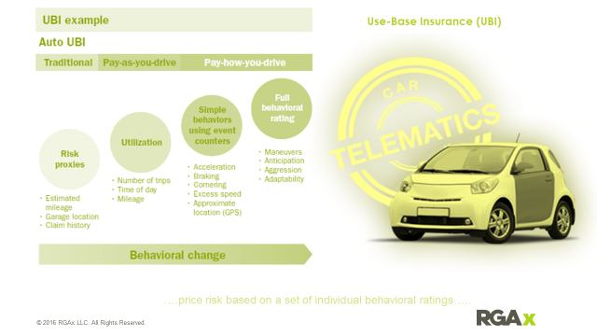

InsurTech
19th Global
Conference of Actuaries
30th – 31st January, 2018 | Mumbai, India
Product Innovation
Enabling novel insurance experience

Slide 18
CONTENT
19th Global
Conference of Actuaries
30th – 31st January, 2018 | Mumbai, India
Innovation – a look into RGAx: Why, How and What
Digital transformation of Insurance experience
  Marketing Innovation
  Product Innovation
  Process Innovation
The road ahead

Slide 19


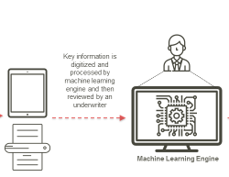
InsurTech
19th Global
Conference of Actuaries
30th – 31st January, 2018 | Mumbai, India
Process Innovation
Application of AI and Machine Learning to remove frictions
Sense.ly
Shift Technology
OmniScience

Slide 20

THE ROAD AHEAD

Slide 21

InsurTech
19th Global
Conference of Actuaries
30th – 31st January, 2018 | Mumbai, India
The Road Ahead
Key trends that will revolutionize Insurance
Data and Analytics
Machine Learning and AI
Blockchain

Slide 22





RGAx guides our partners through the entire joint venture journey, from Lightbulb to Launch.
19th Global
Conference of Actuaries
30th – 31st January, 2018 | Mumbai, India
Our process
IDENTIFY
TEST
COMMERCIALIZE
SCALE
Idea / Concept is the beginning of our Innovation Pipeline funnel.
Ideation takes place in highly structured, methodical design-sprint format with high intensity and output.
Ideas are documented into formal Problem Statements vetted based on viability and scalability
The output is a POC supported by quantitative and qualitative data, In-depth interviews, lo-fi wireframes etc.
      Once the POC is identified an audit aligns existing partner capabilities and maps them to the customer journey
Concept Validation quickly stress tests the business model assumptions around (1) sustainability (2) desirability (3) feasibility
RGAx then shares in the long-term risk of commercializing the product by enabling deep industry knowledge, proprietary tools, solutions, and a global distribution network with out channel conflict
Business is in scaling mode.
With dedicated resources, support functions, and separate P&L
Innovation as a Service | Proprietary & Confidential

Slide 23
Organizer
19th Global
Conference of Actuaries
30th – 31st January, 2018 | Mumbai, India
Thank You
Contact details

