Slide 1
Organizer
19th Global
Conference of Actuaries
30th – 31st January, 2018 | Mumbai, India
Mr. Tan Suee Chieh
IFoA’s Council Member

Slide 2
19th Global
Conference of Actuaries
30th – 31st January, 2018 | Mumbai, India
Leading in the Vortex of Change
30 January 2018
215-300 pm
The vortex of digital transformation will disrupt all professions. The actuarial profession needs to adopt new mindsets to be an agent of change to secure our future.

Slide 3
19th Global
Conference of Actuaries
30th – 31st January, 2018 | Mumbai, India
Leading in the VORTEX of Change

Slide 4
19th Global
Conference of Actuaries
30th – 31st January, 2018 | Mumbai, India
Key Points
We are at a vortex of digital transformation – risk of technological unemployment is real
It is better to be an agent of change instead of being a recipient of change
We can be resourceful and pivot our attention and resources to acquire new mindset and competencies. The actuarial profession, and we as individual actuaries, can do something different to survive and thrive in this vortex

Slide 5
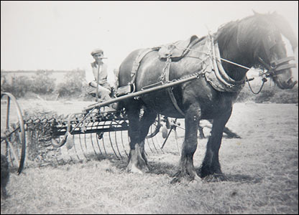
We are in a Vortex of Change;
We need to think about Consequences and Opportunities
19th Global
Conference of Actuaries
30th – 31st January, 2018 | Mumbai, India
Industrial Economy
Digital Economy
How do we play more decisive roles with the
changes brought on by the Digital Economy?

Slide 6
History – Our complacency can be frightening
19th Global
Conference of Actuaries
30th – 31st January, 2018 | Mumbai, India
Are our skill sets still relevant, exclusive, or even practical given the vortex affecting all industries?

Slide 7
What is Digital Transformation?
19th Global
Conference of Actuaries
30th – 31st January, 2018 | Mumbai, India
The convergence of multiple technology innovations
enabled by connectivity

Slide 8
19th Global
Conference of Actuaries
30th – 31st January, 2018 | Mumbai, India
Digitalisation of an Insurance Business
The automation of actuarial and operational work and finance
Digital Distribution and E-commerce
Use of data-analytics and unstructured data
Changing risk types
Revolution in health insurance
Use of block chain on know your customer

Slide 9
VORTEX of Change – Disruption can come from ANYWHERE and impact ALL industries
19th Global
Conference of Actuaries
30th – 31st January, 2018 | Mumbai, India

Slide 10
Amazon started by selling books online and now have built an ecosystem spanning other industries
19th Global
Conference of Actuaries
30th – 31st January, 2018 | Mumbai, India

Slide 11
Changes in Assumptions: Competitive Strategies
19th Global
Conference of Actuaries
30th – 31st January, 2018 | Mumbai, India
Analog
Digital
Competition within defined industries
Clear distinctions between partners and rivals
Competition is a zero-sum game
Key assets are held inside the firm
Products with unique features and benefits
A few dominant competitors per category
Competition across fluid industries
Blurred distinctions between partners and rivals
Competitors cooperate in key areas
Key assets reside in outside networks
Platforms with partners who exchange value
Winner-takes-all due to network effects

Slide 12
19th Global
Conference of Actuaries
30th – 31st January, 2018 | Mumbai, India
The Future of our Profession
Information sub-structure – oral, script, print and technology-based Internet society
Developments – exponential growth in technology, increasingly capable machines, increasingly pervasive devices and increasingly connected humans
Technological Unemployment
New Competencies – Different Ways of Communicating, Data mastery, Relationships with technology and Multi-disciplinary approach

Slide 13
19th Global
Conference of Actuaries
30th – 31st January, 2018 | Mumbai, India
Emerging Skills and Competencies
Different Ways of communicating
Mastery of Data
New Relationship with Technology
Diversification
Flexibility and Adaptability

Slide 14
19th Global
Conference of Actuaries
30th – 31st January, 2018 | Mumbai, India
Resources #1 – Carol Dweck

Slide 15
19th Global
Conference of Actuaries
30th – 31st January, 2018 | Mumbai, India
Our Strengths
A Quick Search on Google shows…
Specialised math knowledge (e.g. calculus, statistics, probability)
Keen analytical, project management, and problem-solving skills
Good business sense (e.g. finance, accounting, economics)
Solid communication skills (oral and written)
Strong computer skills (e.g. formulating spread sheets, statistical analysis programs)

Slide 16
The Job to be Done
19th Global
Conference of Actuaries
30th – 31st January, 2018 | Mumbai, India
Incorporate data science
Communications and Machines
New and Adjacent Domains
Dealing with change for the professions
Get to the right starting point - reading list and social media
Technical and business courses
Get involved in the digital business
Mindset is the most important

Slide 17
19th Global
Conference of Actuaries
30th – 31st January, 2018 | Mumbai, India
The New Society – Future of Work in 2050

Slide 18
19th Global
Conference of Actuaries
30th – 31st January, 2018 | Mumbai, India
Questions and Comments

Slide 19
To update contact details
Organizer
19th Global
Conference of Actuaries
30th – 31st January, 2018 | Mumbai, India
Thank You
Linked-in/ Tan Suee Chieh sueechiehbsn@gmail.com

Slide 20
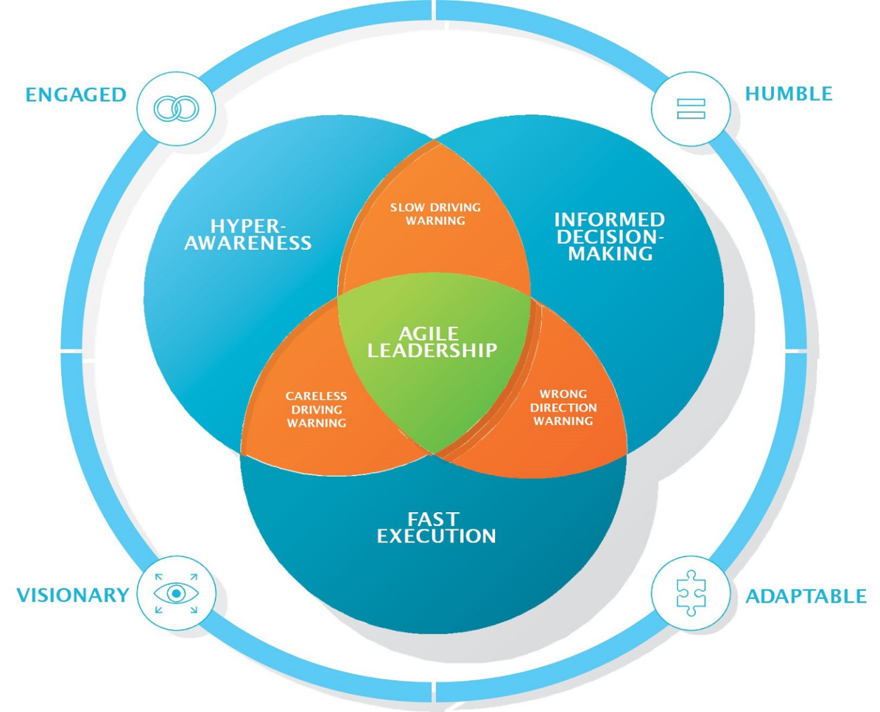
19th Global
Conference of Actuaries
30th – 31st January, 2018 | Mumbai, India
Leadership in an Age of Digital Disruption
I am always in listening mode
I accept that others know more than me
A clear vision is more important than a detailed plan
Changing my mind is a strength, not a weakness

