Slide 1




Organizer
19th Global
Conference of Actuaries
30th – 31st January, 2018 | Mumbai, India
Mr. Brad Lipic
VP, Head of Data Strategy
Global Research and Data Analytics

Slide 2




19th Global
Conference of Actuaries
30th – 31st January, 2018 | Mumbai, India
Data-Driven Decision Frontiers:
C2: Credit-Based Behavioural Index
A New Data Solution for Life Insurance Companies:
TrueRisk® Life
Institute of Actuaries of India
30 January 2018 at 14:15-15:00

Slide 3

Session Objectives
19th Global
Conference of Actuaries
30th – 31st January, 2018 | Mumbai, India
Share a new data solution, TrueRisk® Life, arriving in the India market
Demonstrate the value of TrueRisk® Life
Illustrate how Life insurance companies can create value by using TrueRisk® Life

Slide 4




TrueRisk® Life Introduction
A new source for improved risk selection, segmentation and efficient underwriting
19th Global
Conference of Actuaries
30th – 31st January, 2018 | Mumbai, India
RGA and TransUnion CIBIL Partnership:
  Purpose: Create and validate a credit behavior index that is highly predictive of mortality (and other insurance outcomes)
Cross/Up
Sell
Simply Underwriting
Risk Segmentation
In-Force Policy Management
Claims Repudiation Management
Key Applications:
Global Use:
Built using 6MM public death records and validated on insured lives
12+ life insurance companies are actively using the TRL score
Built using 87k public death records and further validated on insured death claims.
Two life insurance companies are engaged in Pilot programs
Initial score validated using insured death claims
Pilot programs are being designed for life insurance companies
Initial score built upon analyzing ~30k insured death claims

Slide 5
19th Global
Conference of Actuaries
30th – 31st January, 2018 | Mumbai, India
TrueRisk® Life Data Components

Slide 6
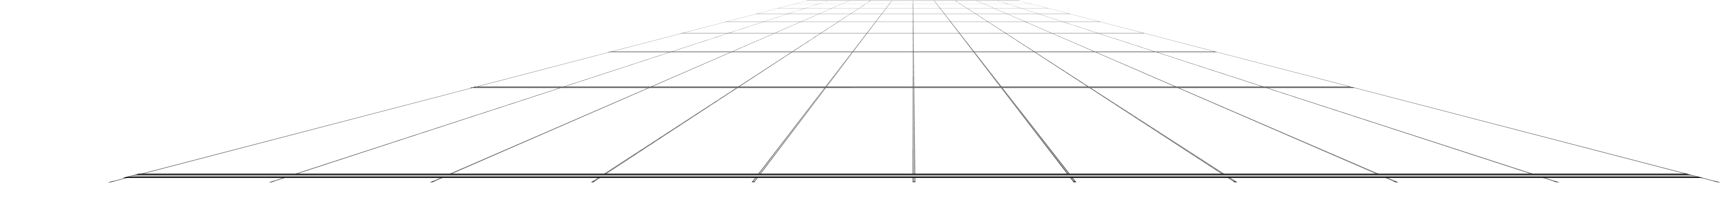
TrueRisk® Life is Presented as a Score from 1-100
19th Global
Conference of Actuaries
30th – 31st January, 2018 | Mumbai, India
Higher
Numbers
Higher Risk
Lower
Numbers
Lower
Risk

Slide 7


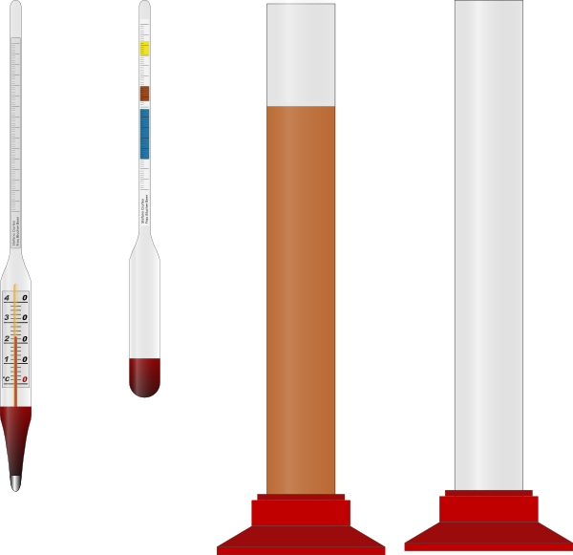
Big Data Universe
Filtered to Get the Most Important Attributes
19th Global
Conference of Actuaries
30th – 31st January, 2018 | Mumbai, India
Credit data
Data not used in the model
Marketing
  Shopper (credit card transactions)
  Social media
  Household information
  Checking/savings
  IRS data
  Income, race, ethnicity
Public Records
  Criminal
  Derogatory records
  Court filings
Titles and Licenses
  Property ownership
  Professional licenses
800 credit attributes that quantify risk associated with access to credit.
25-30 key credit attributes that quantify behavioral risks associated with credit

Slide 8
India Credit Data
19th Global
Conference of Actuaries
30th – 31st January, 2018 | Mumbai, India
Credit Bureau Data is of High Quality
TU CIBIL input data are trusted and utilized for predicting delinquency rates by the largest credit institutions in the country
TU CIBIL holds ~95% of the enquiry market
Credit Information captured is orthogonal to the demographic attributes captured on Insurance applications
Every month around 1.2mm people visit the TU CIBIL website to correct any incorrect data captured

Slide 9
India Match Rates
Insurance applicants generally have credit data available
19th Global
Conference of Actuaries
30th – 31st January, 2018 | Mumbai, India
For the years 2011-2016, the match rates averaged around 45%
Final TRL scores are not available for everyone due to:
  People queried not found on the bureau
  People found do not have enough credit attributes to calculate the TRL score
However, the match rate is increasing over time, and is significantly better for channels such as Banca
Recent (2016 / 2017) match rates have averaged around 80% with TRL scores being calculated for the majority of the population

Slide 10
19th Global
Conference of Actuaries
30th – 31st January, 2018 | Mumbai, India
How it started:
TRL Model Creation and Validation Studies in the U.S.

Slide 11
TrueRisk® Life Model Development in the U.S.
19th Global
Conference of Actuaries
30th – 31st January, 2018 | Mumbai, India
Starting Data
Variable Selection
Model
Process
External Validation
of Model
TRL
Score
Built the model on 44 million lives and >3 million deaths
Started with >800 variables offering features of individual‘s credit history
Selected variables that were:
Most predictive of the outcome
Stable over time
Non-gameable
Not too correlated with the other variables
Binary Logistic Regression
Model validated internally using an additional 30 million lives and 2 million deaths
Age, Gender and Region used as control variables
Tested model using traditional mortality and lapse studies
Used a random holdout dataset of another 18 million lives and 1 million deaths
TrueRisk® Life score from 1-100:
1
to
100
Low Risk
High Risk
Data comes from de-personalized 1998 credit archive (90% of the U.S. population)
Model calibrated to actual deaths occurring over a 12-year period
TransUnion and RGA built and tested TrueRisk® Life on 92 million individuals

Slide 12
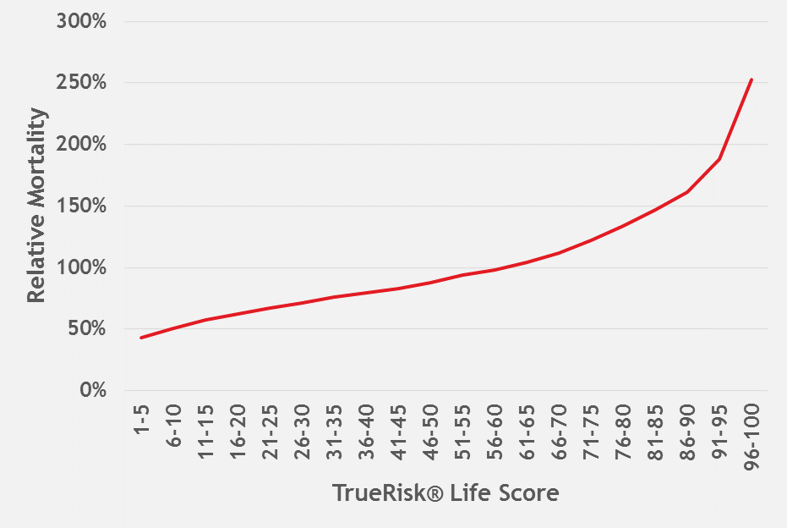
U.S. Population Study
Model Validation
19th Global
Conference of Actuaries
30th – 31st January, 2018 | Mumbai, India
Overall Mortality
Details
Mortality study performed on holdout sample of 18 million lives using a 1998 TransUnion archive and studying the lives during 1999-2010
Score buckets are set to be uniform across the population
Study shows 5 times segmentation (96-100 compared to 1-5)
Social Security Master Death File used as source of deaths; used population mortality tables

Slide 13
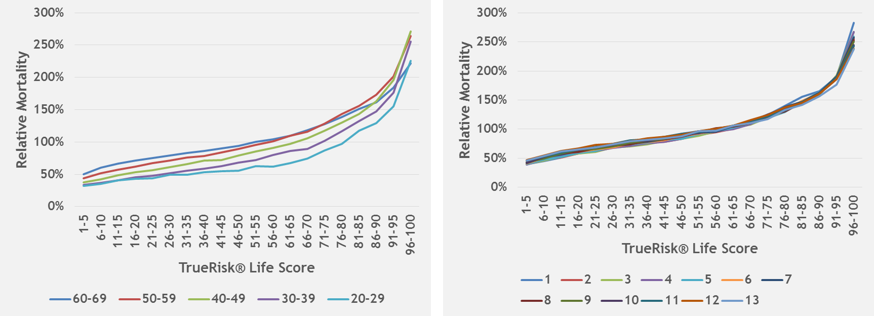
U.S. Population Study
Model Validation by Splits
19th Global
Conference of Actuaries
30th – 31st January, 2018 | Mumbai, India
Mortality by Age Group
Mortality by Duration

Slide 14
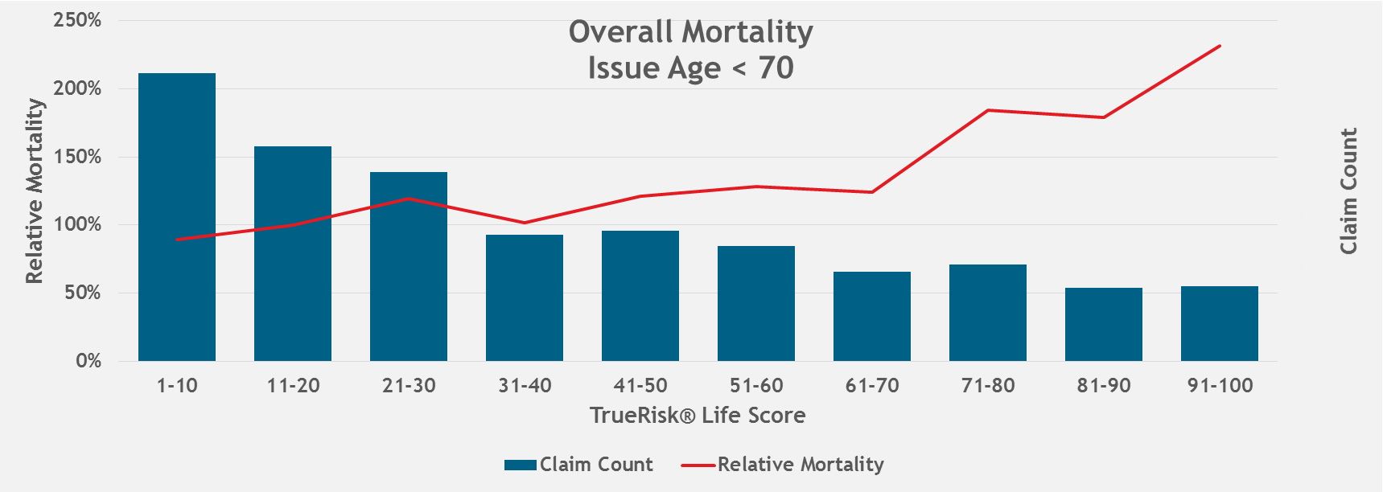
U.S. Insured Lives Study
Model Validation on Fully Underwritten
19th Global
Conference of Actuaries
30th – 31st January, 2018 | Mumbai, India
Mortality of the 91-100 group is 2.6 times higher than the 1-10 group

Slide 15
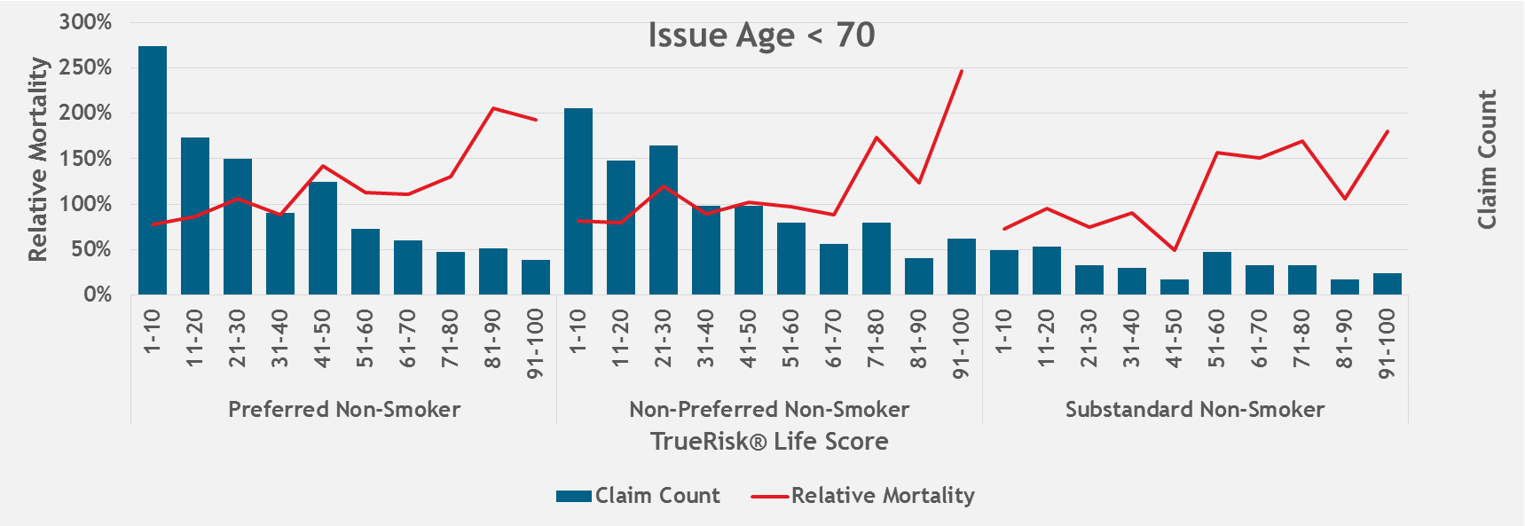
U.S. Insured Lives Study
Model Validation on Fully Underwritten (Cont.)
19th Global
Conference of Actuaries
30th – 31st January, 2018 | Mumbai, India
Segmentation exists within risk classes
Mortality for worst TRL scores (71-100) are about double that of best risks (1-10)
Non-smokers are shown, but results are similar for smokers
Mortality by Underwriting Class

Slide 16
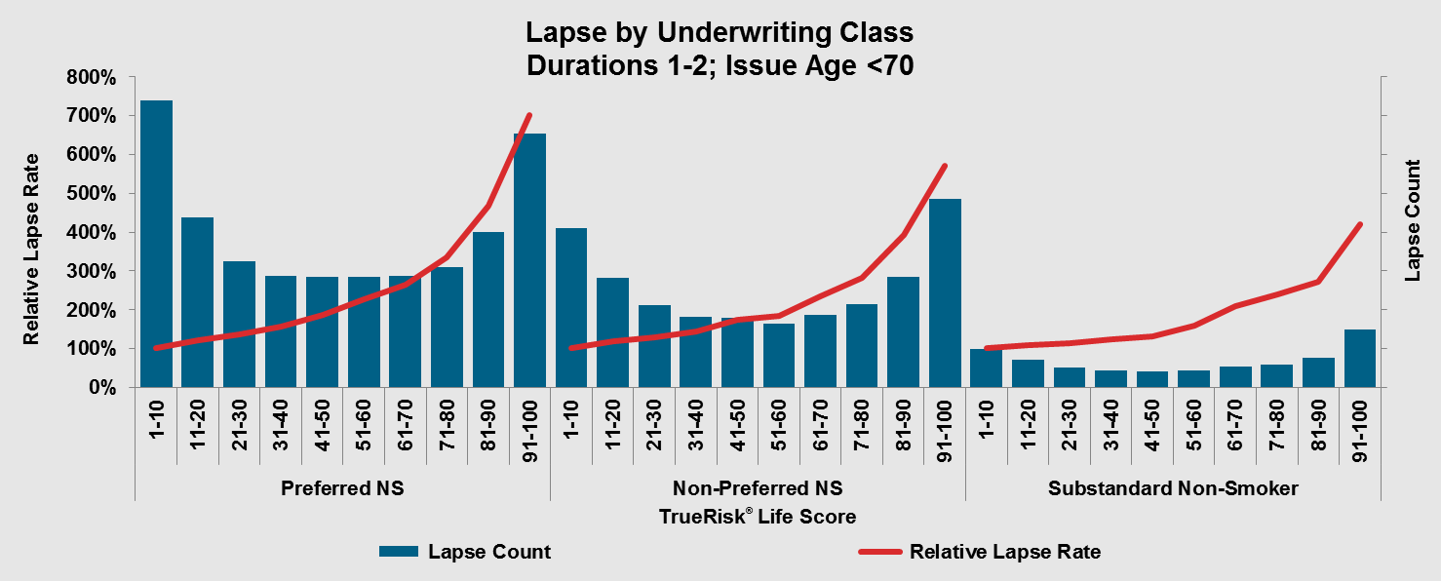
U.S. Insured Lives Study
Lapse by Underwriting Class
19th Global
Conference of Actuaries
30th – 31st January, 2018 | Mumbai, India
Segmentation of about 6 times seen in first two durations within a given risk class
Non-smokers are shown, but results are similar for smokers
Lapse Rate of the Preferred Nonsmoker 91-100 group is 7 times higher than the 1-10 group

Slide 17
19th Global
Conference of Actuaries
30th – 31st January, 2018 | Mumbai, India
India TrueRisk® Life Initial Results

Slide 18
India Results
Relative Mortality by TrueRisk® Life Score
19th Global
Conference of Actuaries
30th – 31st January, 2018 | Mumbai, India
Background and Methodology
Study Period: 01/2012-03/2017
  Exposure Count = 2.86M with a TrueRisk® Life Score
  Claim Count = 5.3K with a TrueRisk® Life Score
TrueRisk® Life Score assigned as close to issue as possible to reflect how the score can be used at the time of underwriting
Expected Basis: IALM 06-08
  Relative mortality is defined as the ratio of a respective A/E to the grand total A/E

Slide 19
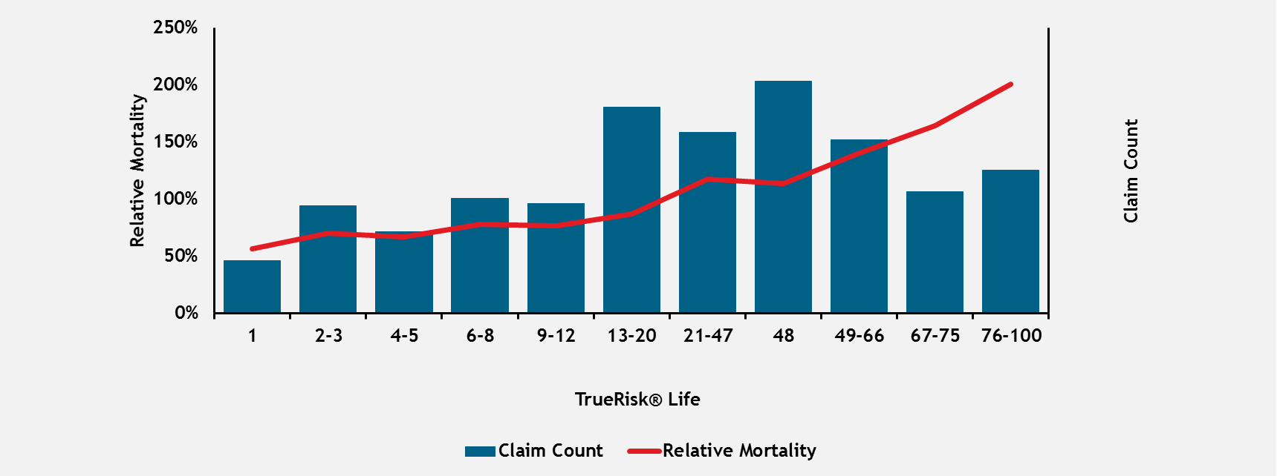
India Results
Relative Mortality by TrueRisk® Life Score
19th Global
Conference of Actuaries
30th – 31st January, 2018 | Mumbai, India
Mortality of the 76-100 group is ~3 times higher than the 1-5 group

Slide 20
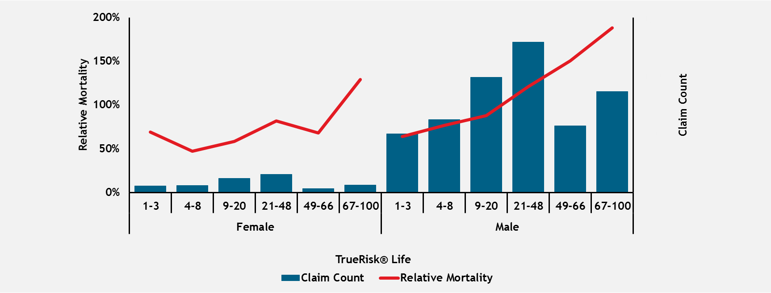
India Results
Relative Mortality by TrueRisk® Life Score
19th Global
Conference of Actuaries
30th – 31st January, 2018 | Mumbai, India
Relative Mortality by Gender

Slide 21
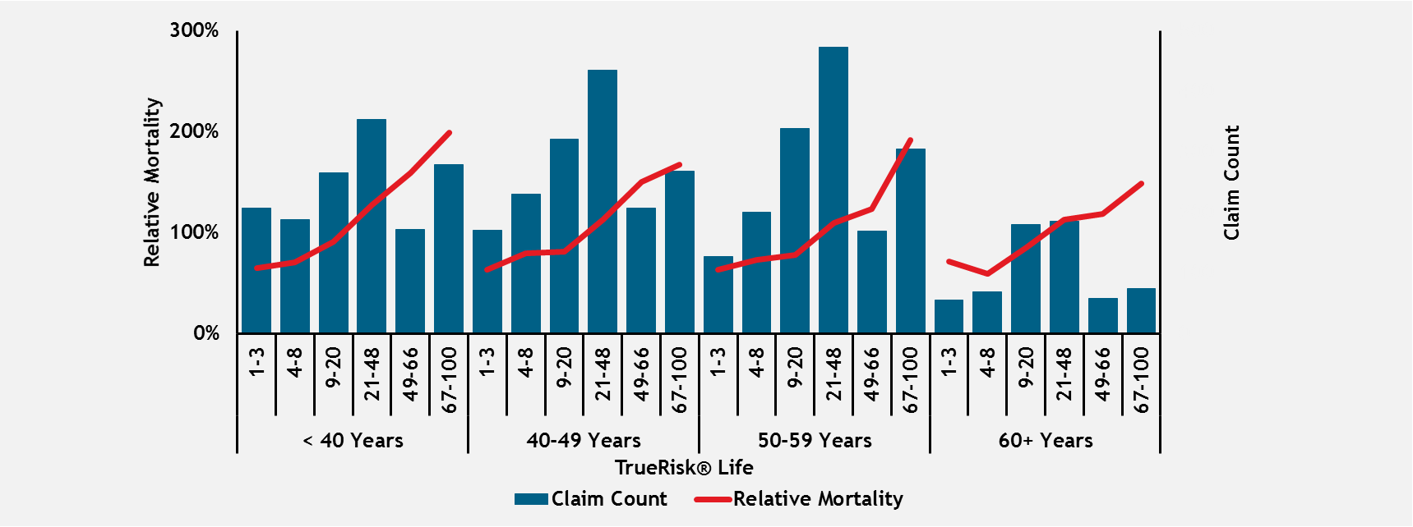
India Results
Relative Mortality by TrueRisk® Life Score
19th Global
Conference of Actuaries
30th – 31st January, 2018 | Mumbai, India
Relative Mortality by Issue Age

Slide 22
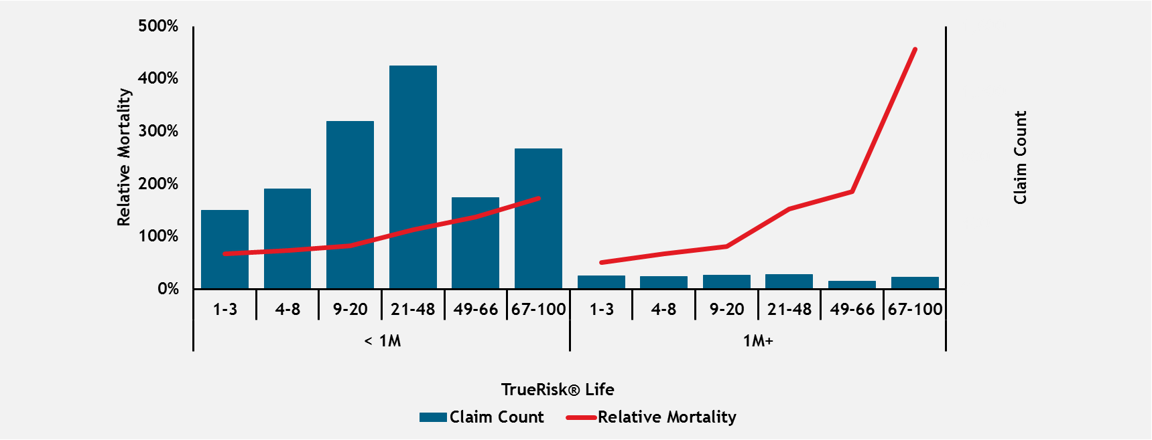
India Results
Relative Mortality by TrueRisk® Life Score
19th Global
Conference of Actuaries
30th – 31st January, 2018 | Mumbai, India
Relative Mortality by Amount at Risk

Slide 23
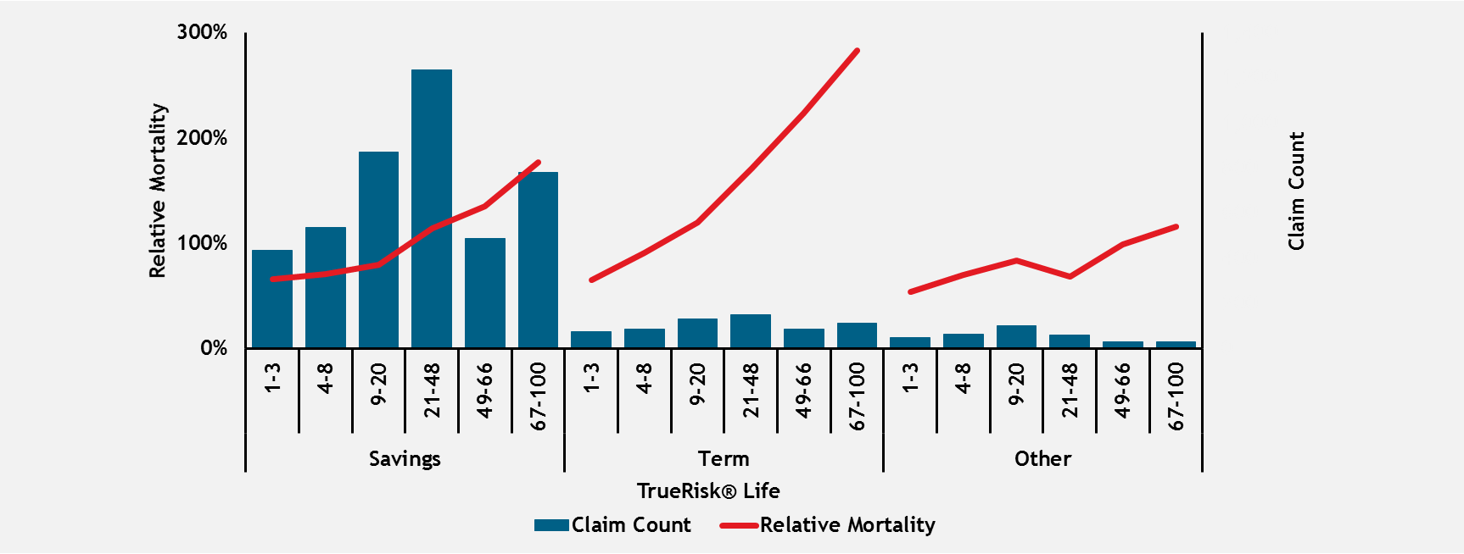
India Results
Relative Mortality by TrueRisk® Life Score
19th Global
Conference of Actuaries
30th – 31st January, 2018 | Mumbai, India
Relative Mortality by Product

Slide 24
19th Global
Conference of Actuaries
30th – 31st January, 2018 | Mumbai, India
Country Specific Results

Slide 25
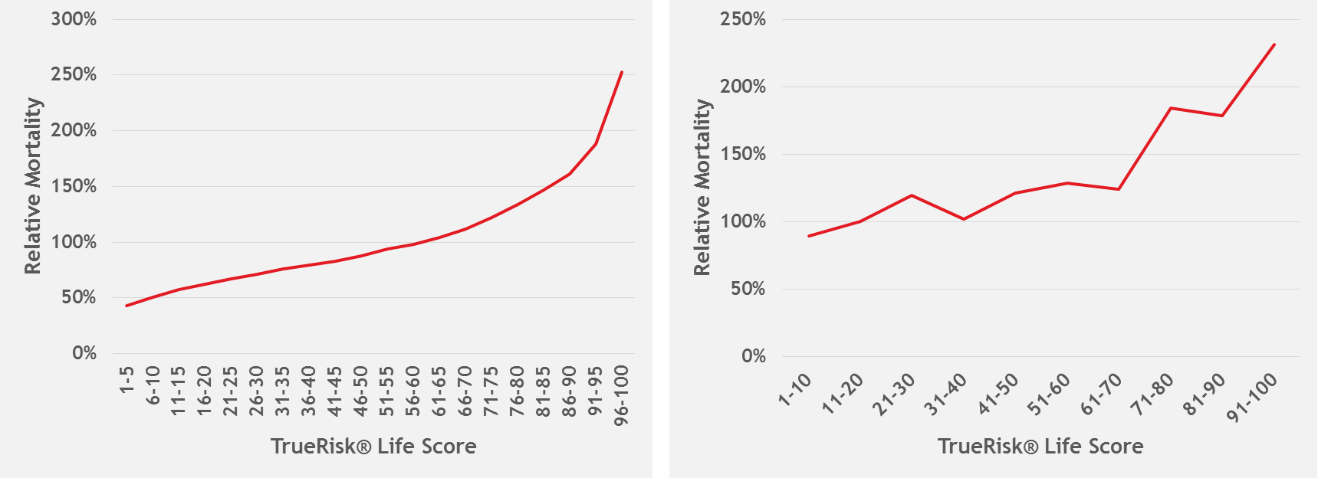
U.S. Specific Results
US Population and Insured Lives Mortality Studies
19th Global
Conference of Actuaries
30th – 31st January, 2018 | Mumbai, India
Population Segmentation
Insured Lives Segmentation

Slide 26
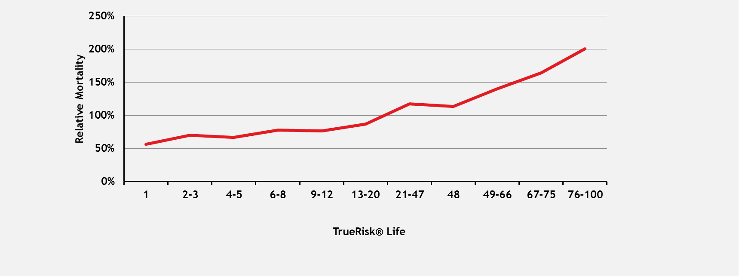
India Specific Results
India Insured Lives Mortality Study
19th Global
Conference of Actuaries
30th – 31st January, 2018 | Mumbai, India
Insured Lives Mortality Segmentation

Slide 27
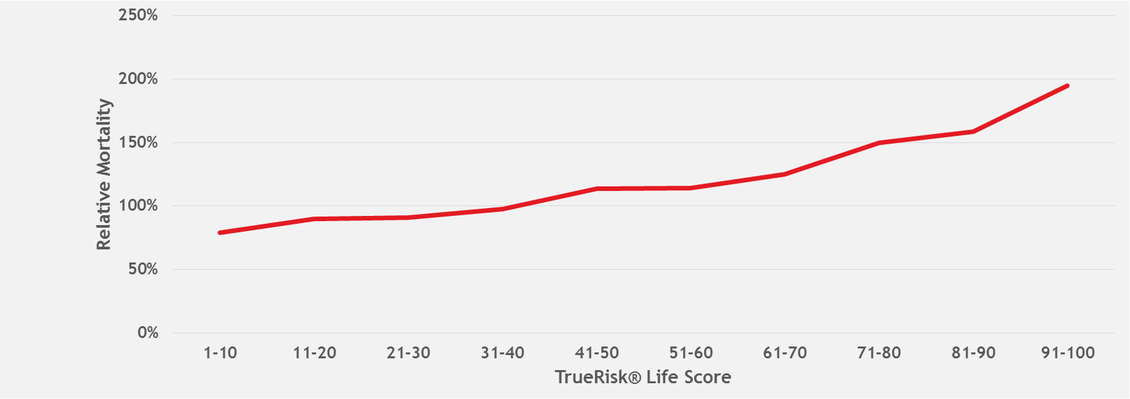
Canada Specific Results
Canada Insured Lives Mortality Study
19th Global
Conference of Actuaries
30th – 31st January, 2018 | Mumbai, India
Insured Lives Mortality Segmentation

Slide 28
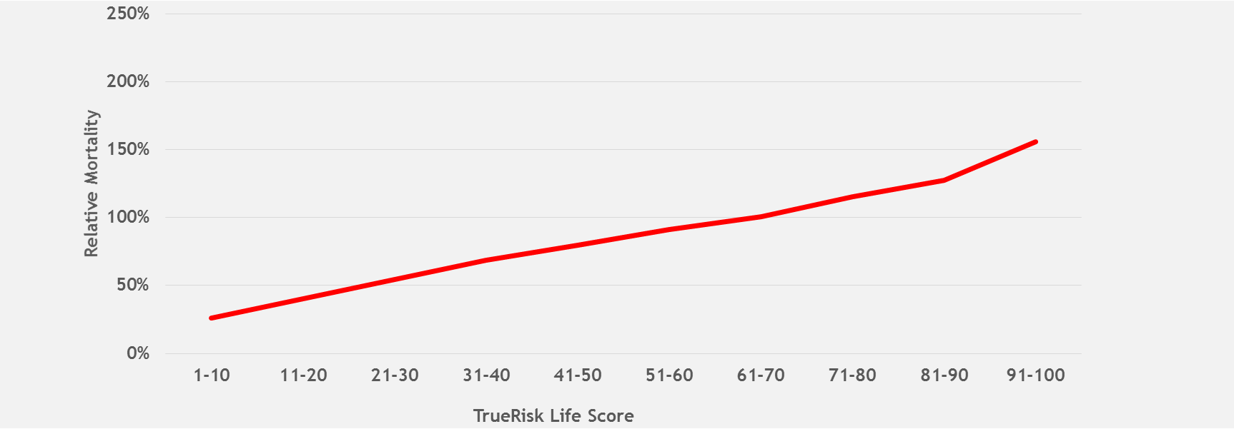
South Africa Specific Results
South Africa Population Study
19th Global
Conference of Actuaries
30th – 31st January, 2018 | Mumbai, India
Population Mortality Segmentation

Slide 29
19th Global
Conference of Actuaries
30th – 31st January, 2018 | Mumbai, India
TrueRisk® Life Applications

Slide 30
Applications within Life Insurance
19th Global
Conference of Actuaries
30th – 31st January, 2018 | Mumbai, India
Targeted Marketing
Improved Risk Segmentation
  Fully or Simplified Issue Underwritten Environments
Accelerated Underwriting
Inforce Policy Management
  Lapse and Mortality Insights
  Cross-sell or Upsell Existing Customers
  Engage Orphaned Policyholders
Repudiated Claims Detection
  Correlated with repudiated claims rates

Slide 31
Targeted Marketing
19th Global
Conference of Actuaries
30th – 31st January, 2018 | Mumbai, India
TrueRisk® Life provides new insights to your target marketing profiles
Market to the consumers you want to attract
  Remove those with scores that fall outside of campaign parameters
Spend marketing dollars more wisely
Decrease processing time by attracting the risks you want

Slide 32
Risk Segmentation
Fully Underwritten Case Study
19th Global
Conference of Actuaries
30th – 31st January, 2018 | Mumbai, India
Large multi-line company
Challenge
  Increase best class qualification rate
  Reduce retail rates
Solution
  Incorporated TRL as an additional piece of evidence to more accurately classify risks, reduce mortality and lapse rates, and improve profitability

Slide 33



Risk Segmentation
Fully Underwritten Case Study
19th Global
Conference of Actuaries
30th – 31st January, 2018 | Mumbai, India
Apply Traditional Full Underwriting
Order TrueRisk® Life Score
TRL Scores 1-5
TRL Scores 6-70
TRL Scores 71-90
TRL Scores 91-100
Upgrade 1 Class
from Full UW
No Change
from Full UW
Downgrade 1 Class from Full UW
Downgrade 2 Classes from Full UW

Slide 34
Accelerated Underwriting Case Study
Case Study
19th Global
Conference of Actuaries
30th – 31st January, 2018 | Mumbai, India
Large Financial Services Company
Challenge
  Improve the underwriting experience for at least 30% of the applicants
    Reduce length of UW process
    Reduce use of fluids and paramedical exams
  Keep retail rates the same (e.g., any mortality slippage must be offset
  by expense savings, higher placement, etc.)
Solution
  Incorporate TRL as part of both the triage and underwriting processes to realize the full power of this new piece of evidence and to minimize mortality slippage
  Created environment for parallel testing to prove out the solution

Slide 35




Accelerated Underwriting Case Study
Application Illustration
19th Global
Conference of Actuaries
30th – 31st January, 2018 | Mumbai, India
Application
Full application with tele-interview and drill downs
Low
TRL Scores
Initial Screen TrueRisk® Life Score
High
TRL Scores
Within Issue Age and Face Amount Parameters?
Intermediate
TRL Scores
Gather 3rd Party Data and Apply UW Guidelines
Meets requirements?
Audit
Assign class and make offer
without additional testing
Apply Full Underwriting
Order Additional Requirements

Slide 36
In Force Policy Management
19th Global
Conference of Actuaries
30th – 31st January, 2018 | Mumbai, India
Enhance mortality and lapse insight into your existing book of business
Target policyholders for cross-sell and upsell opportunities
  Identify those that meet your parameters
  Save time and money
Engage orphaned policyholders
  Create new opportunities for agents
  Retain the policyholders you want

Slide 37
Repudiated Claims Detection
19th Global
Conference of Actuaries
30th – 31st January, 2018 | Mumbai, India
Repudiated Claim Rates Study
Restricted to ages 18 and up
Rates relative to “1-30” group displayed on graph
Relative Claim Repudiation Rates

Slide 38
19th Global
Conference of Actuaries
30th – 31st January, 2018 | Mumbai, India
In Closing

Slide 39
Recap Session Objectives
19th Global
Conference of Actuaries
30th – 31st January, 2018 | Mumbai, India
Share a new data solution, TrueRisk® Life, arriving in the India market
Demonstrate the value of the TrueRisk® Life data solution
Illustrate how Life insurance companies can create value by using TrueRisk® Life

Slide 40
Q&A Time
19th Global
Conference of Actuaries
30th – 31st January, 2018 | Mumbai, India
Questions
Comments

Slide 41
Organizer
19th Global
Conference of Actuaries
30th – 31st January, 2018 | Mumbai, India
Thank You

