Slide 1




Organizer
19th Global
Conference of Actuaries
30th – 31st January, 2018 | Mumbai, India
Dr. John Taylor
Partner, Hymans Robertson LLP

Slide 2


19th Global
Conference of Actuaries
30th – 31st January, 2018 | Mumbai, India
The threat and opportunity that technology presents to the profession:
A robo-advice case study
31st January 2018
Is technology a threat or an opportunity for the actuarial profession? With a small but growing number of consumers using ‘robo-advice’ across the globe, hear how one actuarial consultancy is embracing it as an opportunity to better serve clients.

Slide 3

The threat and opportunity that technology presents to the profession: A robo-advice case study.
19th Global
Conference of Actuaries
30th – 31st January, 2018 | Mumbai, India
Technological Disruption
Yu’E Bao Money Market Fund in Alipay
Peer to Peer Insurance
HDFC Humanoids in Branches
Autonomous Cars

Slide 4
The threat and opportunity that technology presents to the profession: A robo-advice case study.
The Need for Change
19th Global
Conference of Actuaries
30th – 31st January, 2018 | Mumbai, India
“[Professions]…will need to learn to communicate differently, to gain mastery of data in their disciplines, to establish new working relationships with their machines, and to diversify. More generally, there is a catch-all capability that tomorrow’s professionals will need to embrace – that of being flexible.”
Susskind & Susskind
  “The Future of The Professions”

Slide 5

19th Global
Conference of Actuaries
30th – 31st January, 2018 | Mumbai, India
What is Robo-advice?

Slide 6
What is Robo-advice?
A Broad Church
19th Global
Conference of Actuaries
30th – 31st January, 2018 | Mumbai, India
What is a 'Robo-Advisor (Robo-Adviser)‘?
A robo-advisor (robo-adviser) is an online wealth management service that provides automated, algorithm-based portfolio management advice without the use of human financial planners. Robo-advisors (or robo-advisers) use the same software as traditional advisors, but usually only offer portfolio management and do not get involved in more personal aspects of wealth management, such as taxes and retirement or estate planning.
Source: Investopedia

Slide 7
What is Robo-advice?
Strategic Context – Market Advice
19th Global
Conference of Actuaries
30th – 31st January, 2018 | Mumbai, India
Demand
Types
30m UK adults
Unwilling/unable to pay for advice
Individual responsibility
Under-saving
Complex challenges
Supply
c. 20k UK advisers
Cost of advice
Access/availability
Consumer Behavior
More online/mobile
Higher expectations
Increasingly comfortable with finances
Value convenience – 24/7
Anonymity
Technological Enablement
Broadband
Cloud
Scale
Repeatability

Slide 8





What is Robo-advice?
A Broad Church
19th Global
Conference of Actuaries
30th – 31st January, 2018 | Mumbai, India
Fully automated
Convergence
Human involvement
Information
Advice

Slide 9



What is Robo-advice?
Indian Market
19th Global
Conference of Actuaries
30th – 31st January, 2018 | Mumbai, India
Asian robo market lagging western markets but predicted to change as economic growth accelerates
Existing propositions….
Many emphasise lack of bias relative to commissioned advisers

Slide 10
19th Global
Conference of Actuaries
30th – 31st January, 2018 | Mumbai, India
UK Workplace Pensions
A Robo-advice Case Study

Slide 11
UK Workplace Pensions
19th Global
Conference of Actuaries
30th – 31st January, 2018 | Mumbai, India
Trends in UK Pension Provision

Slide 12

UK Workplace Pensions
A Broad Church
19th Global
Conference of Actuaries
30th – 31st January, 2018 | Mumbai, India
 | DB | DC
Investment | Sponsor | Member
Contribution | Sponsor | Member
Term | Sponsor | Member
Advice | EBC | IFA/None
Risk Transfer
Decision Transfer

Slide 13
UK Workplace Pensions
Regulatory Impact on Advice Margin
19th Global
Conference of Actuaries
30th – 31st January, 2018 | Mumbai, India
£800
AMC = 1.5%
F2F
Distribution Commission per
£100 per month premium
£300
AMC
< 0.75%
No advice
AMC = 1.0%
Clinic
£0

Slide 14
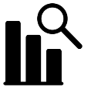
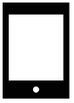
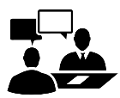

UK Workplace Pensions
Meeting the market challenge
19th Global
Conference of Actuaries
30th – 31st January, 2018 | Mumbai, India
How could we help DC sponsors?
  By using the DB machinery we’d developed over decades
  By making it easy for employees to act.
Hymans Roberston is an independent UK-based actuarial consultancy that helps sponsors with pension plans.
Data and analytics
Rich data and modelling insights
Examples:
Licensed longevity data
Drawdown modelling
Economic scenario generators
Technology
Customer facing tools
Examples:
Web-based calculators
Pensions websites
Consulting
Strategy and proposition development
Examples:
Workplace proposition development
D2C launch
Distribution strategy
Note that we are paid by sponsors. Our “robo” service is paid via an increase to sponsor fees. Our remuneration is not affected by employee usage.

Slide 15

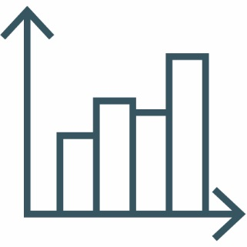


UK Workplace Pensions
DB Machinery
19th Global
Conference of Actuaries
30th – 31st January, 2018 | Mumbai, India
Consider each DC member as
providing their own DB scheme
Assets
Pot value
Investment
Investment
choice
Inflows
Employer and
employee
contributions
Liability
Pensions Commission
(Salary-Related)
Income (proportioned
for current employment)

Slide 16
UK Workplace Pensions
Results by Demographic Factors
19th Global
Conference of Actuaries
30th – 31st January, 2018 | Mumbai, India

Slide 17

UK Workplace Pensions
Who’s the Customer?
19th Global
Conference of Actuaries
30th – 31st January, 2018 | Mumbai, India
Homo
Economicus
Human

Slide 18
UK Workplace Pensions
Indian Market
19th Global
Conference of Actuaries
30th – 31st January, 2018 | Mumbai, India
We have assessed member’s current trajectory…
….but we can also assess alternative trajectories:
  20 different contributions choices
  15 different retirement ages
  10 different investment strategies
  up to 3,000 different choices

Slide 19
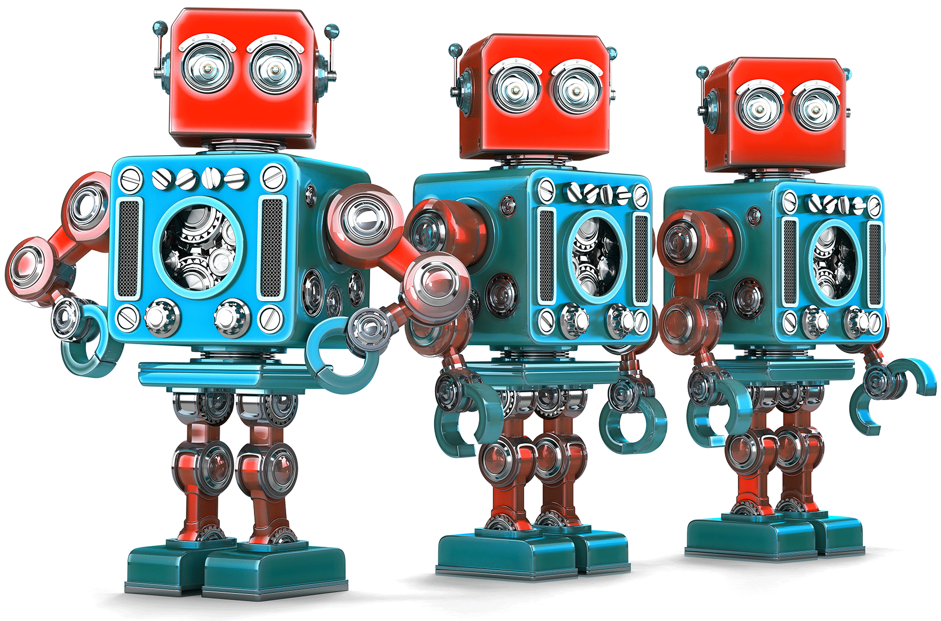
UK Workplace Pensions
Employee Action
19th Global
Conference of Actuaries
30th – 31st January, 2018 | Mumbai, India
Use Utility to present a preferred intervention based on:
  A probability level agreed with sponsor
  Employment characteristics
Note that none of our (UK)
sponsors want to vary
investment choice via robo
Individuals can reject/over-ride preferred intervention

Slide 20
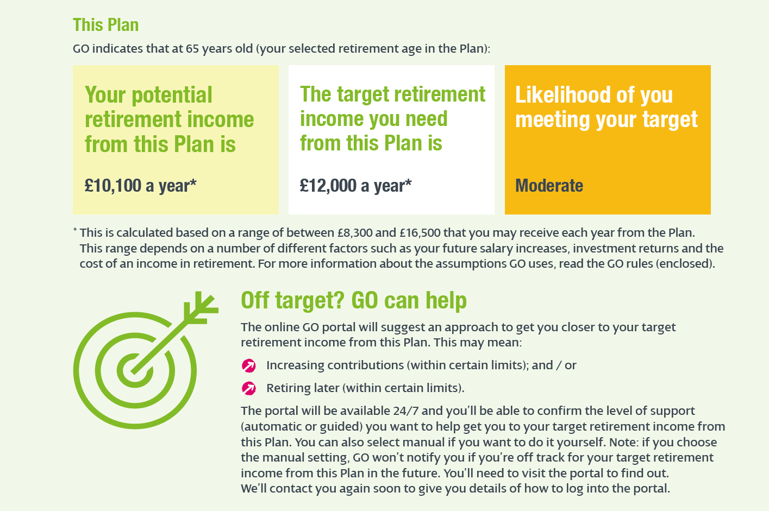

UK Workplace Pensions
Statements
19th Global
Conference of Actuaries
30th – 31st January, 2018 | Mumbai, India

Slide 21


UK Workplace Pensions
Employee Interface
19th Global
Conference of Actuaries
30th – 31st January, 2018 | Mumbai, India
Notes:
If video doesn't work click here: https://vimeo.com/228363913/f173f2a1b0

Slide 22

UK Workplace Pensions
Member Experience: The Results
19th Global
Conference of Actuaries
30th – 31st January, 2018 | Mumbai, India
staff have logged in and looked around
(engagement on a typical pensions website can be around 10%)
of staff have returned for
repeated visits to the site
69%
50%
of users surveyed felt well or very well informed about their retirement savings following using GO
(compared to 40% before)
of users surveyed said the information GO provided was useful or very useful
78%
92%
1 in 5
employees immediately increased contributions
(average 3.5% increase)
“I received my pack this week and I have to say it is best pension’s communication I have ever received. I was really impressed & for first time in my life actually understood what my pension could be and how I could improve it.”
“It is a very good tool and very easy and intuitive to use which is what I like best about it.”

Slide 23

UK Workplace Pensions
IT: Compute Requirements for one Scheme
19th Global
Conference of Actuaries
30th – 31st January, 2018 | Mumbai, India
Projections:
  Scheme with 20k employees
  30 years of projections
  1000 stochastic scenarios
  300 trajectories per employee
180bn years projected
(Universe is 14bn years old).
Cloud-based computing
Seamless data integration
and fulfilment

Slide 24

UK Workplace Pensions
Work in Progress
19th Global
Conference of Actuaries
30th – 31st January, 2018 | Mumbai, India
Artificial Intelligence
Pensions
Dashboard
Decumulation

Slide 25
UK Workplace Pensions
The Need for Change
19th Global
Conference of Actuaries
30th – 31st January, 2018 | Mumbai, India
“Insight and guidance that once could only be delivered directly by professionals are routinized and then represented in, say, an online service. Some of these systems may have complex models of practical expertise embodied within them, even though this may not be apparent because the interactive platforms have been designed with lay users in mind.”
Susskind & Susskind
  “The Future of The Professions”

Slide 26
The threat and opportunity that technology presents to the profession: A robo-advice case study.
Q&A
19th Global
Conference of Actuaries
30th – 31st January, 2018 | Mumbai, India
Questions
Comments
The views expressed in this [publication/presentation] are those of invited contributors and not necessarily those of the IFoA. The IFoA do not endorse any of the views stated, nor any claims or representations made in this [publication/presentation] and accept no responsibility or liability to any person for loss or damage suffered as a consequence of their placing reliance upon any view, claim or representation made in this [publication/presentation].
The information and expressions of opinion contained in this publication are not intended to be a comprehensive study, nor to provide actuarial advice or advice of any nature and should not be treated as a substitute for specific advice concerning individual situations. On no account may any part of this [publication/presentation] be reproduced without the written permission of the IFoA [or authors, in the case of non-IFoA research].

Slide 27
Organizer
19th Global
Conference of Actuaries
30th – 31st January, 2018 | Mumbai, India
Thank You
John Taylor
john.taylor@hymans.co.uk
+44 (0) 131 656 5143

