Slide 1
Organizer
19th Global
Conference of Actuaries
30th – 31st January, 2018 | Mumbai, India
John Ferguson
Regional Chief Actuary, Gen Re
FIA, FSA

Slide 2
19th Global
Conference of Actuaries
30th – 31st January, 2018 | Mumbai, India
Product Development Trends In Asia
Session C11 (Wednesday, January 31, 2018 ( Day 2 ) 14:00- 14:45)

Slide 3
Agenda
19th Global
Conference of Actuaries
30th – 31st January, 2018 | Mumbai, India
Critical Illness in Hong Kong
Online Insurance in China
Diabetes Products

Slide 4
Agenda
19th Global
Conference of Actuaries
30th – 31st January, 2018 | Mumbai, India
0. Context
Critical Illness in Hong Kong
Online Insurance in China
Diabetes Products

Slide 5
Agenda
19th Global
Conference of Actuaries
30th – 31st January, 2018 | Mumbai, India
Critical Illness in Hong Kong
Online Insurance in China
Diabetes Products

Slide 6
Critical Illness in Hong Kong
19th Global
Conference of Actuaries
30th – 31st January, 2018 | Mumbai, India
Background to the Hong Kong Market
Critical Illness is a well-established product in Hong Kong – it has been around for 30 years
Typically whole of life coverage with a limited premium payment term (10-20 years)
Mostly sold by agency force
Unlike India, disease definitions are not standardised
Companies compete by:
Adding more diseases
Extending coverage for major diseases after the first claim
Adding special extra benefits with perceived high customer value

Slide 7
Critical Illness in Hong Kong
19th Global
Conference of Actuaries
30th – 31st January, 2018 | Mumbai, India
Multiple Payments For The Same Disease
The main idea is that the policyholder can claim more than once for the same major disease.
Cancer continuation benefit: pay again if the same or another cancer is present and n years, 2n years
Heart attack: pay on second incidence
Stroke: pay on second incidence

Slide 8
Critical Illness in Hong Kong
19th Global
Conference of Actuaries
30th – 31st January, 2018 | Mumbai, India
AIA Hong Kong - Smart Elite Ultra
Whole of Life
56 Major illnesses covered in 6 groups
Group | Diseases | Coverage
1 | Cancers | 300% (3x100%)
2 | Heart Related Illness | 200% (2x100%)
3 | Nervous System | 100%
4 | Major Organs and Functions | 100%
5 | Other Major Illnesses | 100%
6 | Terminal Illnesses and LIE | 100%
3 year waiting period between cancer payments
1 year waiting period for all other diseases

Slide 9
Critical Illness in Hong Kong
19th Global
Conference of Actuaries
30th – 31st January, 2018 | Mumbai, India
AIA Hong Kong - Smart Elite Ultra
Recurring Cancer Coverage
Pays 100% of Sum Assured on initial diagnosis.
At least 3 years after diagnosis, if any cancer is present, 100% of Sum Assured is paid again.
Covers the same cancer (or metastisis) or a completely unrelated cancer
Heart Attack
After first diagnosis, a second heart attack or another heart related illness will be paid out at 100%.

Slide 10
Critical Illness in Hong Kong
19th Global
Conference of Actuaries
30th – 31st January, 2018 | Mumbai, India
AIA Hong Kong - Smart Elite Ultra
First Cancer Diagnosis
Still has cancer
3 years
3 years
100% Sum Assured
Premiums Cease
100% Sum Assured
Still has cancer
Major Head Trauma
Still has 500% SA coverage in other disease groups
1 year
1 year
100% Sum Assured
100% Sum Assured

Slide 11
Critical Illness in Hong Kong
19th Global
Conference of Actuaries
30th – 31st January, 2018 | Mumbai, India
AIA Hong Kong - Smart Elite Ultra
Other Benefits
Premiums waived on first 100% payment
Certain conditions that might mean coverage would be declined are covered at 20% SA for the first year. If, after one year, evidence is provided that the disease has not worsened, then cover is increased to 100%. Covers benign breast disorder, uterine fibroids, elevated PSA
Additional 50% benefit during first 10 / 15 years (depending on issue age)
44 early stage diseases covered (typically 20% benefit)
13 childhood diseases (20% benefit)
Diabetes complications covered as early stage CI

Slide 12
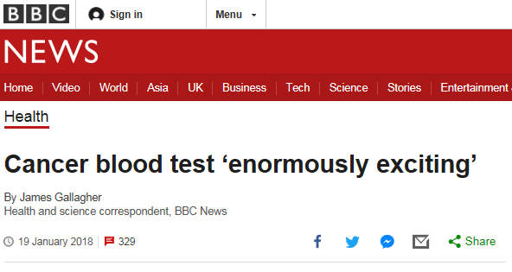
Critical Illness in Hong Kong
19th Global
Conference of Actuaries
30th – 31st January, 2018 | Mumbai, India
Risks With Multiple Payments For Same Disease
Improvements in cancer diagnosis
Improvements in cancer treatment mean more people are living with cancer, longer.
Definitions
Heart attack (ejection fraction)
Stroke (“Evidence of permanent neurological deficit lasting for at least 3 months has to be produced”)
Complexity of Product
Many more exclusions and limitations may make it more difficult to sell.
“Scientists have taken a step towards one of the biggest goals in medicine - a universal blood test for cancer. A team at Johns Hopkins University has trialled a method that detects eight common forms of the disease.”
Notes:
Trialled on 1,005 patients with cancers in the ovary, liver, stomach, pancreas, oesophagus, colon, lung or breast that had not yet spread to other tissues.
Overall, the test found 70% of the cancers

Slide 13
Critical Illness in Hong Kong
19th Global
Conference of Actuaries
30th – 31st January, 2018 | Mumbai, India
Risk Mitigation (SEU)
Other Benefits
Reduce premium payment period, especially if waiving premiums
10/18/25 premium payment
Maximum cash amounts for certain diseases (regardless of SA)
“Minor” benefits have US$50,000 cap
Limit coverage age
No multiple claims after age 85
Impose Further Conditions
After age 70, subsequent prostate cancer claims must be undergoing full treatment to claim

Slide 14
Agenda
19th Global
Conference of Actuaries
30th – 31st January, 2018 | Mumbai, India
Critical Illness in Hong Kong
Online Insurance in China
Diabetes Products

Slide 15
Market Overview - China
19th Global
Conference of Actuaries
30th – 31st January, 2018 | Mumbai, India
Insurance Industry – Doubled size in 5 years

Slide 16
Market Overview - China
19th Global
Conference of Actuaries
30th – 31st January, 2018 | Mumbai, India
E-Commerce
Premium volume expanded by 69 times during 2012~2015;
Online insurance penetration rate increased from 0.2% to 9.2%;
2015
110 insurance companies operating online insurance business
74% of insurance companies in China
Data Source: Insurance Association of China

Slide 17
Market Overview - China
19th Global
Conference of Actuaries
30th – 31st January, 2018 | Mumbai, India
E-Commerce
World’s largest online retail market
approximately 5.16 trillion yuan ($752 billion)
Unique degree of Centralization
75% of e-commerce from Alibaba
Mobile-first market
mobile represented nearly 50% of all e-commerce sales in 2015
compared to 22% in the U.S.
Well-developed mobile payment system
Alipay and WeChat Pay (TenPay) together account for 90% of the market.
400 million users
846 million users
Notes:
Singles day 2017: For Alibaba RMB 168.2 billion (US$25.3 billion)) in sales
39% increase
90% on mobile phone
256,000 transaction per second
83 brands ex

Slide 18
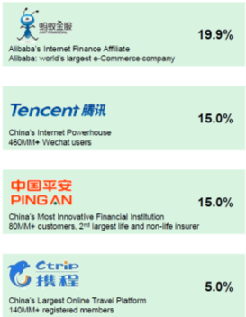
Market Overview - China
19th Global
Conference of Actuaries
30th – 31st January, 2018 | Mumbai, India
Zhong An
Launched in Nov 2013
The first purely online insurer approved by CIRC
Strong founding shareholders
2013
Flagship product: return-delivery insurance on Taobao
Over 1 billion policies were sold in the first year
2014
Expanded in auto, health, and travel business
Had written more than 4 billion policies to more than 400 million customers
2016
Raised $1.5 billion in Hong Kong floatation
The world’s first “insurtech” public offering.
2017

Slide 19
How Do The Online Giants Sell Insurance?
19th Global
Conference of Actuaries
30th – 31st January, 2018 | Mumbai, India
Shifting Power Balance
Alibaba / WeChat do not have insurance licenses. They partner with a traditional insurance company. (But they are not monogamous!)
Alibaba / WeChat decide on the product features, who to target and selection criteria.
Relationship between insurer and customer is very distant:
Insurer does not “own” the customer
Insurer carries the insurance risk
Power balance has shifted dramatically
400 million users
846 million users
Notes:
Insurer doesn’t even have contact details of customer

Slide 20
Popular Online Product - China
19th Global
Conference of Actuaries
30th – 31st January, 2018 | Mumbai, India
Short Term Medical Product with High Deductible
Coverage range
Hospitalisation reimbursement, outpatient bf/after inpatient, outpatient surgery reimbursement cost
Normal wards in public hospital (Tier II & III hospital) only
Include expensive/imported drugs
Annual limit:
RMB 3 million (30 lakhs)
Coverage age:
up to age 80
Deductible:
10K RMB (INR 1 lakh)

Slide 21
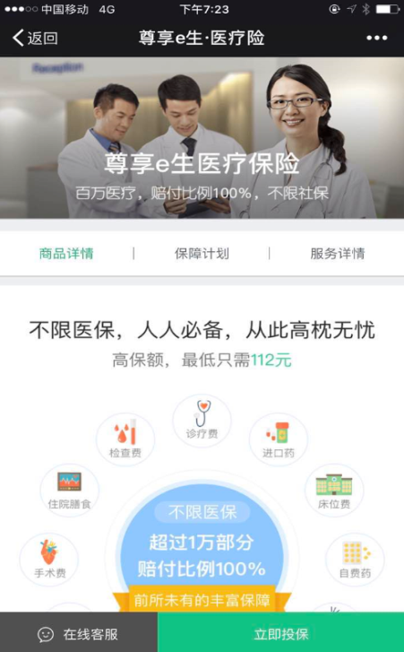
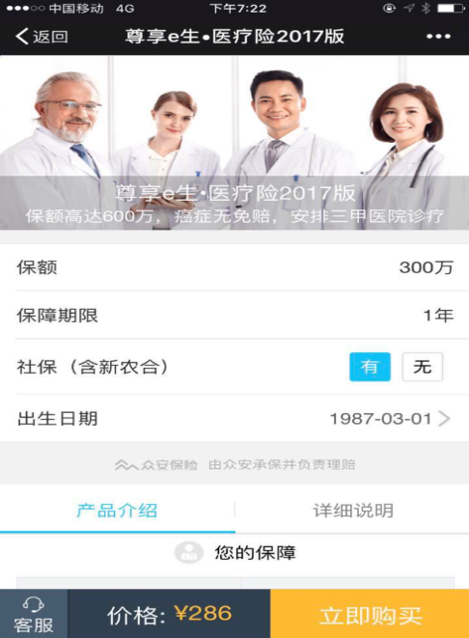
Popular Online Product - China
19th Global
Conference of Actuaries
30th – 31st January, 2018 | Mumbai, India
Short Term Medical Product with High Deductible
Generation 2016
Sold online and via Wechat
ZhongAn achieved sales of 100 Million RMB new business premium within 4 months.
Generation 2017
New generation of the product ZhongAn sold 60,000 policies within 8 days

Slide 22
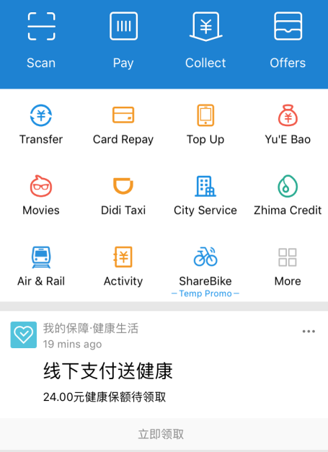
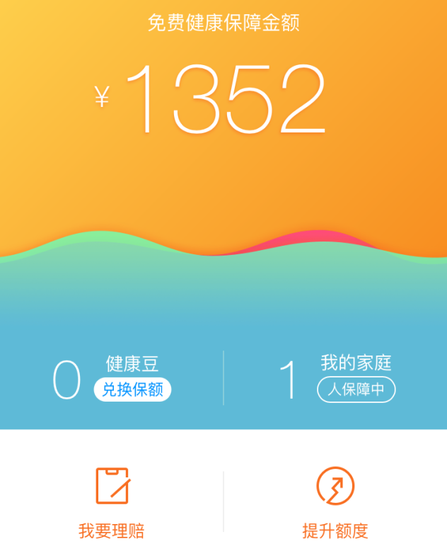
Popular Online Product - China
19th Global
Conference of Actuaries
30th – 31st January, 2018 | Mumbai, India
Alipay launches Free Critical Illness Insurance
Alipay sets the criteria to decide who qualifies for free CI coverage
Selected users can activate free CI coverage by two clicks in the Alipay app
1-year CI coverage without medical examination and waiting period
INR 13,500 coverage,
Free sum assured varies by person, depends on personal payment records.
Can increase up to INR 50,000
Free CI Notification
Notes:
The free CI sum assured will continuously increase upon offline Alipay payment: RMB 24 sum assured will be given for free when people use Alipay for offline payment, e.g. buying coffee in 7-11. The free sum assured will be granted once per day no matter how many times you use Alipay in a single day.
The Free CI sum assured will be capped at CNY 5,000 (around USD 750)
We don’t know how Alipay selected qualified users, age would be one of them, age 65+ will not be selected.

Slide 23
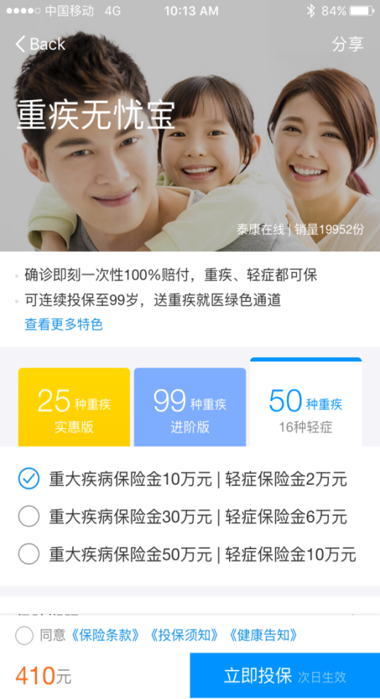
Popular Online Product - China
19th Global
Conference of Actuaries
30th – 31st January, 2018 | Mumbai, India
Easy Upgrade To Coverage
5 Clicks to upgrade the Coverage
Two products available: CI and Mid-level Medical
Premium pre-calculated by Alipay
Premium will be settled via Alipay
Various CI plans to choose:
Diseases covered from 25 to 99;
Sum assured from CNY 100,000 to 500,000 (INR 10 -50 lakhs)
Health Declaration
upgrade
Notes:
Trialled on 1,005 patients with cancers in the ovary, liver, stomach, pancreas, oesophagus, colon, lung or breast that had not yet spread to other tissues.
Overall, the test found 70% of the cancers

Slide 24
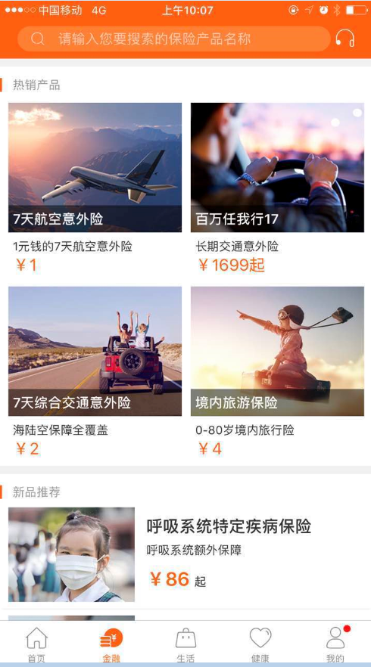
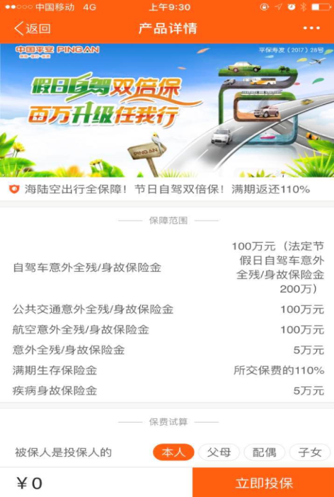
Another Distribution Method
19th Global
Conference of Actuaries
30th – 31st January, 2018 | Mumbai, India
PingAn Life’s Mobile App
Agent refers customer to App
Customer downloads App
Customers can purchase insurance directly within the App
Hot Sellers
Product Details
Download from APP Store and get registered
Coverage
Prem Calc
Purchase
Notes:
Trialled on 1,005 patients with cancers in the ovary, liver, stomach, pancreas, oesophagus, colon, lung or breast that had not yet spread to other tissues.
Overall, the test found 70% of the cancers

Slide 25
Popular Online Product - China
19th Global
Conference of Actuaries
30th – 31st January, 2018 | Mumbai, India
Other Popular On Line Products
Personal Accident
high multiples for motor vehicle deaths
Non-Life
Shipping return insurance
Flight delay insurance (uses weather information to adjust price for insurance sold hours before departure.)
Notes:
Trialled on 1,005 patients with cancers in the ovary, liver, stomach, pancreas, oesophagus, colon, lung or breast that had not yet spread to other tissues.
Overall, the test found 70% of the cancers

Slide 26
Online Products - Experience
19th Global
Conference of Actuaries
30th – 31st January, 2018 | Mumbai, India
How Will Experience Turn Out?
Possible Influences
High deductible medical products have potential for large anti-selection, especially with simplified issue underwriting
Target market is different. (Younger, “better connected”)
But selection criteria for whom to target may help.
Selective lapsation with policyholders in good health either switching to new products or simply lapsing as the novelty of buying wears off.
Early experience seems to be good.

Slide 27
Online Products - China
19th Global
Conference of Actuaries
30th – 31st January, 2018 | Mumbai, India
What is driving the success of online sales?
A supportive regulatory environment
Massively underserved market
Popularity of Internet consumption and mobile Internet usage
Willingness to buy online
The leading roles of Internet giants
Notes:
Vice chairman of CIRC generally favourable towards online sales.
But has warned about mis-selling – adding travel insurance to plane tickets without the customer knowing. (CTRIP)

Slide 28
Challenges To Insurance Companies
19th Global
Conference of Actuaries
30th – 31st January, 2018 | Mumbai, India
An exciting but challenging future...
Online giants own the customer
Huge change in sales dynamic
Regulatory clampdown?
Challenge of expanding to long term products
Conflict with agency force
Notes:
Vice chairman of CIRC generally favourable towards online sales.
But has warned about mis-selling – adding travel insurance to plane tickets without the customer knowing. (CTRIP)

Slide 29
Agenda
19th Global
Conference of Actuaries
30th – 31st January, 2018 | Mumbai, India
Critical Illness in Hong Kong
Online Insurance in China
Diabetes Products

Slide 30
What Is Diabetes?
19th Global
Conference of Actuaries
30th – 31st January, 2018 | Mumbai, India
What is Diabetes?
It’s a disease when a person’s blood glucose level is too high.
This happens when the body doesn’t produce enough insulin, which gets the glucose into the body’s cells. Having too much glucose in the blood can cause long term health problems.
Types of Diabetes
Type 1 diabetes: the body doesn’t make any insulin at all. Typically diagnosed in children and young adults
Type 2 diabetes: most common form of diabetes Most common in middle-aged and older people.
Gestational diabetes: occurs during pregnancy (higher risk of developing Type 2 diabetes later on.)
Other types of diabetes: Monogenic diabetes, cystic fibrosis-related.

Slide 31
Diabetes Products
19th Global
Conference of Actuaries
30th – 31st January, 2018 | Mumbai, India
Diabetes - Complications and Increased Risks
Cardiovascular disease (heart attack, stroke, CAD)
Kidney damage (neuropathy)
Blindness (retinopathy)
Nerve damage (neuropathy)
Foot damage (poor blood flow)

Slide 32
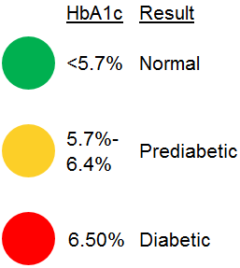
Diabetes Products
19th Global
Conference of Actuaries
30th – 31st January, 2018 | Mumbai, India
Diabetes – HbA1c
HbA1c measures glycated haemoglobin as a percentage of total haemoglobin.
Used to measure plasma glucose concentration. Normal glucose levels in the blood produce normal amounts of glycated haemoglobin.
Relatively stable measure – regarded as an average measure over the past three months.
But HbA1c isn’t perfect
Not as sensitive as fasting glucose test (may miss up to 30%)
Doesn’t pick up short term spikes in blood sugar.

Slide 33
Diabetes Products
19th Global
Conference of Actuaries
30th – 31st January, 2018 | Mumbai, India
CHD Risk and HbA1c Level – 10 Year Time Horizon
Notes:
Ethnicity 3 (Asian-Indian, NS)
30 yo male, just diagnosed, BP 120
50 yo male, diagnosed 10 years ago, slightly elevated BP (140), cholestrol

Slide 34
Diabetes Products
19th Global
Conference of Actuaries
30th – 31st January, 2018 | Mumbai, India
Diabetes Prevalence

Slide 35
Diabetes Products
19th Global
Conference of Actuaries
30th – 31st January, 2018 | Mumbai, India
Risk Factors For Diabetes (India)
Results From A Sample of 57,117 Individuals from 14 States
Urban
Male
Age
Obesity
Hypertension
Family History
Socio-economic status (but depends….)
47% of people had not been diagnosed previously
Source: The Lancet, Diabetes and Endocrinology, Vol 5 No 8, August 2017
Notes:
Higher socio-economic status has higher rates but in some more affluent states ((Chandigarh, Maharashtra, and Tamil Nadu)), this reverse was seen in urban

Slide 36
Diabetes Products
19th Global
Conference of Actuaries
30th – 31st January, 2018 | Mumbai, India
Compliance
Well controlled diabetes has significantly better prognosis than poorly controlled diabetes. (HbA1c < 7%)
Biggest problem with diabetes is compliance
Diet
Exercise
Medication

Slide 37
Diabetes Products
19th Global
Conference of Actuaries
30th – 31st January, 2018 | Mumbai, India
Diabetics
Policy issue is complicated and slow due to extra medical underwriting.
Many diabetics do not feel they are ill or substandard
High cost
Very high proportion of diabetics are undiagnosed
Product was first launched in India in 2005 but not well received
Nevertheless, insurance companies still are very interested in targeting diabetics (Hong Kong, Singapore, Malaysia, Vietnam)

Slide 38
Diabetes Products
19th Global
Conference of Actuaries
30th – 31st January, 2018 | Mumbai, India
Two Main Types
Cover healthy lives who may develop diabetes after issue
Cover people who are already diabetic at issue

Slide 39
Diabetes Products
19th Global
Conference of Actuaries
30th – 31st January, 2018 | Mumbai, India
1. Healthy Lives Who Develop Diabetes
Benefits added to “ordinary” CI or health policies.
Pay benefits for diabetes related conditions:
Diabetic Retinopathy, Less Severe Kidney Disease, Loss of One Limb, Loss of Sight of One Eye
Pay a “compliance benefit”, encouraging policyholder to manage or reduce HbA1c level.
E.g. Pay 5% Sum Assured, if HbA1c level below 7% for two consecutive years after diagnosis
The insurer hopes to encourage good diabetes control – and gain from lower claims from diabetes complications later on. But does this encourage compliance or are you paying out a benefit to people who would have complied anyway?

Slide 40
Diabetes Products
19th Global
Conference of Actuaries
30th – 31st January, 2018 | Mumbai, India
2. Products For People Who Are Already Diabetic
Products types
Death benefit (and TPD)
Critical Illness
Medical
Aim is to encourage “compliance”, i.e. encouraging policyholder to reduce HbA1c level.

Slide 41
Diabetes Products – Example 1
19th Global
Conference of Actuaries
30th – 31st January, 2018 | Mumbai, India
Cigna HK’s Diamedic Plan – Annual Renewable
Covers medical expenses of diabetics or pre-diabetics
Reimburses in-patient expenses (with limits)
Covers visits to General Practitioner
Organ Transplant
Dialysis
Reward for compliance
1 year free trial of “Health2Sync” mobile app
24 hour medical hotline
Must meet certain health criteria on renewal (HbA1c, blood pressure, BMI, cholesterol, protein concentration in urine)

Slide 42
Diabetes Products – Example 2
19th Global
Conference of Actuaries
30th – 31st January, 2018 | Mumbai, India
AIA HK’s Metro Trio – Annual Renewable
Covers the “three highs” - diabetes, hypertension and hyperlipidaemia
Combination of medical reimbursement, death cover and critical Illness cover (6 major, 3 early stage)
Hospital daily room and board covered up to specified amount per day (depends on plan chosen)
Other confinement benefits (specialist’s fee, surgeon’s fee, operating theatre costs, etc.) subject to 30%-45% co-payment, depending on health status
Guaranteed renewal, rate not affected by claim history
Discount if join AIA’s Vitality program

Slide 43
Diabetes Products – Example 3
19th Global
Conference of Actuaries
30th – 31st January, 2018 | Mumbai, India
Problem of Issue
Policy issuance is complicated and slow due to extra medical underwriting.
AllLife developed a solution
Online application with premium quoted immediately. (Takes about 5 minutes to fill in the application.)
Rate is quoted immediately
Must submit proof of HbA1c level within 3 months
Lower premiums if evidence of improved HbA1c

Slide 44
Organizer
19th Global
Conference of Actuaries
30th – 31st January, 2018 | Mumbai, India
Thank You
jferguson@genre.com

