Slide 1
Organizer
19th Global
Conference of Actuaries
30th – 31st January, 2018 | Mumbai, India
Darryl Wagner
Principal
Mahasen Kunapuli
Managing Director

Slide 2
19th Global
Conference of Actuaries
30th – 31st January, 2018 | Mumbai, India
Exponential Actuary TM
Concurrent Session Life Insurance
January 31st
Day 2
C10

Slide 3
KEY TAKEAWAYS
19th Global
Conference of Actuaries
30th – 31st January, 2018 | Mumbai, India
Demands on Actuaries and opportunities for Actuaries are increasing as the business landscape transforms
How professionals do their work is fundamentally changing and will continue to change
Change is happening at an increasing rate, led by Exponential Technologies
There are opportunities for efficiency and increased added value
Need to embrace, promote, and manage change

Slide 4
WE ARE LIVING IN A TIME OF UNPRECEDENTED CHANGE AND OPPORTUNITY
19th Global
Conference of Actuaries
30th – 31st January, 2018 | Mumbai, India
AI, Cognitive Computing, Robotics
Technology is everywhere
6.0 billion+ smartphones in the world by 2020¹
$500,000 in 2008
$22,000 today⁵
7
Disruptors
Jobs vulnerable to automation
Tsunami of data
9x more in last 2 years²
Major enabler of machine learning
35% UK
47% US
77% China⁶
Diversity and generational change
Explosion in contingent work
Millennials 50%³ 25% global pop in Africa by 2050 ⁵
Longevity Dividend– 50 year careers⁴
US Contingent workers 40% by 2020⁷
Change in nature of a career
2.5 – 5 years: Half-life of skills
4.5 years: Average tenure in a job⁸
1 https://www.cnbc.com/2017/01/17/6-billion-smartphones-will-be-in-circulation-in-2020-ihs-report.html
2 https://www-01.ibm.com/software/data/bigdata/what-is-big-data.html
3 Annual Global Millennial Study, https://www2.Deloitte.com/uk/en/pages/about-Deloitte-uk/articles/millennial-survey.html
4 https://www.newscientist.com/article/mg23130810-800-the-100year-life-how-should-we-fund-our-lengthening-lives/
5 https://www2.deloitte.com/content/dam/Deloitte/il/Documents/human-capital/Thriving_in_times_of_digita_disruption.pdf
⁶ http://www.oxfordmartin.ox.ac.uk/downloads/reports/Citi_GPS_Technology_Work_2.pdf
7 Intuit 2020 Report: Twenty Trends that will Shape the next Decade https://http-download.intuit.com/http.intuit/CMO/intuit/futureofsmallbusiness/intuit_2020_report.pdf
8 https://www2.deloitte.com/content/dam/Deloitte/global/Documents/HumanCapital/dttl-hc-english-opentalenteconomy.pdf

Slide 5
OUR POINT OF VIEW: A CONTINUUM OF TALENT OPTIONS
19th Global
Conference of Actuaries
30th – 31st January, 2018 | Mumbai, India
New talent approaches are being embraced by organizations to meet the needs of the business and increased expectations from workers
TRADITIONAL
OPEN
ORGANIZATION-LED
EMPLOYEE-LED
JOINT VENTURES
FREELANCERS
CROWDS
FULL / PART TIME
EMPLOYEES
CONTRACTORS
GIG WORKERS

Slide 6
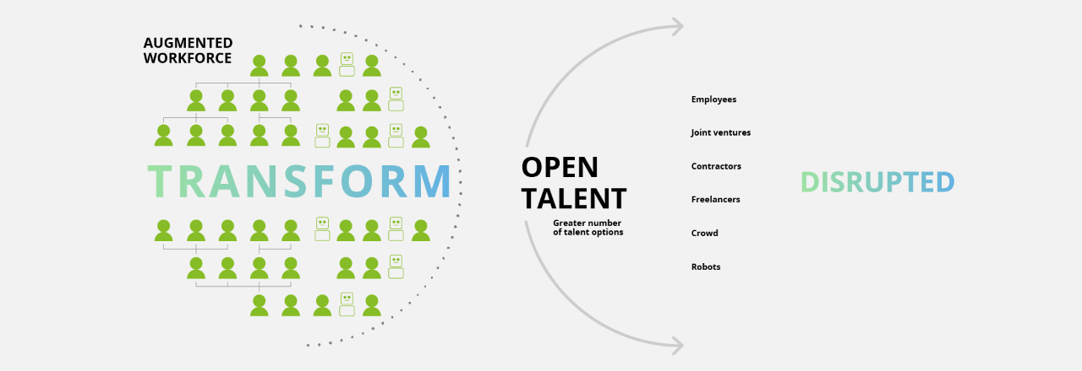
OUR POINT OF VIEW: THE AUGMENTED WORKFORCE
19th Global
Conference of Actuaries
30th – 31st January, 2018 | Mumbai, India

Slide 7
THE EMERGENCE OF HYBRID JOBS
19th Global
Conference of Actuaries
30th – 31st January, 2018 | Mumbai, India
Research performed by Deloitte Consulting indicates that wage increases are primarily going to two types of jobs.
First, as one might expect, are the hot “technical roles” where skills are (currently) scarce.
Second, however, are what we might call “hybrid jobs”—jobs that create whole new job categories by mashing up disciplines.
Source: Deloitte, 2017

Slide 8
THE EMERGENCE OF HYBRID JOBS
19th Global
Conference of Actuaries
30th – 31st January, 2018 | Mumbai, India
A 2017 study by Burning Glass, Business– Higher Education Forum, and IBM analyzed new jobs being created in data science and digital marketing and found several important things:
• Organizations are driving a huge increase in demand for analytic roles. Jobs called “data scientist” or “analyst” are growing rapidly, with the overall number of data science and analytics jobs expected to reach 2.7 million annual postings globally by 2020. These jobs are growing in all industries and all developed economies, with particularly high growth in the United Kingdom, Canada, and Australia.
• These jobs are not simply degreed positions— they are jobs that combine math, statistics, critical thinking, and industry expertise, not just skills in data management. Data scientists with industry expertise and experience, for example, command almost 50 percent higher pay than those with pure technical skills.
Source: Deloitte, 2017

Slide 9
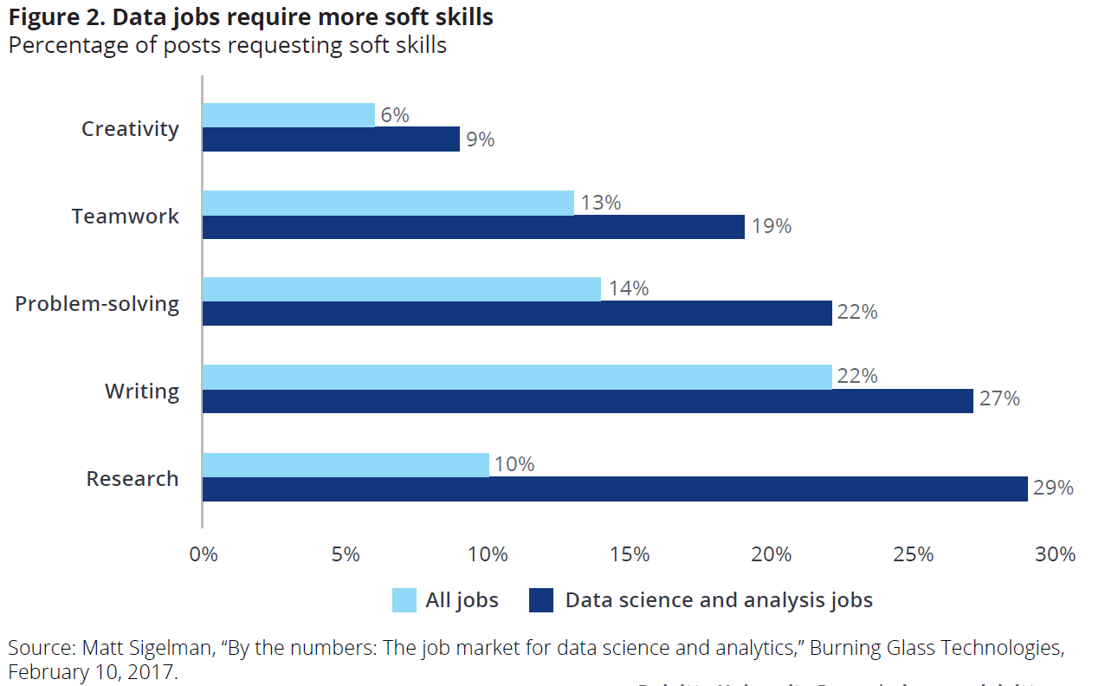
THE EMERGENCE OF HYBRID JOBS
19th Global
Conference of Actuaries
30th – 31st January, 2018 | Mumbai, India
These roles now require new types of soft skills, or what I call “enduring skills”.
Figure 2 shows the types of expertise for which employers are looking in data analysis positions: research skills, writing skills, and problem-solving skills, along
with teamwork and creativity.
These are not always developed through coursework in math or statistics— they can potentially emerge from a background in English, history, art, or business.
Source: Deloitte, 2017

Slide 10
SPECTRUM OF ROBOTIC AND COGNITIVE TECHNOLOGIES
19th Global
Conference of Actuaries
30th – 31st January, 2018 | Mumbai, India
The automation continuum ranges from enabling strategies that improve business processes to sophisticated technologies with cognitive elements
Futuristic
Degree of Cognition
High
Medium
Low
Robotic Process Automation
Intelligent Automation
Cognitive Automation
Artificial Intelligence
“Mimics human actions”
Computer program or “robot” that mimics rules-based actions in existing applications
“Mimics human judgment”
Tools that enable processes requiring decision making
“Augments human intelligence”
Computerized models that simulate human thought processes through predictive decision making
“Mimics human intelligence”
The theory and development of computer systems that can perform tasks which normally require human intelligence
As the appetite for automation grows, the interplay of emerging technologies will lead to fundamental changes in how actuaries operate and deliver services to stakeholders

Slide 11
DIGITAL FORCES IMPACTING PROFESSIONALS
19th Global
Conference of Actuaries
30th – 31st January, 2018 | Mumbai, India
As powerful digital forces, disruption, and rapid-fire innovation influence the business climate, select digital disruptors can be leveraged to transform Actuarial and other Professionals to effectively and efficiently serve the organization
High
Internet of Things
Blockchain
Machine Learning & Predictive Analytics
Cognitive Computing
Cloud
Data Lakes
Value Potential
Robotic Process Automation
Crowd Sourcing & Competitions
Visualization
Actuarial Models
In-Memory
Processing
Natural Language Processing & Generation
Data Warehousing
Business Intelligence
ERP Applications
Data Modelling
Big
Data
Cyber
Security
Low
Low
Level of Capability Maturity
High
“TABLE STAKES”
“MODERNIZERS”
“EXPONENTIALS”

Slide 12
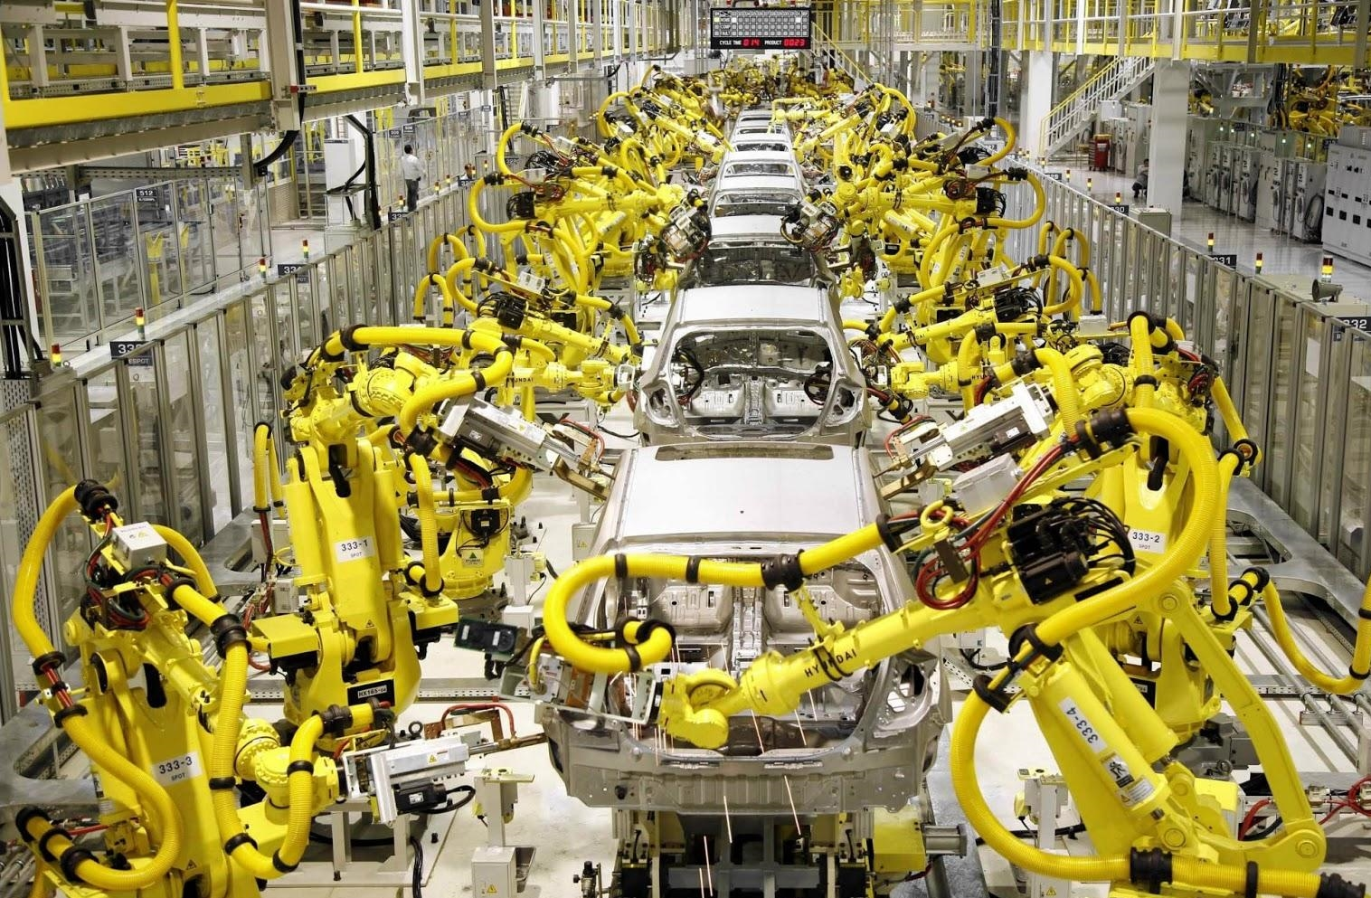
THIS IS WHAT A FACTORY LOOKS LIKE TODAY
19th Global
Conference of Actuaries
30th – 31st January, 2018 | Mumbai, India

Slide 13
…AND THIS IS HOW A TYPICAL OFFICE LOOKS TODAY
19th Global
Conference of Actuaries
30th – 31st January, 2018 | Mumbai, India

Slide 14
HOW WILL ACTUARIES AND OTHER PROFESSIONALS WORK A FEW YEARS FROM NOW?
19th Global
Conference of Actuaries
30th – 31st January, 2018 | Mumbai, India

Slide 15
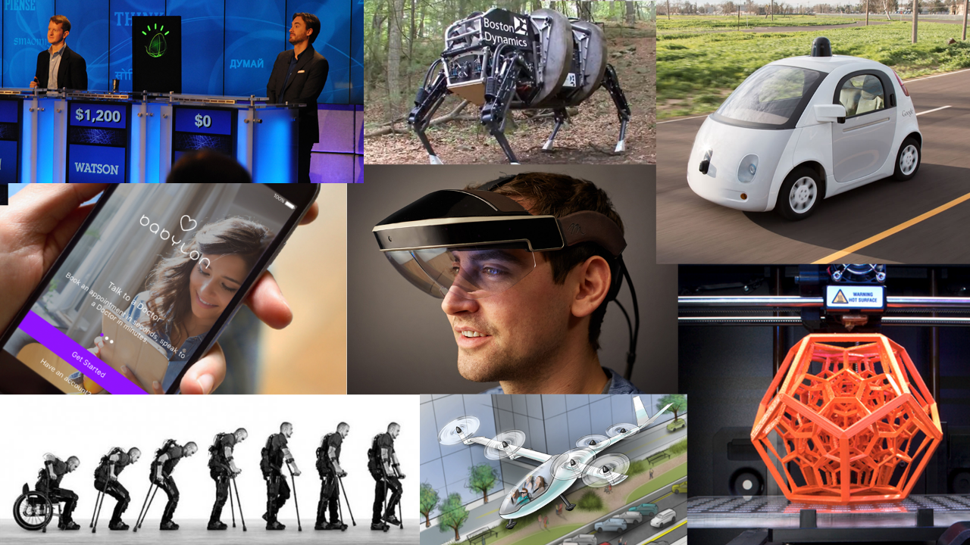
THE FUTURE LOOKS LIKE THIS…
19th Global
Conference of Actuaries
30th – 31st January, 2018 | Mumbai, India
Source: ‘Introduction to exponentials’. Singularity Education Group, 2014

Slide 16
EXPONENTIAL TECHNOLOGIES INTRO VIDEO
19th Global
Conference of Actuaries
30th – 31st January, 2018 | Mumbai, India
https://play.buto.tv/gJmyb

Slide 17
WHAT’S THE ACTUARIAL OPPORTUNITY?
19th Global
Conference of Actuaries
30th – 31st January, 2018 | Mumbai, India
I KNOW ACTUARIAL TRANSFORMATION IS ON THE HORIZON AND CAN BRING GREAT BENEFITS BUT WHERE DO I BEGIN? AND WHAT ROLE WILL TECHNOLOGY PLAY?
DEMANDS
DESIRES
Need to consolidate or improve data capability, actuarial systems, and processes
Response to concerns around Quality – e.g., observed errors, lack of consistency
Cost Reduction and related strategies to improve efficiency
Keeping pace with evolving Regulatory Change such as implementing IFRS 17 by 2021, a large and complex undertaking
Desire to serve business in a more proactive strategic capacity – insights vs production
Wants to implement new technologies but believes they are too nascent and unproven
Wants to position herself as a catalyst for change and an industry pioneer
Struggles to know where to start, but wants to lead and share knowledge with team and senior management
CHIEF CHRISTINE

Slide 18
THE NEED FOR CHANGE
19th Global
Conference of Actuaries
30th – 31st January, 2018 | Mumbai, India
Insurers have pain points and gaps whose solutions require shifts in technology, talent, and governance in order to better respond to their organization’s strategic objectives
Drivers
Issues
Solutions
Desire for greater degree of Strategic insight into the organization
Keeping pace with evolving Regulatory Change
Pain Points &
Capability Gaps
Spanning:
People
Process
Technology
Governance
Systems Strategy
Process Automation
Business Insight
Redeploy Talent
Outsourcing Services
Response to concerns around Quality – e.g., observed errors, lack of consistency
Cost Reduction and related strategies to improve efficiency
Availability of disruptive technologies that are required for businesses to stay competitive

Slide 19
Topic Heading or Sub Topic
19th Global
Conference of Actuaries
30th – 31st January, 2018 | Mumbai, India
Actuaries ability to provide deep business insight is negated by overwhelming Operational and Stewardship Activities they perform today
Representative Actuarial Pain Points
Many spreadsheets linked together to calculate, capture, and allocate investment income
Life Insurance company doesn't know how many 90+ year olds they insure
Thousands of unique tools and spreadsheets required for monthly actuarial financial reporting processes
Users wake up at 2:00 a.m. to confirm models have successfully completed and to kick-off next job
Hundreds of people involved in a 6 month process of updating regulatory AAT memos
Hundreds of Actuarial models all need to be maintained, updated, and launched manually and reconciled
Thousands of hours spent annually drafting hundreds of actuarial reports after analysis has been completed
Company produces hundreds of product filings every year
The role of the Actuary needs to be redefined and refocused on more value added and strategic activities

Slide 20
IN THE NEXT FEW YEARS, ACTUARIAL ORGANIZATIONS WILL LOOK VERY DIFFERENT
19th Global
Conference of Actuaries
30th – 31st January, 2018 | Mumbai, India
Imagine A World Where…
An automated robot completes running of actuarial models and reserves/DAC. Output is sent to its analytics engine
Automation software adds in narratives to the dashboard
The Chief Actuary interacts with the chatbot to drill down into splits by channel/product
5:00 AM
7:00am
8:10am
The data from the modeling engine is staged on a Tableau or BI server and dashboards are refreshed
The Chief Actuary has access to the updated reports and narratives as soon as he/she arrives in the office
The Chief Actuary further drills down into variance analyses for products /services with dropping margins
6:00 AM
8:00am
8:15am
We are moving into a world of the augmented professional
Deloitte Consulting | The Future of Work

Slide 21
VARIOUS PARTS OF ACTUARIAL PROCESSES CAN BE EXPONENTIATED
19th Global
Conference of Actuaries
30th – 31st January, 2018 | Mumbai, India
End-to-End Actuarial Process
Data
Model
Reporting and Analysis
Automation is spreading

Slide 22
WHAT IS RPA?
19th Global
Conference of Actuaries
30th – 31st January, 2018 | Mumbai, India
RPA is delivered through software that can be configured to undertake rules-based (deterministic) tasks; it is not actual robots in a production line.
RPA is…
Computer-coded software
Programs that replace humans performing repetitive rules-based tasks
Cross-functional and cross-application macros
RPA is not…
Walking, talking auto-bots
Physically existing machines processing paper
Artificial intelligence or voice recognition and reply software

Slide 23
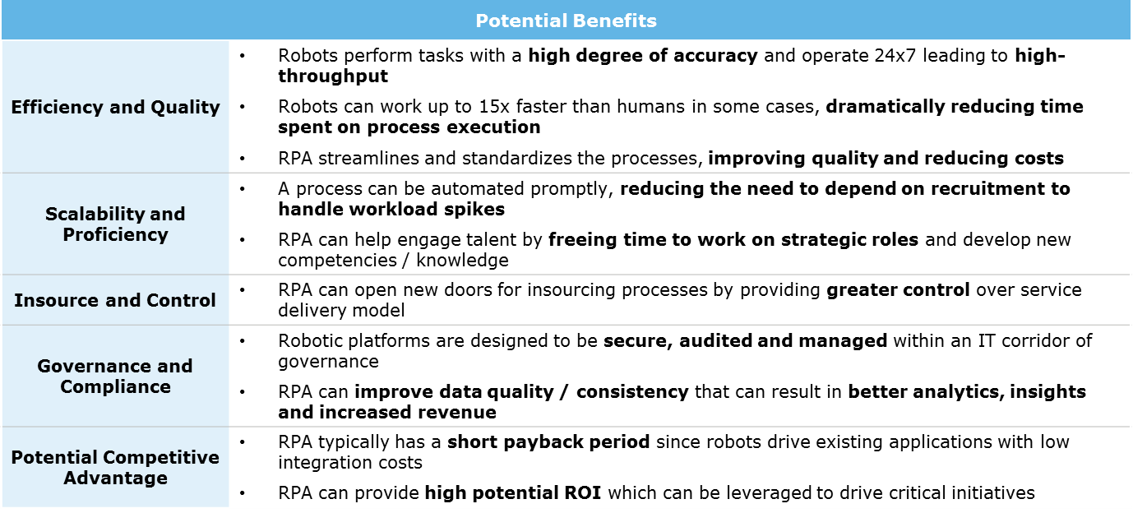
WHAT ARE THE POTENTIAL BENEFITS OF RPA?
19th Global
Conference of Actuaries
30th – 31st January, 2018 | Mumbai, India
RPA can be executed with low costs, high accuracy, and high scalability, with the potential to produce transformative change and benefits
Actuaries are able to shift focus from repetitive tasks to higher-value tasks that inform senior leadership decision making
New Competencies

Slide 24
RPA – VIDEO DEMO
19th Global
Conference of Actuaries
30th – 31st January, 2018 | Mumbai, India
Demo of process using illustrative vendor

Slide 25
OUR POINT OF VIEW: POINTING INDIVIDUALS,
ORGANIZATIONS, AND PUBLIC POLICY IN ONE DIRECTION
19th Global
Conference of Actuaries
30th – 31st January, 2018 | Mumbai, India
Implications for individuals
Engage in lifelong learning
Shape your own career path
Pursue your passion
Implications for organizations
Redesign work for technology and learning
Source and integrate talent across networks
Implement new models of organizational structure, leadership, culture, and rewards
Implications for public policy
Reimagine lifelong education
Transition support for income and health care
Reassess legal and regulatory policies
Source: Hagel, John, Schwartz, Jeff, Bersin, Josh. “Navigating the future of work: Can we point business, workers, and social institutions in the same direction?” Deloitte Review 31 July 2017.

Slide 26
KEY TAKEAWAYS
19th Global
Conference of Actuaries
30th – 31st January, 2018 | Mumbai, India
Demands on Actuaries and opportunities for Actuaries are increasing as the business landscape transforms
How professionals do their work is fundamentally changing and will continue to change
Change is happening at an increasing rate, led by Exponential Technologies
Opportunities for efficiency and increased added value
Need to embrace, promote and manage change

Slide 27
Organizer
19th Global
Conference of Actuaries
30th – 31st January, 2018 | Mumbai, India
Thank You
Darryl Wagner – dawagner@deloitte.com
Mahasen Kunapuli - mkunapuli@deloitte.com
Deloitte refers to one or more of Deloitte Touche Tohmatsu Limited, a UK private company limited by guarantee (“DTTL”), its network of member firms, and their related entities. DTTL and each of its member firms are legally separate and independent entities. DTTL (also referred to as “Deloitte Global”) does not provide services to clients. Please see www.deloitte.com/about for a more detailed description of DTTL and its member firms.
This communication is for internal distribution and use only among personnel of Deloitte Touche Tohmatsu Limited, its member firms, and their related entities (collectively, the “Deloitte network”). None of the Deloitte network shall be responsible for any loss whatsoever sustained by any person who relies on this communication.
© 2017. For information, contact Deloitte Touche Tohmatsu Limited

