Slide 1

Curriculum 2019: one university’s perspective
Department of Mathematics
Nick Foster
Global Conference of Actuaries, Mumbai
January 2018

Slide 2
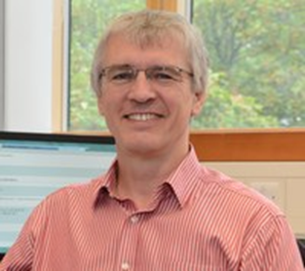

Who is this person talking to you?
Nick Foster
I am an actuary, lecturer and writer
Fellow of the Institute and Faculty of Actuaries
Lecturer in actuarial sciences at the University of Leicester and programme director of the BSc Mathematics and Actuarial Science
I write from time to time at www.weknow0.co.uk, on a range of pensions and economics-related topics
@C20Actuaries

Slide 3
Outline
1 | Curriculum 2019
2 | Our response to Curriculum 2019
3 | The Chartered Actuary qualification
4 | Leicester’s actuarial programmes

Slide 4

Curriculum 2019
Ensure actuaries who qualify with the IFoA remain ‘fit for purpose’ over the next ten years
  Content of subjects is cutting edge and relevant
  Removal of less relevant and duplicated material
Ensure members of the IFoA are equipped to fulfil wider roles in more diverse areas of work
  Balance between technical and softer skills and between theory and application
Maintain the IFoA’s reputation internationally by ensuring our qualification structure is up-to-date with the current issues facing actuaries world-wide
  Focus on assessing understanding and competence
  Appropriate use of technology

Slide 5
Leicester’s response to Curriculum 2019
Started January 2016, when we invited the IFoA to Leicester to set out the education strategy review in detail
December 2016 we volunteered for 5 of the IFoA’s module development teams
February 2017 launched our own internal curriculum transformation exercise
August 2017 proposal to IFoA for new BSc course to deliver Curriculum 2019
November 2017 Programme approval at university level for BSc Mathematics and Actuarial Science
January 2018 we volunteered for the module lead of the IFoA practice modules

Slide 6
Leicester’s response to Curriculum 2019 (2)
September 2018
  launch of BSc Mathematics and Actuarial Science programme, offering exemptions from CM, CS and CB modules
September 2019
  launch of MSc Actuarial Science
  followed by launch of MSc Actuarial Science (distance learning)

Slide 7
The new route to fellowship…

Slide 8
The new route to fellowship…
…or the route to a new qualification!
Chartered Actuary (CAct)

Slide 9
Chartered Actuary proposal
There is a new Institute and Faculty of Actuaries consultation on launching a new actuarial qualification of Chartered Actuary
Qualification as a recognised actuarial professional would focus initially on the generalist actuarial skills which are developed in the core part of our current and future Curriculum 2019
This initial qualification would be established around the current IFoA Associate level
The curriculum for CAct would be aligned to the new International Actuarial Association (IAA) syllabus to ensure it is globally recognised, with the additional requirement for one year’s supervised work-based Personal and Professional Development (PPD): this PPD requirement would be identical to that currently required for IFoA Associateship
After the launch date of the proposed framework, any new Student member would be required to complete the CAct qualification before taking any further examinations towards Fellowship. Transitional arrangements will apply to current Student members. Those who meet the CAct standard can, if they wish, transfer to this membership category
WOULD YOU BE INTERESTED IN TAKING UP THE CHARTERED ACTUARY QUALIFICATION?

Slide 10
Our focus at Leicester

Slide 11
Curriculum 2019 Transformation

Slide 12
Leicester’s Actuarial Science Programmes
BSc Mathematics and Actuarial Science – With Industry – 3 or 4 years
BSc accredited by the Institute and Faculty of Actuaries (IFoA) offering exemptions from Core Principles stage of the professional exams.
PGDip/MSc Actuarial Science – 1 year campus based full-time
PgDip/Msc Actuarial Science – Distance Learning – 2 or 3 years part-time
MSc courses accredited by the IFoA offering exemptions from Core Principles and Core Practice modules (from Sept 2019 campus-based and Sept 2020 distance learning).
WHICH COURSE SOUNDS OF MOST INTEREST FOR YOUR EMPLOYEES?
  MSc distance learning
  MSc campus-based
  BSc campus-based

Slide 13
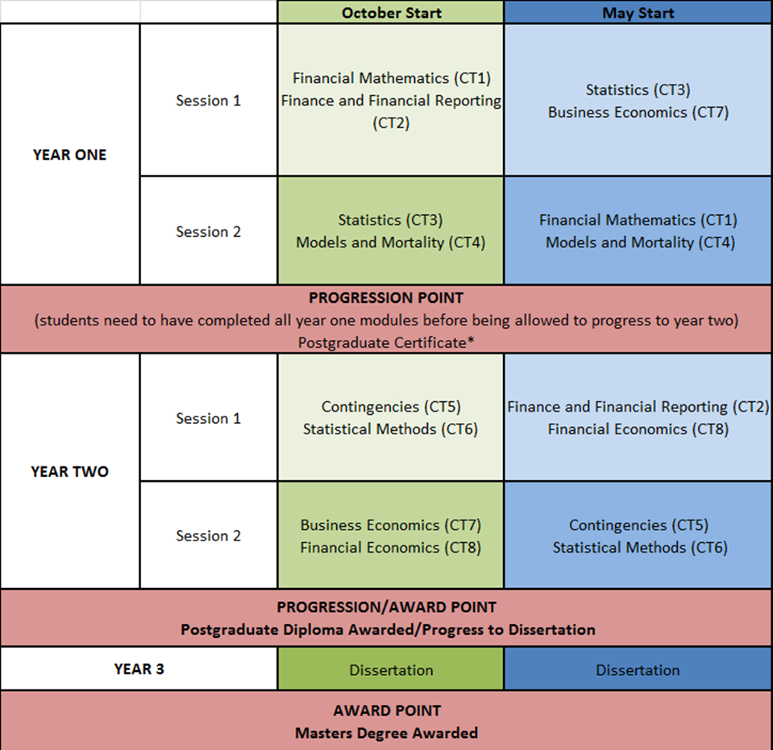
Distance Learning MSc in Actuarial Science – what we currently teach

Slide 14
Why Study the DL MSc at Leicester?
Become a Chartered Actuary!
Industry focused teaching
With Industry
Employer Steering Board
Accredited Programme
Early adoption of Curriculum 2019
Actuarial Society (LASS)
Qualified Actuaries Teaching
Actuarial Research

Slide 15
Graduate identity
Our new curriculum aims to develop graduates who:
  ARE comfortable with data and manipulating it
  HAVE great team working skills
  CAN communicate persuasively in speech and writing
  KNOW why they are in an organisation and what they can contribute

Slide 16










We have current students with many companies and organisations throughout the world

Slide 17
Actuarial Teachers and Researchers Conference 2018 at University of Leicester
30-31 July 2018 – SAVE THE DATE!

Slide 18

Any questions?

Slide 19
Curriculum 2019: one university’s perspective
Department of Mathematics
Nick Foster
Global Conference of Actuaries, Mumbai
January 2018

Slide 20
Curriculum 2019 – MSc campus-based

Slide 21
Curriculum 2019 – BSc campus-based

